Slide 1
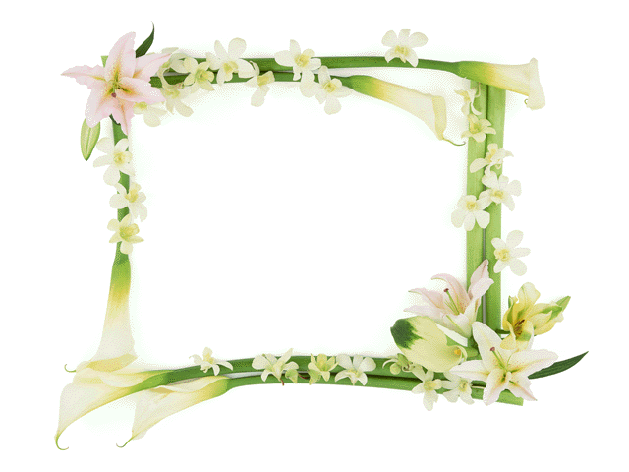
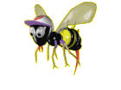

CU KHOI SECONDARY SCHOOL
WELCOME TO OUR CLASS
Teacher: 034.989.5579

Slide 2
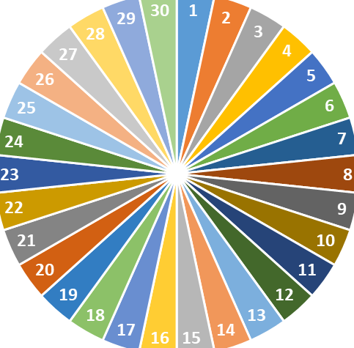
WARM-UP
Check out the old lesson by spinning the wheel to call out the name
spin
Quý Thầy, Cô thay ds học sinh mình nhé

Slide 3
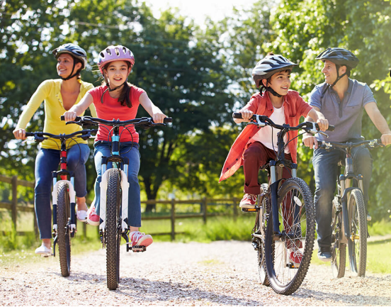
1
Look at the pictures. What activities can you see?
riding a bike/ cycling

Slide 4
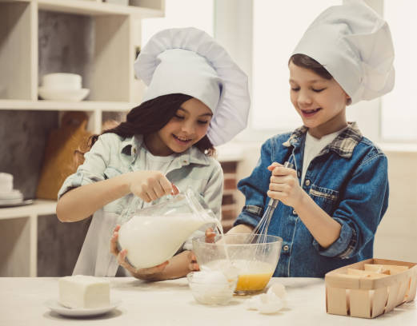
1
Look at the pictures. What activities can you see?
cooking

Slide 5
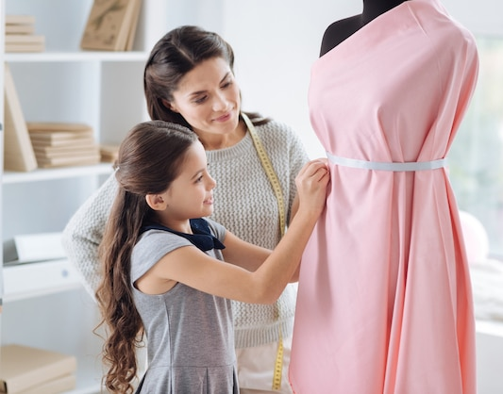
1
Look at the pictures. What activities can you see?
making a dress

Slide 6
1
Look at the pictures. What activities can you see?
riding a bike/ cycling
LEISURE ACTIVITIES
cooking
making a dress

Slide 7

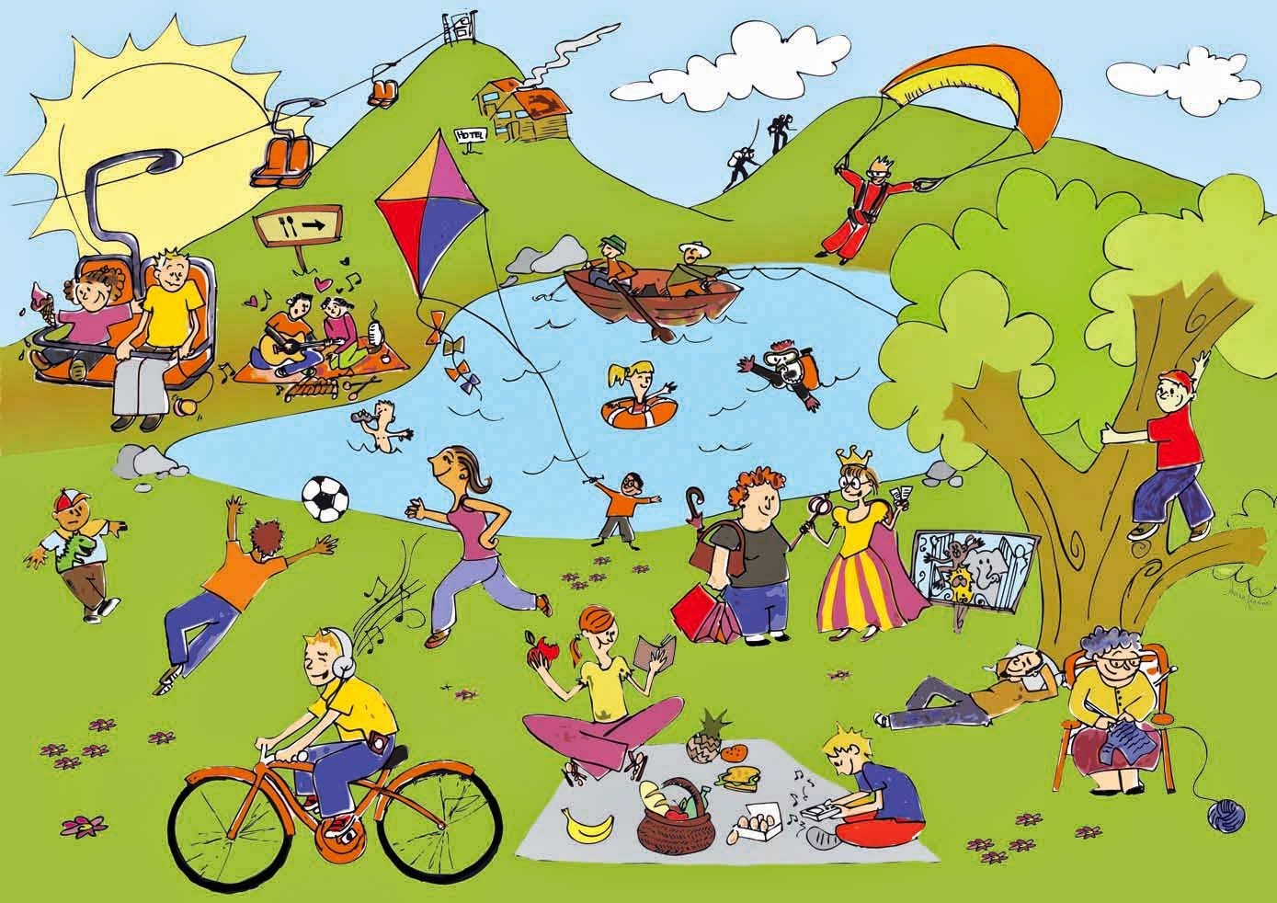
Unit
1
LEISURE TIME
LESSON 5: SKILL 1
1

Slide 8
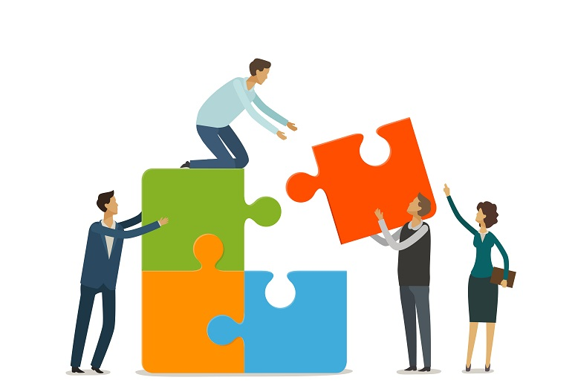
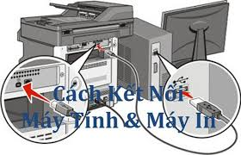

* Vocabulary
connect (v)
/kəˈnekt/
kết nối

Slide 9
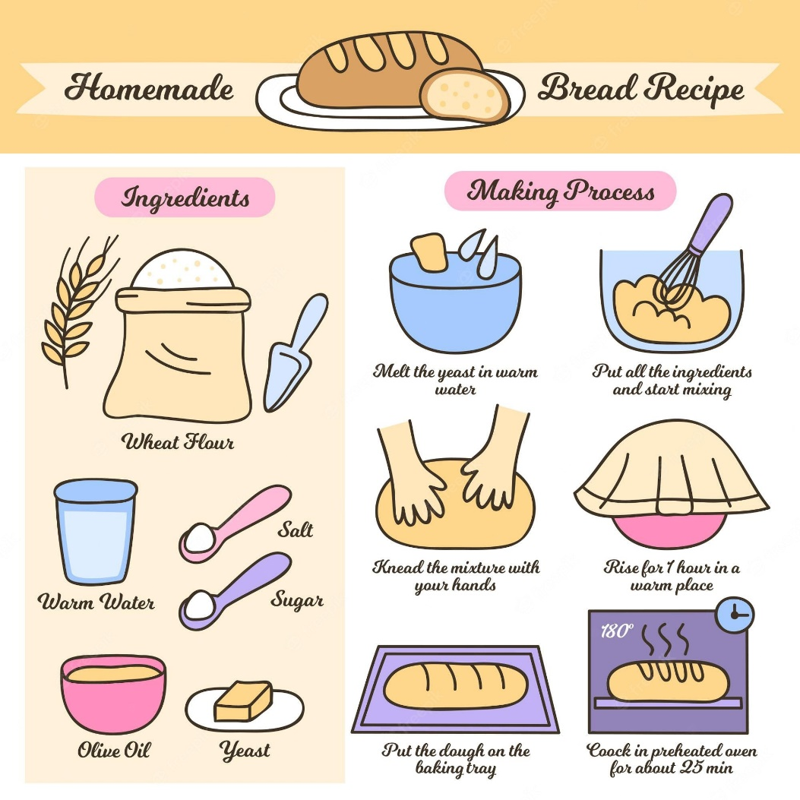
* Vocabulary
recipe (n)
/ˈresɪpi/
công thức

Slide 10
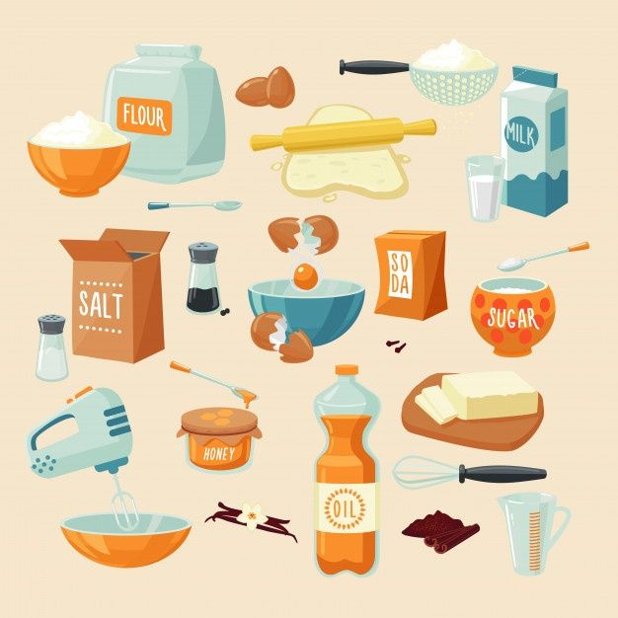
* Vocabulary
ingredient (n)
/ɪnˈɡriːdiənt/
nguyên liệu

Slide 11
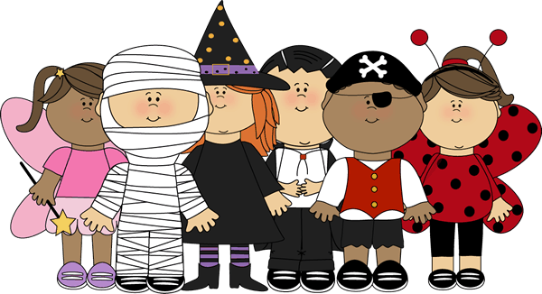
* Vocabulary
costume (n)
/ˈkɒstʃuːm/
trang phục

Slide 12
* Vocabulary
New words | Pronunciation | Meaning
1. connect (v) | /kəˈnekt/ | kết nối
2. recipe (n) | /ˈresɪpi/ | công thức
3. ingredient (n) | /ɪnˈɡriːdiənt/ | nguyên liệu
4. costume (n) | /ˈkɒstʃuːm/ | trang phục

Slide 13
I. READING
2
Read about Trang’s leisure activities. Choose the correct answer.
Some teenagers enjoy spending free time with their friends. Others prefer doing leisure activities with their family members. I love spending time with my family because it’s a great way to connect with them.
At the weekend, we usually go for a bike ride. We cycle to some nearby villages to enjoy the fresh air. We take photos and look at them later. My big brother and I are also into cooking. My brother looks for easy recipes. After that, we prepare the ingredients and cook. Sometimes the food is good, but sometimes it isn’t; nevertheless, we love whatever we cook. The leisure activity I like the most is doing DIY projects with my mum. She teaches me to make my own dresses and doll clothes. On special occasions, we make special dresses together. Once I won the first prize in a costume contest at my school.

Slide 14
I. READING
2
Read about Trang’s leisure activities. Choose the correct answer.
Some teenagers enjoy spending free time with their friends. Others prefer doing leisure activities with their family members. I love spending time with my family because it’s a great way to connect with them.
At the weekend, we usually go for a bike ride. We cycle to some nearby villages to enjoy the fresh air. We take photos and look at them later. My big brother and I are also into cooking. My brother looks for easy recipes. After that, we prepare the ingredients and cook. Sometimes the food is good, but sometimes it isn’t; nevertheless, we love whatever we cook. The leisure activity I like the most is doing DIY projects with my mum. She teaches me to make my own dresses and doll clothes. On special occasions, we make special dresses together. Once I won the first prize in a costume contest at my school.

Slide 15
2
Read about Trang’s leisure activities. Choose the correct answer.
1. The text is about Trang’s leisure activities ______.
A. in the past B. with her friends C. with her family
2. The word “connect” is closest in meaning to ______.
A. join with something
B. better understand someone
C. speak to someone by phone

Slide 16
3
Read the text again and answer the questions.
* Questions
1. What does Trang do with her family members at the weekend?
2. Who looks for recipes when Trang and her brother cook?
3. Which leisure activity does she love the most?
4. What does Trang’s mum teach her to do?
5. What did she win?
Game

Slide 17
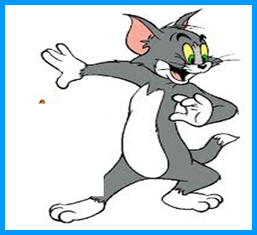
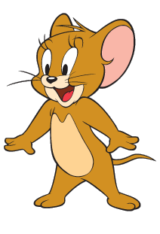
Questions: Lucky numbers
1
2
3
4
2
2
4
5
6
7
8
4
6
6
8
8
10
10
12
12
14
14

Slide 18
3
Read the text again and answer the questions.
* Questions
1. What does Trang do with her family members at the weekend?
→ She goes for a bike ride, cooks, and does DIY projects.

Slide 19
3
Read the text again and answer the questions.
* Questions
2. Who looks for recipes when Trang and her brother cook?
→Her brother does.

Slide 20
3
Read the text again and answer the questions.
* Questions
3. Which leisure activity does she love the most?
→ She loves doing DIY projects with her mum the most.

Slide 21
3
Read the text again and answer the questions.
* Questions
4. What does Trang’s mum teach her to do?
→ Her mum teaches her to make her own dresses and doll clothes.

Slide 22
3
Read the text again and answer the questions.
* Questions
5. What did she win?
→ She won the first prize in a costume contest at her school.

Slide 23
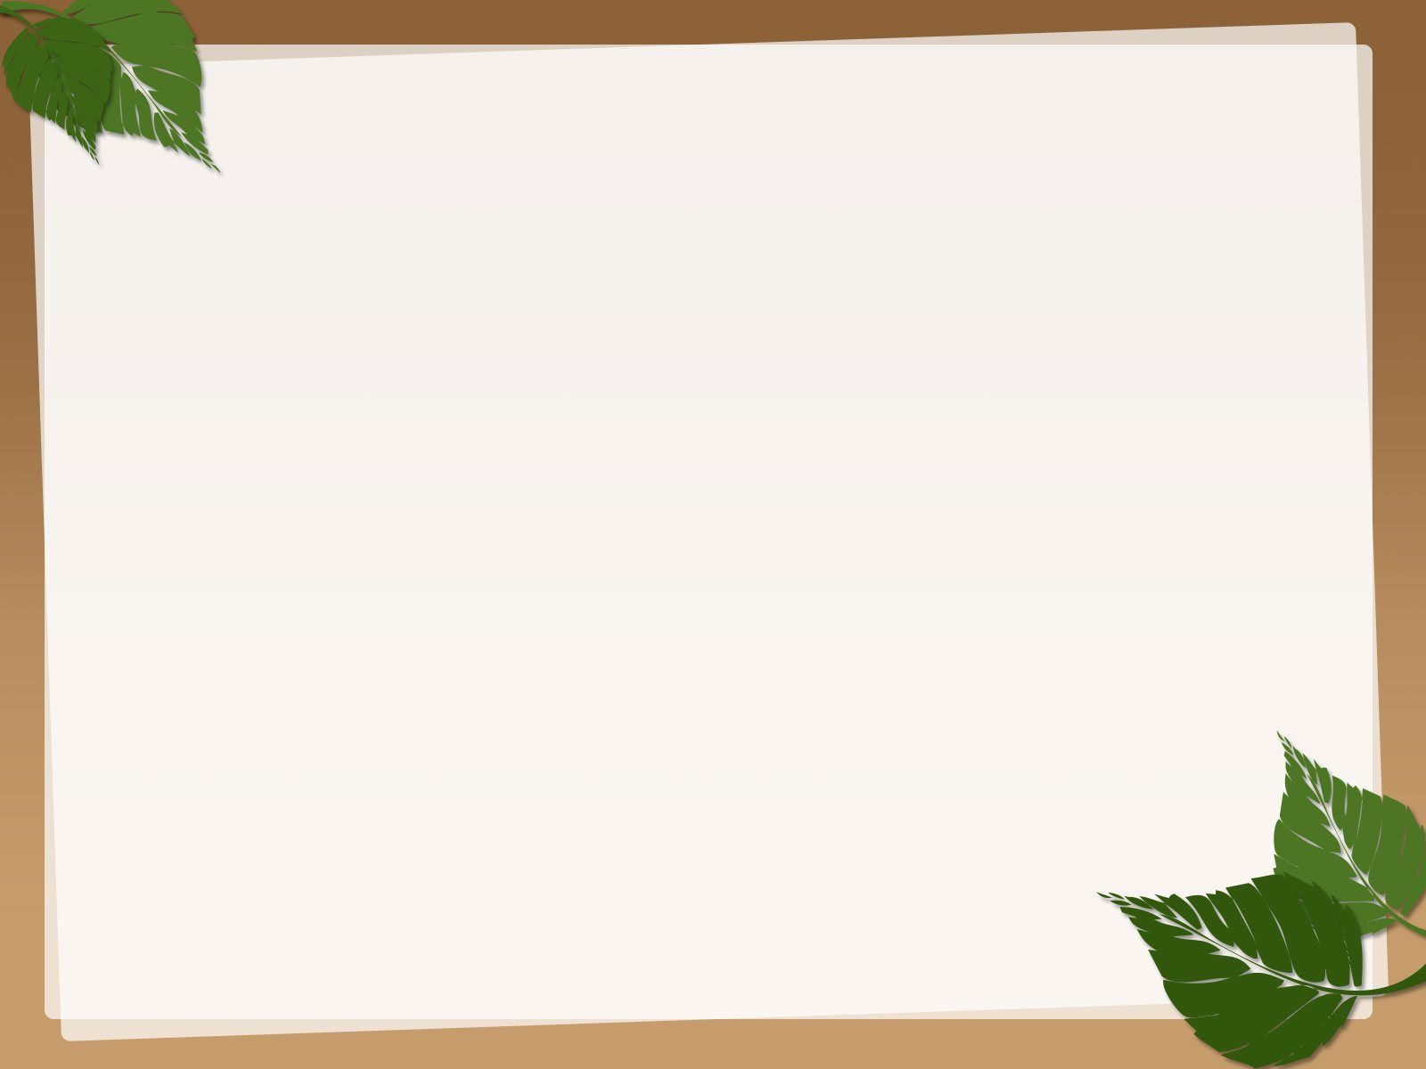

LUCKY NUMBER!

Slide 24
LUCKY NUMBER!

Slide 25
II. SPEAKING
4
Work in groups. Take turns to ask and answer the questions. Record your friends’ answer in the table below.
1. What leisure activities do you usually do with your family?
2. Which one do you like the most? Why?
3. How do you feel when you spend time with your family members?
Friends’ name | Questions 1 | Questions 2 | Questions 3

Slide 26
II. SPEAKING
4
Work in groups. Take turns to ask and answer the questions. Record your friends’ answer in the table below.
1. What leisure activities do you usually do with your family?
2. Which one do you like the most? Why?
3. How do you feel when you spend time with your family members?
→ We usually……………………………....
→The leisure activity I like the most is ………………….because it’s ……..…………
→ I feel ………………….
Friends’ name | Questions 1 | Questions 2 | Questions 3

Slide 27
II. SPEAKING
4
Work in groups. Take turns to ask and answer the questions. Record your friends’ answer in the table below.
1. What leisure activities do you usually do with your family?
→ We usually……………………………....
play badminton.
have dinner.
go jogging.
watch TV.
go to the beach.
Visit grandparents
Have a picnic
…………………….

Slide 28
II. SPEAKING
4
Work in groups. Take turns to ask and answer the questions. Record your friends’ answer in the table below.
2. Which one do you like the most? Why?
I like going to the beach the most. Because it helps me relax and it reduces stress.
- help me relax
- reduce stress
- good for my health
- explore interesting areas
- make delicious meal
- spend time together

Slide 29
II. SPEAKING
4
Work in groups. Take turns to ask and answer the questions. Record your friends’ answer in the table below.
3. How do you feel when you spend time with your family members?
→ I feel ………………….
- very happy.
- really comfortable.
- very cozy
- the relationship is connected

Slide 30
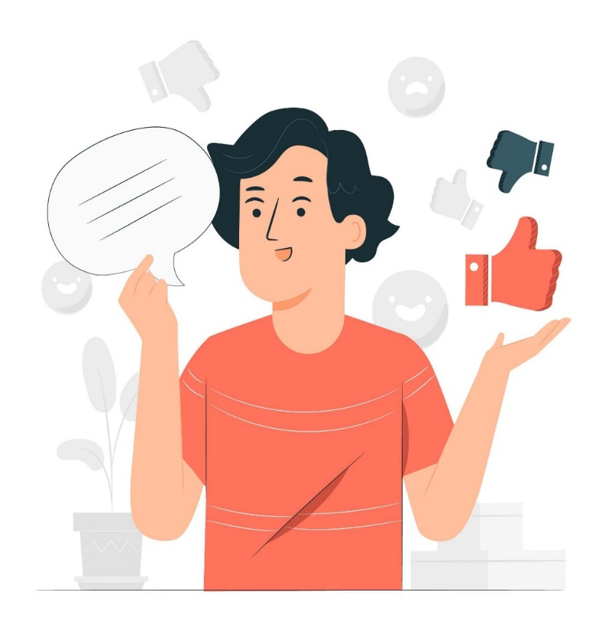
5
Report your group members’ answers to the class. What activities are the most common?
The most common activities is …
After discussing with members in our group, we see that riding bike is the most popular activity in our group. Also, almost members in our group are into………………………………….

Slide 31
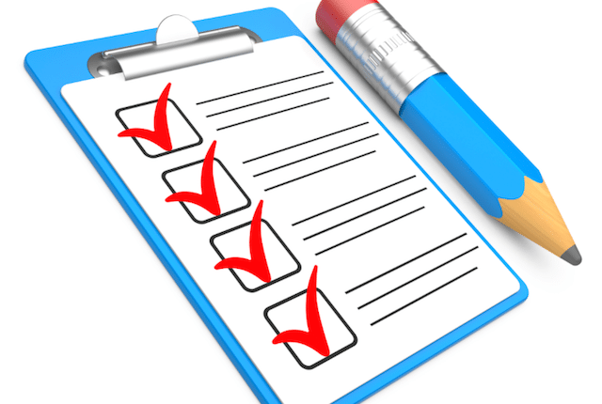
CONSOLIDATION
What have we learnt in this lesson?
read about teen’s leisure activities
talk about friends’ leisure activities

Slide 32
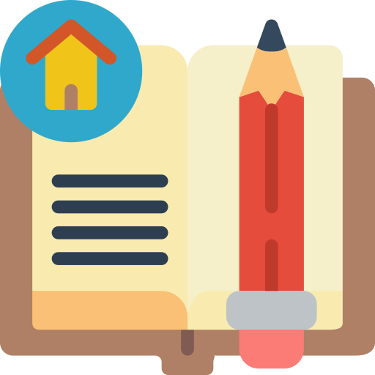
Homework
Do exercises in the workbook.

Slide 33

Website: hoclieu.vn
Fanpage: facebook.com/www.tienganhglobalsuccess.vn/

