Slide 1

GOOD MORNING CLASS !!!

Slide 2
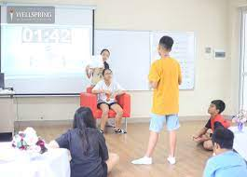
WARM-UP
HOT SEAT
How to play:
One student goes to the board and gets one activity from the teacher.
This student acts the activity without saying.
The rest of class guess the activity.
Example: - Flying the kites
- go fishing
- listening to music
- arranging flowers
- taking photos

Slide 3

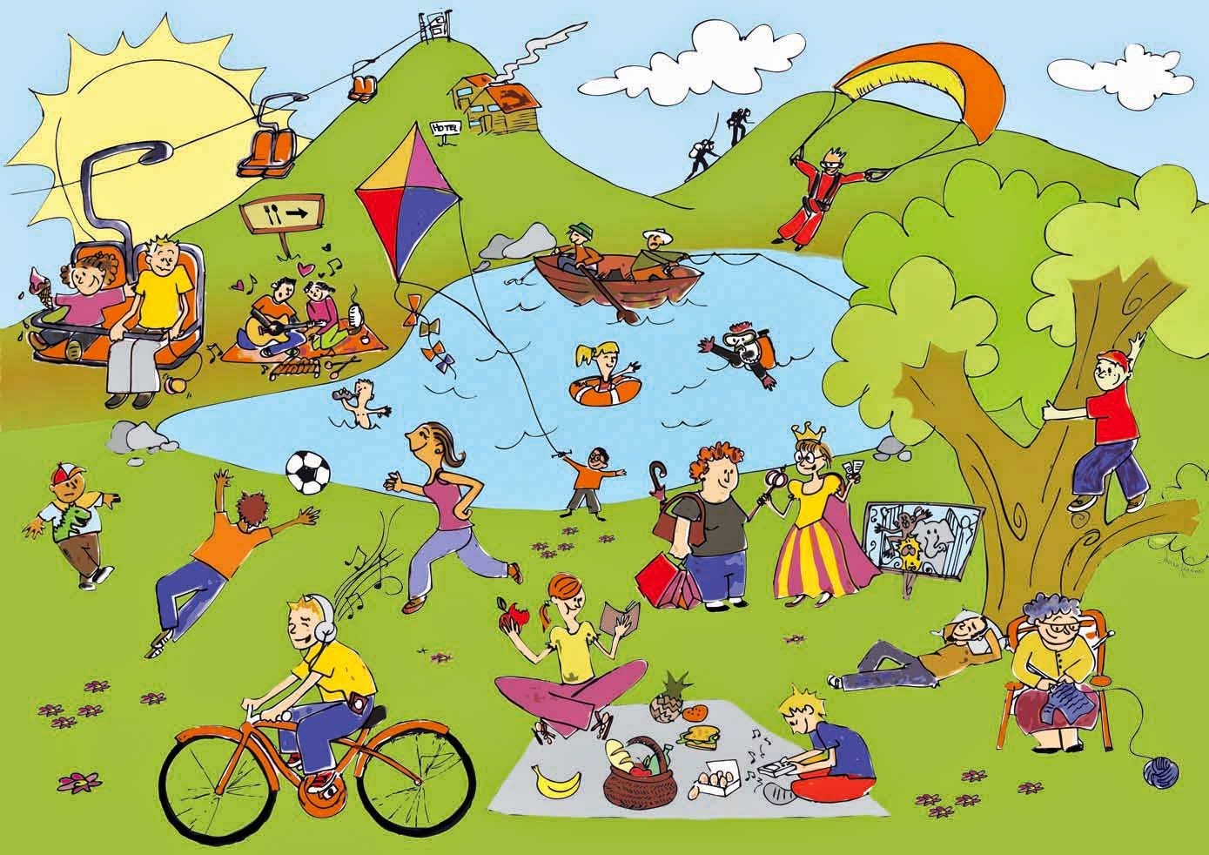
Unit
1
LEISURE TIME
LESSON 6: SKILLS 2
1

Slide 4

I. LISTENING
1
Answer the questions.
1. In your opinion, what activities can we do with our friends in our leisure time?
2. Why should we spend time
with our friends?

Slide 5
I. LISTENING
1
Answer the questions.
1. In your opinion, what activities can we do with our friends in our leisure time?
2. Why should we spend time
with our friends?
1. - going to the cinema
- playing sport
- going to the park
- having dinner party
- going fishing
- playing video games
2. - connect with other people and become closer with them.
- boost your happiness and reduce your stress.
- improve your self-confidence.
- help you overcome happy and sad time

Slide 6

2
Listen to an interview with Mark about his leisure activities. Choose the correct answer.
1. When does Mark usually have free time?
A. At weekends. B. On Sundays. C. On Saturdays.
2. Who does he spend his free time with?
A. His neighbours and friends.
B. His family and relatives.
C. His family and friends.

Slide 7
3
Listen to the interview again. Fill in each blank in the table with no more than two words.
Activities | Reason
Inviting friends to his house Cooking and watching a (1) ______ | Fun and better than going to the (2) ________
Going to the (3) ______ to play volleyball or skateboard | Stay in (4) ______
Going for a (5) ________ around our city | See different (6) ______
video
cinema
park
shape
bike ride
places
K

Slide 8
Tapescript
Interviewer: When do you usually have free time?
Mark: I usually have free time at the weekend.
Interviewer: So how do you spend it?
Mark: I spend time to connect with my family on Saturdays. We do puzzles, play board games or go camping.
Interviewer: What about Sundays?
Mark: I usually spend Sundays with my friends. I have a group of friends and we do lots of things together.
Interviewer: For example?
Mark: Sometimes I invite them to my house. We cook our favourite food and watch a video. It's fun and better than going to the cinema.
Interviewer: Do you do outdoor activities together?
Mark: Yes, we love spending time outdoors. We go to the park to play volleyball or skateboard. It helps us stay in shape. Sometimes we go for a bike ride around our city. This gives us a chance to see different places in our city.
Interviewer: Thanks for letting us interview you.

Slide 9
II. WRITING
4
Work in pairs. Ask and answer the questions.
Questions
Sample answers
1. When do you usually have free time?
2. What do you usually do with your friends in your free time?
3. Why do you do these activities?
1. I often have free time at the weekend.
2. I usually hang out with my friends.
I usually play badminton …..
I usually go swimming ………
I play video games…………..
3. I do these activities because it helps me reduce stresses and it also improves my mental health.

Slide 10
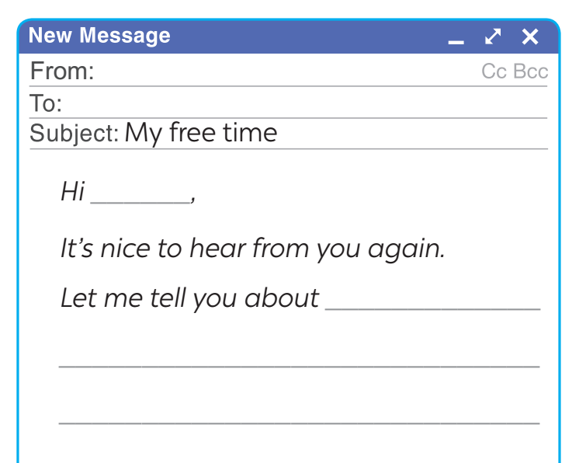
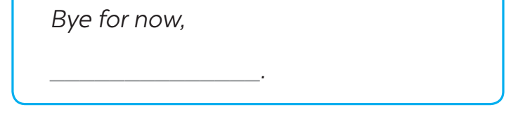

5
Write an email (80 - 100 words) to a penfriend to tell him / her about what you usually do with your friends in your free time. Use your answers in 4.
Start and end the email as follows:
Hi,
It’s nice to hear from you again.
Let me tell you about my leisure activities. At the weekend, I usually hang out and talk with my close friends. We also go swimming on Saturday afternoon. This helps us relax and have a lot of fun. Sometimes, I always help my mom with housework and cooking meals.
How do you spend your free time? I’m looking forward to your reply.
Bye for now,

Slide 11
*CONSOLIDATION
What have we learnt in this lesson?
Listen to someone talking about their leisure activities
Write an email to talk about leisure activities

Slide 12

* Homework
Do exercises in the workbook.
Prepare lesson 7: Looking back

Slide 13
Thanks for your atendance!
Goodbye. See you again
Notes:
13

