Slide 1
WELCOME TO OUR CLASS!!!

Slide 2
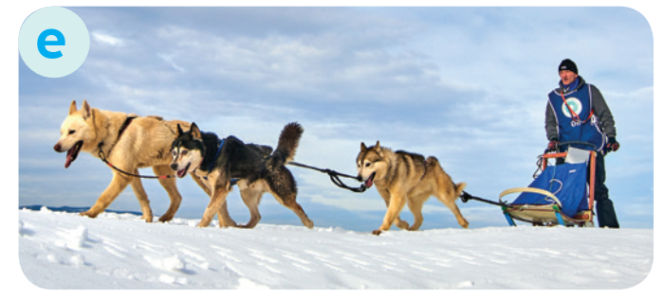
* WARM-UP:
Match the words to the suitable pictures
dogsled
make crafts
native art
weave
tribal dance

Slide 3
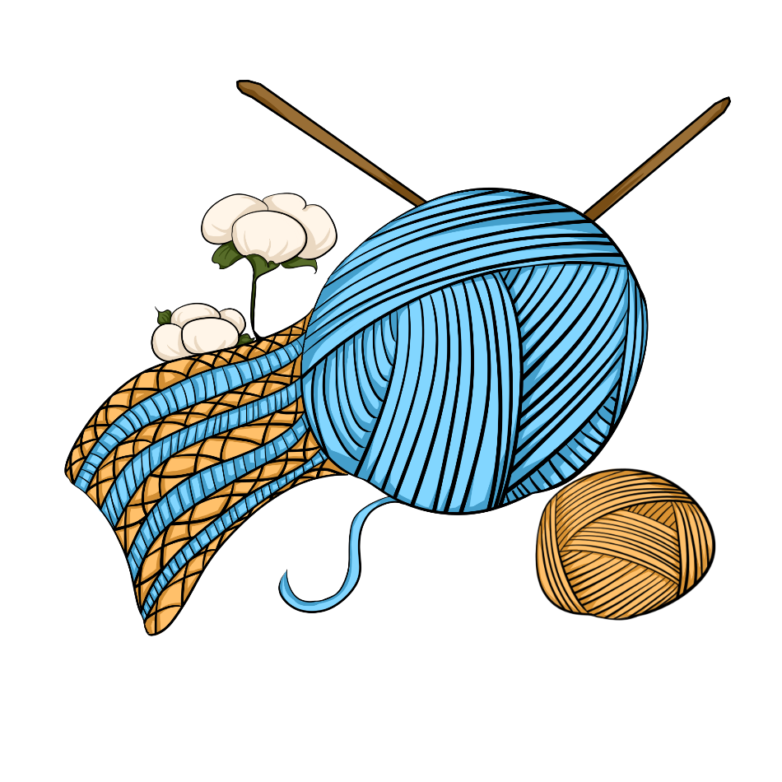
Unit
6
LIFESTYLES
LESSON 2: A CLOSER LOOK 1

Slide 4
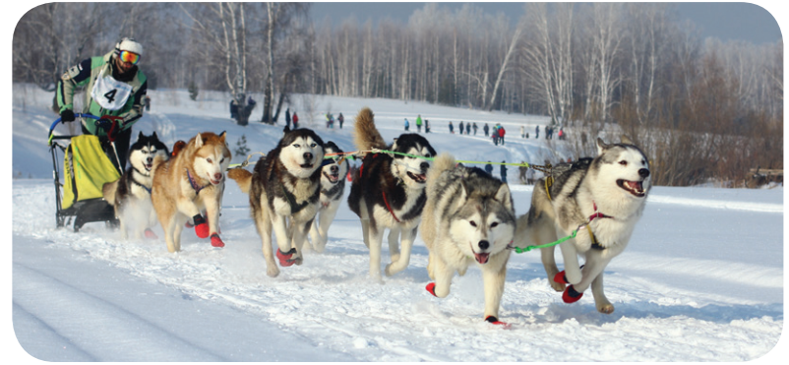
* VOCABULARY
- dogsled (n):
a sledge pulled by dogs
xe trượt tuyết chó kéo
/ˈdɒɡsled/

Slide 5
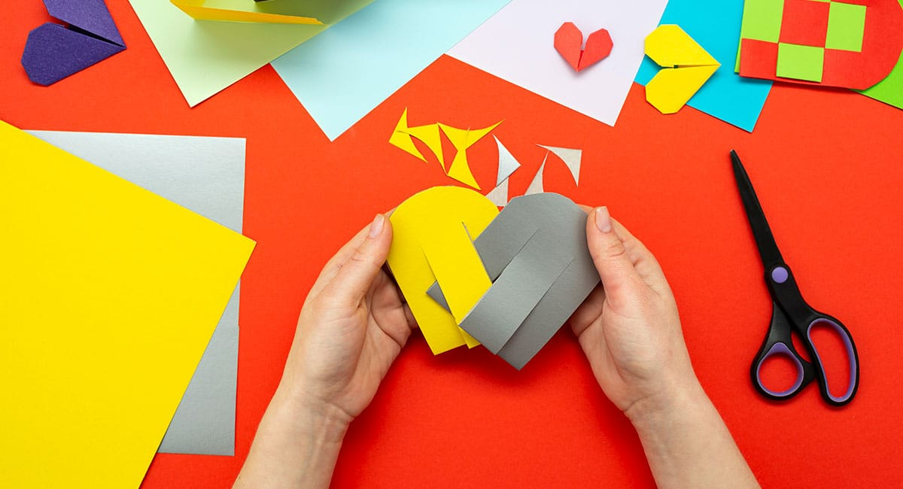
* VOCABULARY
﻿- make crafts (v):
make things with your hands in a skilled way
Làm đồ thủ công
/meɪk krɑːft/

Slide 6
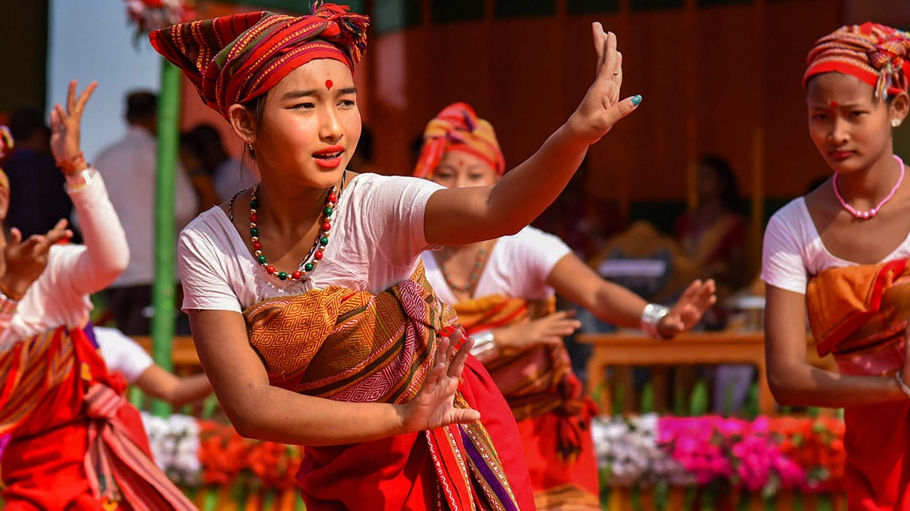
* VOCABULARY
﻿tribal dance (n)
/ˈtraɪbl dɑːns/
a dance performed by tribal people based on their customs and beliefs

Slide 7
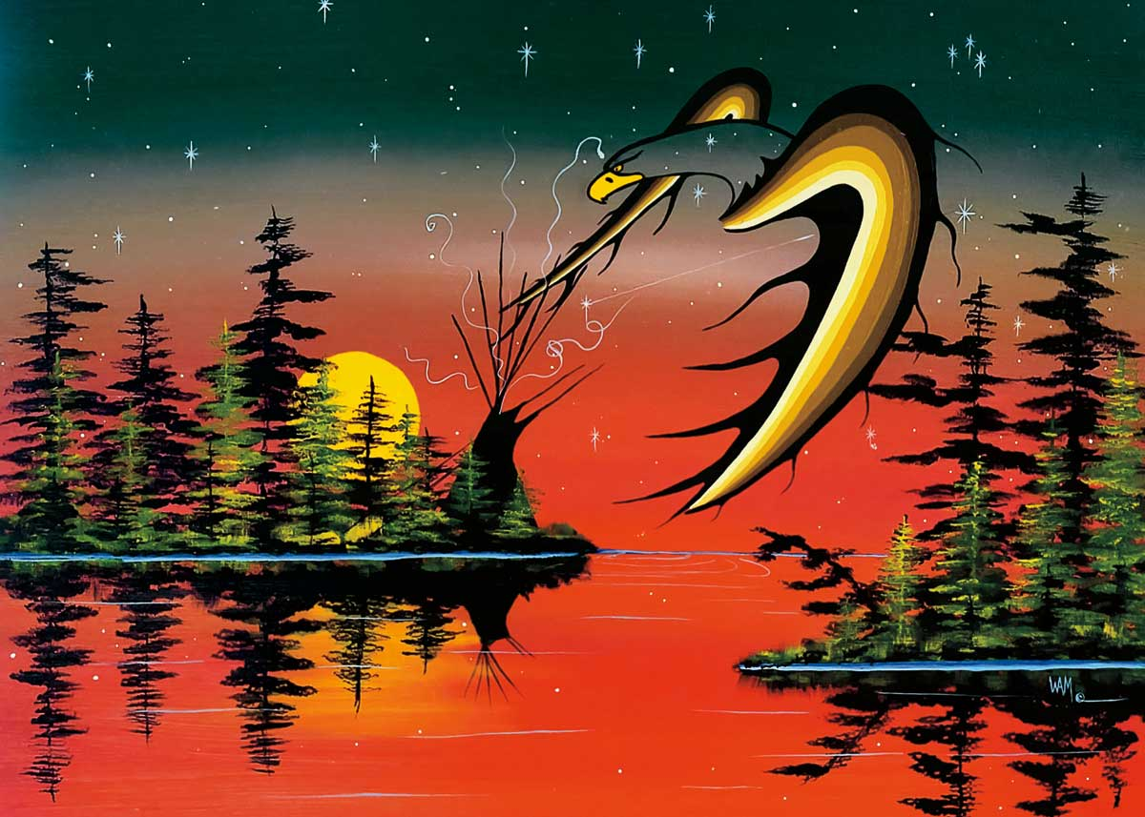
* VOCABULARY
﻿native art (n)
/ˈneɪtɪv ɑːt/
the artwork created by the original native people

Slide 8
* VOCABULARY
New words | Pronunciation | Meaning
1. dogsled (n) | ﻿/ˈdɒɡsled/ | ﻿xe trượt tuyết chó kéo
2. ﻿make crafts (v) | ﻿/meɪk krɑːft/ | ﻿làm đồ thủ công
3. tribal dance (n) | ﻿/ˈtraɪbl dɑːns/ | ﻿điệu nhảy của bộ tộc, bộ lạc
4. native art (n) | /ˈneɪtɪv ɑːt/ | tác phẩm nghệ thuật bản địa

Slide 9
* CHECKING VOCABULARY
New words | Pronunciation | Meaning
1. dogsled (n) | ﻿/ˈdɒɡsled/ | ﻿
2. ﻿make crafts (v) | ﻿/meɪk krɑːft/ | ﻿
3. tribal dance (n) | ﻿/ˈtraɪbl dɑːns/ | ﻿
4. native art (n) | /ˈneɪtɪv ɑːt/
xe trượt tuyết chó kéo
làm đồ thủ công
điệu nhảy của bộ tộc,
bộ lạc
tác phẩm nghệ thuật
bản địa

Slide 10
2
Complete the sentences with the words and phrases from the box.
tribal dances
weaving
dogsled
making crafts
native art
﻿1. The traditional craft of the villagers is _________ bamboo baskets.
2. We all joined in the ______________ when we attended the local festival.
3. The gallery in the city centre has an excellent collection of ___________.
4. Hoa is very keen on _____________. She loves to knit gloves after school.
5. The _________ is still used as a means of transport in Alaska today.

Slide 11
Choose the best answer

Slide 12
The tribal women know how to ______ these threads into beautiful clothes.
1
weave
make
cut
A
B
C

Slide 13
She comes from Korea, so her ______ language is Korean.
2
native
practical
modern
A
B
C

Slide 14
Sticking out one’s tongue was a way of greeting in ______ Tibetan culture.
3
traditional
leisurely
simple
A
B
C

Slide 15
How do people ______ New Years in your country, Jack?
4
practise
keep
celebrate
A
B
C

Slide 16
We like that restaurant: it ______ very delicious food.
5
practises
serves
buys
A
B
C

Slide 17
3
﻿Choose the correct answer A, B, or C to complete each sentence.
1. The tribal women know how to ______ these threads into beautiful clothes.
A. weave B. make C. cut
2. She comes from Korea, so her ______ language is Korean.
A. modern B. native C. practical
3. Sticking out one’s tongue was a way of greeting in ______ Tibetan culture.
A. traditional B. leisurely C. simple
4. How do people ______ New Years in your country, Jack?
A. practise B. keep C. celebrate
5. We like that restaurant: it ______ very delicious food.
A. practises B. serves C. buys

Slide 18
* PRONUNCIATION
How to pronounce to the sounds /br/ and /pr/.

Slide 19
*PRONUNCIATION
4
Listen and repeat the words. Pay attention to the sounds /br/ and /pr/.
/br/ | /pr/
﻿bridge broccoli breakfast algebra celebrate | present practise precious programme express

Slide 20
5
Listen and practise the sentences. Underline the words with the sound /br/ and circle the words with the sound /pr/.
﻿1. My brother says online learning improves our IT skills.
2. Santa Claus brings a lot of presents to children.
3. She briefly introduced the new programme.
4. He spent a lot of time preparing for his algebra test.
5. My mum prays at the temple before breakfast on Sundays.

Slide 21
* CONSOLIDATION
What have we learnt in this lesson?
Vocabulary: The lexical items related to Lifestyles
Pronunciation: How to correctly pronounce words that contain the sounds: /br/ and /pr/

Slide 22
* Homework
Do exercises in the Workbook.
Prepare lesson 3 : A closer look 2

Slide 23
Thanks for your atendance!
Goodbye. See you again
Notes:
23

