Slide 1
OUR TET HOLIDAY
LESSON 2: A CLOSER LOOK 1
Notes:
Dạy vocab kèm ví dụ
Practice pronun – chinese whisper

Slide 2
Lesson objectives
Vocabulary
By the end of the lesson, students will be able to:
Pronunciation
Remember 6 collocations related to Tet: have fun, visit relatives, clean the furniture, give lucky money, make a wish, watch fireworks
Pronounce the sounds /s/ and /∫/ in isolation and in context.

Slide 3
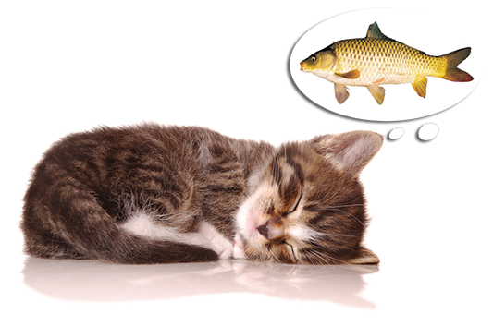
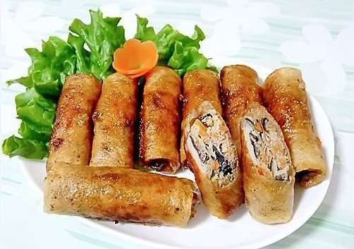
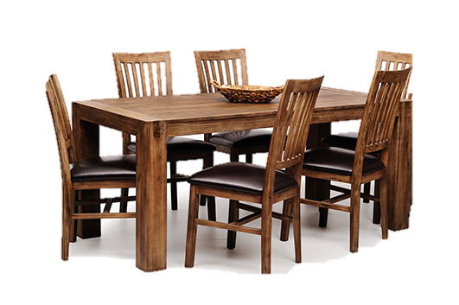
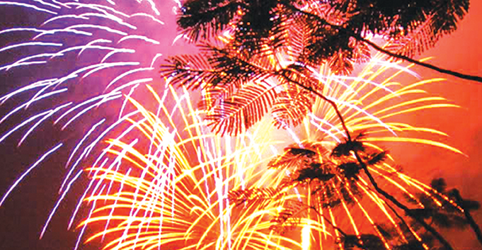
1
 |  |  |  | 2
 | 1
3
 |  |  |  |  |  |  |  |  |  | 4
 |  |  | 5
W | I | S | H
S
P
E
C
I
A
L
F
O
O
D
F | I | R | E | W | O | R | K | S
2
4
F
U
N
F | U | R | N | I | T | U | R | E
3
5
Notes:
Click the pictures for their answers

Slide 4
I always …………. fireworks on New Year’s Eve.
I want to make a sentence with fireworks. Can someone help me complete it?
a. give b. visit c. watch d. clean
Some verbs and nouns go together but some don’t.

Slide 5
Act 2 (p.60). In pairs, match the verbs with the nouns. Write your answer into your notebooks.
1. have
2. visit
3. give
4. make
5. clean
6. watch
fun
A. a wish
relatives
B. fireworks
lucky money
Tet activities
C. the furniture
a wish
D. lucky money
the furniture
E. relatives
fireworks
F. fun
Notes:
What are those activities called? Tet activities

Slide 6
What else do we do at Tet?
Complete the sentences (Act 3, page 60)
shopping
clean
peach
celebrate
food
1. In Viet Nam, we _________ Tet in January or February.
2. At Tet, we decorate our houses with _________ flowers.
3. Children should help their parents to _________ their houses.
4. People do a lot of __________ before Tet.
5. My mother usually cooks special ________ during Tet.

Slide 7
Can you pronounce these words?
/∫/
/s/
wish
rice
Are they the same?

Slide 8
How are they different?
/∫/
/s/
Watch, listen and write down the words in 2 columns.
Notes:
Click on the videos to play or pause them
Video 1: /∫/: 0:00-1:20; /∫/ vs /s/: 1:24 - end
Video 2: /s/: 0:00-0:38; /s/ vs /z/: 0:38 - end

Slide 9
Listen and repeat (Act 4 p.60)
Put them in the correct column
shopping
special
rice
wish
celebrate
special
spring
/∫/ | /s/
Notes:
Special: s: /s/; c /∫/

Slide 10
Listen and repeat the poem (Act 5 p.60)
Pay attention to the sounds /s/ and /∫/ in the underlined words.
Spring is coming!
Tet is coming!
She sells peach flowers.
Her cheeks shine.
Her eyes smile.
Her smile is shy.
She sells peach flowers.

Slide 11
What have we learned today?

Slide 12
Extra activities

Slide 13
Minimal pairs
C she
sea she
seat sheet
see she
sock shock
boss bosh
save shave
seal she’ll
so show
sofa chauffeur
sore sure
sort short

Slide 14
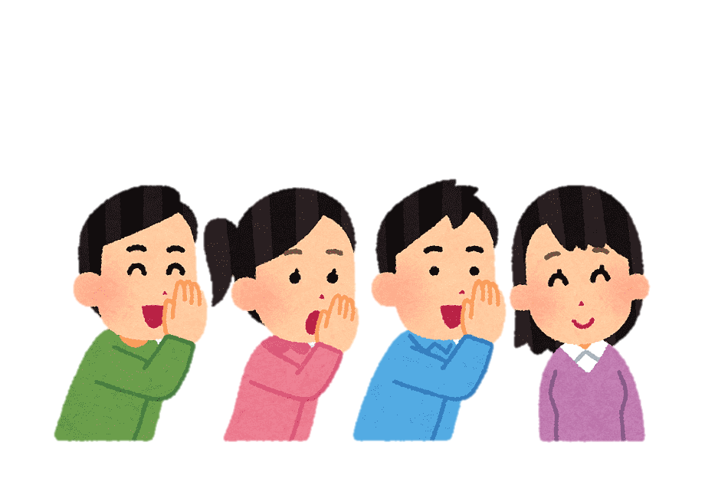
Chinese whisper
Step 1: Players form 2 lines (2 teams).
Step 2: Teacher give the first player of each team a sentence.
Step 3: The 1st player whispers the sentence to the 2nd player and so on.
Step 4: The last player runs to the board and write it down. If the sentence is correct, the team gets 1 point.
Step 5: If the last player can read the sentence with correct pronunciation, the team gets 1 more point.

Slide 15
Sentence 1
She sells sea shells by the sea shore.

Slide 16
Sentence 2
The shells she sells are surely seashells.

Slide 17
Sentence 3
If she sells shells on the seashore,
I'm sure she sells seashore shells.

Slide 18
What have we learned today?

