Slide 1
OUR TET HOLIDAY
Unit 1
LESSON 4: COMMUNICATION

Slide 2
OBJECTIVE
By the end of the lesson, students will be able to:
- Produce New Year’s wishes;
- Introduce students to some New Year’s practices in other countries.

Slide 3
WARM-UP GAME: FLAGS OF THE WORLD
In 2 teams.
Look at the flags and and guess the countries
The team with the correct answer gets red envelopes following each question.
The team with the most red envelopes will win.

Slide 4
Question 0
Viet Nam

Slide 5
Question 1
JAPAN

Slide 6
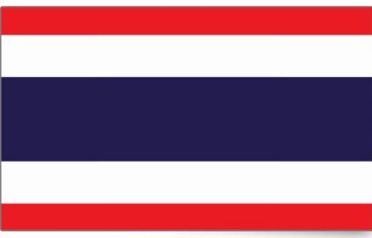
Question 2
THAILAND

Slide 7
Question 3
ROMANIA

Slide 8
Question 4
SPAIN

Slide 9
Question 5
SWITZERLAND

Slide 10
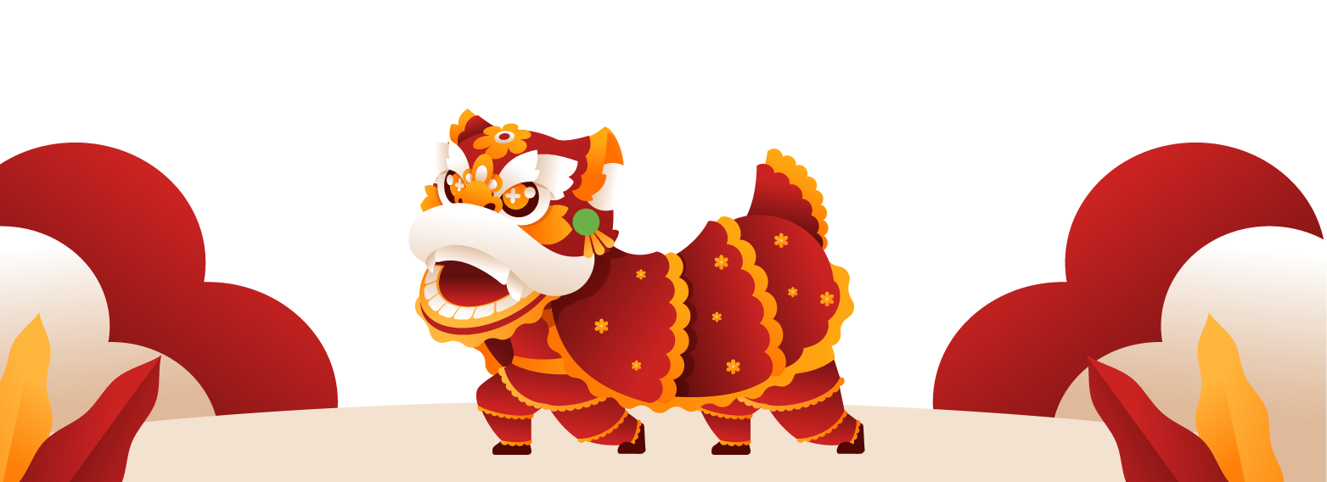
01
NEW YEAR’S WISHES

Slide 11
EX 1: Listen and read the New Year’s wish
What structure is he using?
Wishing you + N

Slide 12
Any wishes for the new year?
In group of 4.
Take turn to make wishes with your friends using these phrases:
– happy days from January to December
– a year full of fun
– happiness and cheers
– a life full of happy moments
– success in your studies

Slide 13
02
NEW YEAR PRACES
IN THE WORLD

Slide 14
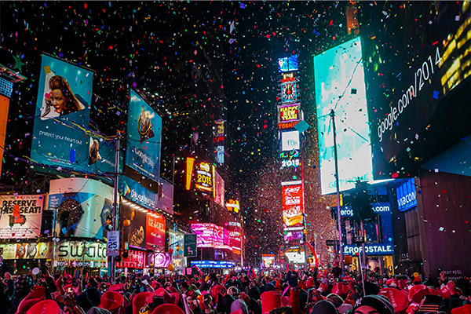
Ex 3: match the sentences with the countries
The USA
They go to Times Square to watch New Year’s Eve Ball Drop

Slide 15
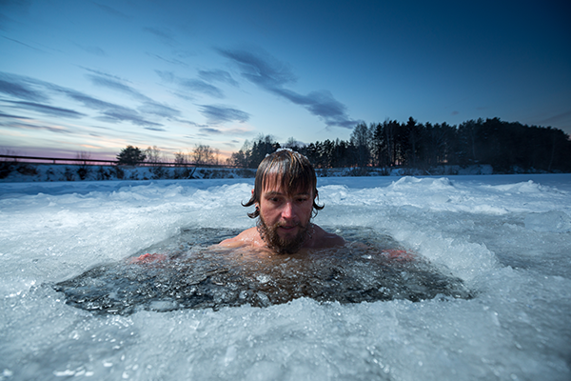
Ex 3: match the sentences with the countries
Russia
They bathe in an ice hole

Slide 16
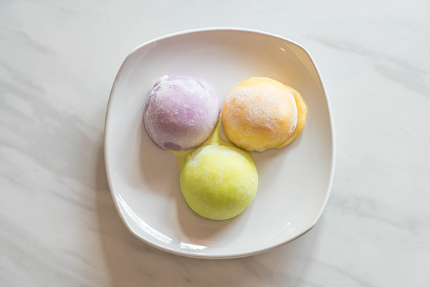
Ex 3: match the sentences with the countries
Japan
They eat mochi rice cakes

Slide 17
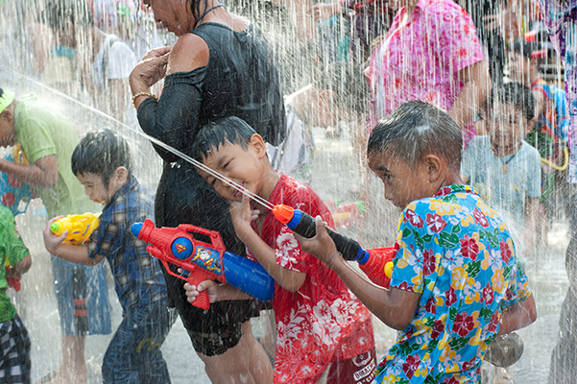
Ex 3: match the sentences with the countries
Thailand
They throw water on other people

Slide 18
Ex 4: read about new year practices in different countries
In Japan, temples ring their bells 108 times at midnight on December 31. By doing so, people believe the bad things of the past year will leave. In Spain, people try to put 12 grapes in their mouth at midnight for good luck. In Switzerland, they drop ice cream on the floor to celebrate the New Year. In Romania, they throw coins into a river for good luck. In Thailand, they throw water on other people to wash away bad luck.

Slide 19
Let’s match!!!
Japan
Spain
SWITZERLAND
ROMANIA
Thailand
a. drop ice cream on the floor
b. throw water on other people
c. throw coins into a river
d. put 12 grapes in their mouth
e. ring bells 108 times

Slide 20
GAME TIME: SUPER MEMORY!!!
In 2 teams.
Look at the actions and and guess the countries
The team with the correct answer gets red envelopes following each question.
The team with the most red envelopes will win.

Slide 21
GAME TIME: SUPER MEMORY!!!
01
02
03
Japan
Spain
Switzerland
04
05
06
Romania
Russia
The USA
ring bells 108 times
Eat mochi rice cake
put 12 grapes in their mouth
drop ice cream on the floor
throw coins into a river
go to Times Square to watch New Year’s Eve Ball Drop
They bathe in an ice hole

Slide 22
Let’s recap
The structure for New Year’s Wishes?
What do Thai people do to wash away bad luck?
To to celebrate the New Year, they drop ice cream on the floor in ....
Wishing you ....
throw water on other people
Switzerland

Slide 23
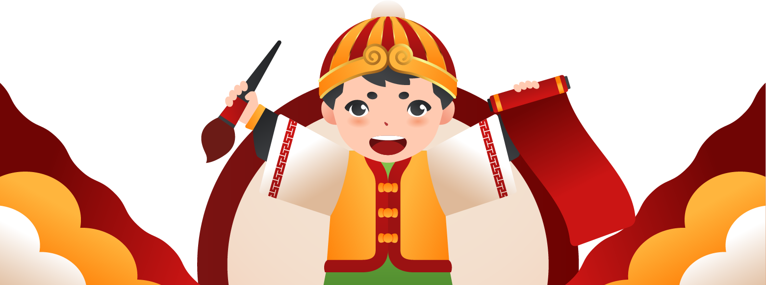
Thank you
Wishing you lots of happiness and cheers

Slide 24
Icon pack: Chinese New Year

