Slide 1
TRƯỜNG THCS LONG BIÊN
BÀI GIẢNG ĐIỆN TỬ MÔN TIẾNG ANH 8
REVIEW 2
Lesson 2: Skills
GV: Nguyễn Thị Hiền
Tổ Ngoại Ngữ - Năng khiếu

Slide 3
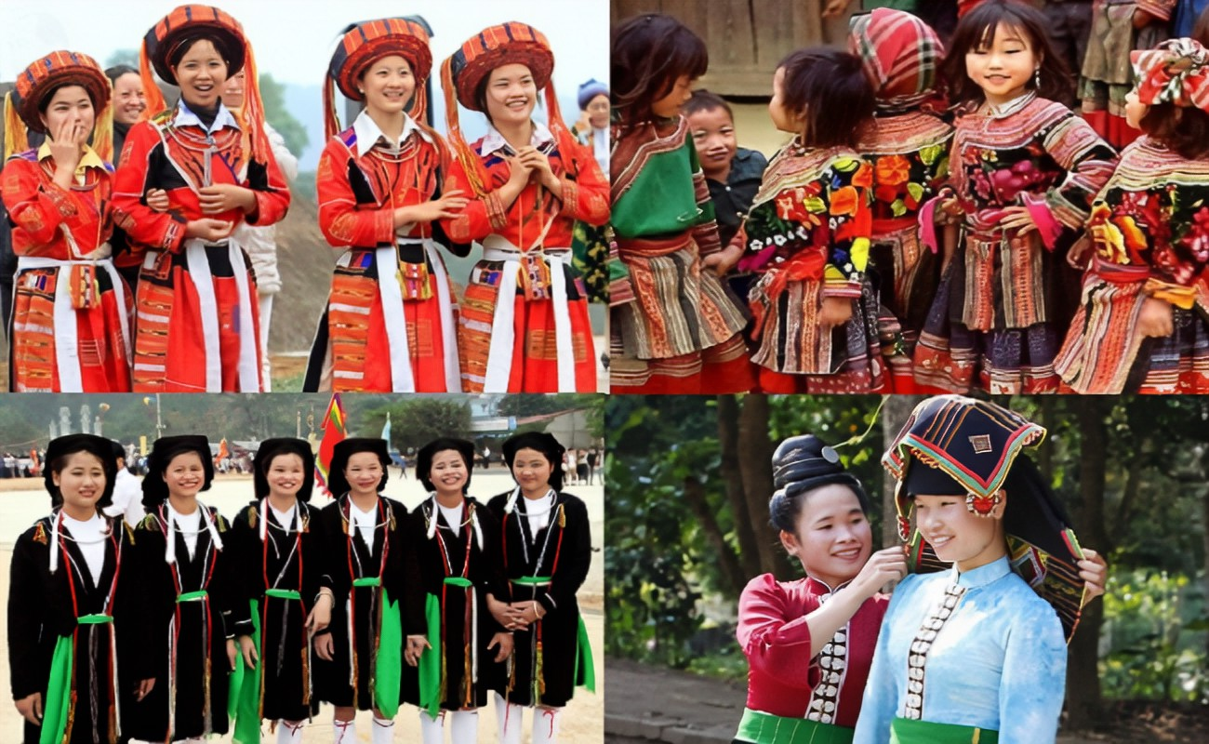
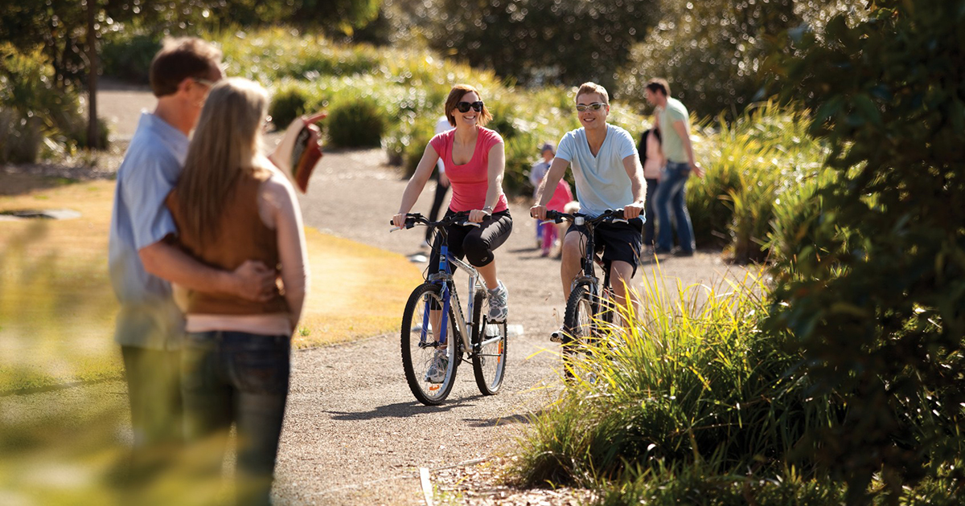
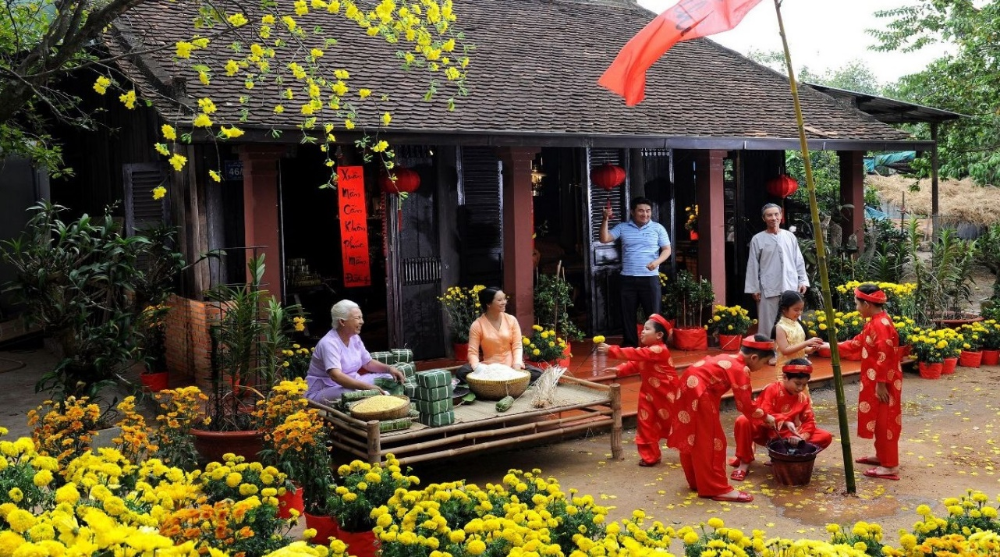
REVIEW 2
Unit
ETHNIC GROUPS OF VIET NAM
LESSON 2: SKILLS

Slide 4
SKILLS
WARM-UP
Chatting: CUSTOMS AND TRADITIONS
READING
Task 1: Read the schedule of the Spring Fair and select the event that each person wants to attend.
Task 2: Work in pairs. Read the list and tick the main reason(s). Explain your choice.
SPEAKING
LISTENING
Task 3: Listen to Phong talking about life in the countryside and complete each sentence with one word.
Task 4: Write complete sentences from the clues below.
WRITING
Wrap-up
Homework
CONSOLIDATION

Slide 5
WARM-UP
Customs and traditions

Slide 6
READING
1
Read the schedule of the Spring Fair and select the event that each person wants to attend. Write the event names in the table.
PEOPLE | EVENTS
1. Ann wants to take her children out to play folk games.
2. Tom wants to learn about making pottery.
3. Alice wants to see ethnic dance performances.
4. Mai wants to learn more about farm products.
5. Mark wants to see a collection of ethnic people’s daily activities.
Childhood Fun
A Pottery Village
Performances
Ethnic Markets
Photo Exhibition

Slide 7
SPEAKING
2
Work in pairs. Read the list below and tick the main reason(s) for people moving from the countryside to the city. Explain your choice.
1. To look for well-paid jobs.
2. To look for better services.
3. To enjoy crowded and noisy areas.
4. To have better educational opportunities.
5. To experience different types of food and entertainment.

Slide 8
LISTENING
3
Listen to Phong talking about life in the countryside and complete each sentence with one word.
1. Phong always spends his summer ________ with his grandparents. 2. He likes the _________ games the children play. 3. The villagers sell their home-grown________. 4. They buy food and other _________ things. 5. At the market, the villagers _____ and talk
vacation
traditional
products
necessary
meet

Slide 9
WRITING
4
Write complete sentences from the clues below.
﻿1. Many / Vietnamese families / teach / children / respect / elders.﻿
→ Many Vietnamese families often teach their children to respect the elders.
2. There / many ways / show / respect.
→ ﻿There are many ways to show respect.
3. You / give up / seat / or oﬀer / carry something heavy / elders.
→ ﻿You can give up a seat or offer to carry something heavy for the elders.

Slide 10
WRITING
4
Write complete sentences from the clues below.
﻿4. You / listen / not talk back / elders / speak.﻿
→ You should listen and don’t talk back when the elders speak.
5. At mealtimes / children should not / start / eat / before / elders do.
→ ﻿At mealtimes, children should not start eating before the elders do.

Slide 11
CONSOLIDATION
1
WRAP-UP
In this lesson, you have:
practised reading for specific information about an event schedule.
practised talking about the reasons for people moving from the countryside to the city.
practised listening for specific information about life in the countryside.
practised writing correct sentences from clues.

Slide 12
CONSOLIDATION
2
HOMEWORK
Do exercises in the workbook.
Prepare for Unit 7 – Getting started

Slide 13
Website: hoclieu.vn
Fanpage: facebook.com/www.tienganhglobalsuccess.vn/

