Slide 1
TRƯỜNG THCS LONG BIÊN
BÀI GIẢNG ĐIỆN TỬ MÔN TIẾNG ANH 8
UNIT 11: SCIENCE AND TECHNOLOGY
Lesson 2 : A closer look 1
GV: Nguyễn Thị Hiền
Tổ Ngoại Ngữ - Năng khiếu

Slide 3
Unit
11
SCIENCE AND TECHNOLOGY
LESSON 2: A closer look 1
1

Slide 4
LESSON 2: A CLOSER LOOK 1
WARM-UP
Game: Labelling
Task 1: Write a word or phrase from the box under each picture.
Vocabulary
Task 2: Choose the option that best completes each phrase.
Task 3: Complete the sentences with the words and phrases from the box.
VOCABULARY
Task 4: Listen and repeat the sentences. Pay attention to the bold syllables.
Task 5: Listen and repeat the sentences. How many stressed words are there in each sentence?
PRONUNCIATION
CONSOLIDATION
Wrap-up
Homework

Slide 5
GAME: LABELLING
WARM-UP
RULE:
Work in 2 teams
Receive the pictures of things and strips of paper with the phrases.
Stick the phrases to the right pictures.
The team with the most correct answers wins

Slide 6
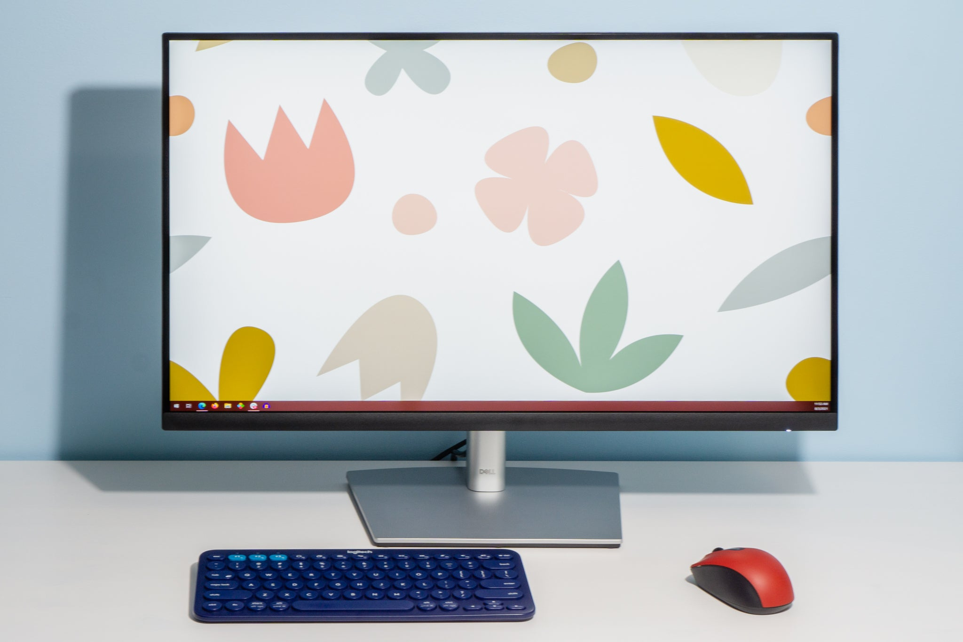
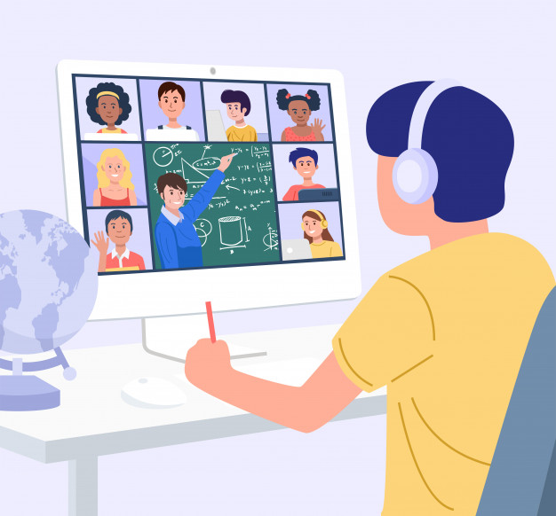
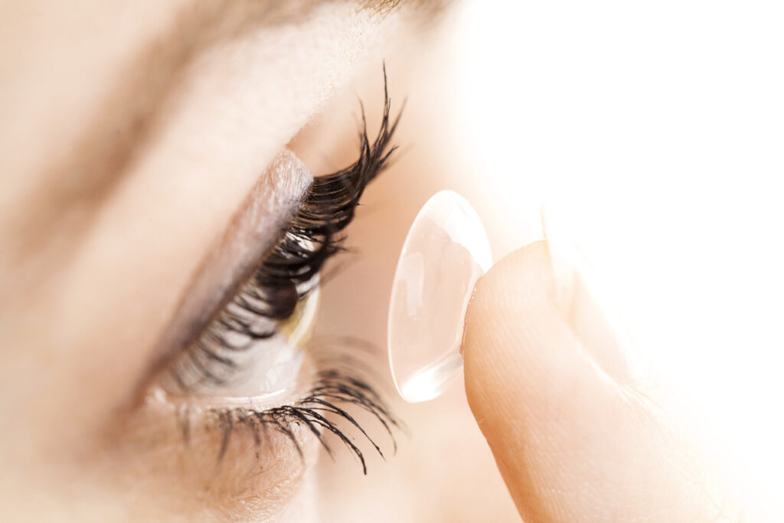
GAME: LABELLING
WARM-UP
Computer screen
Breakout rooms
Robot teacher
Online class
3D contact lenses
Connection

Slide 7
VOCABULARY
1
Write the words and phrases under each picture.
face recognition
1. ___________________
2. _______________
digital communication

Slide 8
VOCABULARY
1
Write the words and phrases under each picture.
3. ___________
experiment
eye-tracking
4. ___________

Slide 9
VOCABULARY
1
Write the words and phrases under each picture.
fingerprint scanner
6. ________________
5. ________________
video conferencing

Slide 10
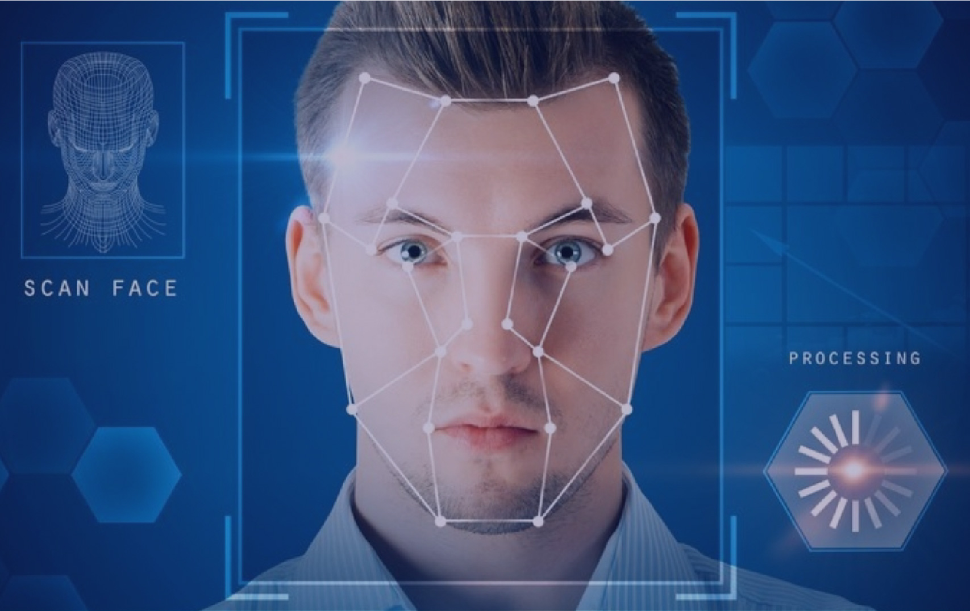
VOCABULARY
face recognition (n)
/feɪsˌrekəɡˈnɪʃn/
công nghệ nhận diện gương mặt

Slide 11
VOCABULARY
experiment (n)
/ɪkˈsperɪmənt/
thí nghiệm

Slide 12
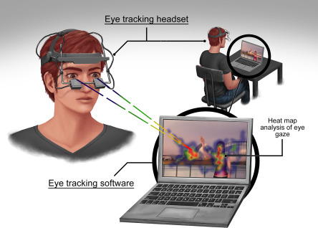
VOCABULARY
eye-tracking (n)
/ˈai ˌtrækɪŋ/
theo dõi (cử động) mắt

Slide 13
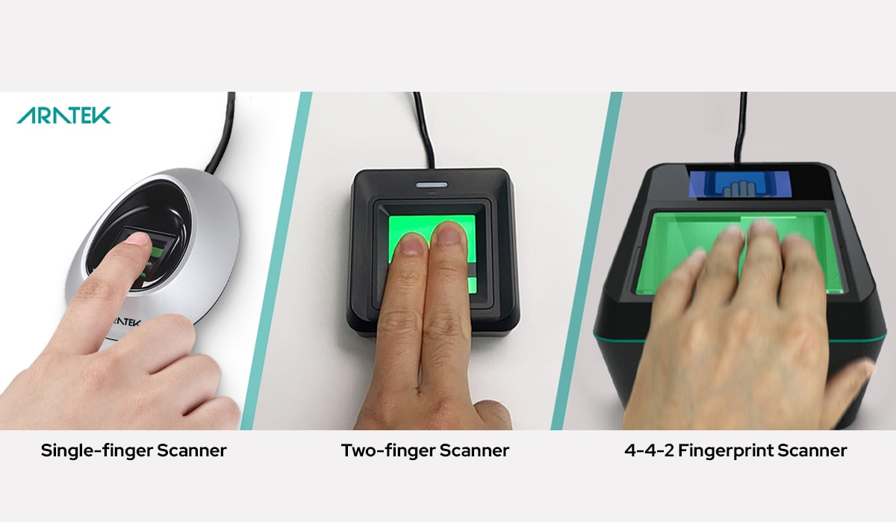
VOCABULARY
fingerprint scanner (n)
/ˈfɪŋɡəprɪnt ˈskænə/
máy quét vân tay

Slide 14
VOCABULARY
digital communication (n)
/ˈdɪdʒɪtl kəˌmjuːnɪˈkeɪʃn/
giao tiếp kỹ thuật số

Slide 15
VOCABULARY
New words | Pronunciation | Meaning
1. face recognition (n) | /feɪsˌrekəɡˈnɪʃn/ | công nghệ nhận diện gương mặt
2. experiment (n) | /ɪkˈsperɪmənt/ | thí nghiệm
3. eye tracking (n) | /ˈai ˌtrækɪŋ/ | công nghệ dõi (cử động) mắt
4. fingerprint scanner(n) | /ˈfɪŋɡəprɪnt ˈskænə/ | máy quét vân tay
5. digital communication (n) | /ˈdɪdʒɪtl kəˌmjuːnɪˈkeɪʃn/ | giao tiếp kỹ thuật số

Slide 16
VOCABULARY
2
Choose the option that best completes each phrase.
A. a device
1.
invent
B. a new area
A. a device
2.
discover
B. a new area
A. a device
3.
create
B. a new area
A. a device
4.
develop
B. a new area

Slide 17
VOCABULARY
3
Complete the sentences with the words and phrases from the box.
invented
created
experiments
discovered
fingerprint scanner
1. Marie Curie and Pierre Curie __________ radium and polonium.
2. Thomas Edison _________ the light bulb in 1880.
3. Sarah Gilbert is the creator of a vaccine. She ______ it in 2020.
4. Scientists have carried out many __________ to find a cure for cancer.
5. Scan your finger on this _______________ to check attendance, please.

Slide 18
PRONUNCIATION

Slide 19
PRONUNCIATION
4
Listen and repeat the sentences. Pay attention to the bold syllables.
1. I don’t have a computer.
2. Do you call her every day? – No, I don’t.
3. They are not familiar with that new computer.
4. Did you lend her your laptop? – Yes, I did.
5. Who do you work with on Sundays?

Slide 20
PRONUNCIATION
5
Listen and repeat the sentences. How many stressed words are there in each sentence?
1. He is an inventor.
2. We won’t have a robot teacher next year.
3. She likes learning online.
4. Was she checking attendance when you came? - No, she wasn’t.
5. What did he invent?
1. He is an inventor.
2. We won’t have a robot teacher next year.
3. She likes learning online.
4. Was she checking attendance when you came? - No, she wasn’t.
5. What did he invent?
→ 1 stressed words
→ 6 stressed words
→ 3 stressed words
→ 6 stressed words
→ 2 stressed words

Slide 21
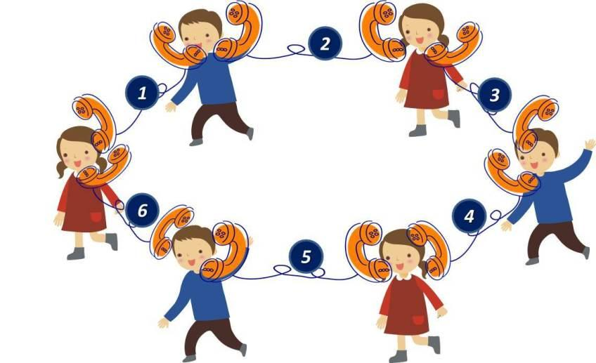
PRODUCTION
5
GAME: BROKEN TELEPHONE

Slide 22
CONSOLIDATION
1
Wrap-up
What have we learnt in this lesson?
words and phrases related to new technologies.
new verb phrases that are used to talk about inventions, discoveries, creation, and development.
sentences stress

Slide 23
CONSOLIDATION
2
Homework
Learn by heart words and phrases learned
Do exercise in the workbook

Slide 24
Website: hoclieu.vn
Fanpage: facebook.com/tienganhglobalsuccess.vn/

