Slide 1



Ngoc Lam Secondary School

Slide 2






HIDDEN PICTURES
LET’S PLAY!

Slide 3
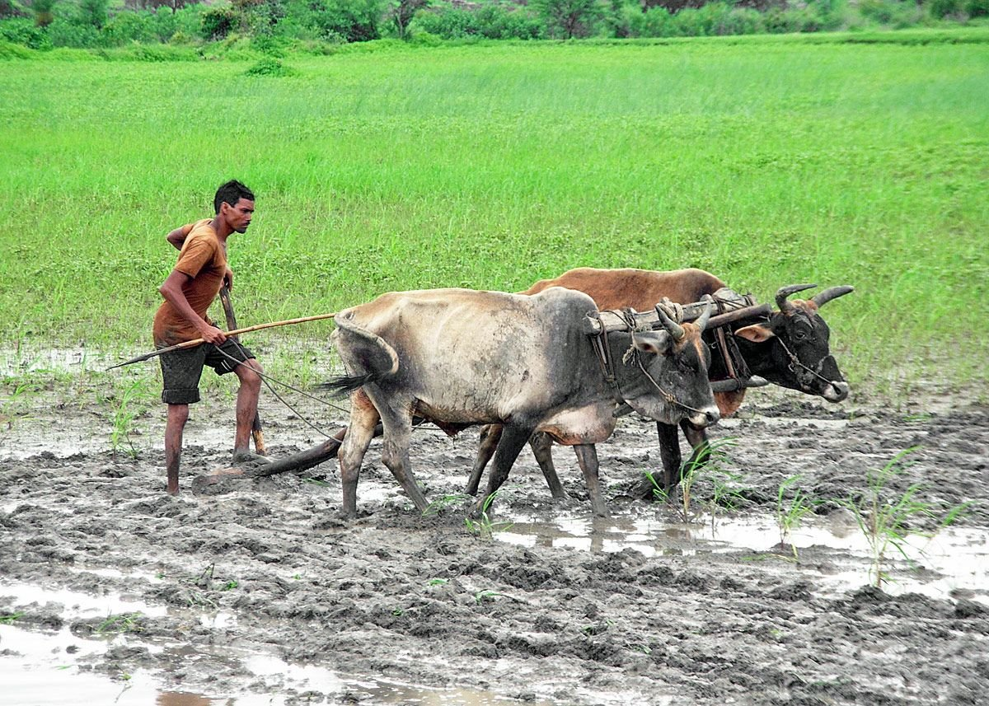
ploughing fields
SHOW
KEY

Slide 4
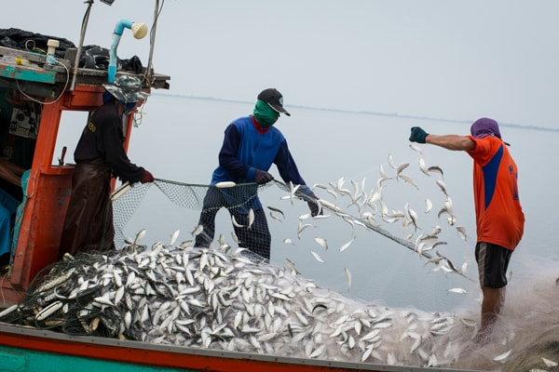
catching fish
SHOW
KEY

Slide 5
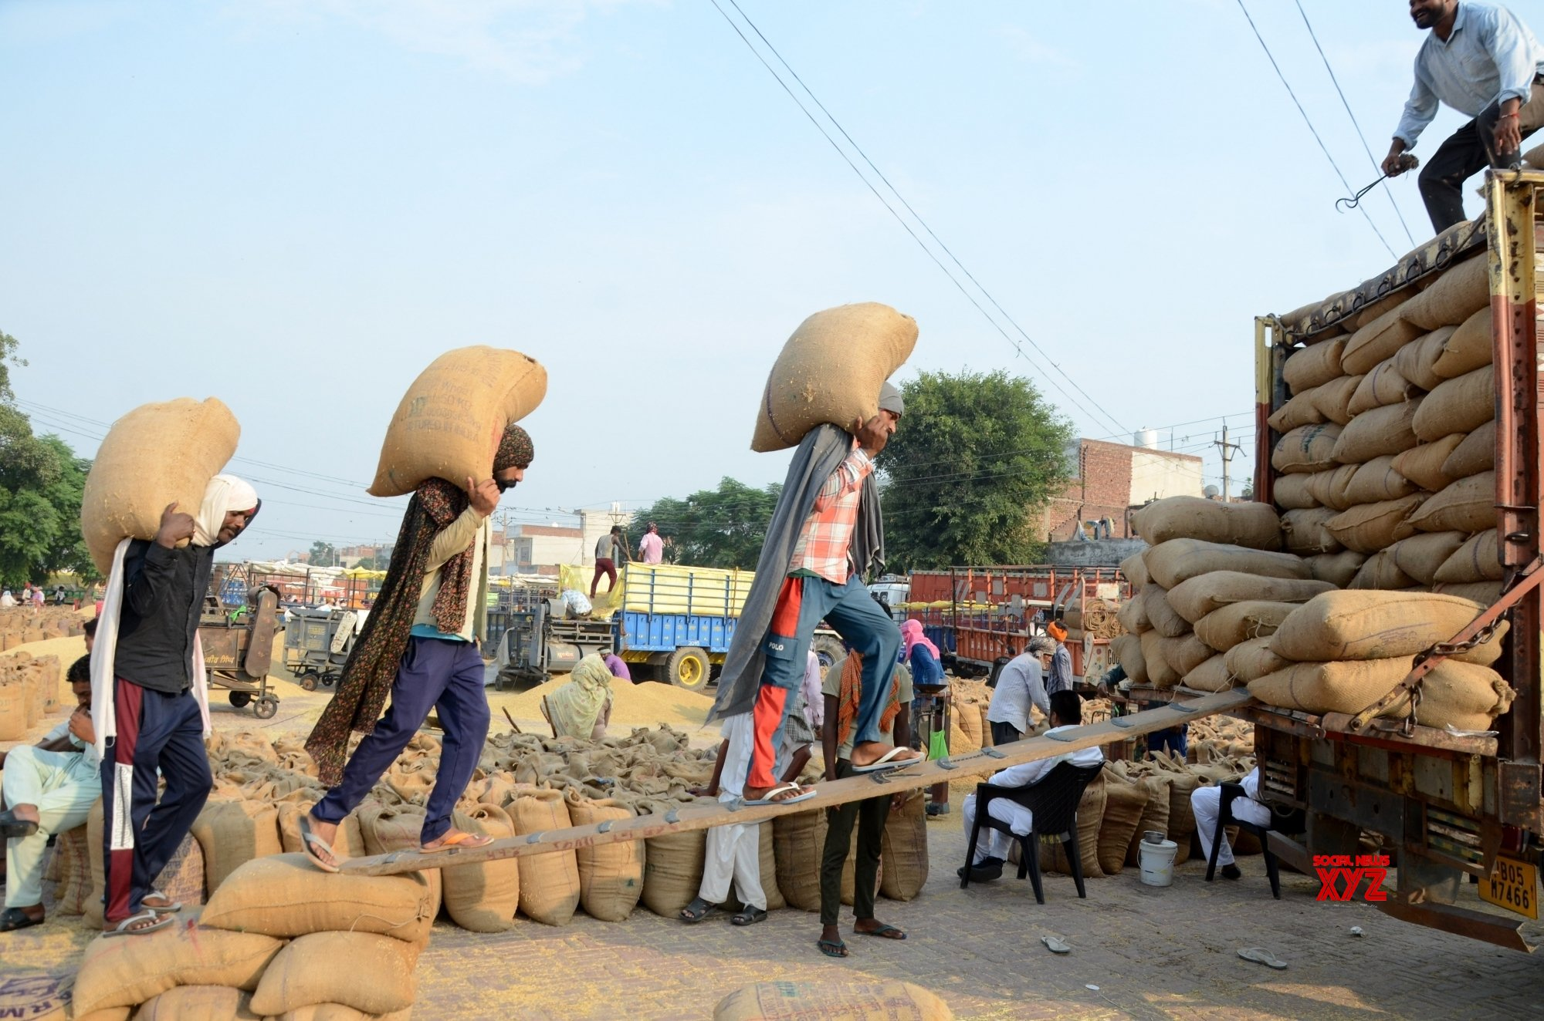
loading rice
SHOW
KEY

Slide 6
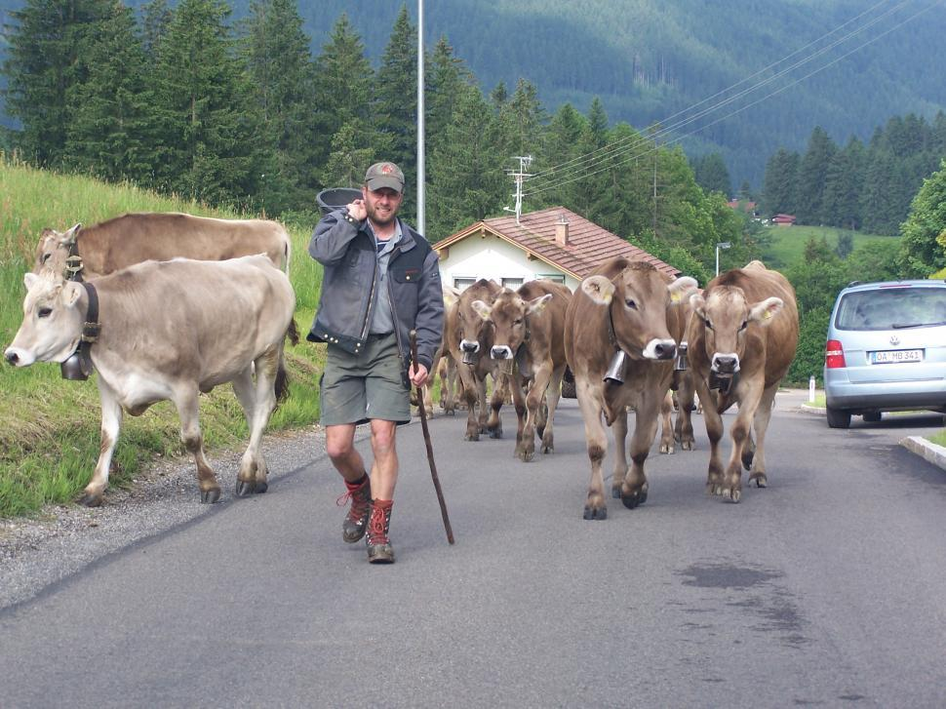
herding cows
SHOW
KEY

Slide 7
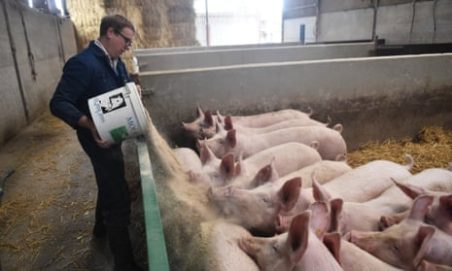
feeding pigs
SHOW
KEY

Slide 8







Unit 2:
LIFE IN THE COUNTRYSIDE
Lesson 2: A Closer Look 1

Slide 9






VOCABULARY

Slide 10

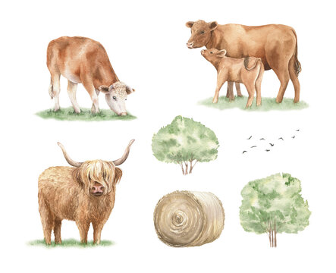
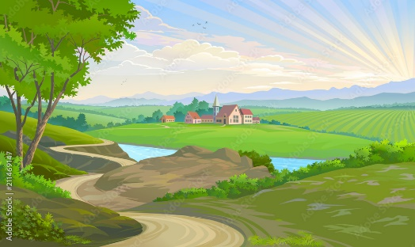
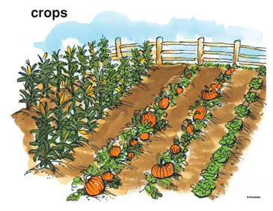
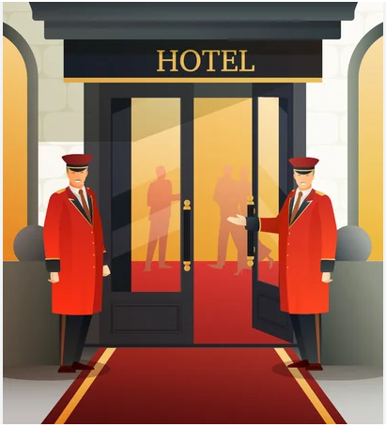
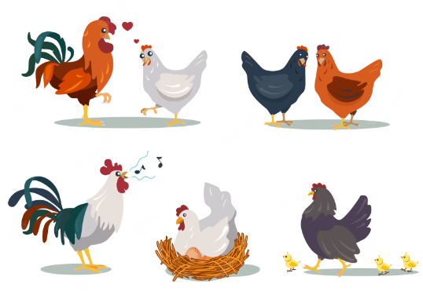
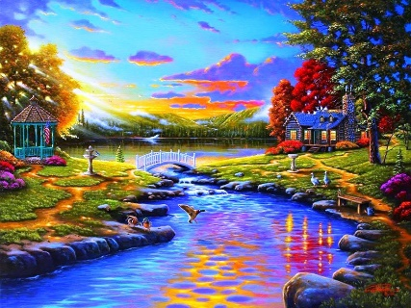
Match the words to the suitable pictures
cattle
crop
hospitable
vast
poultry
picturesque
1
2
3
4
5
6

Slide 11









VOCABULARY
S
T
A
R
I
N
G
- cattle (n) | /ˈkæt(ə)l/ | gia súc
- poultry (n) | /ˈpəʊltri/ | gia cầm
- crop (n) | /krɒp/ | hoa màu
- vast (adj) | /vɑːst/ | mênh mông
- hospitable (adj) | /hɒˈspɪtəbl/ /ˈhɒspɪtəbl/ | hiếu khách
- picturesque (adj) | /ˌpɪktʃəˈresk/ | đẹp như tranh vẽ

Slide 12




1. Circle the correct words to complete the sentences.
T
T
E
1. We helped the farmers herd cattle / poultry.
2. They are helping their parents pick plants / fruit in the orchard.
3. At harvest time farmers are busy cutting and collecting food / crops.
4. The driver loaded / unloaded the rice from the back of the truck.
5. People here live by catching / holding fish from nearby lakes
and ponds.
herd cattle: chăn thả gia súc
pick fruit: hái quả
collecting crops: thu hoạch nông sản
unloaded: dỡ hàng
catching fish: bắt cá

Slide 13




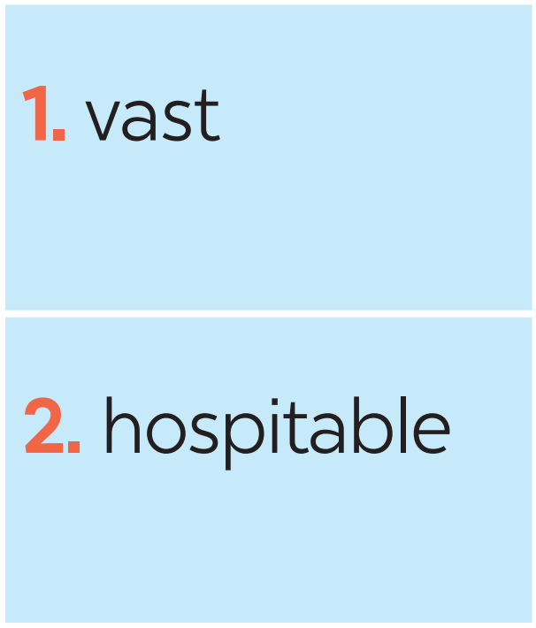
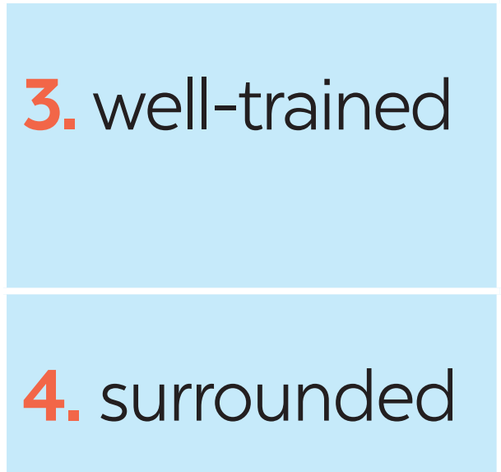


2. Match the following adjectives with their definitions.
a. pretty, especially in a way that looks old-fashioned
b. having something near or around
c. extremely large in area, size, amount, etc.
d. pleased to welcome guests; generous and friendly to visitors
e. having received good or thorough training
M
E
E
T
M
Y
P
E
T

Slide 14



3. Complete the sentences with the words from 2
hospitable
1. The local people are kind and __________ to visitors.
2. Our factory needs a lot of ____________ workers.
3. While travelling up the mountain, people always stop and take photos of the ___________ scenery.
4. The Sahara is a ______ desert that covers parts of eleven countries in Northern Africa.
5. The lake is _____________ by a lot of trees.
- kind and hospitable: tốt bụng và hiếu khách
well-trained
- well- trained: được đào tạo tốt
picturesque
- picturesque scenery: cảnh đẹp như tranh vẽ
vast
- a vast desert: sa mạc rộng lớn mênh mông
- is surrounded by: được bao phủ bởi
surrounded

Slide 15
PRONUNCIATION
/ə/ and /ɪ/

Slide 16

Watch a video and pay attention to the sounds /ə/ and /ɪ/.

Slide 17


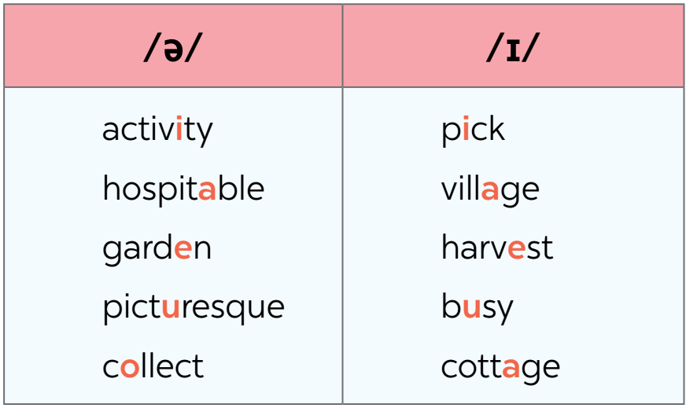
4. Listen and repeat the words. Pay attention to the sounds /ə/ and /ɪ/.

Slide 18


5. Listen and practice the sentences. Underline the bold words with /ə/ and circle the bold words with /ɪ/
1. There is a lot of water in the bottle.
2. The farmers here are hard-working.
3. They are picking fruits in the orchard.
4. People in my village usually gather at weekends.
5. Please buy some milk and pasta at the supermarket.

Slide 19



Wrap-up
T
H
A
N
K
S
What have we learnt in this lesson?
Vocabulary: The lexical items related to Life in the countryside
Pronunciation: The sounds /ə/ and /ɪ/ in words and sentences

Slide 20



THANK YOU!

