Slide 1




KIM’S GAME
LET'S GET STARTED!

Slide 2


What activities can you remember?

Slide 3

Check your answers.
1. watch tv
7. go shopping
2. play video game
8. hang out with friend
3. chat online
9. go for a bike ride
4. play an instrument
10. read a book (magazine)
5. make videos
11. listen to music
6. take photos
12. download songs

Slide 4
Let’s think!
1. In your opinion, what activities can we do with our friends in our leisure time?
2. Why should we spend time
with our friends?

Slide 5
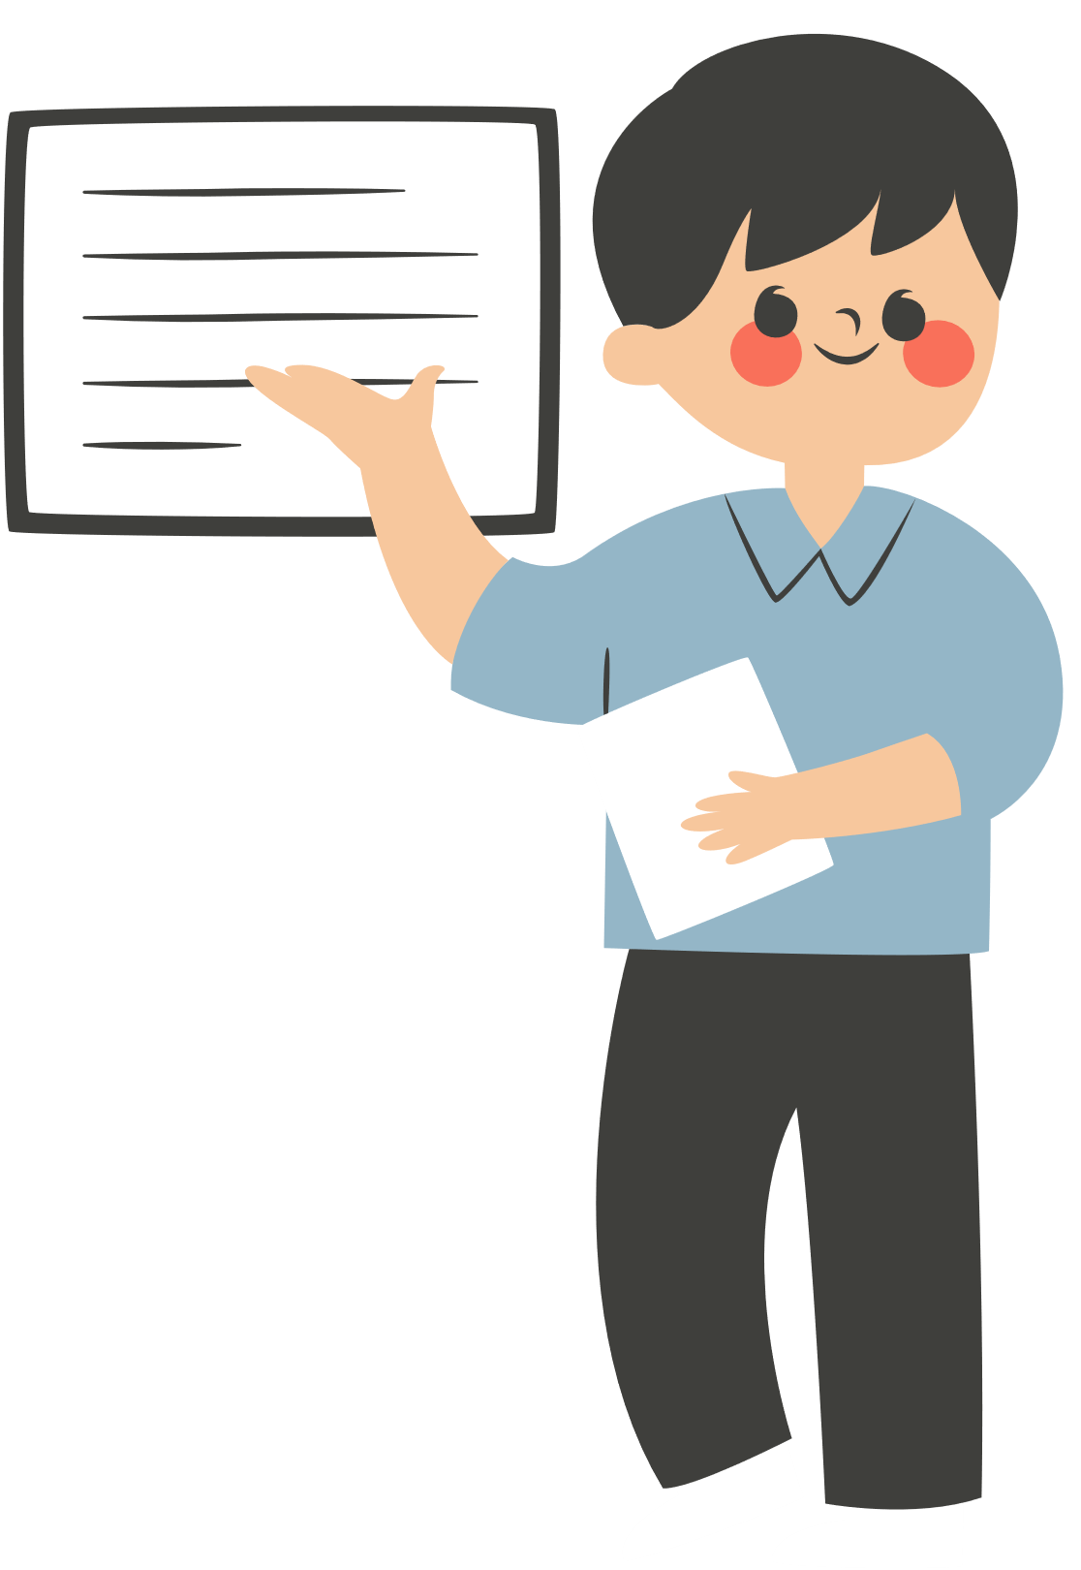
UNIT 1: LEISURE TIME
Lesson 6: Skills 2

Slide 6

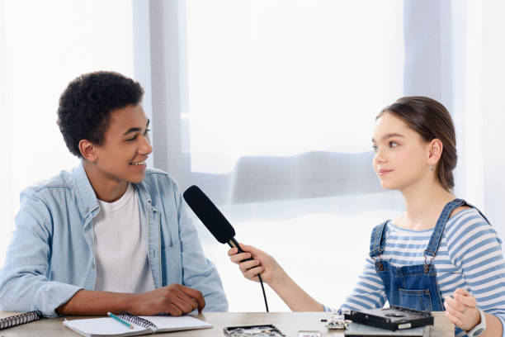
2. Listen to an interview with Mark about his leisure activities. Choose the correct answer.
1. When does Mark usually have free time?
A. At weekends. B. On Sundays. C. On Saturdays.
2. Who does he spend his free time with?
A. His neighbours and friends.
B. His family and relatives. C. His family and friends.
Mark

Slide 7



3. Listen to the interview again. Fill in each blank in the table with no more than two words.
Activities | Reason
Inviting friends to his house Cooking and watching a (1) ______ | Fun and better than going to the (2) ________
Going to the (3) ______ to play volleyball or skateboard | Stay in (4) ______
Going for a (5) ________ around our city | See different (6) ______
cinema
video
park
shape
bike ride
places

Slide 8

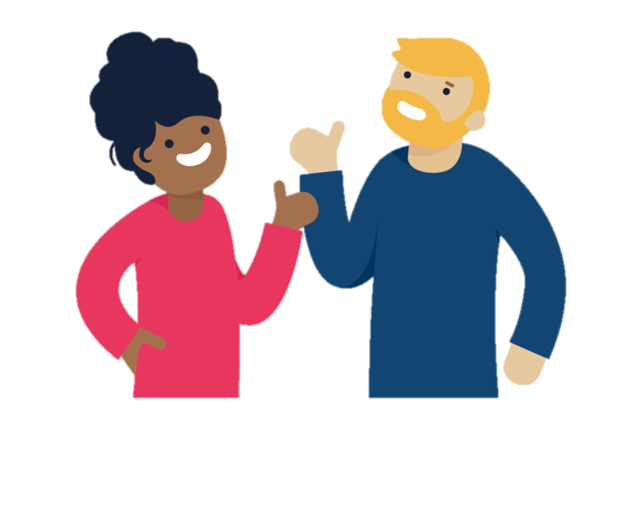
4. Work in pairs. Ask and answer the questions.
When do you usually have free time?
I often have free time at the weekend.
What do you usually do with your friends in your free time?
Sometimes I hang out with my friends in our favourite café
Why do you do these activities?
Because it’s the time that we can talk with each other.

Slide 9

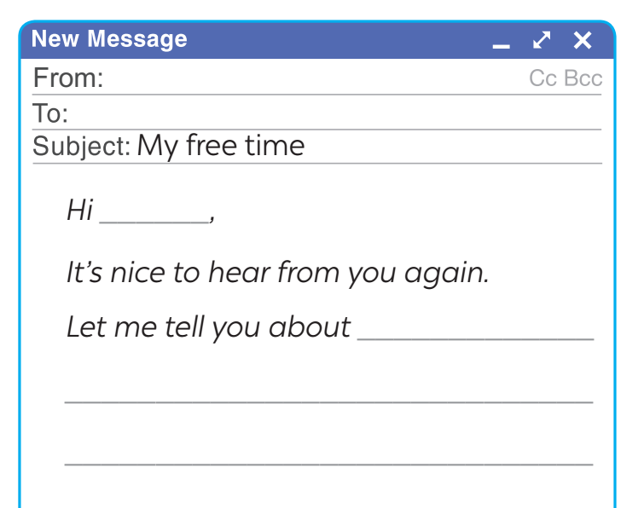
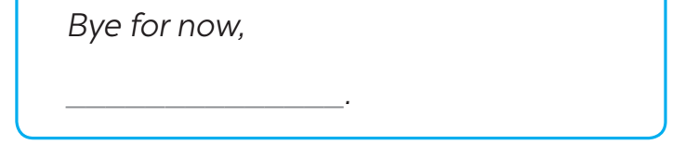
5. Write an email (80-100 words) to a penfriend to tell him/her about what you usually do with your friends in your free time. Use your answer in 4.
- I often have free time ……
- Sometimes I ………with ……….in ………
- Because ……………
- I feel ……………

Slide 10
Suggested answer:
Hi Ann,
It’s nice to hear from you again. Let me tell you about the things I usually do with my friends in my free time.
I usually have free time at weekends, and I often spend Sunday mornings with my friends. I have three close friends, and they live near my house. We usually play badminton together for about one hour in the playground. After that we cycle around the neighbourhood. We had a lot of fun and these activities can keep us in shape.
What about you? What do you usually do with your friends in your free time?
Tell me in your next email.
Bye for now,
Mi

Slide 11


Wrap-up
What have we learnt in this lesson?
Listen to someone talking about their leisure activities
Write an email to talk about leisure activities

Slide 12
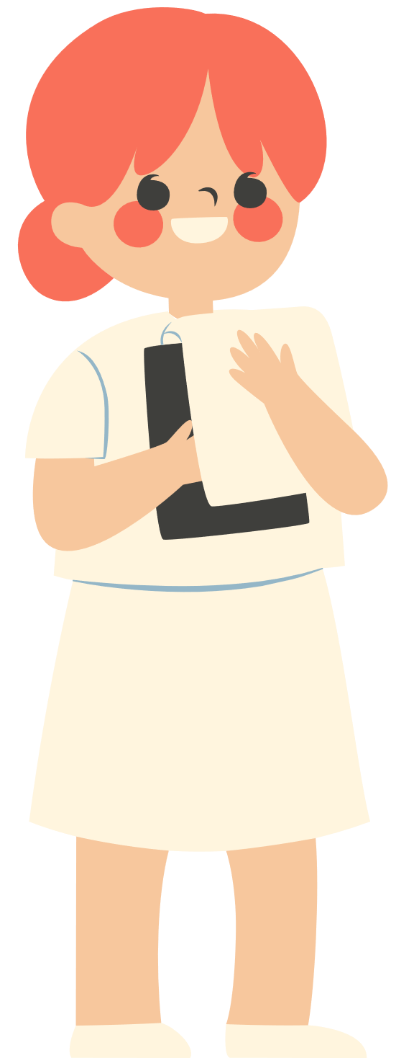
THANK YOU!

