Slide 1





… SECONDARY SCHOOL
WELCOME TO OUR CLASS
Teacher: …………….

Slide 2




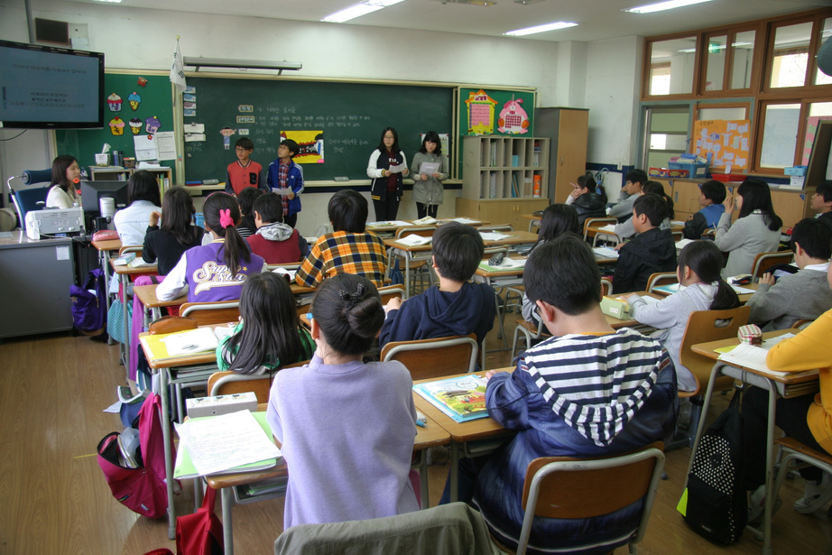


I.N.I.T.I.A.L GAME

Slide 3





RULES
Work in 2 teams.
Look at 9 pictures.
Find the word for each picture, then take the first letter from each picture to form the mystery word.
Which team finds the mystery word first will become the winner.

Slide 4



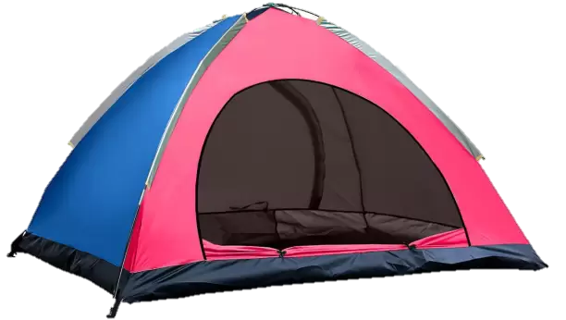

Tent
1

Slide 5
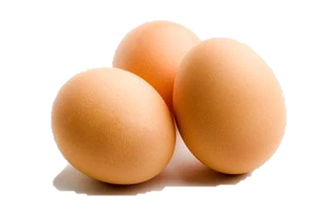
Eggs
2

Slide 6
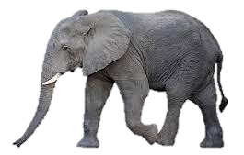
Elephant
3

Slide 7

Nose
4

Slide 8

Apple
5

Slide 9

Grapes
6

Slide 10

Eagle
7

Slide 11
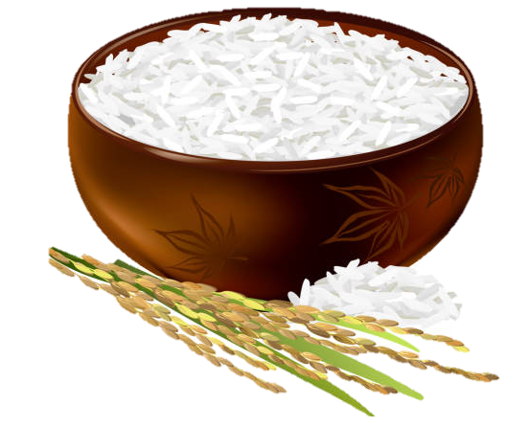
Rice
8

Slide 12

Sunflower
9

Slide 13
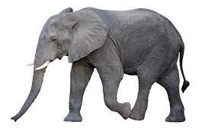

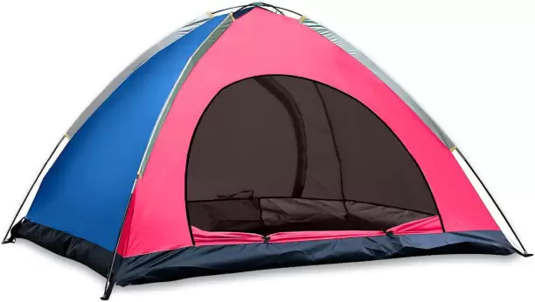
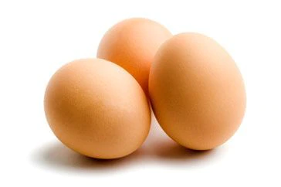


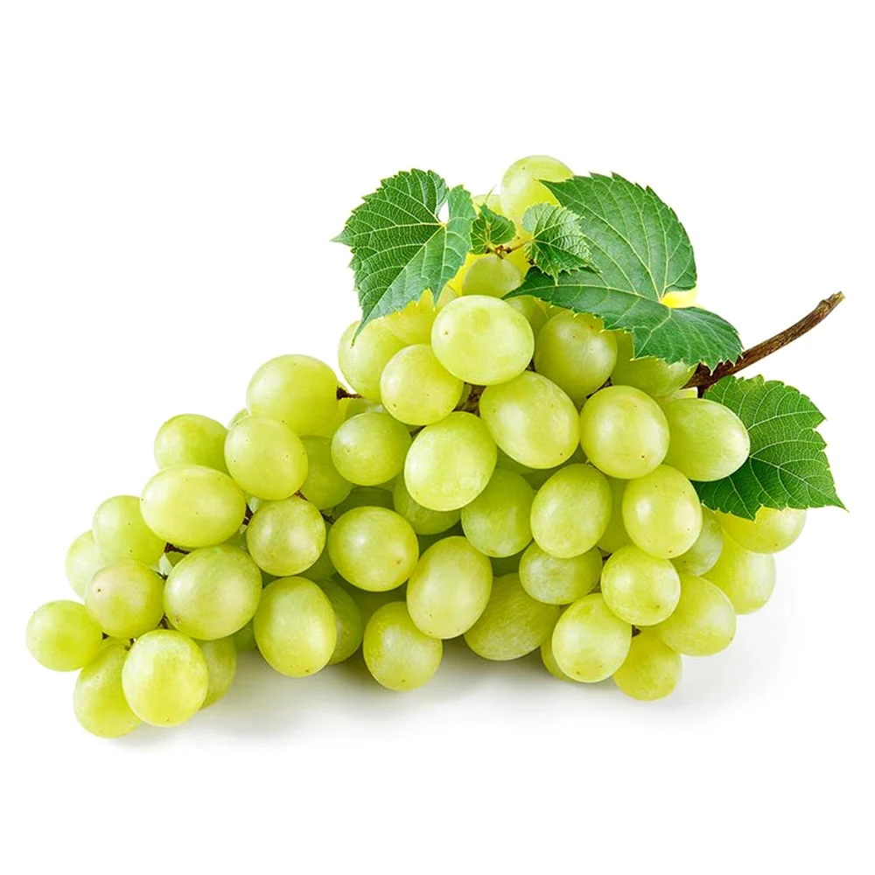
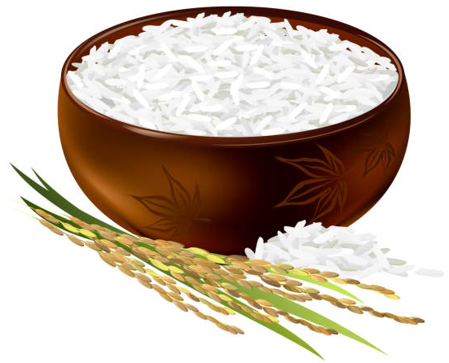
The mystery word is……
Tent
Eggs
Elephant
Nose
Apple
Grapes
Eagle
Rice
Sunflower

Slide 14





Unit 3:
TEENAGERS
Lesson 1:
Getting Started

Slide 15

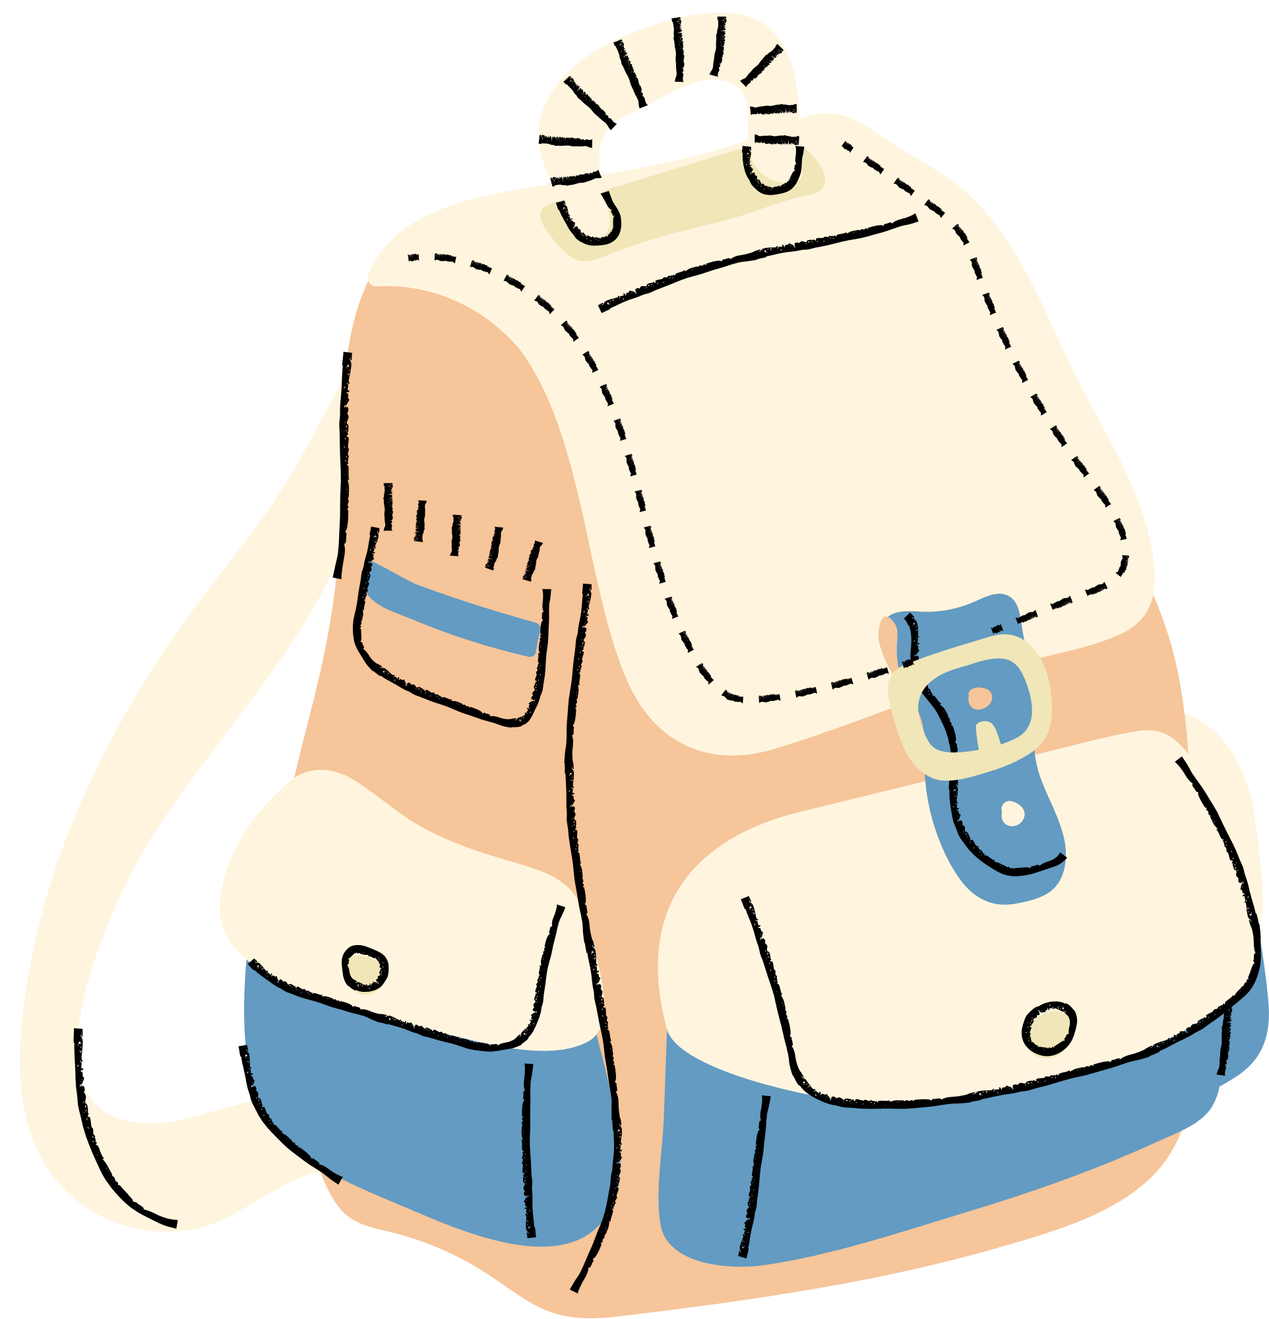


VOCABULARY

Slide 16


VOCABULARY
forum (n)
/ˈfɔːrəm/
diễn đàn

Slide 17

VOCABULARY
stress (n)
/ˌstres/
sự căng thẳng

Slide 18
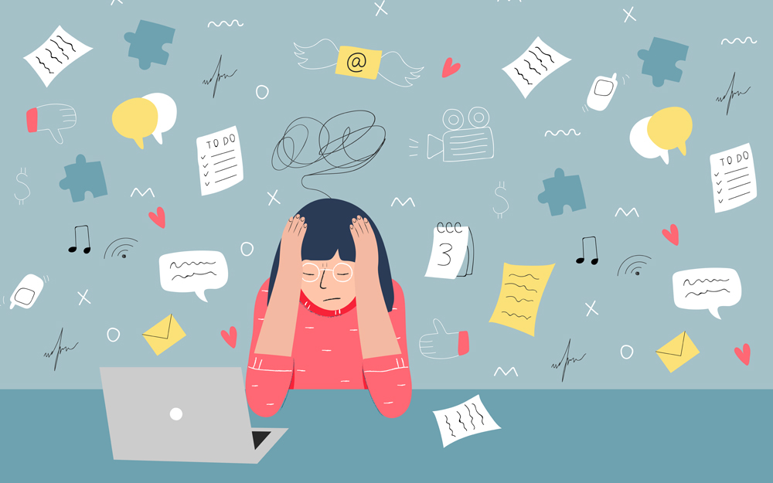
VOCABULARY
stressful (adj)
/ˈstresfl/
căng thẳng, tạo áp lực

Slide 19

VOCABULARY
pressure (n)
/ˈpreʃə(r)/
áp lực

Slide 20
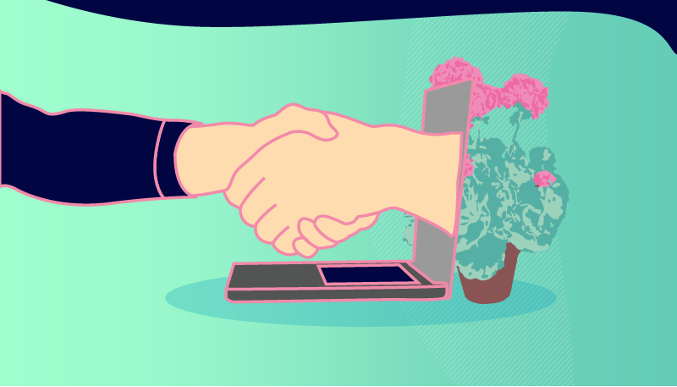
VOCABULARY
user-friendly (adj)
/ˈjuːzə-ˈfrendli/
thân thiện với
người dùng

Slide 21

VOCABULARY
midterm (adj)
/ˌmɪdˈtɜːm/
giữa kì

Slide 22
VOCABULARY
- forum (n) | /ˈfɔːrəm/ | diễn đàn
- stress (n) | /stres/ | sự căng thẳng
- stressful (adj) | /ˈstresfl/ | căng thẳng, tạo áp lực
- pressure (n) | /ˈpreʃə(r)/ | áp lực
- user-friendly (adj) | /ˌjuːzə ˈfrendli/ | thân thiện với người dùng, dễ dùng
- midterm (adj) | /ˌmɪdˈtɜːm/ | giữa kì

Slide 23
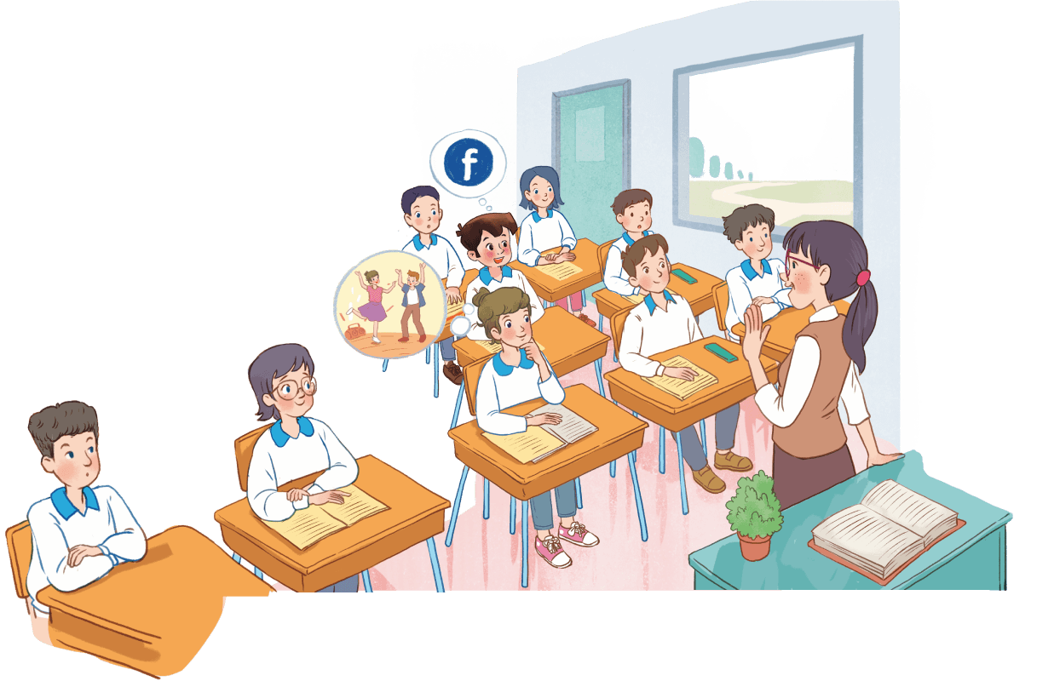
Look and answer:
Where are they?
Who are the people?
What might they be talking about?

Slide 24

2. Read the conversation again and write T (True) or F (False).
Sentences | T | F
1. The students finished their midterm tests.
2. Minh mentions the different types of pressure they are facing.
3. The teacher tells them to stay calm and work hard.
4. The class will discuss their problems offline.
5. The school has different clubs for its students.

Slide 25


Check your answer:
1. The students finished their midterm tests.
Minh: We’ve decided to use Facebook for our class forum, and we joined some school club activities. We’re also preparing for the midterm tests. It’s really stressful.
F

Slide 26
Check your answer:
2. Minh mentions the different types of pressure they are facing.
T
Minh: Well, we also have pressure from our parents and friends.

Slide 27
Check your answer:
3. The teacher tells them to stay calm and work hard.
Teacher: I’m sorry to hear that. I know exams may give you a lot of stress. But stay calm and work hard. What other pressure do you have?
T

Slide 28
Check your answer:
4. The class will discuss their problems offline.
F
Teacher: Do you? Let’s discuss these problems in your new Facebook group. By the way, why did you choose Facebook?

Slide 29
Check your answer:
5. The school has different clubs for its students.
Ann: Yes. This year there are some new clubs like arts and crafts, and music. The club leaders will provide us with a variety of activities to suit different interests. And there will also be competitions as usual.
T

Slide 30

Look at the answers again.
Sentences | T | F
1. The students finished their midterm tests.
2. Minh mentions the different types of pressure they are facing.
3. The teacher tells them to stay calm and work hard.
4. The class will discuss their problems offline.
5. The school has different clubs for its students.

Slide 31




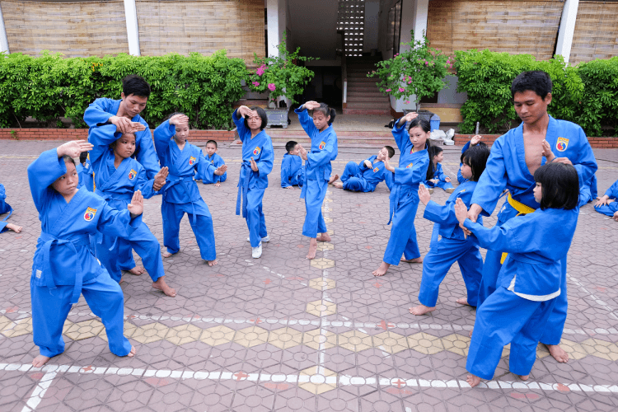
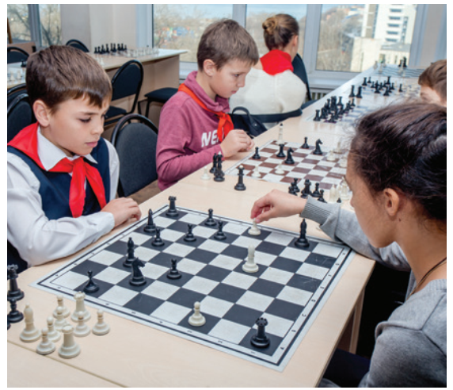
3. Write a word or phrases from the box under the correct pictures.
chess club
forum
arts and crafts club
language club
sports club
pressure
1
2
3
4
5
6

Slide 32
chess club
language club
forum
sports club
arts and craft club
pressure
pressure
Notes:
Write down the phrases of daily activities.

Slide 33
chess club
language club
forum
sports club
arts and craft club
arts and craft club
pressure
Notes:
Write down the phrases of daily activities.

Slide 34
chess club
language club
forum
sports club
arts and craft club
language club
pressure
Notes:
Write down the phrases of daily activities.

Slide 35
chess club
language club
forum
sports club
arts and craft club
forum
pressure
Notes:
Write down the phrases of daily activities.

Slide 36
chess club
language club
forum
sports club
arts and craft club
chess club
pressure
Notes:
Write down the phrases of daily activities.

Slide 37
chess club
language club
forum
sports club
arts and craft club
sports club
pressure
Notes:
Write down the phrases of daily activities.

Slide 38
Look at the answers again
1
2
3
language club
pressure
arts and crafts club
4
5
6
forum
sports club
chess club

Slide 39
4. Complete each of the sentences with a word or phrase in 3. There is one extra word or phrase.
1. Minh is a member of our ___________________. The greeting cards he makes are really creative.
2. Students can discuss their problems in their class ______.
3. We share the essays and stories that we write in English in our _____________.
4. She is not feeling very well this weekend because of all the _______
from her school work.
5. The coach of our _____________ tells us to drink plenty of water during our practice sessions.
arts and crafts club
forum
language club
pressure
sports club

Slide 40
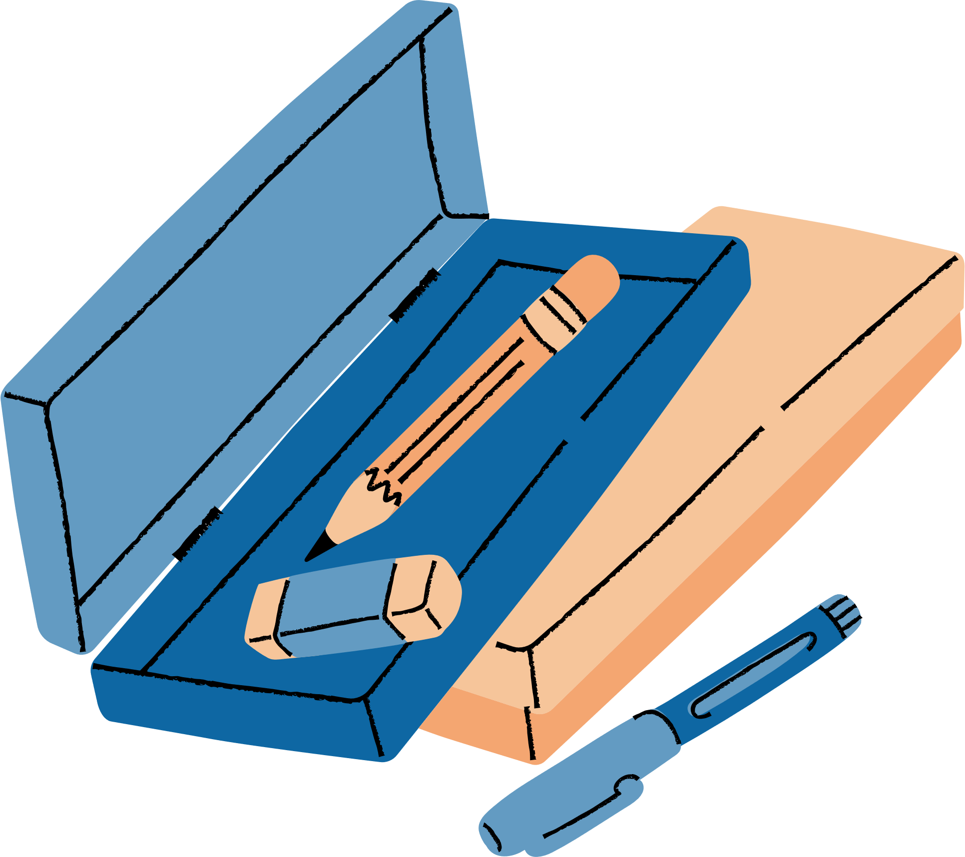

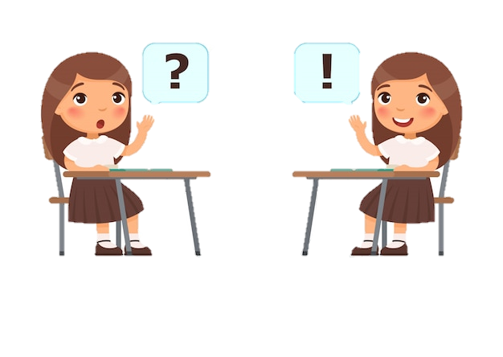
- What types of social media do you use?
What kinds of pressure do you have?
- What clubs do you participate in?
- Why do you choose to participate in that club?
- I use Facebook, Instagram…
I have pressure from study and my parent’s expectation.
I participate in the language club.
I choose to participate in that club because I want to improve my English-speaking skill.

Slide 41
5. Work in pairs. Ask and answer the question below. Report your friend’s answers to your class.
- What types of social media do you use?
What kinds of pressure do you have?
- What clubs do you participate in?
- Why do you choose to participate in that club?
- I use ………….
I have pressure from ……….
I participate in the ………
I choose to participate in that club because I want to….

Slide 42

WRAP-UP
What have we learnt in this lesson?
identify the topic of the unit
use lexical items related to hobbies
identify the language features that are covered in the unit

Slide 43
Thank You!

