Slide 1
UNIT 1 HOBBIES
Lesson 6: Skills 2

Slide 2
OBJECTIVES
01
02
After this lesson, students will be able to:
LISTENING
Listen for specific information about one’s hobby;
WRITING
Write a paragraph about one’s hobby

Slide 3
01
Listening

Slide 4
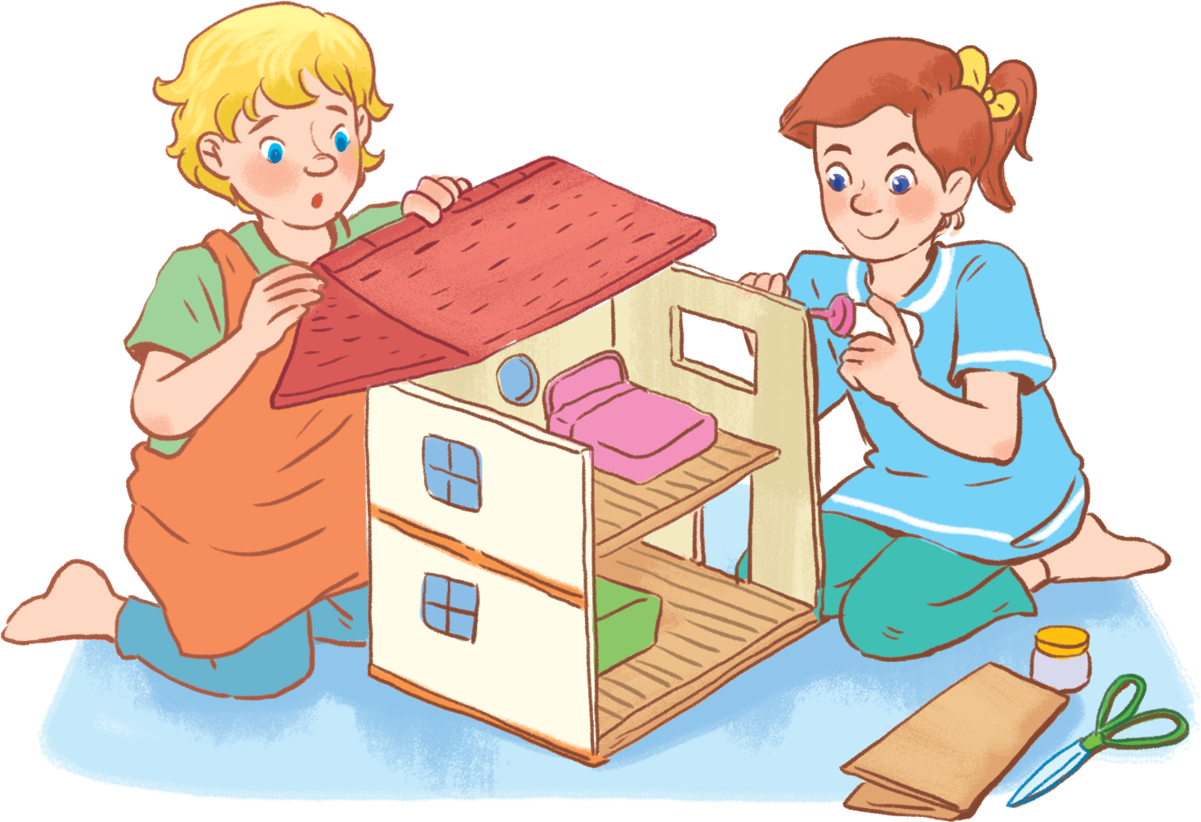
1. Look. Answer the questions.
Lan
Trang
What hobby is it?
Do you think it is a good hobby? Why/ Why not?

Slide 5
2. Listen to an interview about Trang’s hobby. Fill in each blank in the mind map with ONE word or number.
1. Her hobby is: building _____
2. She started her hobby: ______ years ago.
Trang’s hobby
3. She shares her hobby with her _____.
5. Benefits:
She becomes more patient and _____.
4. To do her hobby Trang needs:
a) Cardboard and glue to build the _____ and furniture.
b) _____ to make some dolls

Slide 6
2. Listen to an interview about Trang’s hobby. Fill in each blank in the mind map with ONE word or number.
1. Her hobby is: building _____
2. She started her hobby: ______ years ago.
sth
number
Trang’s hobby
3. She shares her hobby with her _____.
sb
5. Benefits:
She becomes more patient and _____.
4. To do her hobby Trang needs:
a) Cardboard and glue to build the _____ and furniture.
b) _____ to make some dolls
sth
adj
sth

Slide 7
2. Listen to an interview about Trang’s hobby. Fill in each blank in the mind map with ONE word or number.
1. Her hobby is: building _____
dollhouses
Trang’s hobby
Lan: Today well talk about hobbies. I know that your hobby is building dollhouses. It's quite unusual, isn't it?
Trang: Not really. A lot of girls like it.

Slide 8
2. Listen to an interview about Trang’s hobby. Fill in each blank in the mind map with ONE word or number.
1. Her hobby is: building _____
2. She started her hobby: ______ years ago.
dollhouses
3
Trang’s hobby
Lan: When did you start doing this?
Trang: Three years ago. I read an article about building dollhouses, I loved the idea right away.

Slide 9
2. Listen to an interview about Trang’s hobby. Fill in each blank in the mind map with ONE word or number.
1. Her hobby is: building _____
2. She started her hobby: ______ years ago.
dollhouses
3
Trang’s hobby
3. She shares her hobby with her _____.
cousin
Lan: Do any of your friends or relatives build dollhouses too?
Trang: Yes, my cousin Atli loves building them too.

Slide 10
2. Listen to an interview about Trang’s hobby. Fill in each blank in the mind map with ONE word or number.
1. Her hobby is: building _____
2. She started her hobby: ______ years ago.
dollhouses
3
Trang’s hobby
3. She shares her hobby with her _____.
cousin
I use cardboard and glue to build the house and make the furniture.
Then I make the dolls from cloth.
4. To do her hobby Trang needs:
a) Cardboard and glue to build the _____ and furniture.
b) _____ to make some dolls
house
cloth

Slide 11
2. Listen to an interview about Trang’s hobby. Fill in each blank in the mind map with ONE word or number.
1. Her hobby is: building _____
2. She started her hobby: ______ years ago.
dollhouses
3
Trang’s hobby
3. She shares her hobby with her _____.
cousin
Trang: Well, I'm more patient and creative now.
5. Benefits:
She becomes more patient and _____.
4. To do her hobby Trang needs:
a) Cardboard and glue to build the _____ and furniture.
b) _____ to make some dolls
house
creative
cloth

Slide 12
02
Writing

Slide 13
You can use a mind map to organize ideas for your writing.
1. Her hobby is: building _____
2. She started her hobby: ______ years ago.
dollhouses
3
Trang’s hobby
3. She shares her hobby with her _____.
cousin
5. Benefits:
She becomes more patient and _____.
4. To do her hobby Trang needs:
a) Cardboard and glue to build the _____ and furniture.
b) _____ to make some dolls
house
creative
cloth

Slide 14
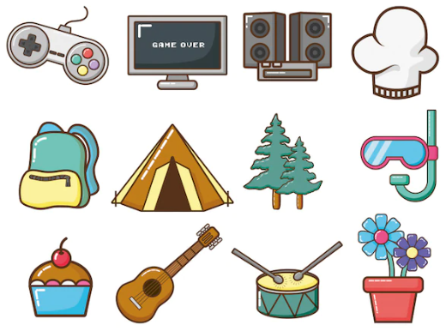
You can use a mind map to organize ideas for your writing.
1. My hobby: _____
2. Started: ______ ago.
My hobby
3. I share my hobby with _____.
5. Benefits:
_____.
4. To do her my hobby I need: _____

Slide 15
Your teacher’s mind map
1. My hobby: _____
2. Started: ______ ago.
10 years
Reading books
My hobby
3. I share my hobby with _____.
mother
5. Benefits:
_____.
4. To do her my hobby I need: _____
books
widen my knowledge

Slide 16
Make your own mind map.
1. My hobby: _____
2. Started: ______ ago.
My hobby
3. I share my hobby with _____.
5. Benefits:
_____.
4. To do her my hobby I need: _____

Slide 17
Write a paragraph of about 70 words about your hobby. Use the notes In 3. Start your paragraph as shown below.
1. My hobby: _____
2. Started: ______ ago.
My hobby is __________
____________________
____________________
____________________
____________________
____________________
____________________
My hobby
3. I share my hobby with _____.
5. Benefits:
_____.
4. To do her my hobby I need: _____

Slide 18
Your teacher’s hobby
My hobby is reading books. I started this hobby 5 years ago when I saved money and bought my first book on my 15th birthday. I share this hobby with my mom. To do this, you only need the book that you love and read it. After all, I think reading can help me widen my knowledge, so I will keep this in the future.
1. My hobby: _____
2. Started: ______ ago.
10 years
Reading books
My hobby
3. I share my hobby with _____.
mother
5. Benefits:
_____.
4. To do her my hobby I need: _____
widen my knowledge
books

Slide 19
Now, it’s your turn.

Slide 20
Write a paragraph of about 70 words about your hobby. Use the notes In 3. Start your paragraph as shown below.
1. My hobby: _____
2. Started: ______ ago.
My hobby is __________
____________________
____________________
____________________
____________________
____________________
____________________
My hobby
3. I share my hobby with _____.
5. Benefits:
_____.
4. To do her my hobby I need: _____

Slide 21
Class gallery
Students can:
go and see others’ work
give comments to one another

Slide 22
Wrap up

Slide 23
Wrap up
Listening
Writing
Listen for specific information about one’s hobby;
Write a paragraph about one’s hobby

Slide 24
Thanks
Do you have any questions?

