Slide 1
Unit 9: Natural disasters
Lesson 7: Looking back

Slide 2
VOCABULARY
TYPES OF NATURAL DISASTERS
WORDS DESCRIBING NATURAL DISASTERS
flooding, rains, tropical cyclones, earthquake, storm, volcanic eruption, tornado, landslide, tsunamis, wildfires, heat waves, drought, avalanches, hailstorm, hurricane, snowstorm, thunderstorm, ect

Slide 3
PRONUNCIATION stress in words ending in –al and -ous
- al | -ous
Musical, national, personal, practical, tropical, natural, capital, chemical, festival, signal, journal, manual, ect
‘ ’
’ ‘ ’ ‘ ’ ‘
‘ ’ ’
‘ ’ ’
‘ ’ ’
‘ ’ ’
Dangerous, humorous, poisonous, numerous, mountainous, delicious, generous, serious, ect

Slide 4
GRAMMAR: Past Continuous
Thì quá khứ tiếp diễn (Past Continuous) thường được dùng để diễn tả hành động, sự việc hoặc sự vật đang diễn ra tại một thời điểm trong quá khứ.
Câu khẳng định | S+ was/were + Ving | The earthquake was causing destruction to buildings and infrastructure. (Trận động đất đã gây ra sự phá hủy cho các tòa nhà và cơ sở hạ tầng.)
Câu phủ định | S+ was/were not + Ving | The volcano was not erupting at that time, so we were able to visit safely. (Lúc đó núi lửa không phun trào, vì vậy chúng tôi có thể tham quan một cách an toàn.)
Câu hỏi | Was/were + S + Ving? | Was the volcano erupting when you visited the area? (Khi bạn đến khu vực đó, núi lửa có đang phun trào không?)

Slide 5
GRAMMAR: Past Continuous
Cách sử dụng:
- Thì quá khứ tiếp diễn được dùng để diễn tả một hành động đang diễn ra trong quá khứ, có mốc thời gian cụ thể.
- Thì quá khứ tiếp diễn được dùng để diễn tả một hành động đang diễn ra trong quá khứ thì bị một hành động khác cắt ngang.
- Lưu ý: Với động từ tình thái (stative verbs, i.e. need, want, hate, love etc.), ta không dùng thì quá khứ tiếp diễn.
Dấu hiệu nhận biết:
- At + giờ trong quá khứ. (at 10 pm yesterday,…)
- At this time + thời gian trong quá khứ. (at this time last month,…)
- In + năm (in 2015, in 1999)

Slide 6
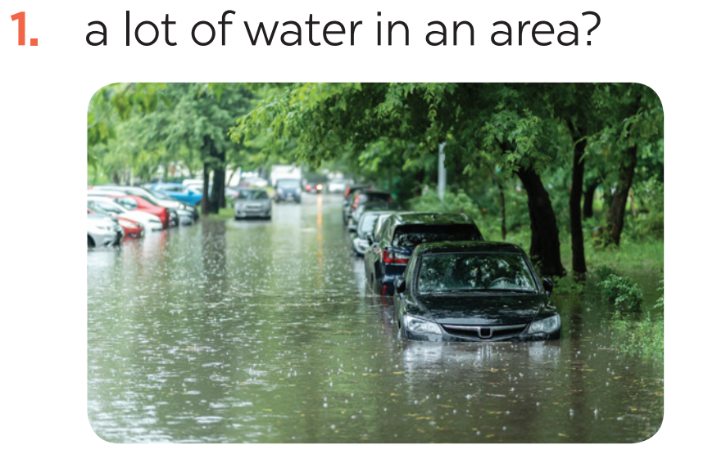
1. A lot of water in a area?
Write the name of a natural disaster in each blank.
flood
lũ lụt

Slide 7
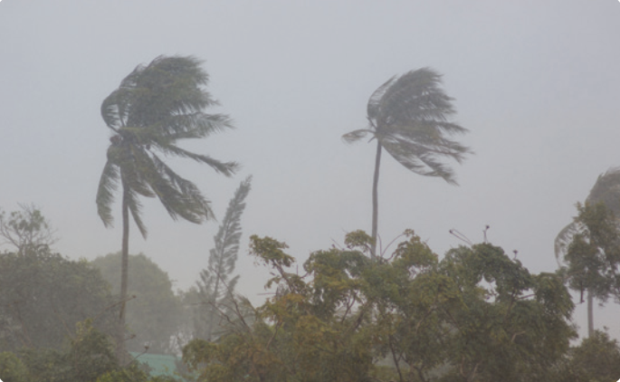
2. Heavy rain and strong winds?
Write the name of a natural disaster in each blank.
storm
cơn bão

Slide 8
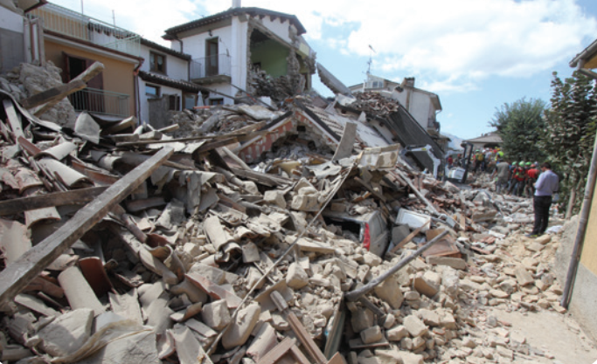
3. The earth trembling?
Write the name of a natural disaster in each blank.
earthquake
trấn động đất

Slide 9
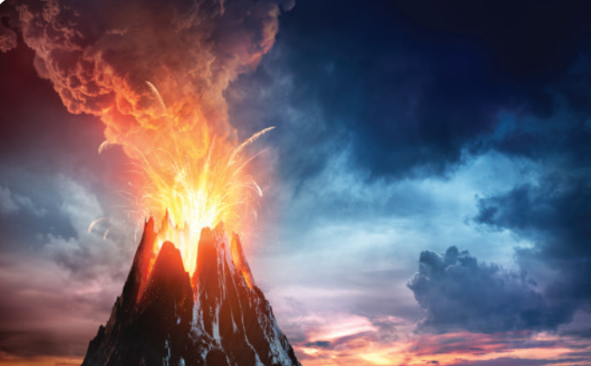
4. Ash and gas?
Write the name of a natural disaster in each blank.
volcanic eruption
núi lửa phun trào

Slide 10
5. Rocks and mud coming down hills or mountains?
Write the name of a natural disaster in each blank.
landslide
lở đất

Slide 11
Fill in each blank with the correct form of the word in brackets.
1. The tsunami brought __________ to cities and towns near the sea. (destroy)
2. The government has developed some systems to help make __________ about natural disasters. (predict)
3. We are donating money and food to help the ______ of the landslide. (victim)
4. The local authorities _______ the villagers about a landslide yesterday. (warning)
5. Rescue _______ are trying hard to save people in the flooded area. (work)
destruction
predictions
victims
warned
workers

Slide 12
Put the verbs into the correct tense: the past simple or past continuous.
1. What _____ you (do) _____ at 8 o’clock yesterday morning?
2. Last year, earthquakes (destroy) _________ a lot of houses in Japan.
3. He (water) ____________ the flowers in his garden when the tornado (come) _____.
4. While they (call) __________ for help, the rescue workers (appear) ________.
5. _______ you (listen) ________ to music at 9 o’clock yesterday evening?
were
doing
destroyed
was watering
came
were calling
appeared
Were
listening

Slide 13
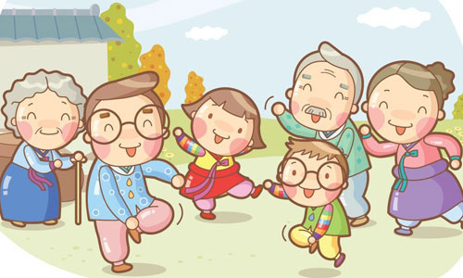
Complete the sentences about you and your family members.
At 7 p.m. yesterday, …
1. I was ________________________________.
2. my grandmother/ grandfather ____________.
3. my mother ____________________________.
4. my father _____________________________.
5. my sister / brother ______________________.

Slide 14
Complete the sentences about you and your family members.
Suggest:
At 7 p.m. yesterday, ...
1. I was doing my homework.
2. my grandmother / grandfather was watching TV.
3. my mother was reading a book.
4. my father was drinking a tea.
5. my sister / brother was washing dishes.

Slide 15
Thank you!

