Slide 2
Unit
10
HOUSES IN THE FUTURE
LESSON 7: LOOKING BACK & PROJECT
1

Slide 3
LESSON 7: LOOKING BACK & PROJECT
LESSON 1: GETTING STARTED
WARM-UP
Short video
Task 1: Fill in the blanks and the table. (Ex. 1-2, p. 46)
Task 2: Game: Kahoot. (Ex. 3-4)
LOOKING BACK
PROJECT
My future appliance
CONSOLIDATION
Wrap-up
Homework

Slide 4
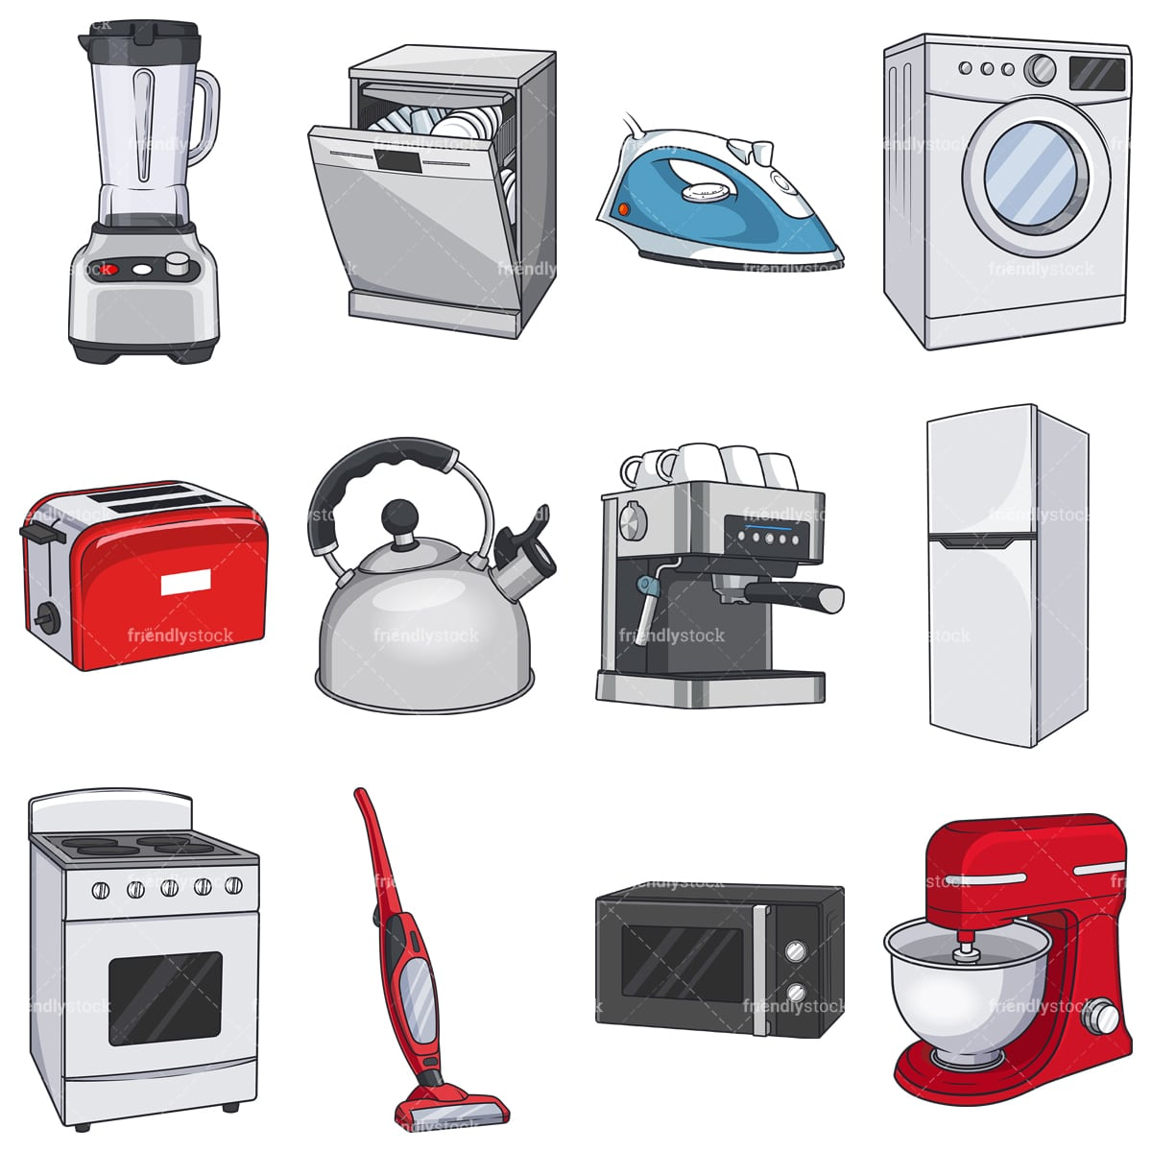
WARM-UP
HOUSEHOLD APPLIANCES
OF THE FUTURE
BRAIN STORMING

Slide 5
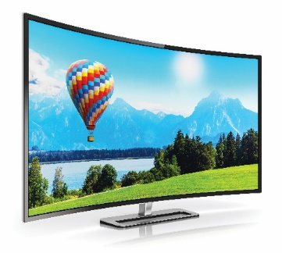
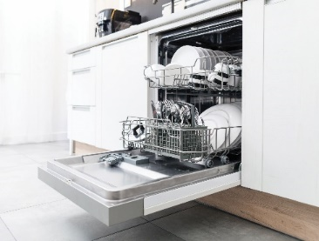
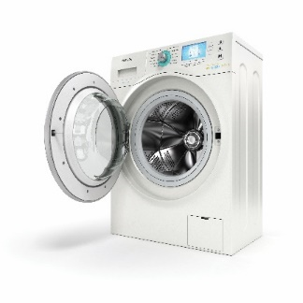
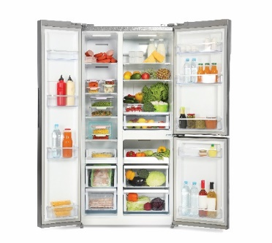
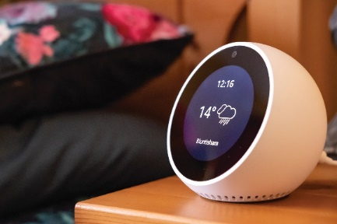
LOOKING BACK
1
1
Write the words / phrases under the correct pictures.
computer
computer
wireless tv
wireless tv
dishwasher
dishwasher
washing machine
smart clock
washing machine
smart clock
fridge
fridge
1. computer
1. computer
2. dishwasher
2. dishwasher
3.
2.
3.
1.
2.
1.
3. wireless TV
3. wireless TV
6. smart clock
4. washing machine
6. smart clock
4. washing machine
6.
5.
6.
4.
5.
4.
5. fridge
5. fridge

Slide 6
LOOKING BACK
2
Think about what the appliances will do in the future. Fill the table:
1. robots
2. washing machines
3. wireless TVs
4. super cars
5. smart clocks
6. dishwashers
T

Slide 7
LOOKING BACK
3
Complete the sentences with will ('ll) or won’t.
1. Tomorrow is Sunday, so I.............. have to get up early.
2. When I see Tom tomorrow, I .................. invite him to our party.
3. You must meet Anna. I am sure you ............ like her.
4. We ........... start our dinner until Jack arrives.
5. I ............ phone you when I get home from school.
6. Tony ............. pass his examination. He hasn't studied yet.
won’t
will/’ll
will/’ll
won’t
will/’ll
won’t

Slide 8
LOOKING BACK
4
Complete the sentences with might or might not.
I am still not sure where to go for my holiday.
I
1.
might
_______ go to Da Lat.
2.
The weather is not very good.
It
might
_______ rain this afternoon.
might not
___________ be a meeting on Friday
3.
There
because the teacher is ill.
4.
___________ come to the party tonight
Ann
because she is busy.
might not
5.
Phong is thinking about what he will do on Sunday. He
_______ go to a judo club, or he _______ stay at home and study English.
might
might

Slide 9
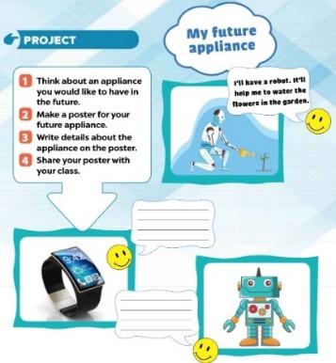
PROJECT
Think about one appliance you want to have in the future.
+ Make a poster about it.
+ Write the details of the appliance in the poster. (what they want to have, what it will help them to do).

Slide 10
CONSOLIDATION
1
Wrap-up
What have we learnt in this lesson?
Review the vocabulary items and grammar points in the unit

Slide 11
CONSOLIDATION
2
Homework
Prepare for the next lesson: Unit 11 – Lesson 1: Getting started.

Slide 12
Website: hoclieu.vn
Fanpage: facebook.com/www.tienganhglobalsuccess.vn/

