Slide 2
Unit
8
SPORTS AND GAMES
LESSON 5: SKILLS 1
Reading
Speaking
1

Slide 3
LESSON 5: SKILLS 1
LESSON 1: GETTING STARTED
WARM-UP
Hidden picture
I. Reading
PRESENTATION
Task 1: Work in pairs. Discuss the questions.
Task 2: Read the dialogue and quickly check your ideas in Task 1
Task 3: Read the text again and answer the questions
PRACTICE
II. Speaking
Task4: Read the following facts about two famous sportspeople.
Choose one sportsperson in Task 4. Talk about him/her. Use the following cues.
PRODUCTION
CONSOLIDATION
Wrap-up
Homework

Slide 4
Game: Hidden picture
WARM-UP

Slide 5
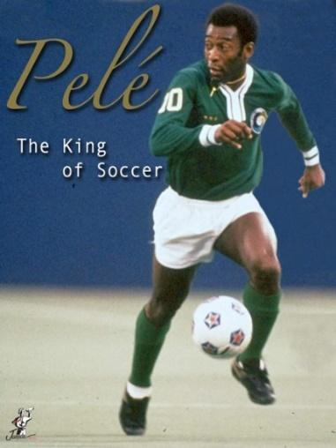
WARM-UP
HIDDEN PICTURE
1
2
3
4
5
6
END GAME

Slide 6
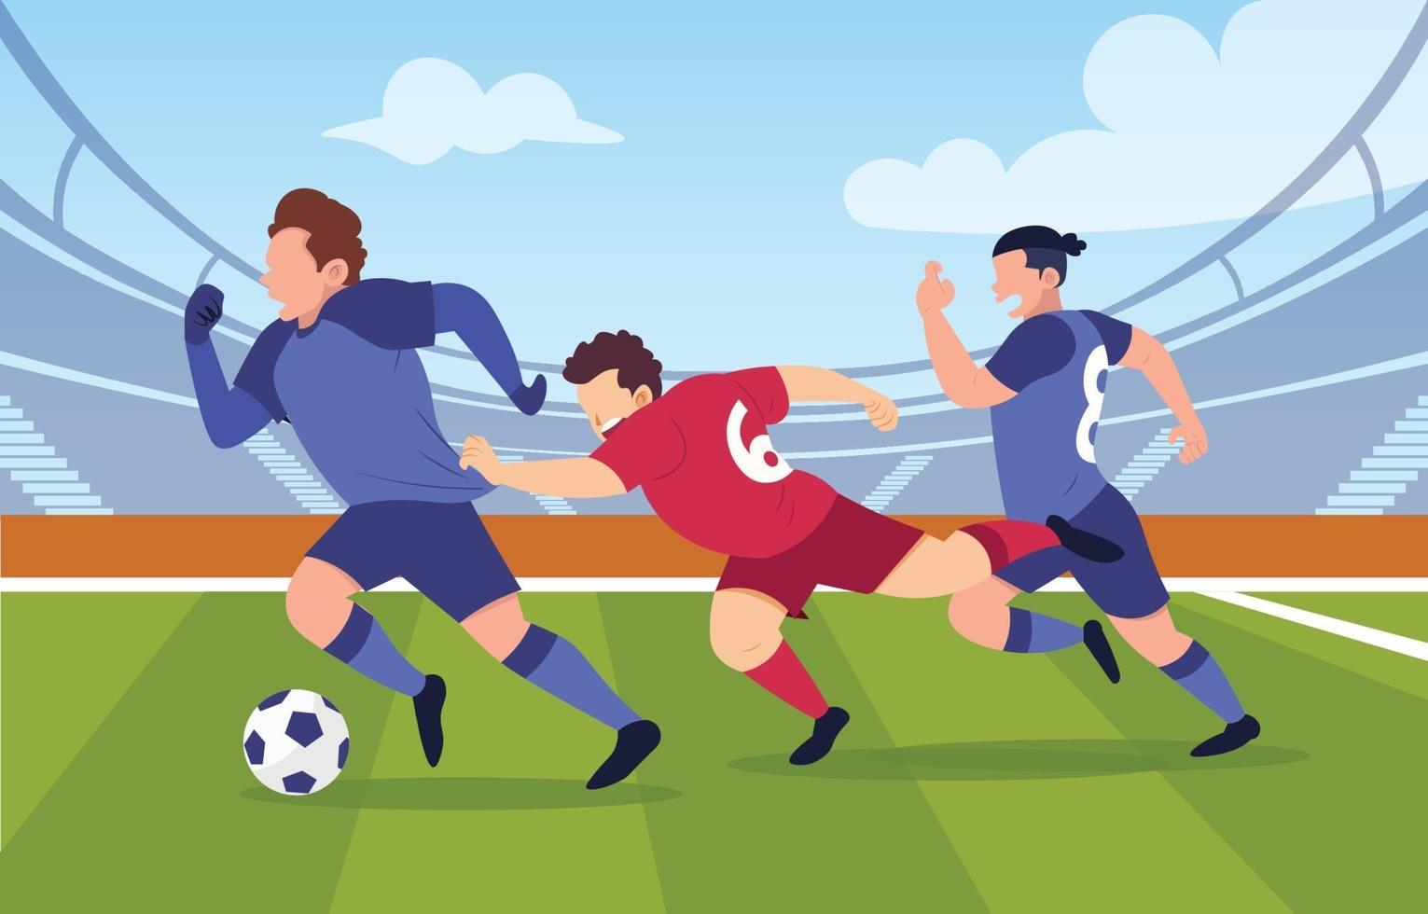
WARM-UP
Lucky numbers
Question 1:
How many players are there in a football match?
→ There are 22 players
GO BACK

Slide 7
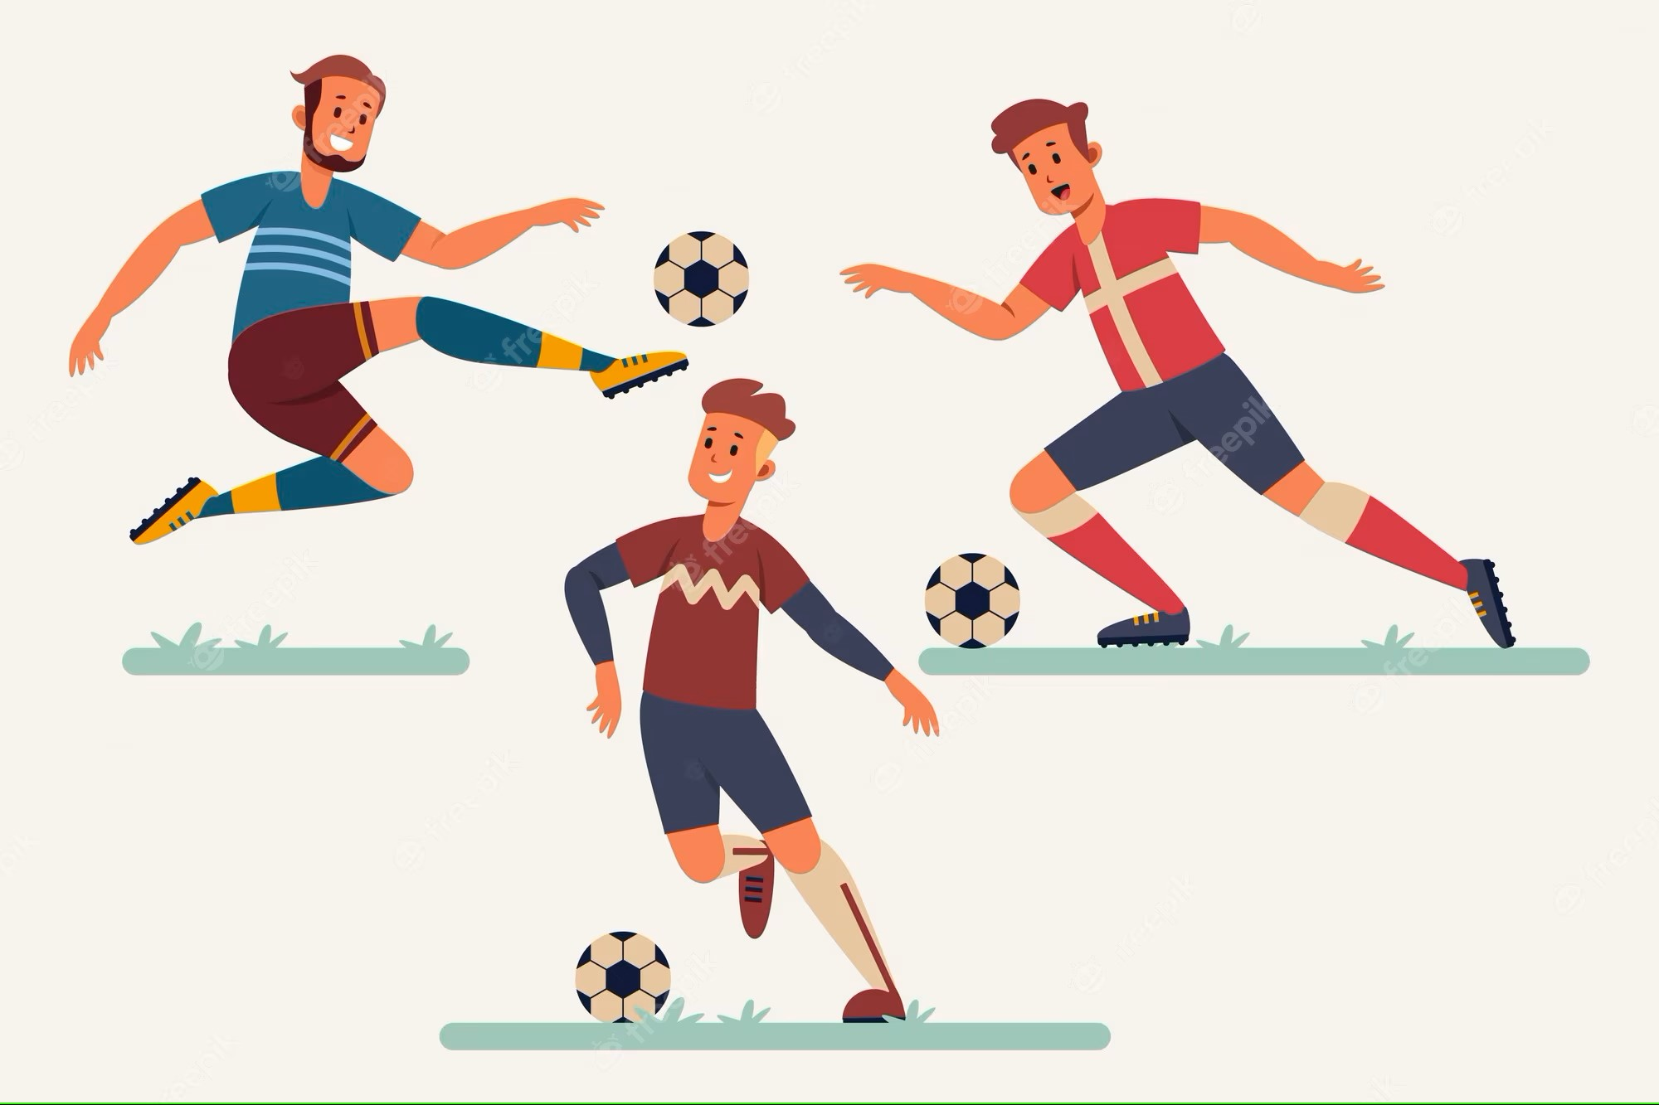
WARM-UP
Lucky numbers
Question 2:
How long does a football match last?
→ It lasts 90 minutes.
GO BACK

Slide 8
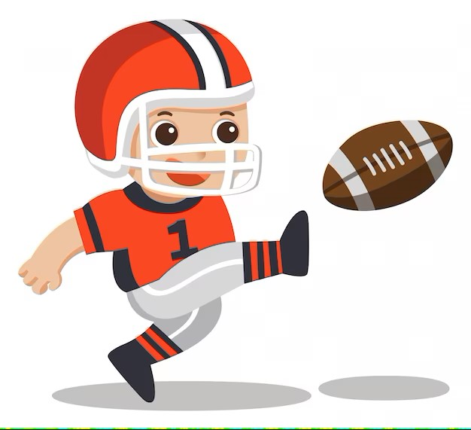
WARM-UP
Lucky numbers
Question 3:
Is football in America the same sport as football in other countries?
→ No, it isn’t.
GO BACK

Slide 9
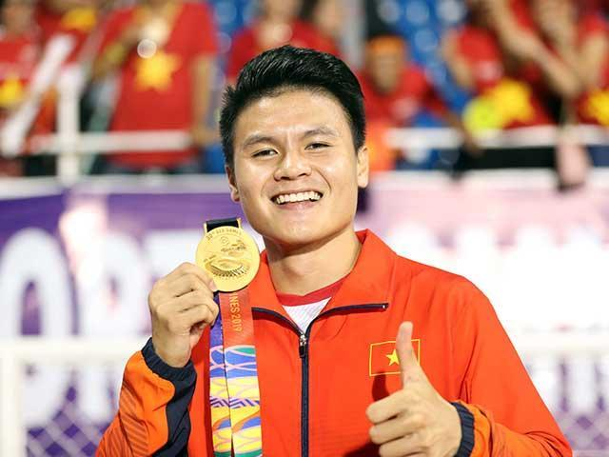
WARM-UP
Lucky numbers
Question 4:
Who is this man?
→ He is Quang Hai – a Vietnamese footballer
GO BACK

Slide 10
WARM-UP
Lucky numbers
Question 5:
Which sport happens in a ring?
→ Boxing
GO BACK

Slide 11
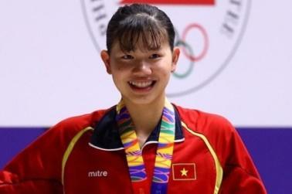
WARM-UP
Lucky numbers
Question 6:
Who is this girl?
→ She is Anh Vien – a Vietnamese swimmer
GO BACK

Slide 12
I. READING
PRACTICE

Slide 13
PRACTICE
1
Work in pairs, discuss the questions.
1. What do you know about Pele?
2. What is special about him?

Slide 14
VOCABULARY
career (n)
/kəˈrɪə(r)/
nghề nghiệp,
sự nghiệp

Slide 15
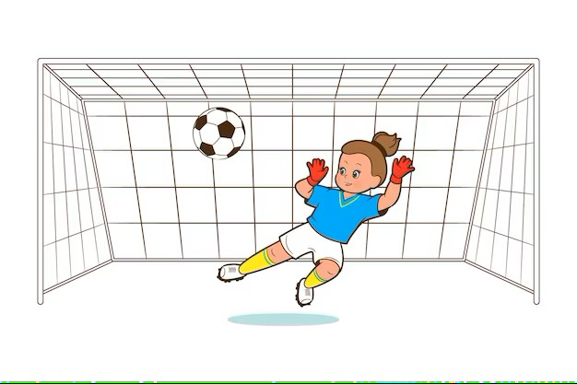
VOCABULARY
goal (n)
/ɡəʊl/
bàn thắng

Slide 16
VOCABULARY
score (v)
/skɔː(r)/
ghi điểm,
ghi bàn

Slide 17
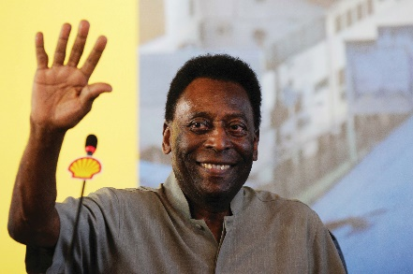
PRACTICE
2
Read the dialogue quickly to check your idea in the Ex1
The PE teacher is talking to her students about Pelé.
Teacher: Today we’re going to talk about Pelé. Do you know him?
Nick: Yes, I think he’s the best footballer of all time.
Teacher: Right. He was born in 1940 in Brazil. His father taught him to play football at a very young age.
Susan: Oh. When did he begin his career in football?
Teacher: At 15, when he started playing for Santos Football Club. In 1958, he won his first World Cup.
Nick: How many goals did he score in his career?
Teacher: 1,281 goals in total, I think.
Nick and Susan: Wow! Amazing!
Teacher: And he became “Football Player of the Century” in 1999.
Michael: Surely Pelé’s a national hero in Brazil.
Teacher: Yes, and he’s known around the world as “The King of Football”.

Slide 18
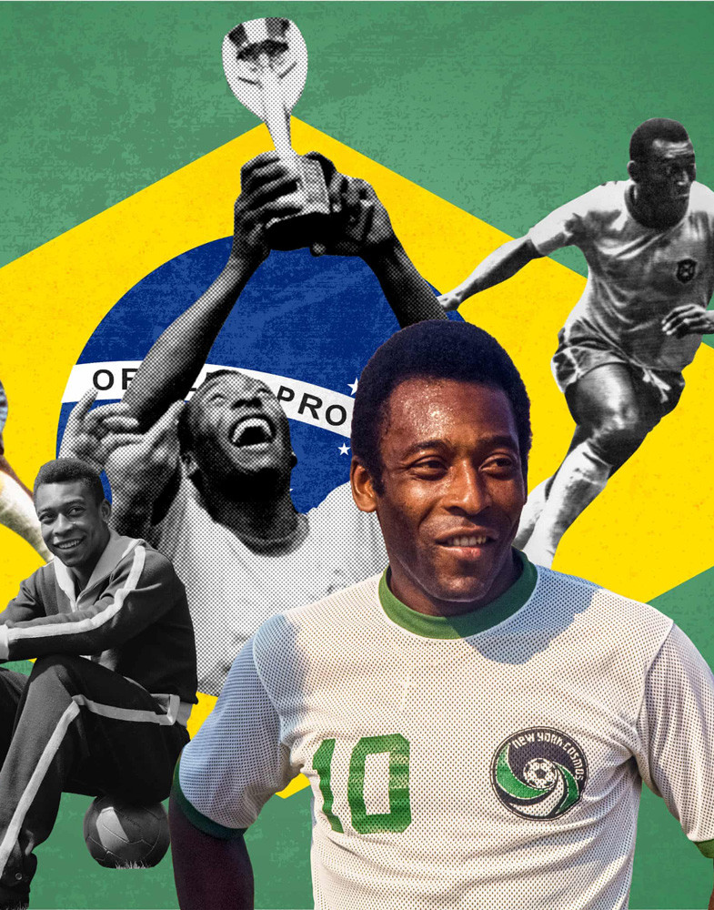
PRACTICE
3
Read the text again and answer the questions
When was Pelé born?
Who first taught him to play football?
How many goals did he score in total?
→ Pelé was born in 1940
→ His father taught him.
→ He scored 1,281 goals in total.

Slide 19
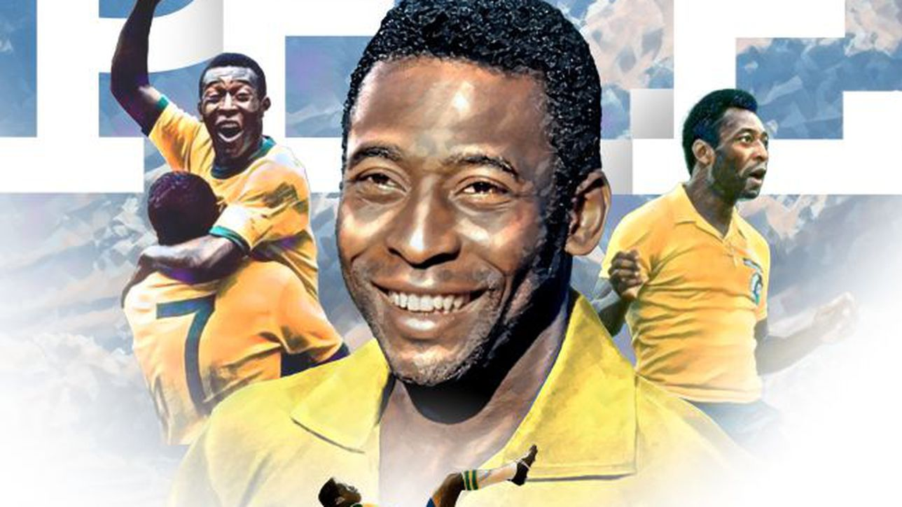
PRACTICE
3
Read the text again and answer the questions
4. When did he become “Football Player of the Century?
5. What do people call him?
→ He became the “Football Player of the Century in 1999.
→ They call him “The King of Football”

Slide 20
II. SPEAKING
PRACTICE

Slide 21
PRACTICE
4
Read the following facts about two famous sportspeople.
Hoang Giang
No.1 sportsman in shooting
Jenny Green
One of the best female golfers in history
- Born: 1978 in Viet Nam
-1995: finished sports school
- 1996: took part in a shooting competition
- 2001: won a gold medal for shooting
- Born: 1972 in Greenland
- 1987: became a member of local golf club
- 1994: took part in a female golf tournament
- 2002: became the female golf champion

Slide 22
PRACTICE
5
Choose one sportsperson and talk about him/ her
- His/ her name
- The sport he/ she plays
- Why he/ she is famous
- You like him/her or not
Explain why
Example
- Jenny Green
- golf
- one of the best female golfers in history
- like because …
In group. Tell about him/her. Use your note.

Slide 23
CONSOLIDATION
1
Wrap-up
What have we learnt in this lesson?
Read for general and specific information about Pelé
Talk about famous sportspeople

Slide 24
CONSOLIDATION
2
Homework
Write down your opinion about s famous sportsman
Prepare for the next lesson: Skills 2

Slide 25
Website: hoclieu.vn
Fanpage: facebook.com/www.tienganhglobalsuccess.vn/

