Slide 1
WARM-UP: WHO IS FASTER?
Easter
It is the symbol of the moon, prosperity and family reunion.

Slide 2
READING
1
Work in pairs. Look at the pictures. Which events do you think happen
at the Twins Day Festival?

Slide 3
1
Now quickly read the email below and check your answers.

Slide 4
VOCABULARY
2
Match each word from the email in 1 with its meaning.
1. gathering | a. two children born to the same mother at the same time
2. featured | b. meeting
3. twins | c. the act of entertaining other people by singing, dancing, and playing music, etc.
4. performance | d. showed something as the most important part
1. b
2. d
3. a
4. c

Slide 5
VOCABULARY CHECK
gathering
/ˈɡæð.ər.ɪŋ/
cuộc hội họp

Slide 6
VOCABULARY
twin (n)
/twɪn/
song sinh

Slide 7
VOCABULARY
feature (v)
/ˈfiːtʃər/
trình diễn đặc biệt

Slide 8
VOCABULARY
performance (n)
/pəˈfɔːməns/
màn biểu diễn

Slide 9
READING
3
Read the email again. Complete each sentence with no more than TWO words.
People hold the festival in Twinsburg on the ____________ every August.
There are twins from many ____________.
In the Double Take Parade, twins in uniforms _____________.
Mark enjoyed the ____________ by the Korean twins the most.
Mark and his twin sister ran in the ____________.
In his opinion, the festival was very ____________.
first weekend
countries
walked together
performance
Fun Run
exciting

Slide 10
SPEAKING
4
Match the questions and answers about a festival someone joined.
1
1. What festival did you join? | a. Yes, very much because there was a lot to do.
2. Where and when did you join it? | b. I joined the festival in Phu Yen last March.
3. Why do people celebrate it? | c. I watched people play drums, sing traditional songs, and dance. I also played traditional games with the children there.
4. What did you do there? | d. I joined the Hoi Mua Festival.
5. Did you like the festival? Why or why not? | e. They celebrate it to thank the Rice God and pray for a better new crop.
1. d
2. b
3. e
4. c
5. a

Slide 11
SPEAKING
5
Work in pairs. Ask and answer about a festival you and your friend joined, using the questions in 4 as cues. Tell the class about the festival your partner joined.

Slide 12
CONSOLIDATION
1
WRAP-UP
In this lesson, we have learnt to
read skill for specific information about an unusual festival
talk about a festival you enjoy

Slide 13
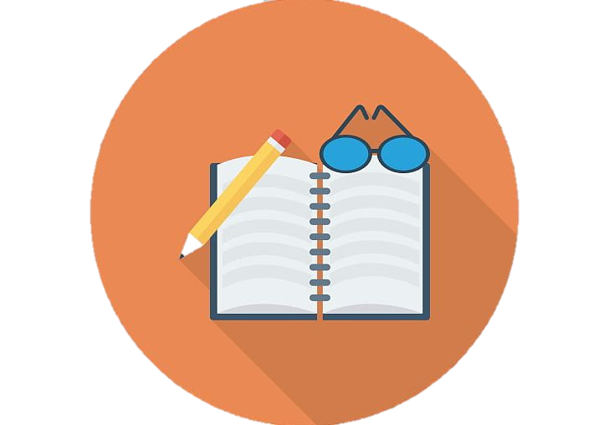
CONSOLIDATION
2
HOMEWORK
Video your presentation about a festival you enjoy.
Do exercises in the workbook.

