Slide 2
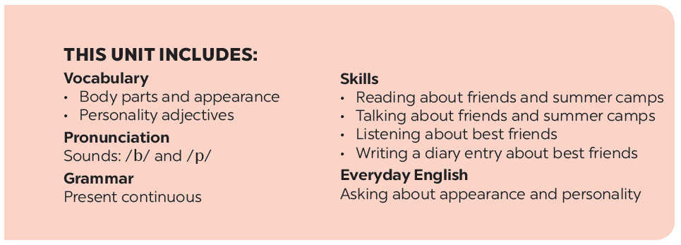

Slide 3
Grammar
The present continuous
Put the verbs in brackets in the present continuous.
Work in pairs. Look at the pictures. Ask and answer.
Look at the pictures. Write sentences like the example. Use positive or negative present continuous verbs.
Put the verbs in brackets in the present simple or present continuous.
Charades

Slide 4
Grammar
The present continuous
We use the present continuous for actions happening now.
Example: - She’s talking.
- They’re not talking.
We can use the present continuous with now, at present, or at the moment.
Example: - I’m doing my homework at present.
- A: Are you reading now?
B: Yes, I am.

Slide 5
Put the verbs in brackets in the present continuous.
is reading
a book now.
1.
Nam (read)
a book now.
They (play)
are playing
football at the moment.
2.
football at the moment.
isn’t making
a sandwich at present.
3.
My sister (not make)
a sandwich at present.
I (go) to the supermarket at the moment.
4.
am going
5.
Are
they (talk) about their new friends?
they (talk) about their new friends?
talking

Slide 6
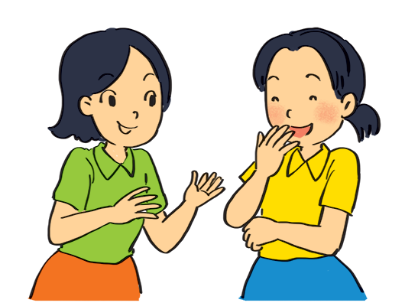
Look at the pictures. Write sentences like the example. Use positive or negative present continuous verbs.
Example:
She’s talking to Mai. (talk)

Slide 7
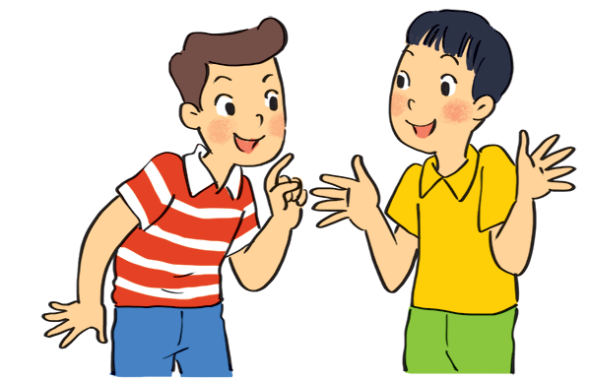
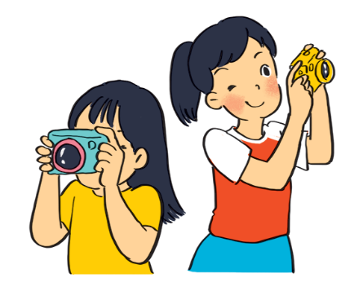
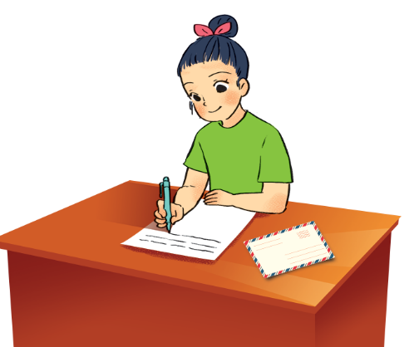
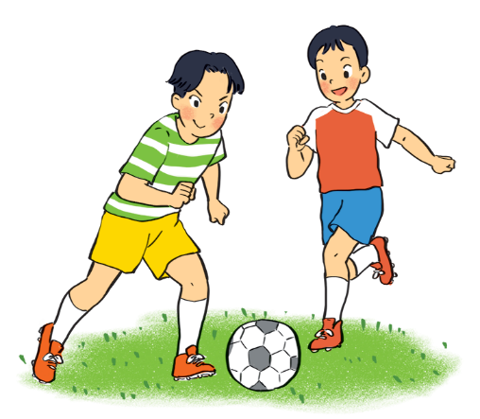
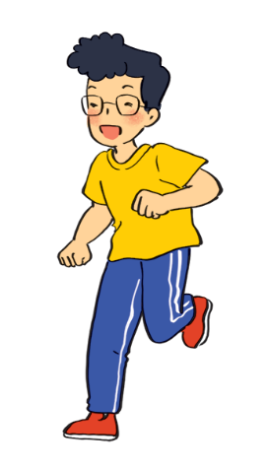
.
1.
Nam and Ba
(eat ice cream)
are not / aren’t eating ice cream.
2.
are taking photos.
Lan and Trang
(take photos)
.
3.
Ha
(write a letter)
is / Ha’s writing a letter.
.
4.
Duong and Hung
(play badminton)
are not / aren’t playing badminton.
.
is not / isn’t drawing a picture.
5.
.
Phong
(draw a picture)

Slide 8
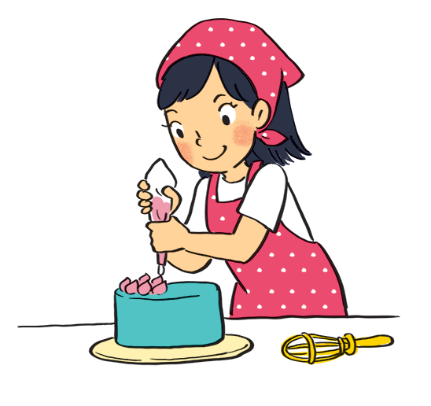
Work in pairs. Look at the pictures. Ask and answer.
Example:
A: your sister / make a cake?
Is your sister making a cake?
B: Yes, she is.

Slide 9
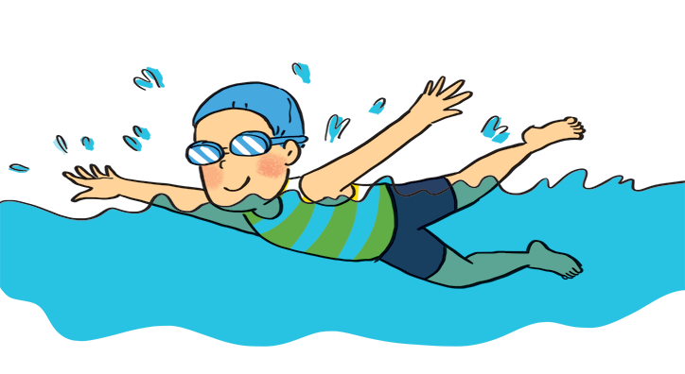
1
A: your friend / swim?
B:
Is your friend swimming?
Yes, he is.

Slide 10
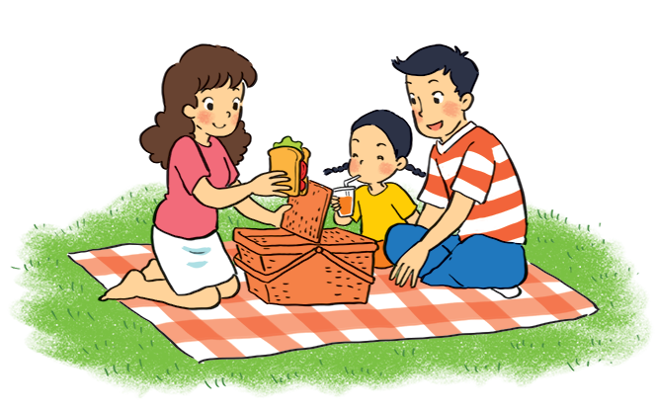
2
A: they / listen to music?
B:
Are they listening to music?
No, they aren’t.
(They’re / They are having a picnic.)

Slide 11
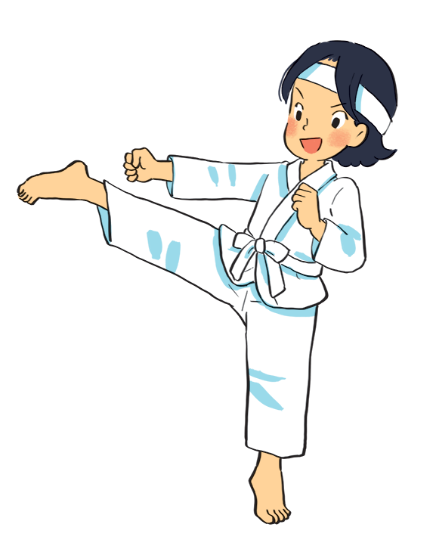
3
A: Mi / play the piano?
B:
Is Mi playing the piano?
No, she isn’t.
(She’s / She is doing karate.)

Slide 12
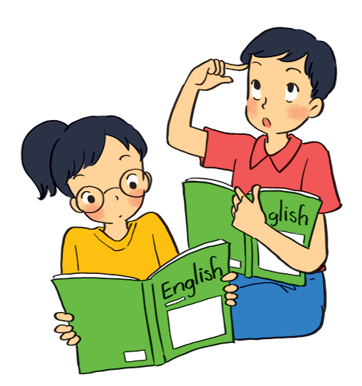
4
A: they / learn English?
B:
Are they learning English?
Yes, they are.

Slide 13
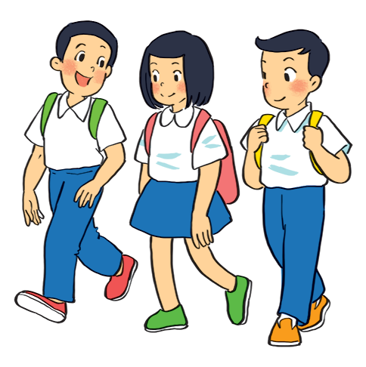
5
A: your friends / cycle to school?
B:
Are your friends cycling to school?
No, they aren’t.
(They’re / They are walking to school.)

Slide 14
Grammar
The present continuous
When something often happens or is fixed, we use the present simple.
When something is happening now, we use the present continuous.

Slide 15
Put the verbs in brackets in the present simple or present continuous.
My best friend (not walk)
Sometimes she (cycle) .
to school every day.
to school every day.
1.
doesnot / doesn’t walk
cycles
2.
he (play) ?
is
playing
Look! What
he (play) ?
your friends (study)
every afternoon?
3.
Do
your friends (study)
study
in the library
in the library
in the library
4.
I (write)
an email to my friend now.
am / ‘m writing
an email to my friend now.
He (not do)
He (read)
his homework now.
5.
is / ‘s reading
his homework now.
is not / isn‘t doing.
.

Slide 16
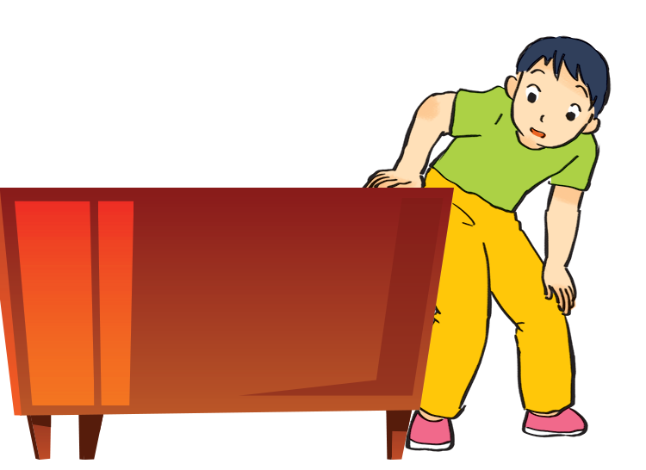
Charades
Take turns to mime different actions.
Others guess what you are doing.
Example:
A: Are you dancing?
B: No, I’m not.
C: Are you looking for something?
B: Yes, I am.

