Slide 1
BOMB GAME
START!

Slide 2
BOMB GAME
1
2
3
4
5
6
7
8

Slide 3
Complete the second sentence.
“I will take an English online club to improve my speaking.”
Mary said that she __________ an English online club to improve her speaking.
would take
1
+ 10 points
Notes:
Ấn vào số đề quay về trang chủ

Slide 4
Complete the second sentence.
“We are having a science test tomorrow.”
Nam said to me that we were having a science test _______________________.
the next day/ the following day
2
+ 20 points
Notes:
Ấn vào số đề quay về trang chủ

Slide 5
3
LUCKY NUMBER: + 50 points
Notes:
Ấn vào số đề quay về trang chủ

Slide 6
Complete the second sentence.
“You can park your car here.”
The security guard said that I could park my car ______.
there
4
+ 20 points
Notes:
Ấn vào số đề quay về trang chủ

Slide 7
5
LOSE ½ POINTS
Notes:
Ấn vào số đề quay về trang chủ

Slide 8
Complete the second sentence.
“They are going to send me an email tonight.”
Mai said that they were going to send ________ an email _________.
her
that night
6
+ 20 points
Notes:
Ấn vào số đề quay về trang chủ

Slide 9
7
LOSE ALL YOUR POINTS
Notes:
Ấn vào số đề quay về trang chủ

Slide 10
Complete the second sentence.
“What are you doing now?”
Duong asked me what ________ doing then.
I was
8
+ 30 points
Notes:
Ấn vào số đề quay về trang chủ

Slide 11
REPORTED SPEECH
1. “I will take an English online club to improve my speaking.”
 Mary said that she would take an English online club to improve her speaking.
Verb tenses
2. “We are having a science test tomorrow.”
 Nam said to me that we were having a science test the next day/ the following day.
time
3. “You can park your car here.”
 The security guard said that I could park my car there.
place
4. “They are going to send me an email tonight.”
 Mai said that they were going to send her an email that night.
pronouns
5. “What are you doing now?”
 Duong asked me what I was doing then.
pronouns
Notes:
Ấn vào số đề quay về trang chủ

Slide 12
REPORTED SPEECH
1. “I will take an English online club to improve my speaking.”
 Mary said that she would take an English online club to improve her speaking.
2. “We are having a science test tomorrow.”
 Nam said to me that we were having a science test the next day/ the following day.
STATEMENTS
3. “You can park your car here.”
 The security guard said that I could park my car there.
4. “They are going to send me an email tonight.”
 Mai said that they were going to send her an email that night.
5. “What are you doing now?”
 Duong asked me what I was doing then.
WH-QUESTIONS
Notes:
Ấn vào số đề quay về trang chủ

Slide 13
Unit 12:
LIFE ON OTHER PLANETS
LESSON 3: A CLOSER LOOK 2
Reported speech (Questions)

Slide 14
OBJECTIVES
By the end of the lesson, students will be able to:
use correctly reported speech to report questions.

Slide 15
Reported speech
(questions)
“What are you doing now?”
Direct speech
WH-QUESTIONS
 Duong asked me what I was doing then.
Reported speech
Use ASK, WONDER, and WANT TO KNOW when reporting QUESTIONS
S + asked + sb + question word + …
S + wondered/ wanted to know + question word + …

Slide 16
Reported speech
(questions)
“What are you doing now?”
Direct speech
are you doing
 Duong asked me what I was doing then.
Reported speech
I was doing
use THE SAME WORD ORDER as IN STATEMENTS
OMIT the question mark (?)

Slide 17
Reported speech
(questions)
“What are you doing now?”
Direct speech
are you doing
now
 Duong asked me what I was doing then.
Reported speech
I was doing
then
Pronouns, possessive adjectives, verb tenses, place and time expressions change in reported questions just as in reported statements.

Slide 18
Reported speech (questions)
OUR TEAM
S + asked + sb + question word + clause.
S + wondered/ wanted to know + question word + clause.
use THE SAME WORD ORDER as IN STATEMENTS
OMIT the question mark (?)
Pronouns, possessive adjectives, verb tenses, place and time expressions change in reported questions just as in reported statements.

Slide 19
Ex 1. Underline the correct word or phrase for each sentence.
1. He phoned to ask his mother what she was doing now / then.
2. Ann wondered what plants Vietnamese people grow / grew for food.
3. Peter phoned the shop to ask what specialities they are selling there / here.
4. The student asked his professor what forms of life can / could exist on Mars.
5. He wanted to know how many planets there were / were there in our solar system.
now → then
phoned to ask
wondered
grow → grew
phoned
to ask
here → there
asked
can → could
are there → there were
wanted to know how many
REPORTED QUESTIONS

Slide 20
Ex 2. Put the words and phrases in the correct order to make reported questions.
1. how many moons / My little brother / asked me / had / Venus / .

2. which / She / planet / the closest / wanted to know / was / to the sun / .

3. asked the scientists / The journalist / what / for / were using / telescopes / in space / they / .

4. wanted to know / when / The scientists / travel to Mars / would be able to / humans / .

5. He / what / were / asked the professor / to have life / for a planet / the conditions / on it / .


Slide 21
Ex 2. Put the words and phrases in the correct order to make reported questions.
1. how many moons / My little brother / asked me / had / Venus / .

2. which / She / planet / the closest / wanted to know / was / to the sun / .

3. asked the scientists / The journalist / what / for / were using / telescopes / in space / they / .

My little brother asked me how many moons Venus had.
She wanted to know which planet was the closest to the sun.
The journalist asked the scientists what they were using telescopes in space for.

Slide 22
Ex 2. Put the words and phrases in the correct order to make reported questions.
4. wanted to know / when / The scientists / travel to Mars / would be able to / humans / .

5. He / what / were / asked the professor / to have life / for a planet / the conditions / on it / .

The scientists wanted to know when humans would be able to travel to Mars.
He asked the professor what the conditions for a planet to have life on it were.

Slide 23
Ex 3. Change the following questions into reported questions.
RESEARCH
1. “Who will be the first to step on Mars?” Mary asked the scientist.

2. “How fast can a UFO travel?” I asked my father.

3. The student asked his friend, “How many craters does the moon have?”

4. The pupils asked the teacher, “Where can we find information about the solar system?”

5. “What is the weather on Mars like?” I asked my teacher.

CONDUCTING THOROUGH RESEARCH ON THE TOPIC.

Slide 24
Ex 3. Change the following questions into reported questions.
1. “Who will be the first to step on Mars?” Mary asked the scientist.

2. “How fast can a UFO travel?” I asked my father.

3. The student asked his friend, “How many craters does the moon have?”

Who
will be
asked
Mary asked the scientist who would be the first to step on Mars.
CONDUCTING THOROUGH RESEARCH ON THE TOPIC.
How fast
can
travel
I asked my father how fast a UFO could travel.
How many
does
have
The student asked his friend how many craters the moon had.
S + asked + sb + question word + clause.
S + wondered/ wanted to know + question word + clause.

Slide 25
Ex 3. Change the following questions into reported questions.
4. The pupils asked the teacher, “Where can we find information about the solar system?”

5. “What is the weather on Mars like?” I asked my teacher.

Where
can we find
CONDUCTING THOROUGH RESEARCH ON THE TOPIC.
The pupils asked the teacher where they could find information about the solar system.
What
is
like
I asked my teacher what the weather on Mars was like.
S + asked + sb + question word + clause.
S + wondered/ wanted to know + question word + clause.

Slide 26
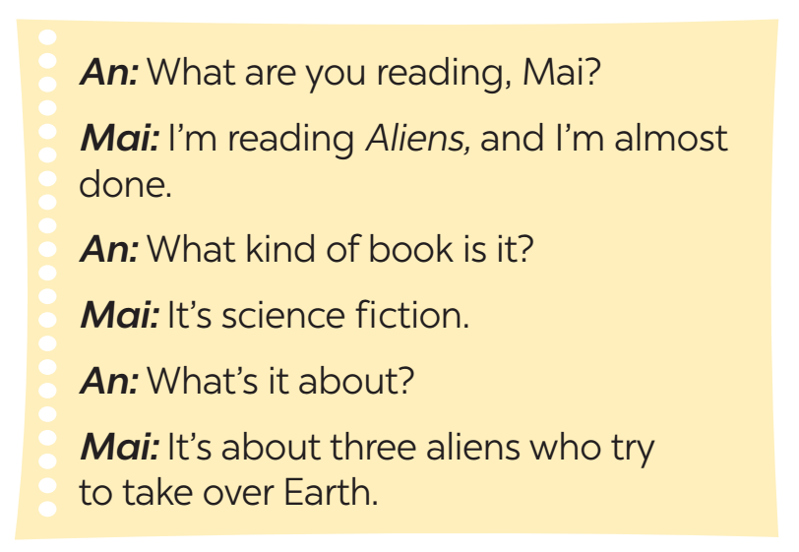
Ex 4. Report the conversation between An and Mai.
Example:
An asked Mai what she was reading.
Mai told An that she was reading Aliens
and she was almost done.
An: What are you reading, Mai?
Mai: I’m reading Aliens, and I’m almost done.
An: What kind of books is it?
Mai: It’s science fiction.
An: What’s it about?
Mai: It’s about three aliens who try to take over Earth.
I’m
done
Next, An asked Mai what kind of book it was.
What
is it
It’s
Mai said to An that it was science fiction.
What’s it
An asked Mai what it was about.
It’s
Mai said it was about three aliens who try to take over Earth.

Slide 27
Ex 5. Work in pairs. Ask your partner five questions about his/her daily routine and make notes of his/her answers. Then report your questions and your partner’s answers to the class.
I asked Minh what time he got up in the morning and he told me (that) he got up at 6 o’clock.
I get up at 6 o’clock.
What time do you get up in the morning?
Minh
Lily

Slide 28
Ex 5. Work in pairs. Ask your partner five questions about his/her daily routine and make notes of his/her answers. Then report your questions and your partner’s answers to the class.
I asked Minh what time he got up in the morning and he told me (that) he got up at 6 o’clock.
Suggested questions:
- What time do you usually wake up?
- What is the first thing you do after getting out of bed?
- What do you usually have for breakfast?
- What time do you go to school?
- How do you get to school?
- Who do you go to school with?
- What time do you get home from school?

Slide 29
WRAP-UP
Analyzing the data and presenting the findings of the project
01
Mary asked me what time the next train _____?
A. leaves B. left C. would leave
02
Ann wondered what she was going to do ____?
A. the day before B. tomorrow C. the next day
03
Harry asked his teacher what _____ on Mars like?
A. the weather is B. was the weather C. the weather was

Slide 30
THANK YOU
Do you have any questions?

