Slide 1

WELCOME  TO  OUR  MEETING ROOM
ENGLISH 9

Slide 2
Unit 9: english in the world lesson 3: a closer look 2

Slide 3
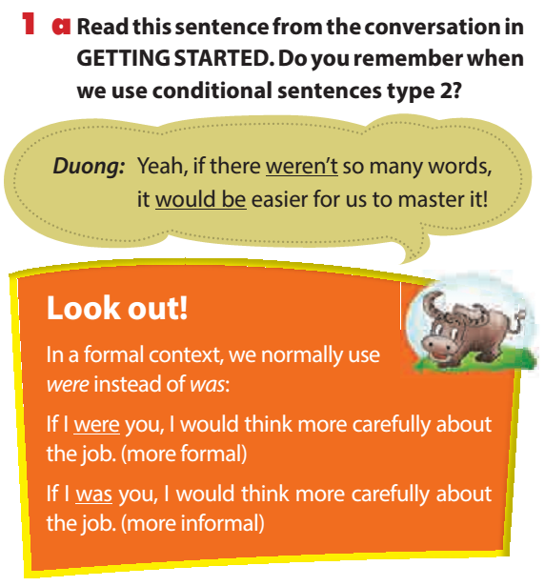

Slide 4
b. Write Yes or No to answer the questions about each sentence.
1. If Tien had an IELTS certificate, he would get the job.
Does Tien have an IELTS certificate?
______
2. If our English teacher weren’t here, we wouldn’t know what to do.
Is the English teacher here now?
______
3. If we went to England this summer, we would have the chance to pick up a bit of English.
Is it possible that they will go to England this summer?
______
4. English would be easy to master if it didn’t have such a large vocabulary.
Is English easy to master?
______
5. If she used English more often, her English wouldn’t be so rusty.
Does she often use English?
______
No
Yes
No
No
No

Slide 5
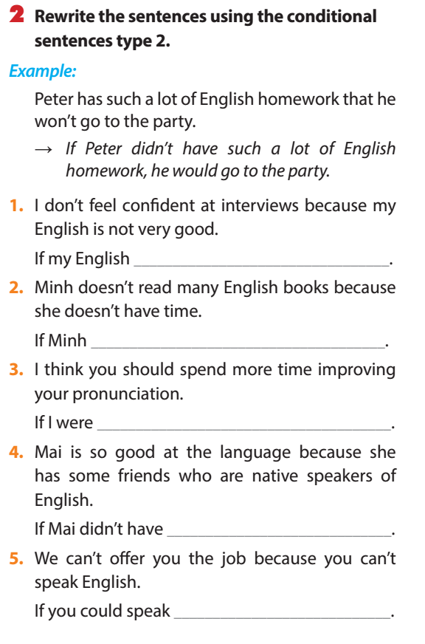
were good, I would feel confident at interviews.
had time, she would read many English books
you, I would spend more time improving my pronunciation.
any friends…, she wouldn’t be so good…
English, I would offer you the job

Slide 6

B. Relative clauses:
I. Read part of the conversation from GETTING STARTED: Ex3a-P35
Teacher: Question one: Is English the language which is spoken as a first language by most people in the world?

Slide 7
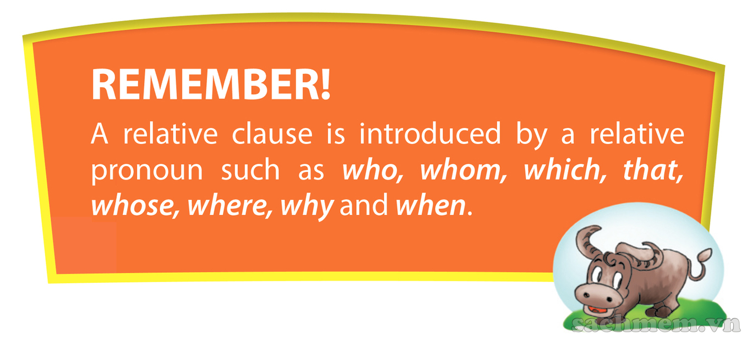
Ex 1: That is my father who is 55 years old

Slide 8
We use relative clause to give extra information about something/someone or to indentify which particular thing/person we are talking about

Slide 9
Relative clause
1. Who
Ex 1: - The woman is standing over there. She is my sister.
→The woman who is standing over there is my sister.
Eg: The girl is wearing a blue shirt. She is my mother
-> The girl who is wearing a blue shirt is my mother
Form: N ( person /người) + Who + V (tobe/ verb thường)

Slide 10
Relative clause
2. Which
Ex 1: - The book was the detective story . I liked it.
→The book which I liked was the detective story.
Eg: - The Iphone X is very expensive. It is black .
-> The Iphone X which is black is very expensive
Form: N ( things /sự vật) + Which+ V (tobe/ verb thường)

Slide 11
Relative clause
3. Whom
Ex 1: - That’s the boy at school yesterday. We saw him.
→that’s the boy whom we saw at school yesterday
Eg: This is the woman. We met her at the party last night.
-> This is the woman whom we met at the party last night
Form: N ( person /người) + Whom+ N( danh từ)

Slide 12
Relative clause
4. When
Ex 1: -Do you remember the day. We first met on that day..
→ Do you remember the day when we first met?
Form: N ( time) + When + S+ V

Slide 13
Relative clause
5. Where
The movie theater is the place. We can see films Stars wars at that place.
→ The movie theater is the place where we can see films Stars wars.
Form: N ( place ) + Where + S+ V

Slide 14
Relative clause
5. Why
Ex: - Tell me the reason. You are so sad for that reason..
→ → Tell me the reason why you are so sad..
Form: N ( reason) + Why/ for which + S+ V

Slide 15
Relative clause
6. Whose
Ex: - This is the man. I borrowed his book.
→→This is the man whose book I borrowed.
Form: N ( người)+ whose+ N

Slide 16
Relative clause
6. That
I can see a girl and her dog. They are running in the park.
→I can see a girl and her dog that are running in the park
Eg: The people that I spoke to were very useful.
Form: N ( person / things/times/+ That + S+V +O

Slide 17

ii. practice
II. practice
Circle the correct word. Sometimes more than one answer is possible: Ex4-P36
1. That’s the boy who / whom / that is bilingual in English and Vietnamese.
2. This is the room which / who / where we are having an English lesson this evening.
3. The girl who / whose / which father is my English teacher is reasonably good at English.

Slide 18
ii. practice
4. Do you remember the year where / when / that we started to learn English?
5. The teacher whom / which / who you met yesterday is fluent in both English and French.
6. That’s the reason where / when / why his English is a bit rusty.

Slide 19
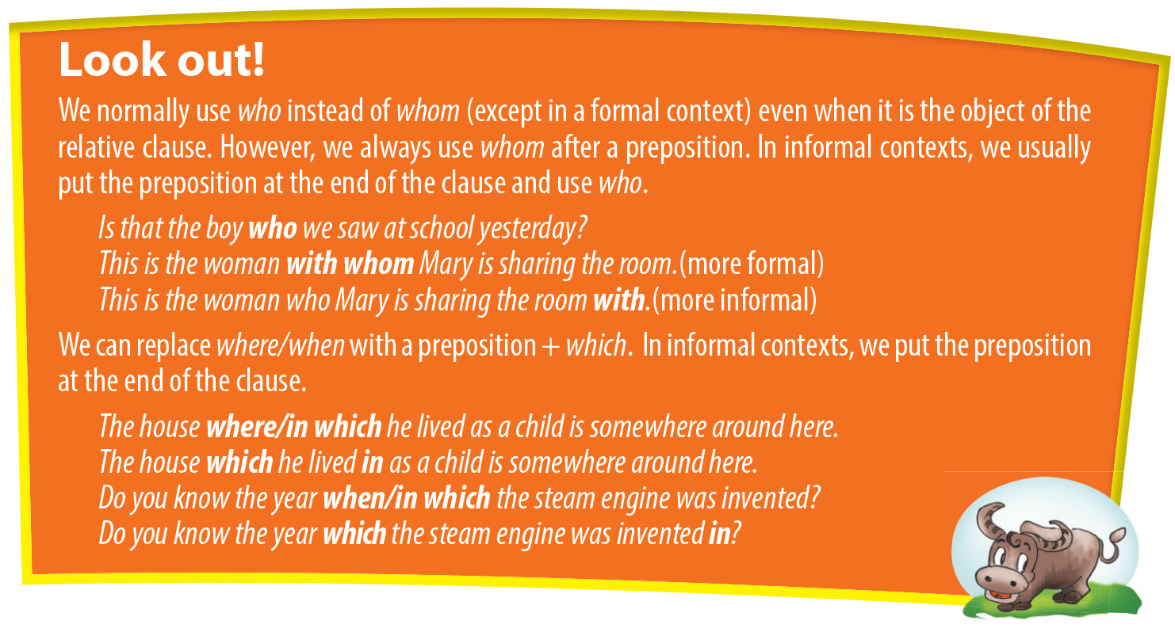

Slide 20

III. Rewrite these sentences as one sentence using a relative clause: Ex6-P36
1. My friend plays the guitar. He has just released a CD.
My friend who/that plays the guitar has just released a CD.
2. Parts of the palace are open to the public. It is where the queen lives.
____________________________________________________________________________.
3. English has borrowed many words. They come from other languages.
________________________________________________________________________________.
Parts of the palace where/in which the queen lives are open to the public.
English has borrowed many words which/that come from other languages.

Slide 21
4. I moved to a new school. English is taught by native teachers there.
________________________________________________________________________________.
5. I don’t like English. There are several reasons for that.
________________________________________________________________________________.
6. The new girl in our class is reasonably good at English. Her name is Mi.
________________________________________________________________________________.
I moved to a new school where/in which English is taught by native teachers.
There are several reasons why I don’t like English
The new girl in our class, whose name is Mi, is reasonably good at English.

Slide 22

Good luck to you

