Slide 1


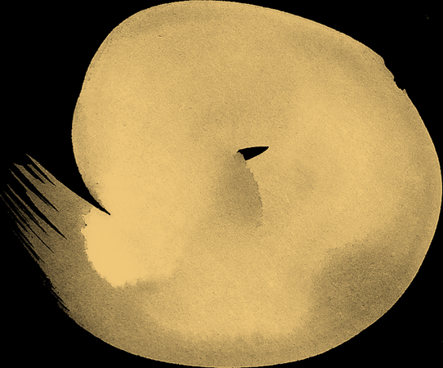

Welcome to our class!
Teacher: …….

Slide 2



Jumbled conversation
1. Thank you. Yours’ re, too.
2. Happy birthday. Wow you’re wearing such a beautiful dress
3. Here is your present. I hope you like it.
4. I’m glad you like it.
5. This is the best gift I have ever had. I love it.
Giving and responding to compliments

Slide 3

UNIT 2:
LIFE IN THE COUNTRYSIDE
Lesson 4: Communication

Slide 4


Everyday English

Slide 5

How to give and respond to compliments

Slide 6



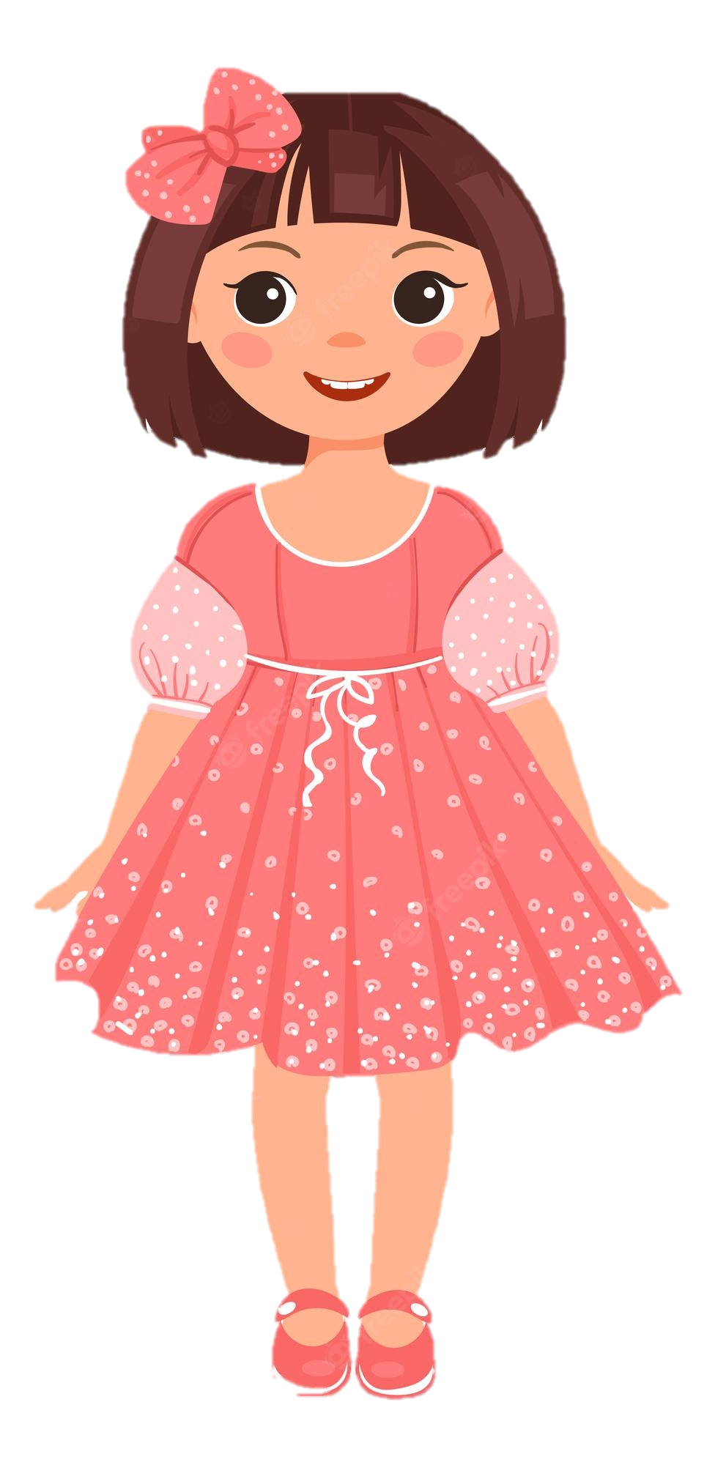
1. Listen and read the conversations. Pay attention to the highlighted sentences.
Tom: What a beautiful kite you have, Mai!
Mai: Thank you, Tom. My dad made it for me last weekend.
1
Nick: You really have a nice dress, Hoa.
Mai: I’m glad you like it, Nick. I think its colour really suits me.
2
Giving compliments | Responding to compliments
- What a beautiful kite you have! - You really have a nice dress. | Thank you. I’m glad you like it.

Slide 7

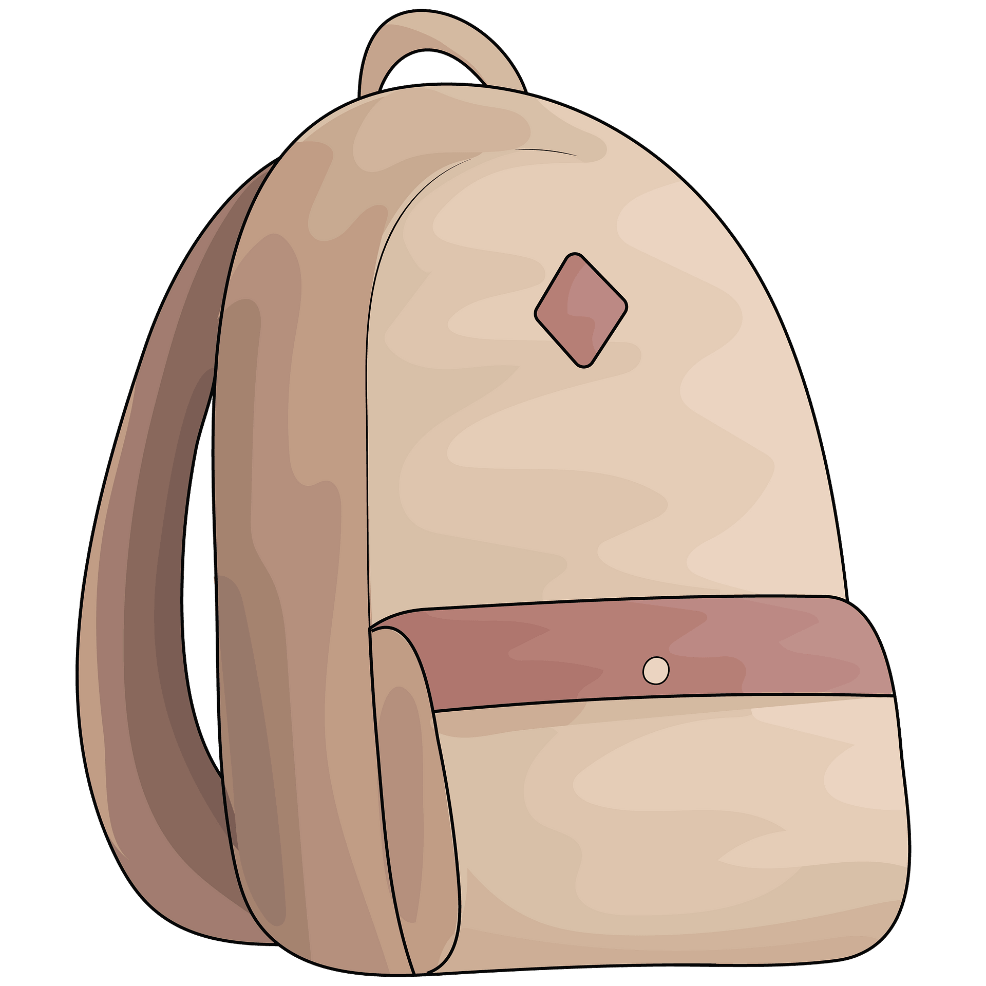
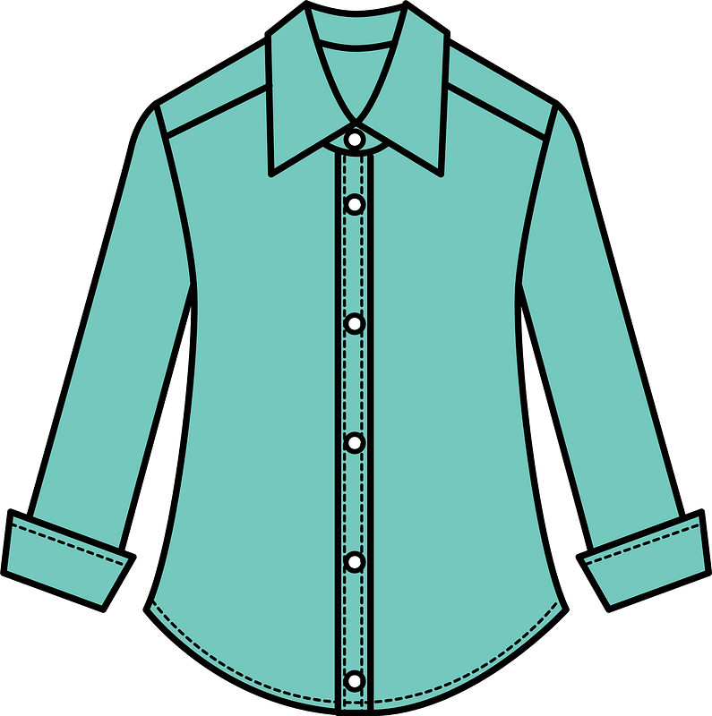
2. Work in pairs. Make similar conversations to practice giving and responding to compliments, using the cues below.
a bicycle
a shirt
a school bag
Example:
A: What……/ You really have …….
B: Thank you,……./ I’m glad you like it.

Slide 8
Adverts for beautiful villages

Slide 9

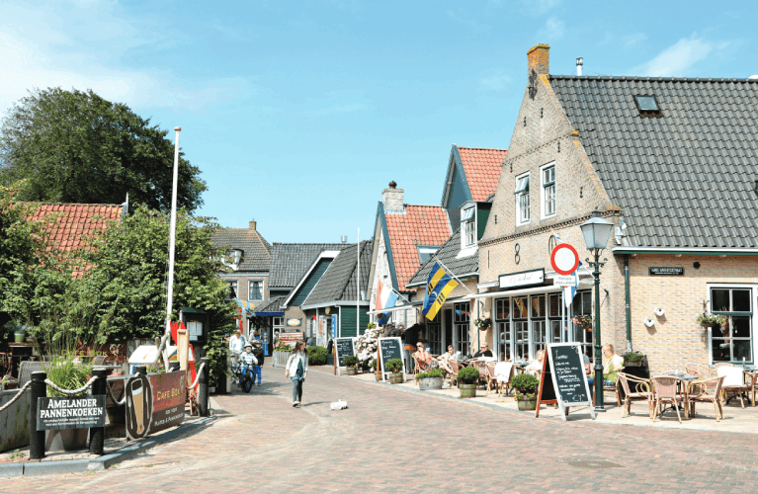

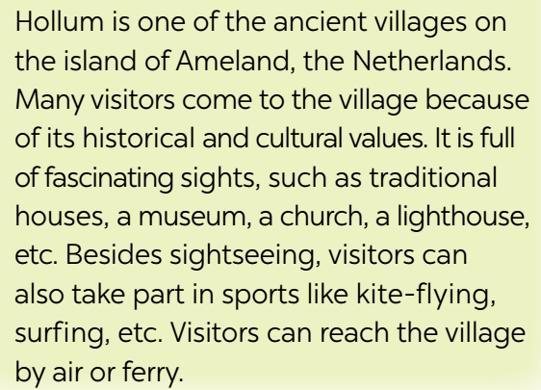
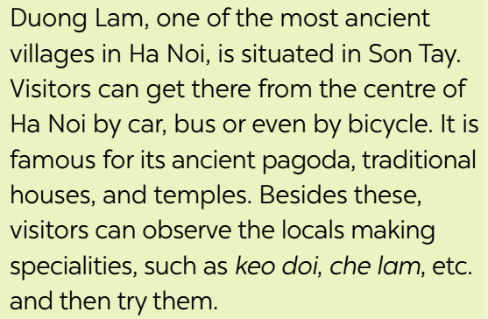
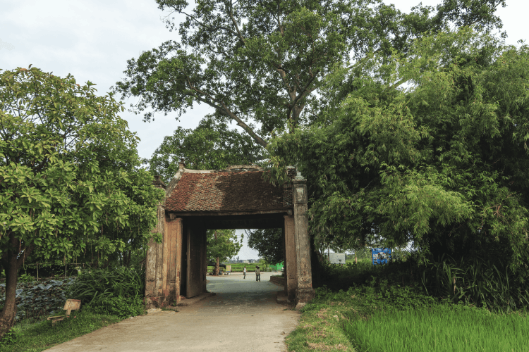
3. Read the adverts for the two beautiful villages. Tick the boxes to show which village the statements describe. Sometimes both boxes need to be ticked.
Statements | Duong Lam | Hollum
1. It’s an ancient village.
2. We can visit an ancient pagoda, traditional houses, and temples in this village.
3. We can get there by plane or ferry.
4. We can go there by car, bus, or bike.
5. It has a lighthouse.

Slide 10


4. Work in groups. Take turns to talk about the similarities and differences between Duong Lam and Hollum.
Duong Lam and Hollum are both ancient villages, …

Slide 11


Suggested answer:
Duong Ham and Hollum are both ancient villages, two of them are famous for their historical attractions. Tourist can visit traditional houses in both Duong Lam and Hollum. However, in Duong Lam, visitors can also observe the locals making specialties, such as keo doi, che lam, etc, and then try them. And in Hollum, besides sightseeing, visitors can also take part in sports like flying kites, surfing, etc. lastly, because Duong Lam is in the rural area of Ha Noi, you can go there by car, bus or even bicycle. Nevertheless, Hollum is on the island of Ameland, so you have to use ferry or plane to go there.

Slide 12


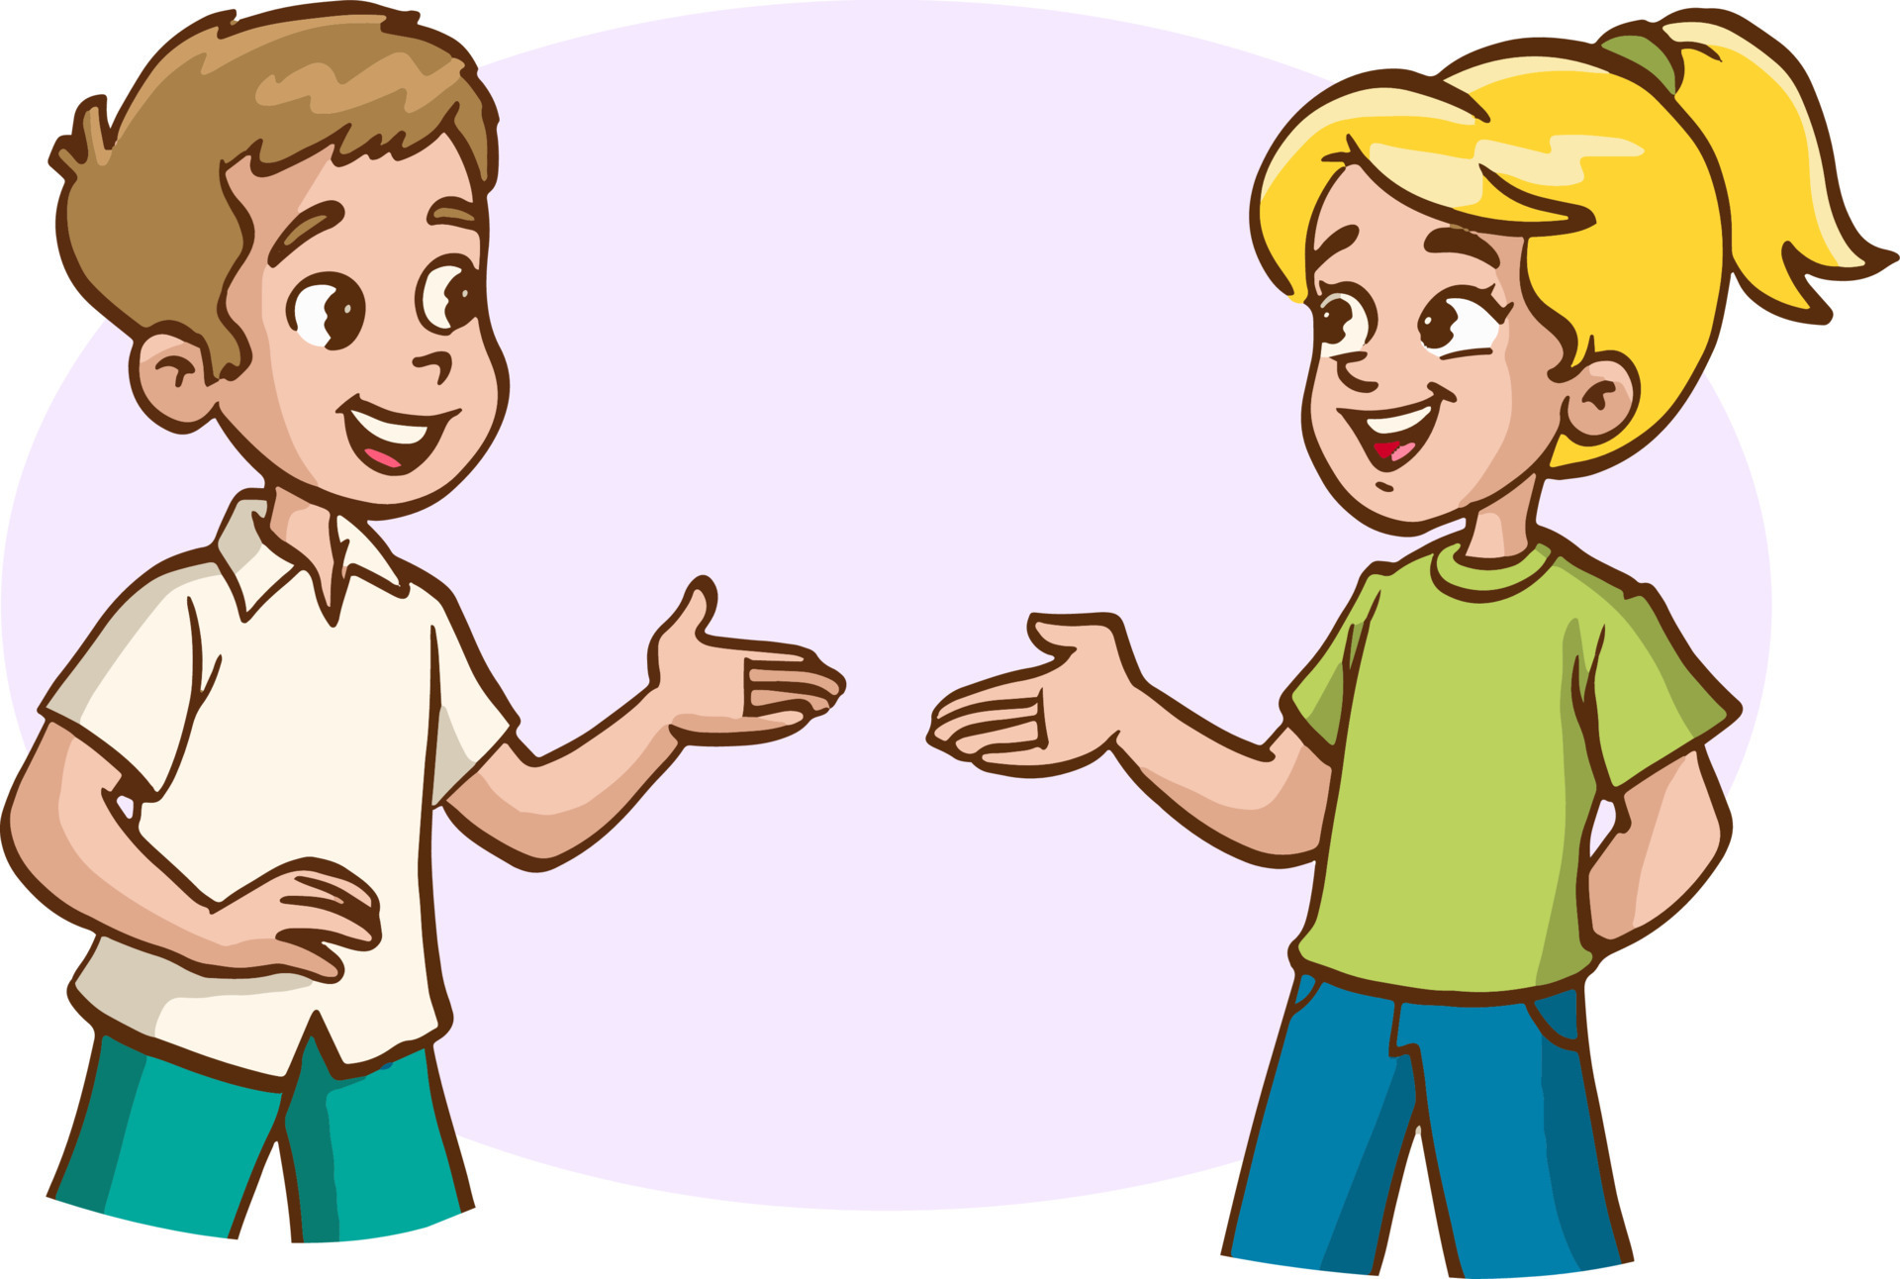

5. Work in pairs. Which village in 3 would you like to visit for a holiday? Explain your choice to your partner.
Duong Lam, of course!
Which village would you like to visit for a holiday?
Why?
Because I love watching the locals making specialties and …

Slide 13
Wrap - up
What have we learnt in this lesson?
How to give and respond to compliments

Slide 14

THANK YOU!

