Slide 1
WELCOME TO OUR CLASS
Teacher: …

Slide 2
Unit 2:
LIFE IN THE COUNTRYSIDE
Lesson 1: Getting Started

Slide 3
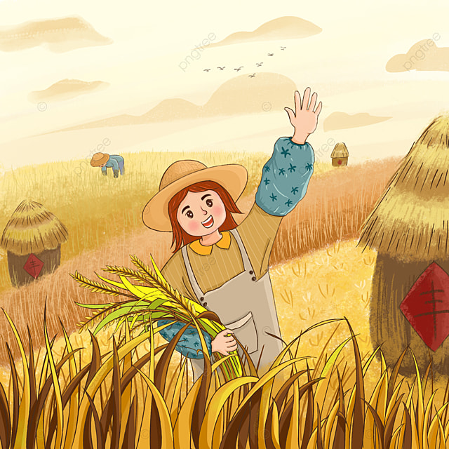
Vocabulary
harvest (v)
/ˈhɑːvɪst/
thu hoạch

Slide 4
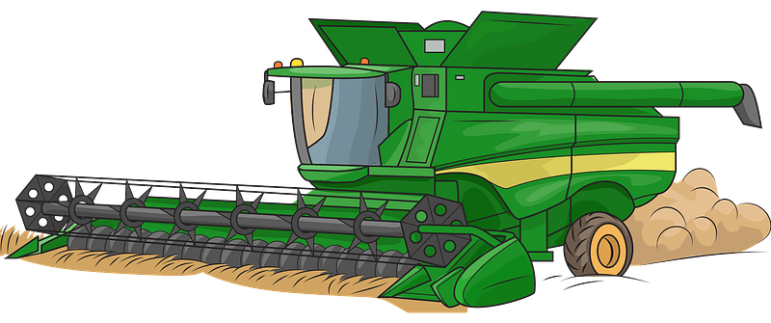
Vocabulary
combine harvester (n)
/kəmˈbaɪn ˈhɑːvɪstər /
máy gặt

Slide 5
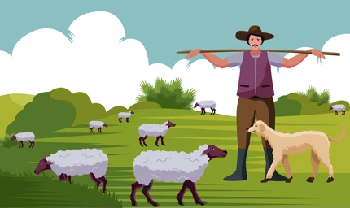
Vocabulary
herd (v)
/hɜːd/
chăn (gia súc)

Slide 6
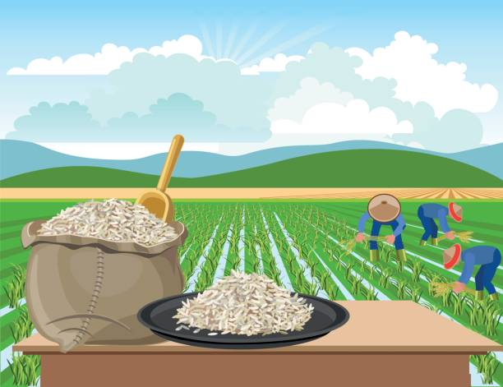
Vocabulary
paddy field (n)
/ˈpædi ˌfiːld/
cánh đồng lúa

Slide 7
Vocabulary
- harvest (v) | /ˈhɑːvɪst/ | thu hoạch
- combine harvester (n) | /kəmˈbaɪn ˈhɑːvɪstər/ | máy gặt
- herd (v) | /hɜːd/ | chăn gia súc
- paddy field (n) | /ˈpædi ˌfiːld/ | đồng lúa

Slide 8
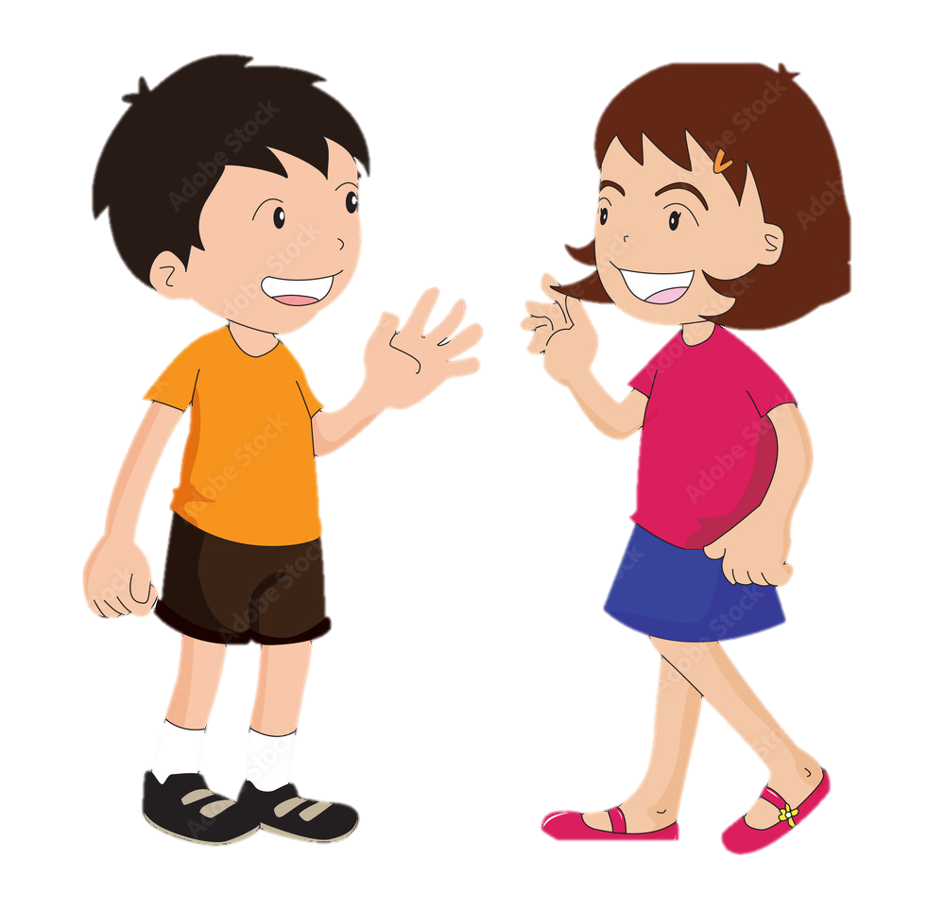
Nick
LAST SUMMER HOLIDAY
Who has just come back from a very enjoyable summer holiday?
Mai

Slide 9
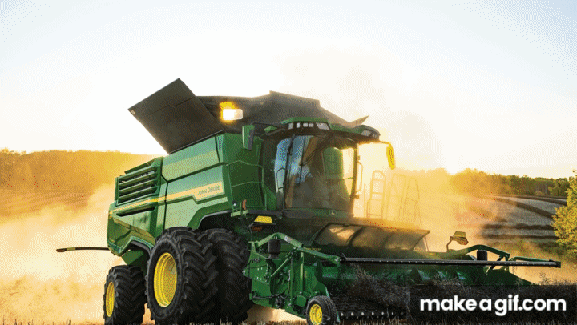
3. Complete the sentences with the words and phrases from the box
paddy field
herd
harvest time
combine harvester
2. Nowadays, people in my village use a __________________ to harvest their rice and separate the grains from the rest of the plant.

Slide 10
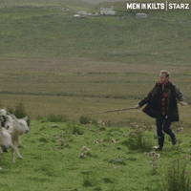
3. Complete the sentences with the words and phrases from the box
paddy field
herd
harvest time
3. Today it is my turn to __________ the cows.

Slide 11
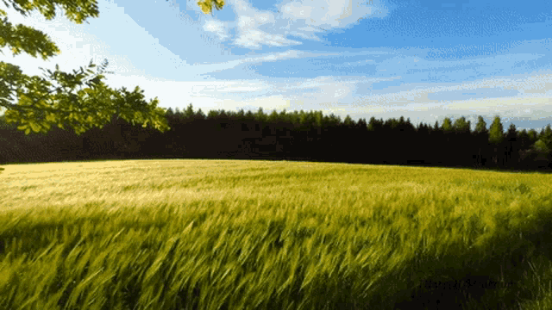
3. Complete the sentences with the words and phrases from the box
paddy field
harvest time
4. A place in which people grow rice is called a ____________.

Slide 12
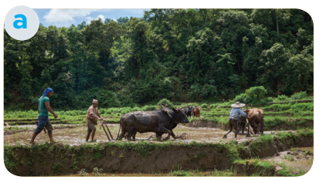
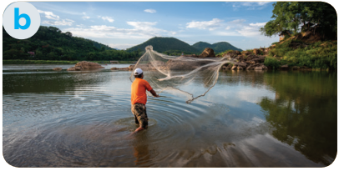
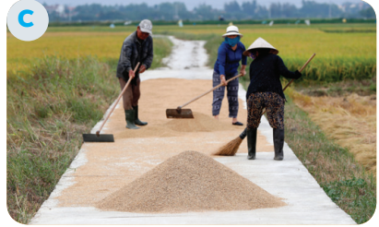
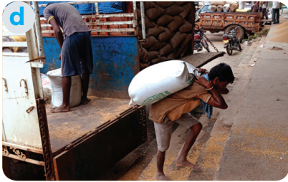
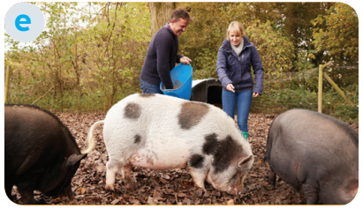
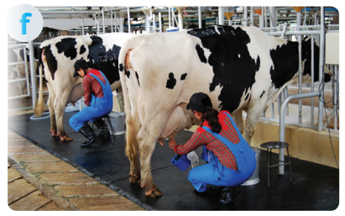
4. Match the activities that people living in the countryside often do with the pictures.
1. unloading rice
2. ploughing fields
3. milking cows
4. feeding pigs
5. catching fish
6. drying rice

Slide 13
Look at the answers again
2. ploughing fields
5. catching fish
6. drying rice
1. unloading rice
4. feeding pigs
3. milking cows

Slide 14
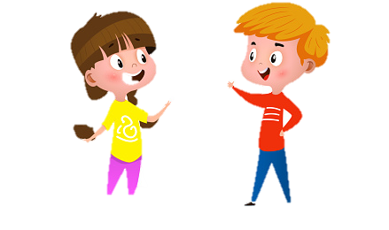
5. Ask and answer about the pictures
What are they doing in picture a?
They are ploughing fields.

Slide 15
Thank
you

