Slide 1
Hello everyone !!!

Slide 2
* WARM-UP
* Game: Sentence puzzling
1. dinner / I / having / yesterday./ was / at 6 p.m/
→ I was having dinner at 6 p.m. yesterday.
2. My sister / at home/ at this time / wasn’t staying /last week./
→ My sister wasn’t staying at home at this time last week
3. you / Were / the shipper /cooking dinner/ when / arrived /?/
→ Were you cooking dinner when the shipper arrived ?

Slide 3
Unit
9
NATURAL DISASTERS
Unit
ETHNIC GROUPS OF VIET NAM
LESSON 3: A CLOSER LOOK 2
LESSON 3: A CLOSER LOOK 2
Unit
HOBBIES

Slide 4
* Grammar:
The past continuous:
(Thì quá khứ tiếp diễn)
Form
(+) S + was/ were + V-ing…
(-) S + was/ were not + V-ing…
(?) Was/ were + S + V-ing…?

Slide 5
Usage of the past continuous:
We use the past continuous to describe:
- an action that was happening at a particular time in the past.
Example: I was having dinner at 6 p.m. yesterday.
Were you having dinner at 6 p.m. yesterday? – Yes, I was.
- a past action that was happening when another action interrupted it. We use the past simple for the action that interrupted it.
Example: When / While we were watching TV, we felt the earthquake.
What were they doing when they felt the earthquake? – They were watching TV.
Notes: - We can use when or while before the past continuous.
- We can only use when before the past simple.

Slide 6
Usage
Chúng ta sử dụng thì quá khứ tiếp diễn để mô tả:
- Một hành động đang xảy ra tại một thời điểm cụ thể trong quá khứ.
Example: I was having dinner at 6 p.m. yesterday.
Were you having dinner at 6 p.m. yesterday? – Yes, I was.
Một hành động đang diễn ra thì có một hành động khác xen vào. Chúng ta sử dụng thì quá khứ đơn cho hành động làm gián đoạn nó.
Example: When / While we were watching TV, we felt the earthquake.
What were they doing when they felt the earthquake? – They were watching TV.
* Notes:
- Chúng ta có thể sử dụng when hoặc while trước thì quá khứ tiếp diễn.
- Chúng ta chỉ có thể dùng when trước thì quá khứ đơn.

Slide 7
* PRACTICE
1
Complete the sentences by putting the verbs in brackets into the past continuous.
1. They (help) ____________ the flood victims at 10 o’clock last night.
2. It (not snow) ______________ when I left home this afternoon.
3. While she (work) ____________ in the field, the tornado came.
4. – What you ______ (do) ______ at 9 o’clock yesterday morning? – I (watch) ____________ the news about a volcanic eruption.
5. – ______ you (cry) ______ when I saw you two days ago? – No, I wasn’t.
were helping
wasn’t snowing
was working
were
doing
was watching
Were
crying

Slide 8
2
Circle the correct answer to complete each sentence.
1. We donated / were donating money to help the earthquake victims last month.
2. – What did you do / were you doing when the volcano erupted? – I slept / was sleeping in my bed.
3. While they camped / were camping near the river, the flood was coming / came suddenly.
4. After Tom ran / was running out of his house, he moved / was moving quickly to a safer place.
5. I didn’t read / wasn’t reading a newspaper at 9 a.m. yesterday, but I watched / was watching the news about the tornado.

Slide 9
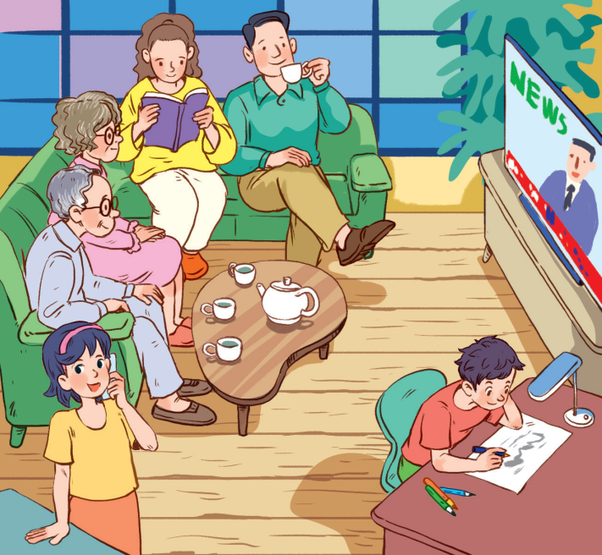
3
Look at the picture and write what each person in Lan’s family was doing when the earthquake happened. Use the given word and phrases from the box.
1. Lan’s grandparents were watching TV.
2. Lan’s/ Her mother was reading a book.
3. Lan’s/ Her father was drinking tea.
4. Lan was talking on the phone.
5. Lan’s/ Her brother was drawing.

Slide 10
4
Form questions using the past continuous. Then in pairs, ask and answer the questions.
Example: you / play / football / 5 o’clock yesterday afternoon?
Were you playing football at 5 o’clock yesterday afternoon?
Yes, I was. / No, I wasn’t. I was doing my homework

Slide 11
4
Form questions using the past continuous. Then in pairs, ask and answer the questions.
1. you / have dinner / 7 o’clock yesterday evening?
=> Were you having dinner at 7 o’clock yesterday evening?
2. you / do / homework / 8 o’clock yesterday evening?
=> Were you doing your homework at 8 o’clock yesterday evening?
3. you / watch / film / 9 o’clock yesterday evening?
=> Were you watching a film at 9 o’clock yesterday evening?

Slide 12
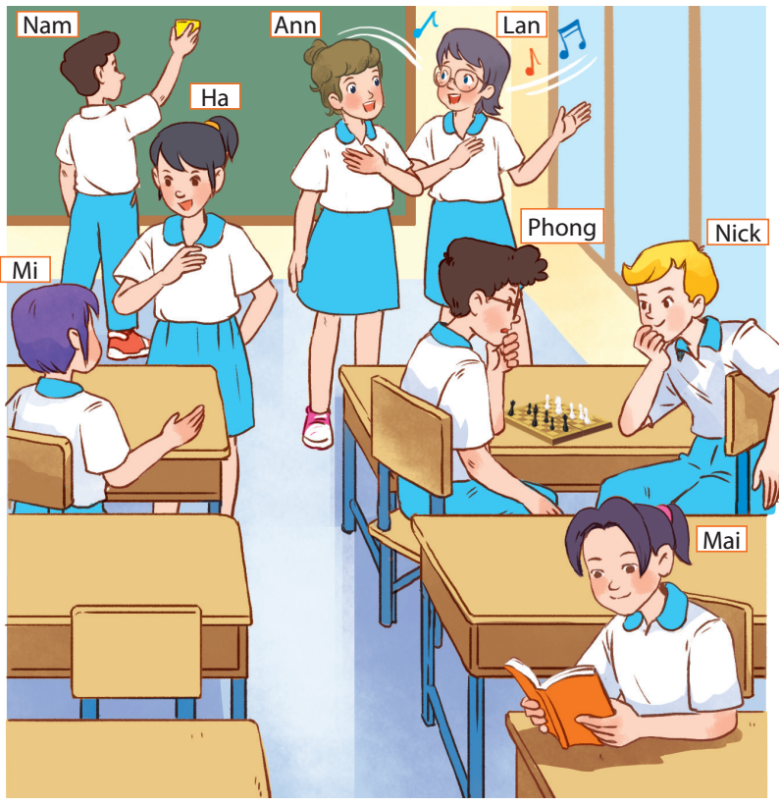
* PRODUCTION
5
Work in groups. Take turns to say a sentence that describes what each person in the picture was doing

Slide 13
* PRODUCTION
5
Work in groups. Take turns to say a sentence that describes what each person in the picture was doing
- Mai was reading.
- Phong and Nick were playing chess.
- Lan and Ann were singing.
- Nam was cleaning the board.
- Mi and Ha were talking.

Slide 14
* CONSOLIDATION
Structures:
(+) S + was/ were + V-ing …
(-) S + was/ were not + V-ing …
(?) Was/ were + S + V-ing …?

Slide 15
* Homework
Remember the structures and the use of the past continuous.
Do exercises in the workbook.
Prepare for Lesson 4 - Communication

Slide 16
Thanks for your atendance!
Goodbye. See you again
Notes:
16

