Slide 1
Hello everyone !!!

Slide 2
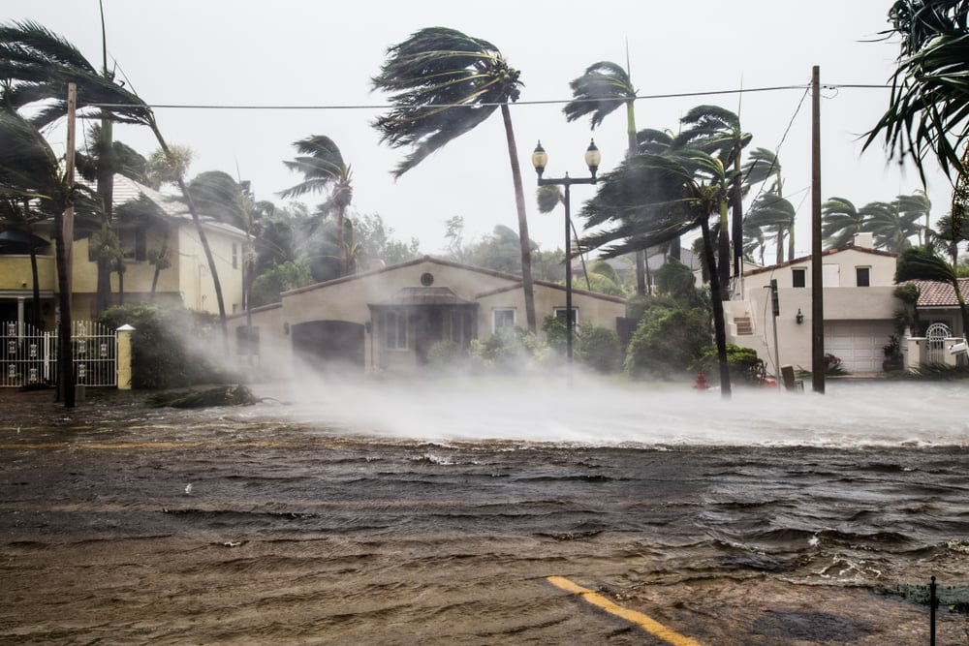
* WARM-UP
- What’s natural disaster?
→ It’s a storm
- What should people do before, during and after a storm?
* Before:
- Listen to the local radio or watch TV for
warnings and information
- Prepare an emergency kit.
- Prepare food, drink and some necessary things
* After:
Avoid moving water.
Listen to important instructions from local authorities
Stay away from damaged areas.
* During:
Stay inside a safe and high place
Follow the routes specified by officials.

Slide 3
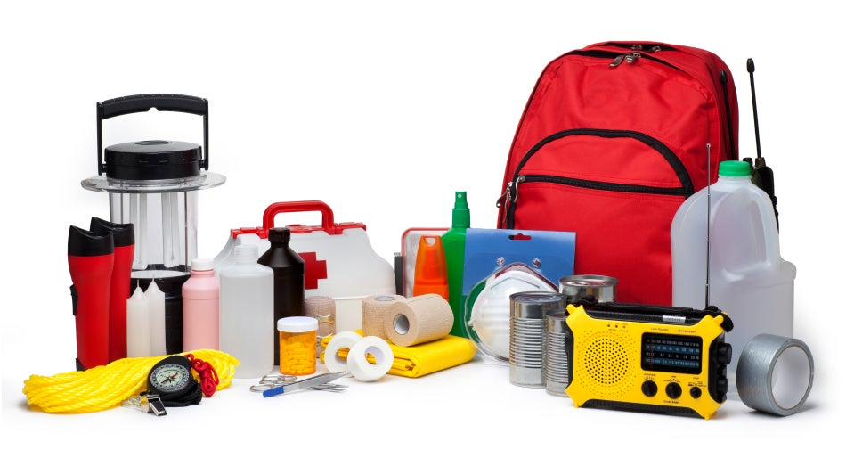
Unit
9
NATURAL DISASTERS
Unit
ETHNIC GROUPS OF VIET NAM
LESSON 3: A CLOSER LOOK 2
LESSON 6: SKILLS 2
Unit
HOBBIES

Slide 5
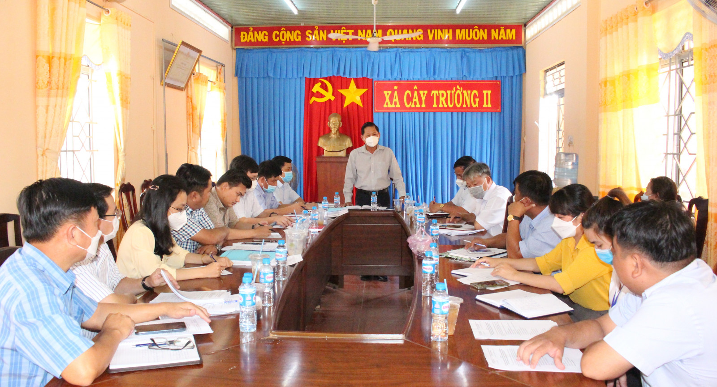
* Vocabulary
- authority (n):
chính quyền
/ɔːˈθɒrəti/

Slide 6
* Vocabulary
warn (v):
cảnh báo
/wɔːn/

Slide 7
* Vocabulary
- avoid (v):
tránh, tránh xa
/əˈvɔɪd/

Slide 8
* Vocabulary
New words | Pronunciation | Meaning
1. authority (n) | /ɔːˈθɒrəti/ | chính quyền
2. warn (v) | /wɔːn/ | cảnh báo
3. avoid (v) | /əˈvɔɪd/ | tránh, tránh xa

Slide 9
* Checking vocabulary
New words |  | Meaning
1. authority (n)
2. warn (v)
3. avoid (v)
cảnh báo
tránh, tránh xa
chính quyền

Slide 10
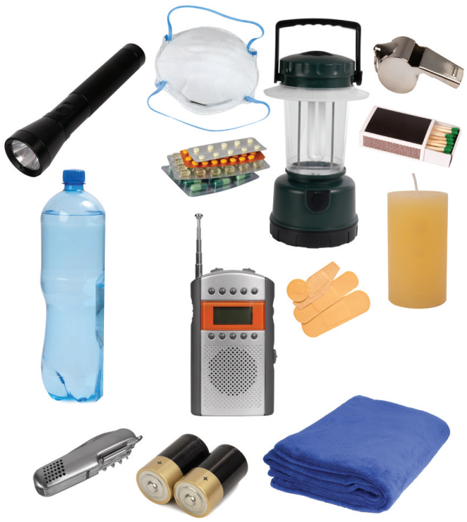
I. LISTENING
1
Work in pairs. Look at the picture and answer the questions.
What can you see in the picture?
A torch, a mask, a lamp, a whistle, a bottle of water, some medicine, matches, a radio, some plasters, a candle, a multi-purpose knife, some batteries, a blanket.
→
An emergency kit.
2. When do we need these things?
We need these things when there are natural disasters because natural disasters can cause damage to buildings and properties and injure people.

Slide 11
I. LISTENING
2
Listen to a broadcast. Put the activities (1 – 6) in the correct column.
Before a storm | During a storm | After a storm
2,6
3,5
1,4
1. Listen to instructions from local authorities
2. Prepare an emergency kit
3. Stay inside the house
4. Keep away from dangerous areas
5. Avoid windows and glass doors
6. Strengthen houses

Slide 12
I. LISTENING
3
Listen again and tick T (True) or F (False) for each sentence.
 | T | F
1. The broadcast is on TV.
2. You should bring flowerpots and rubbish bins into the house.
3. Right after the storm, you can leave your home.
4. The local authority may warn you about dangerous places.

Slide 13
II. WRITING
4
Work in pairs. Discuss what you should do before, during, and after a flood. Write your ideas in the columns.
Before a storm | During a storm | After a storm
-Prepare an emergency
kit.
....
-Stay inside a safe and high place.
…
-Avoid moving water.
…

Slide 14
* Before a flood (trước trận lũ lụt):
Stay informed (cập nhật thông tin)
Prepare an emergency plan (chuẩn bị kế hoạch cấp)
Install check valves (gắn van một chiều)
Move your properties (di chuyển đồ đạc)
Construct barriers around your house (dựng rào chắn quanh nhà)
* During a flood (trong trận lũ lụt):
Follow evacuation orders (thực hiện theo yêu cầu sơ tán)
Avoid walking through deep floodwaters (tránh đi vào vùng nước lụt sâu)
Disconnect electrical devices (ngắt kết nối thiết điện)
Be aware of flash flooding (cảnh giác những cơn lũ bất ngờ)
Seek shelter (tìm chỗ trú ẩn)
* After a flood (sau trận lũ lụt):
Do not return to your home right away (không về nhà ngay)
Clean and disinfect your house and the surrounding areas (dọn dẹp và khử khuẩn nhà cửa và khu vực xung quanh)
Report damages (báo cáo tổn thất)
Stay away from damaged areas (tránh xa những khu vực bị hư hại)
Stay on firm ground (ở lại trên những khu vực đất vững chắc).

Slide 15
5
Write instructions (80 - 100 words) about things to do before, during, and after a flood.

Slide 16
Write instructions (80 - 100 words) about things to do before, during, and after a flood.
5
* Suggested answer:
Here are the things you should do before, during, and after a ﬂood.
Before:
– Prepare an emergency kit with necessary things.
– Build barriers to stop ﬂoodwater from entering the house.
– Move to a higher place if necessary.
During:
– Listen to the radio or television for warnings and information.
– Be careful with ﬂash ﬂooding.
After:
– Avoid moving water.
– Stay away from damaged areas unless the local authority needs your help.
– Listen for local warnings of ﬂash ﬂoods.

Slide 17
Write instructions (80 - 100 words) about things to do before, during, and after a flood.
5
Here are the things you should do before, during, and after a flood.
* Before:
Prepare an emergency kit with necessary things like a torch, a whistle, bottles of water, some medicine and a blanket.
Move your properties to an upper floor or any high place to minimise their damage.
* During:
Disconnect electrical devices because floodwater might cause electric shock.
Be aware of flash flooding. They could come suddenly and violently.
* After:
Do not return to your home right away as it might be dangerous.
Report damages to local authorities or insurance companies to receive support.

Slide 18
* CONSOLIDATION
In this lesson, you have:
learnt new words related to natural disasters.
known more about things to do before, during, and after a storm.
written instructions about things to do before, during, and after a flood.

Slide 19
* Homework
Learn by heart all the words.
Do exercises in the workbook.
Prepare for Lesson 7

