Slide 1


SONG VE SECONDARY SCHOOL
Hello every one !!!
love
NGUYỄN THỊ THU BA

Slide 2
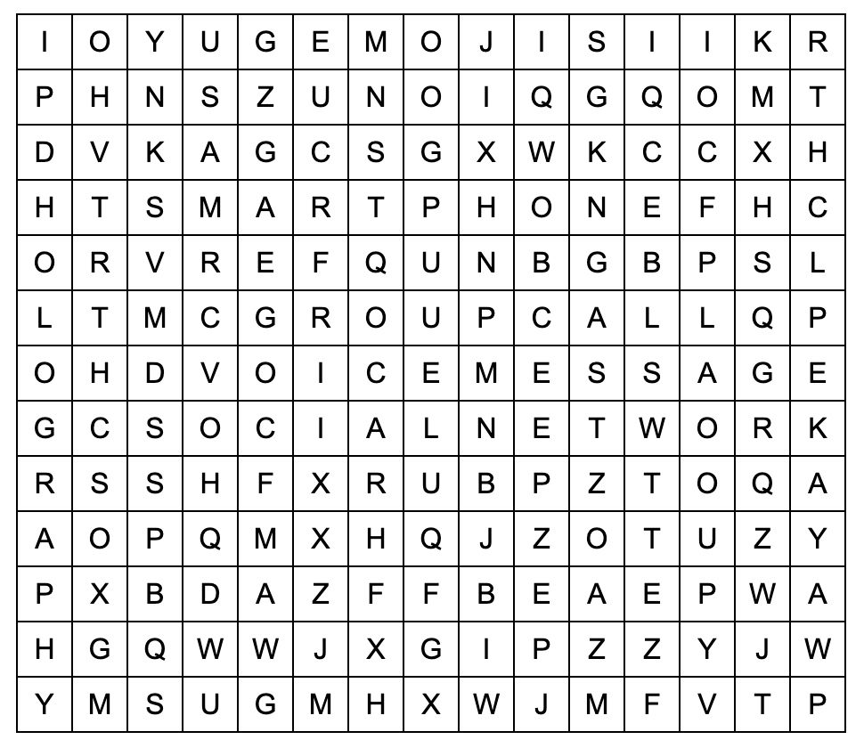
* WARM-UP
Work in pairs. Find the words in the word search.
voice message
social network
group call
smart phone
emojis
Holography
private

Slide 3
* WARM-UP
* Answer the questions:
1. Where is teacher’s smartphone?
2. What will smartphones be like at the end of 2023?
3. What will smartphones be like in 10 years?
Where is it?

Slide 4

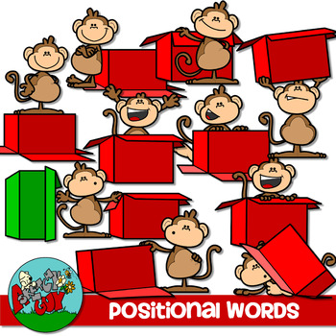
Unit
10
COMMUNICATION IN THE FUTURE
LESSON 3: A CLOSER LOOK 2

Slide 5



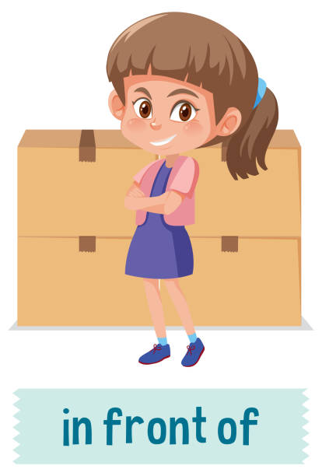

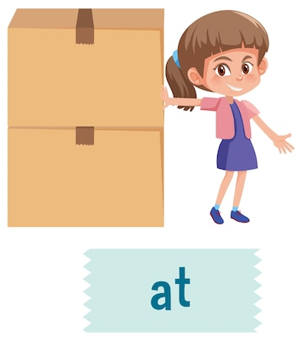
Prepositions of place
on
under
opposite
in front of
next to
in

Slide 6

* Grammar 1:
Prepositions of time
“in + a length of time” can express future meaning.
Example: Robots will replace human shop assistants in ten years.
“for + a length of time” says how long something goes on for.
Example: It rained for three hours yesterday.
“by + a specific time” means “not later than that time”.
Example: We’ll be there by 6 p.m.

Slide 7

* Grammar 1:
Prepositions of time: (Giới từ chỉ thời gian)
in + khoảng thời gian: thể hiện nghĩa tương lai
Ex: Robots will replace human shop assistants in ten years
for + khoảng thời gian: thể hiện sự việc kéo dài trong bao lâu
Ex: It rained for three hours yesterday.
by + thời gian cụ thể: trước thời điểm đó
Ví dụ: We’ll be there by 6 p.m.
Chúng tôi sẽ ở đó trước 6 giờ tối

Slide 8
* Grammar 2:
* Possessive pronouns: Đại từ sở hữu
Có 7 đại từ sở hữu đã học:
- mine: của tôi
- yours: của bạn / của các bạn
- his: của anh ấy
- hers: của cô ấ
- yours: của chúng tôi
- theirs: của họ
- its: của
Vị trí của đại từ sở hữu trong câu
+ Đại từ sở hữu có thể được sử dụng như một chủ ngữ, tân ngữ hoặc đứng sau giới từ
-Vị trí chủ ngữ: His car is red and mine is blue.
-Vị trí tân ngữ: Her house is bigger than mine.
-Đứng sau giới từ: I could deal with their problem, but I don’t know what to do with mine.

Slide 9
Cách dùng đại từ sở hữu trong tiếng Anh
Đại từ sở hữu được sử dụng để thay thế cho cụm tính từ sở hữu + danh từ đã đề cập trước đó.
Đại từ sở hữu được sử dụng để tránh trùng lặp trong cách dùng từ và giúp câu văn trở nên trôi chảy hơn.
Ex: This is my book, not yours. = This is my book, not your book
Đại từ sở hữu yours được sử dụng để thay thế cho cụm your book.
- Lưu ý: Đại từ sở hữu không đứng trước 1 danh từ.

Slide 10
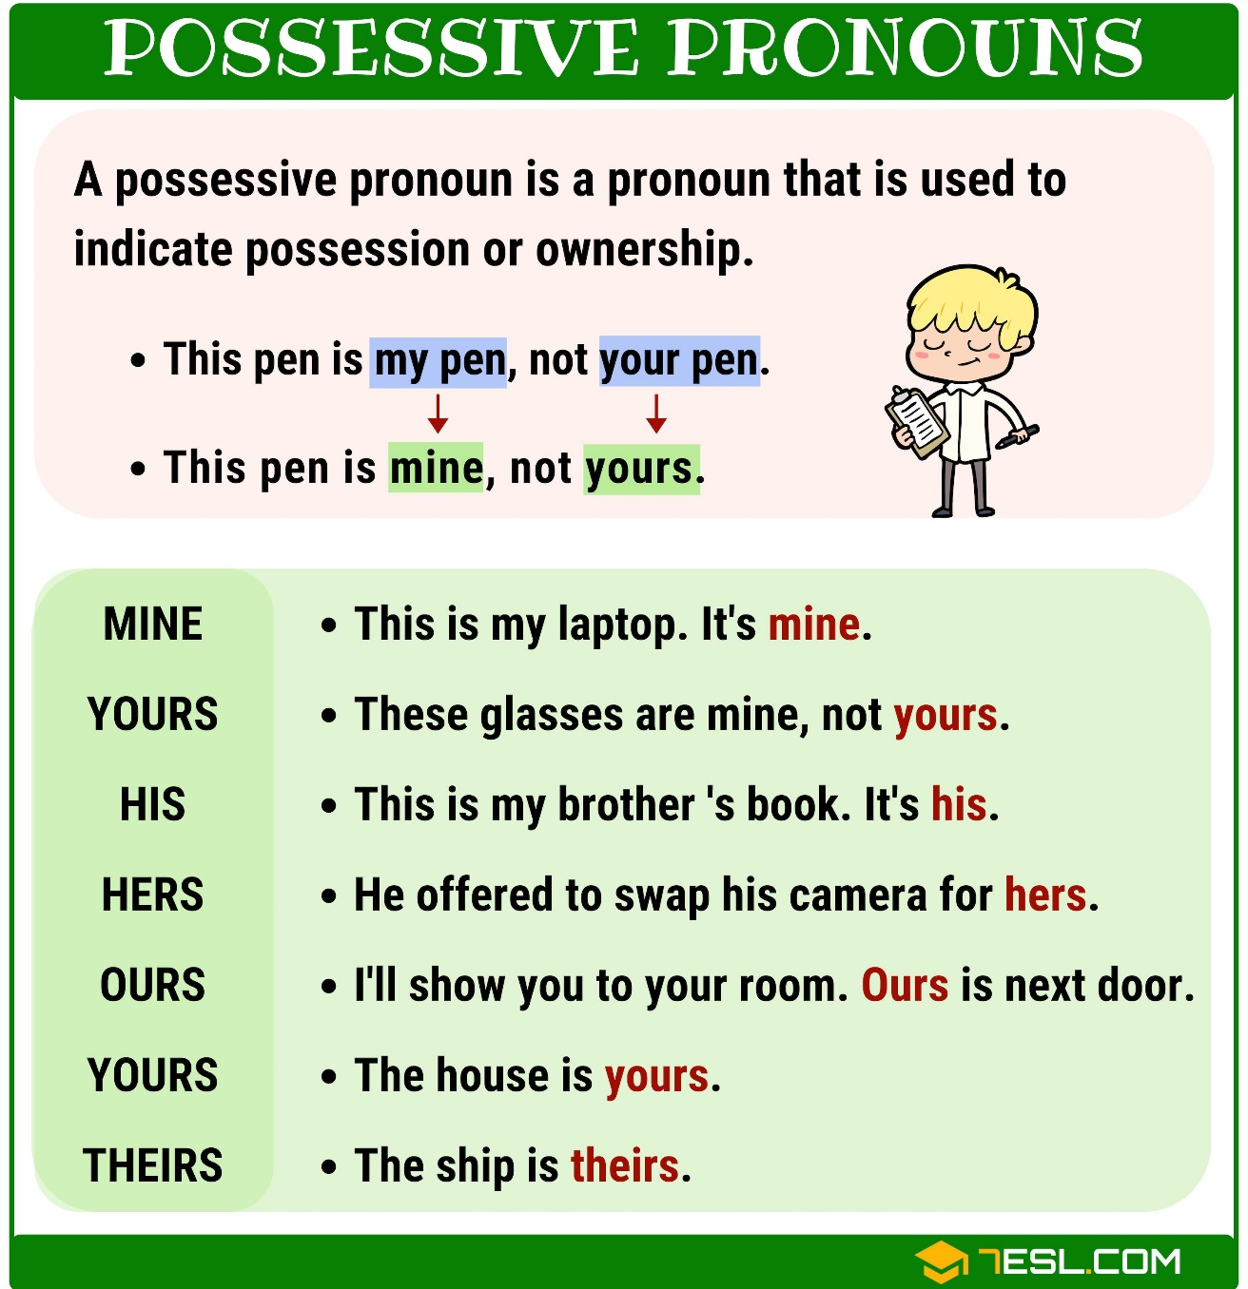

Slide 11

* Grammar 2:
Possessive pronouns
We can use possessive pronouns after of.
Example:
Mi is one of my friends.
Mi is a friend of mine.

Slide 12
* PRACTICE
1
Complete the sentences with at, in, in front of, on, opposite, or under.
at
1. Lily’s house is ______ the end of this street.
2. Players always sit _________ each other in a chess game.
3. She looked ______ the table and finally found her smartwatch.
4. Don’t walk ______ the street. Walk ______ the pavement.
5. Ann stood _________ me in a line to get on the bus.
opposite
under
in
on
in front of

Slide 13
2
Circle the correct preposition in each sentence.
1. Let’s get ready by / on / for 10 a.m. We are meeting Dr Saito at 10:15.
2. The first camera phone appeared on / at / in May 1999 in Japan.
3. We will be away on / for / by two weeks.
4. In the UK, supermarkets always close early in / by / on Sundays.
5. I think language barriers will disappear in / for / by 30 years.

Slide 14
3
Complete the text with the prepositions from the box. Use each preposition only ONCE.
in on at for by
in
I think smartphones will change a lot (1) ______ the near future. They will be much thinner. (2) ______ 2035, we might be able to roll a phone like a sheet of paper. They will become much smarter, too. They will be able to charge their battery automatically when we are (3) ______ home. They might check the latest news (4) ______ the Internet. We won’t have to wait (5) ______ a long time for these super smartphones.
By
at
on
for

Slide 15
5
Complete the second sentence so that it has the same meaning as the first sentence.
1. Jack is one of her cousins.
Jack is a ______________________.
2. Is this one of his tablets?
Is this a _______________________?
3. Can I borrow a pencil of yours?
Can I borrow ___________________?
4. You look like Nick and Peter. Are you one of their relatives?
You look like Nick and Peter. Are you _________________?
5. Last year, two of our classmates won scholarships to the US.
Last year, _____________________ won scholarships to the US.
cousin of hers
tablet of his
one of your pencils
a relative of theirs
two classmates of ours

Slide 16
4
Work in pairs. Tell each other whether you agree or disagree with the following ideas:
We should not use our smartphones for more than a few hours every day.
By 2050, the way people communicate with each other will be different from now.
1.What are some bad points of using smartphones too much? | 2. In the future, will people meet each other face to face like now?
Damage your eyes (will be short-sighted)
Will be bad for sleep
Have negative effect on your health
( will be bad for your neck, can damage
your hands,……
………………….
- In the future, we can meet our friends and relatives using video calls. Moreover, we can make so many friends via chatting or social networking.

Slide 17
*CONSOLIDATION
What have we learnt in this lesson?
How to use prepositions of place and time
How to use possessive pronouns

Slide 18

* Homework
Do the exercise in the Workbook

Slide 19

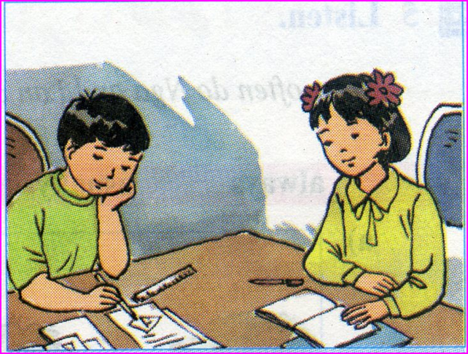
homework
Do exercises in the workbook.
Prepare for Lesson 4 - Communication

Slide 20

Thanks for your atendance!
Goodbye. See you again
Notes:
20

