Slide 1
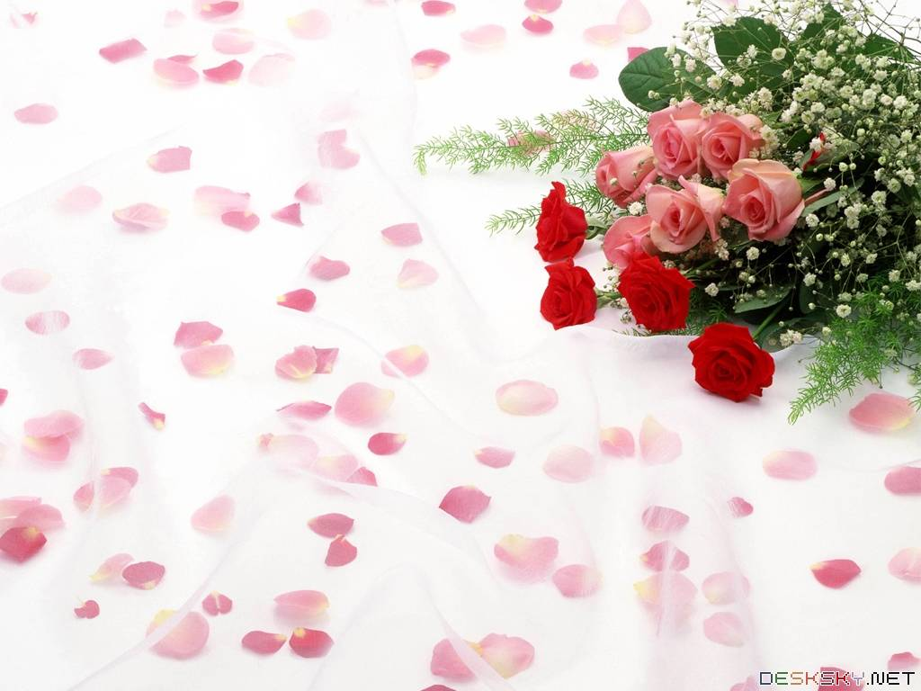
Warmly welcome to our class
English 6 A
Song Ve Lower Secondary School

Slide 2
ENGLISH 6
UNIT 6: OUR TET HOLIDAY
LESSON 3

Slide 3
Warm up:
Game: Pelmanism
1
3
fireworks
Lucky
money
special
food
visit
relatives
2
4
5
6
Tiền lì xì
new
clothes
decorate houses
Pháo hoa
7
8
Món ăn ngon
10
9
Trang trí nhà
Thăm họ hàng
11
Quần áo mới
12

Slide 4
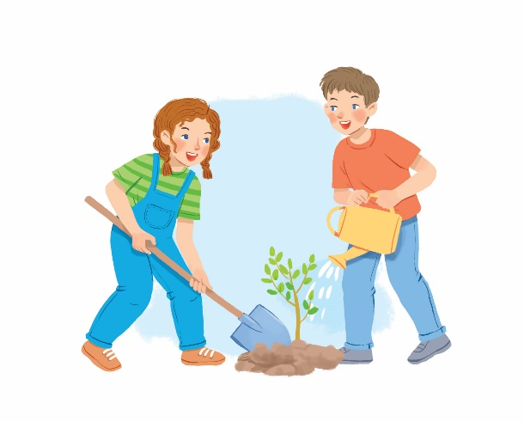
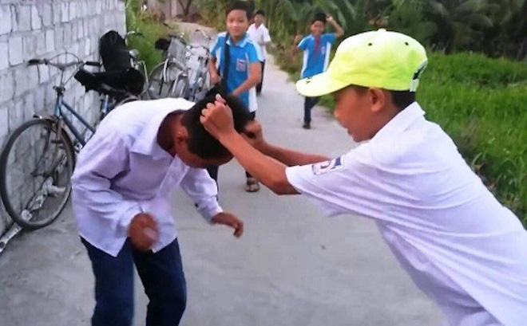
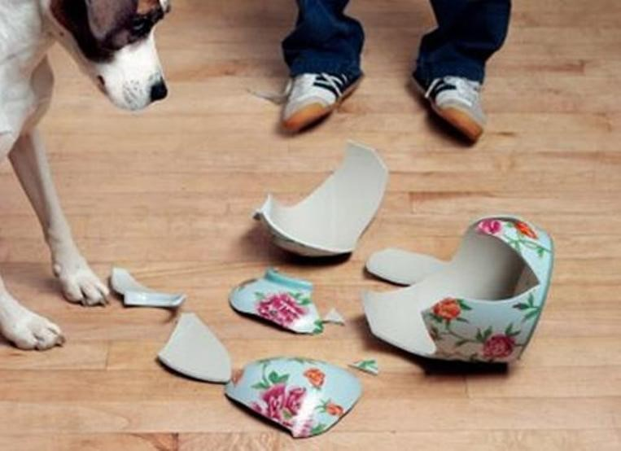
* Vocabulary:
- behave (v):
cư xử, đối xử
- plant (v):
Trồng ( cây)
- fight (v):
đánh nhau
- break (v):
Làm bể, vỡ

Slide 5
* Checking Vocab:
- behave (v):
cư xử, đối xử
- plant (v):
Trồng ( cây)
- fight (v):
đánh nhau
- break (v):
Làm bể, vỡ

Slide 6
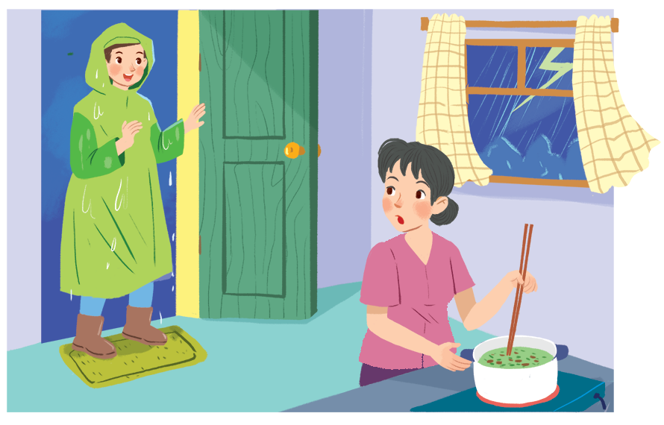
* Grammar 1
Should / shouldn’t for advice
Nam, you shouldn't come in with your raincoat on.

Slide 7
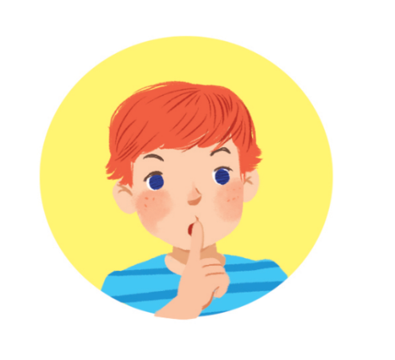
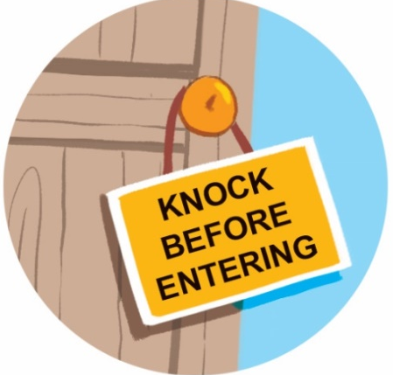
Look at the signs at the library and complete the sentences with should or shouldn’t.
should
1. You. .……….keep quiet.
2. You …………..eat or drink.
shouldn’t
should
shouldn’t
3. You…..………. knock before you enter.
4. You……………....run

Slide 8
* Grammar
When do you use should /shouldn’t?
Should / shouldn’t for advice
- should : nên, - shouldn’t : không nên
* Form : S + should(n’t) + bare-inf..
We use should for things that are good to do.
We use shouldn’t for things that are not good to do.

Slide 9
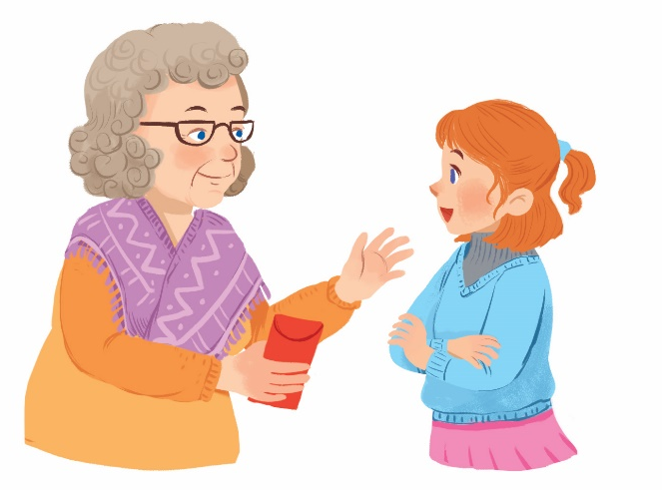
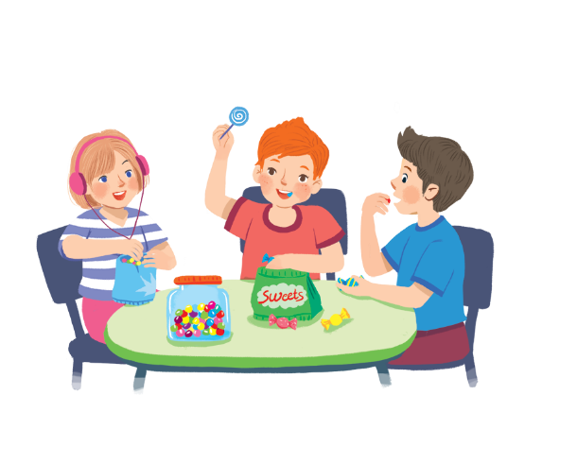
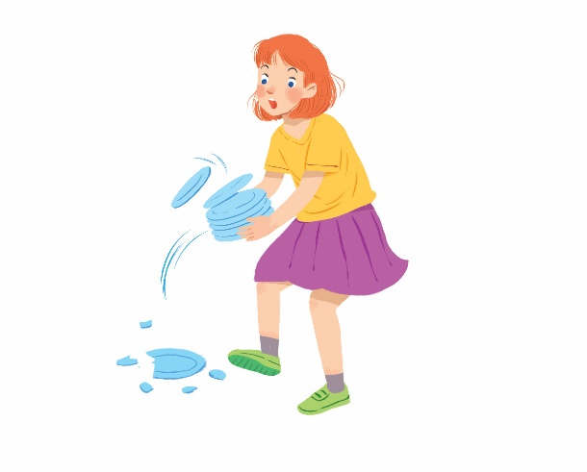
Tick () the activities children should do at Tet and cross (×) the ones they shouldn’t.
Thank you.


1.
behave well
2.
eat lots of sweets


3.
plant trees
4.
break things

Slide 10
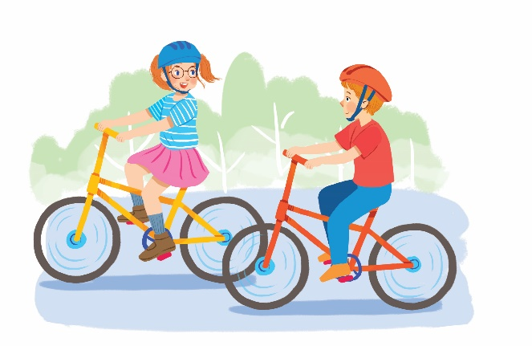
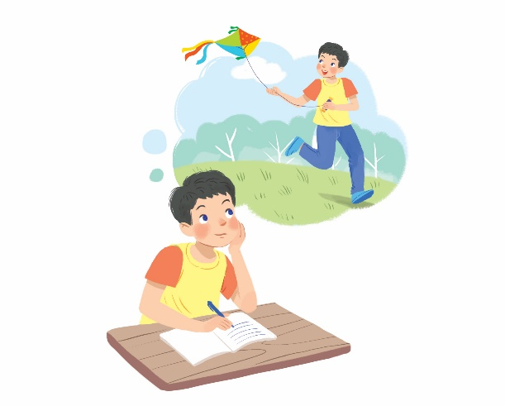
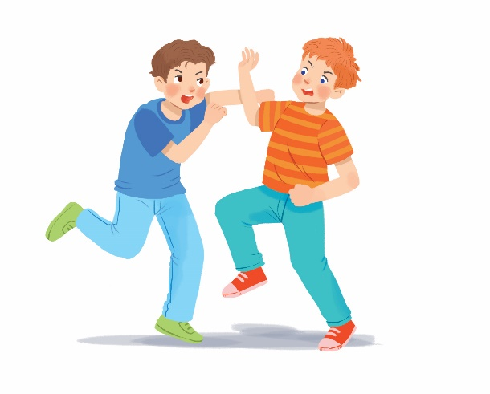
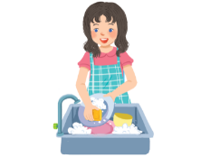
Tick () the activities children should do at Tet and cross (×) the ones they shouldn’t.


5.
go out with friends
6.
make a wish


7.
fight
8.
help with housework

Slide 11
Work in pairs. Look at the activities in 2. Take turns to say what you think children should / shouldn’t do.
Example:
Children should behave well.
Children shouldn’t eat lots of sweets.
Thank you.
1.
behave well
2.
eat lots of sweets

Slide 12
Questions: Lucky numbers
1
2
3
4
Team A
5
6
7
8
Team B
2
4
2
8
4
10
8
6
6
10

Slide 13
3. Children should plant trees

Slide 14
4. Children shouldn’t break thing

Slide 15
5.
Children should go out with friends

Slide 16
6. Children should make a wish.

Slide 17
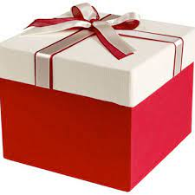
LUCKY NUMBER!

Slide 18
7.
Children shouldn’t fight

Slide 19
8.
Children should help with housework

Slide 20
LUCKY NUMBER!

Slide 21
* Grammar 2.
Some / any for amount
- Some / any: một vài, một ít
Some
any
(+) My mother bought some fruits.
(+) I need some milk for the cake.
(-) I can’t answer any questions.
(?) Do you have any sugar?
Note:
- Some : Dùng trong câu khẳng định.
- Any : Dùng trong câu phủ định và câu hỏi.
* Ngoại lệ câu mời : Would you like some tea?

Slide 22
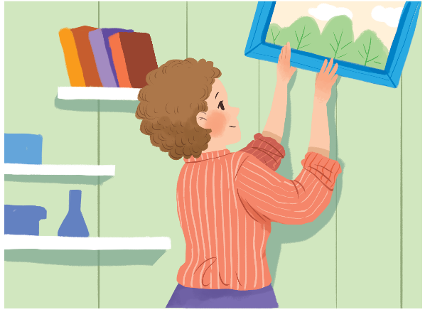
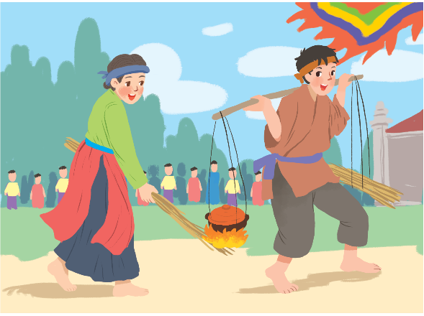
Complete the sentences with some or any.
1.
What do you need to decorate your room?
I need colour paper and pictures.
some
some
any
2.
Do you have free time for spotrs?
Yes, I do.
Are there interesting activities here during Tet?
Yes, there are traditional games like human chess, running and cooking.
3.
any
some

Slide 23
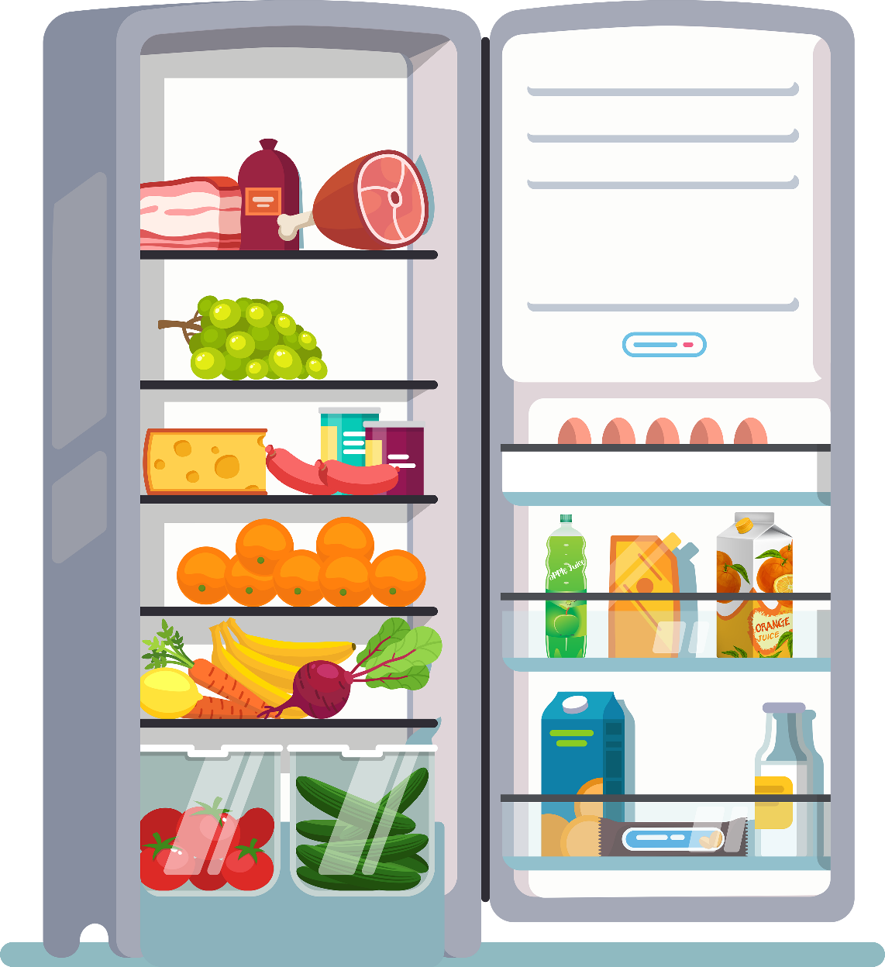
Work in pairs. Look at the fridge. Make sentences with the words / phrases provided, using some or any.
Example:
- ice cream
There is not any ice cream.
- cucumbers
There are some cucumbers.

Slide 24
1.
eggs
There are some eggs (in the fridge).
2.
fruit juice
There is some fruit juice.
3.
apples
There aren’t any apples.
4.
bread
There isn’t any bread.
5.
bananas
There are some bananas.
6.
cheese
There is some cheese.

Slide 25
* PRODUCTION
* Rewrite the following sentences without changing their original meanings.
1. It’s good if children go to bed early.
→ Children should……………………………………………………. .
2. It’s not a good idea when students copy other students’ work.
→ Students shouldn’t ………………………………………………………...
3. I’m not happy when children lie to their parents.
→ Children shouldn’t………………………………………………………..
4. It’s good if you say “Thank you” to a person who has helped you.
→ You should ………………………………………………………………
5. There is no water in the bottle.
→ There is not …………………………………………………………...
6. We have no peach flowers for the New Year here. any water in the bottle
→ We don’t…………………………………….
go to bed early.
copy other students’ work.
lie to their parents.
say “Thank you” to a person who has helped you
any water in the bottle.
have any peach flowers for the New Year here.

Slide 26
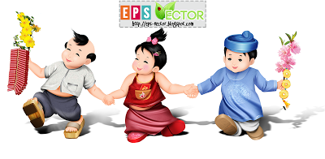
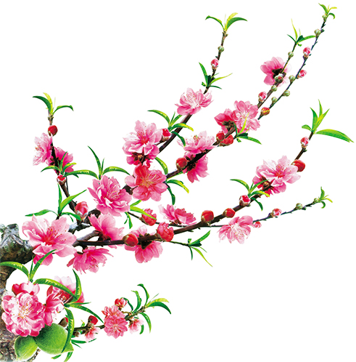
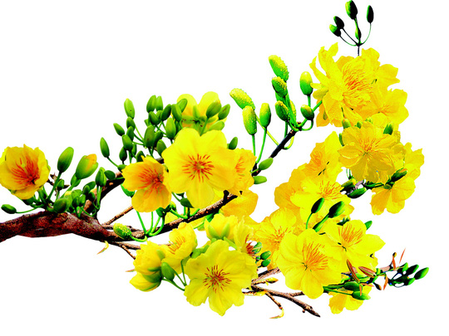
Homework
Learn by heart all new words.
Do exercises on workbook.
Prepare Communication.

Slide 27
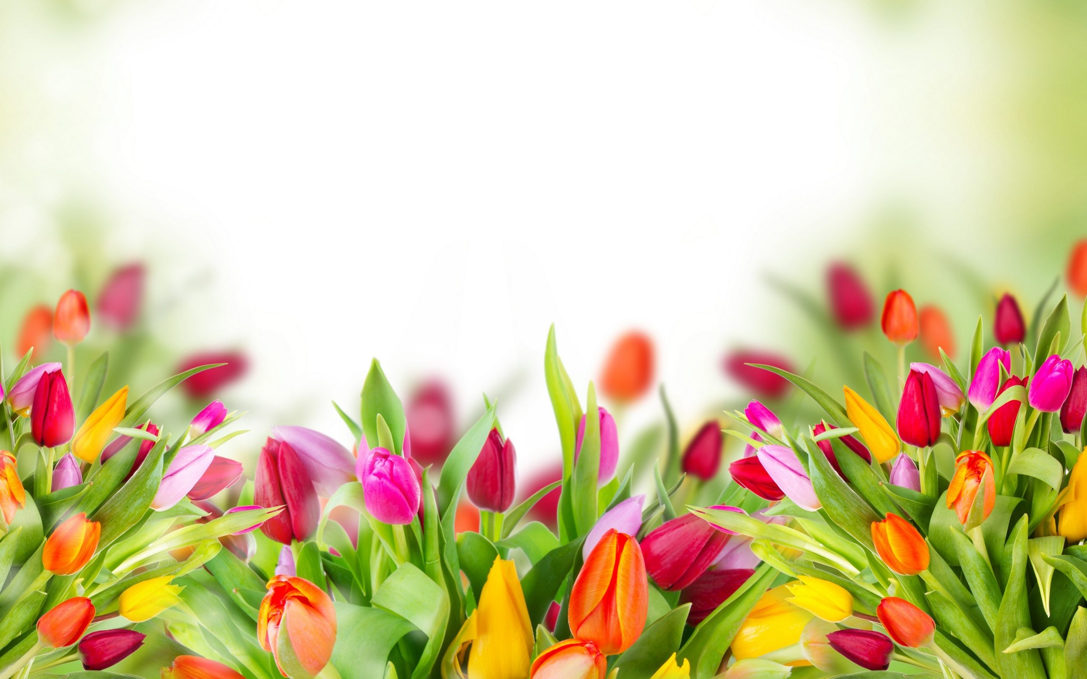
Thank you!
Have a nice day!

