Slide 1
Good morning class !!!

Slide 2
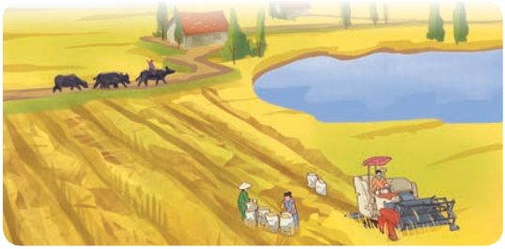
WARM-UP
1
Work in pairs. Look at the picture and discuss the following questions.
1. What can you see in it?
2. Which of the following adjectives describe the picture?

Slide 3
WARM-UP
1
Work in pairs. Look at the picture and discuss the following questions.
1. paddy fields, cattle (buffaloes), farmers, a combine harvester, a lake / pond, trees, houses, etc.
2. peaceful,vast, picturesque
In the picture, I can see a peaceful village with a vast field.
- I can see boy herding buffalos and many people harvesting rice...

Slide 4
Unit
2
LIFE IN THE COUNTRYSIDE
LESSON 5: SKILLS 1

Slide 5
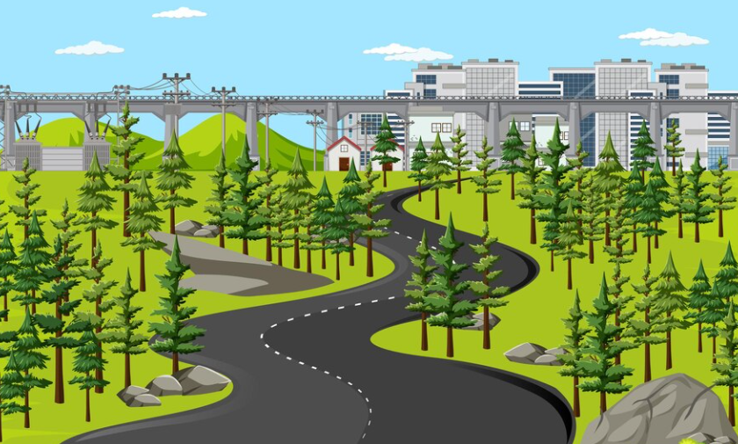
* Vocabulary
stretch (v)
/stretʃ/
trải dài

Slide 6
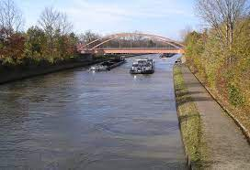
canal (n)
/kəˈnæl/
kênh đào

Slide 7
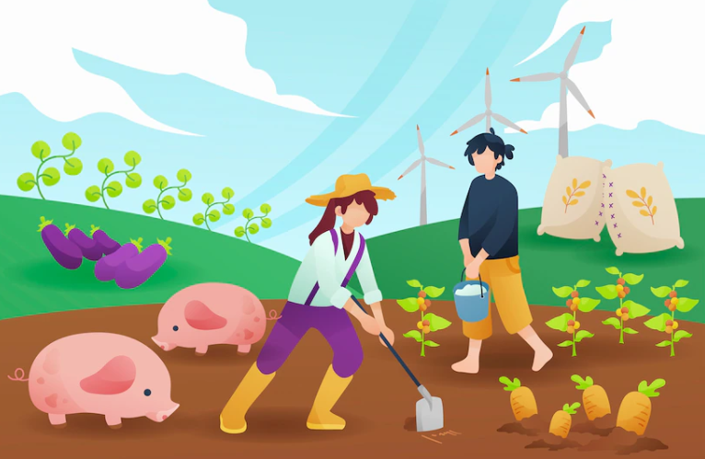
cultivate (v)
/ˈkʌltɪveɪt/
canh tác

Slide 8
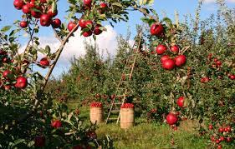
READING
orchard (n)
/ˈɔːtʃəd/
vườn cây ăn quả

Slide 9
* Vocabulary
New words | Pronunciation | Vietnamese equivalent
1. stretch (v) | /stretʃ/ | trải dài
2. canal (n) | /kəˈnæl/ | kênh đào
3. cultivate (v) | /ˈkʌltɪveɪt/ | canh tác
4. orchard (n) | /ˈɔːtʃəd/ | vườn cây ăn quả

Slide 10
I. READING
2
Read the text about life in a village in Viet Nam. Match the highlighted words in the text with their meanings

Slide 11
I. READING
2
Read the text about life in a village in Viet Nam. Match the highlighted words in the text with their meanings
I feel fortunate that I am living in a peaceful village in southern Viet Nam. The scenery here is beautiful and picturesque with vast fields stretching long distances. The houses are surrounded by green trees. There are lakes, ponds, and canals here and there. The air is fresh and cool. Life here seems to move more slowly than in cities. The people work very hard. They grow vegetables, cultivate rice, and raise cattle. At harvest time, they use combine harvesters to harvest their crops. Many families live by growing fruit trees in the orchards. Others live by fishing in lakes, ponds, and canals. Life in the village is very comfortable for children. They play traditional games. Sometimes they help their parents pick fruit and herd cattle. People in my village know each other well. They are friendly and hospitable. They often meet each other in the evening, eating fruit, playing chess, singing folk songs, and chatting about everyday activities.

Slide 12
I. READING
2
Read the text about life in a village in Viet Nam. Match the highlighted words in the text with their meanings
I feel fortunate that I am living in a peaceful village in southern Viet Nam. The scenery here is beautiful and picturesque with vast fields stretching long distances. The houses are surrounded by green trees. There are lakes, ponds, and canals here and there. The air is fresh and cool. Life here seems to move more slowly than in cities. The people work very hard. They grow vegetables, cultivate rice, and raise cattle. At harvest time, they use combine harvesters to harvest their crops. Many families live by growing fruit trees in the orchards. Others live by fishing in lakes, ponds, and canals. Life in the village is very comfortable for children. They play traditional games. Sometimes they help their parents pick fruit and herd cattle. People in my village know each other well. They are friendly and hospitable. They often meet each other in the evening, eating fruit, playing chess, singing folk songs, and chatting about everyday activities.

Slide 13
3
Read the text again and tick T (True) or F (False) for each sentence.
 | T | F
1. Life in the author’s village is very peaceful.
2. The people in the village work very hard.
3. Villagers live only by catching fish in lakes, ponds, and canals.
4. The children are always busy helping their parents.
5. The villagers get along well.

Slide 14
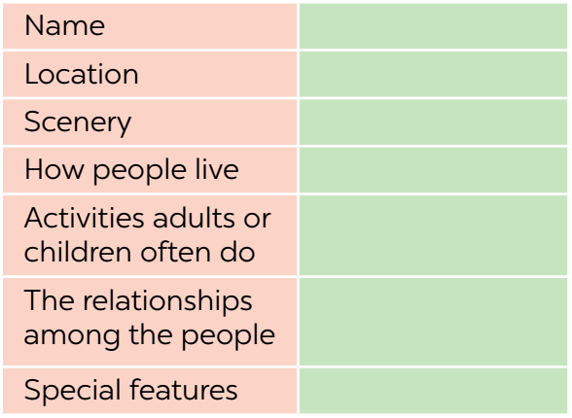
II. SPEAKING
4
Make notes about the village or town where you live or which you know.

Slide 15
II. SPEAKING
4
Make notes about the village or town where you live or which you know.
Location | Quang Ngai city
Scenery | pagodas,.....
How people live | People go to work every day
Activities adult or children often do | Children go to school and help parents after class. Adults go to work in their company or they work in the field,.....
The relationships among the people | People get along well
Special features | peaceful

Slide 16
5
Work in groups. Take turns to talk about the village or town where you live or which you know. Use the information in 4.
Example:
I live in Duong Lam. It’s an old village outside Hanoi. It has ...
I want to talk about my city. That is Quang Ngai city. Quang Ngai is famous for many beautiful landscapes like My Khe Beach, Ly Son Island, Thien An Temple, White Waterfall Minh Long, Sa Huynh Beach, Ca Dam Mountain. People here make a living by different jobs. They go to work at factory, company or work in the field. Children go to school and help their parents after classes. People here get on well together. They are friendly and hospitable. They often meet each other in the evening, eating fruit, playing chess, and chatting about everyday activities.

Slide 17
* CONSOLIDATION
What have we learnt in this lesson?
read about different aspects of a Vietnamese village;
talk about a village or town where one lives or which one knows;

Slide 18
Homework
Do exercises in the workbook.
Prepair lesson 6: Skills 2

Slide 19
Goodbye.
See you again

Slide 20
Website: hoclieu.vn
Fanpage: facebook.com/www.tienganhglobalsuccess.vn/

