Slide 1
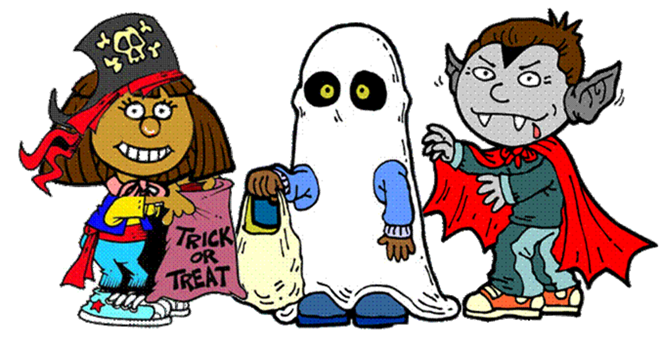
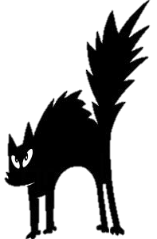
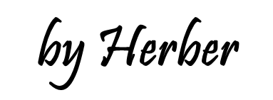

Slide 2
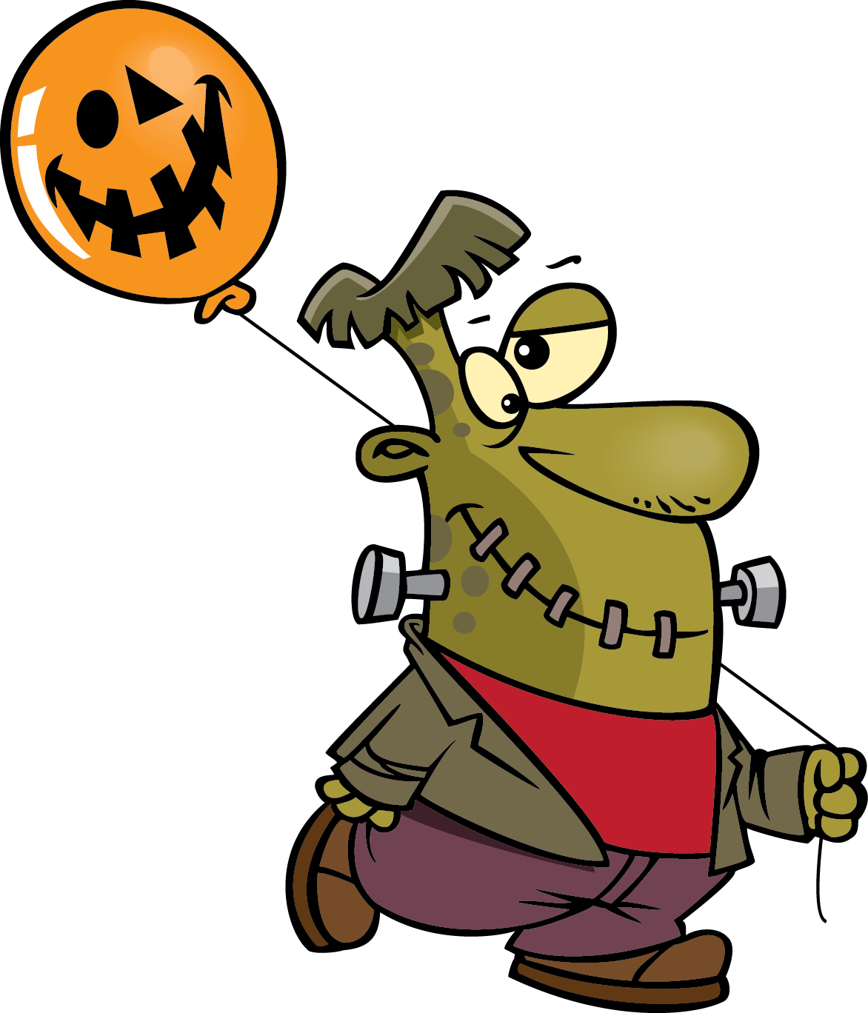
Collect the candy by clicking the word corresponding to the picture.

Slide 3
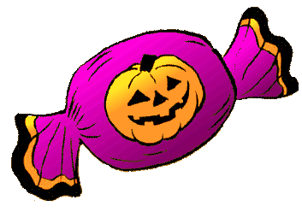
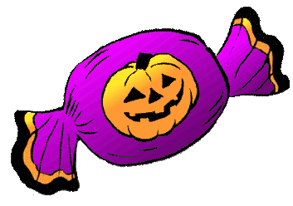
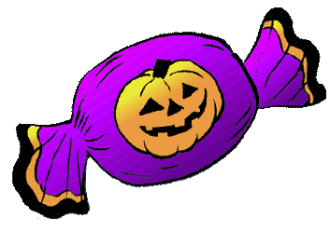
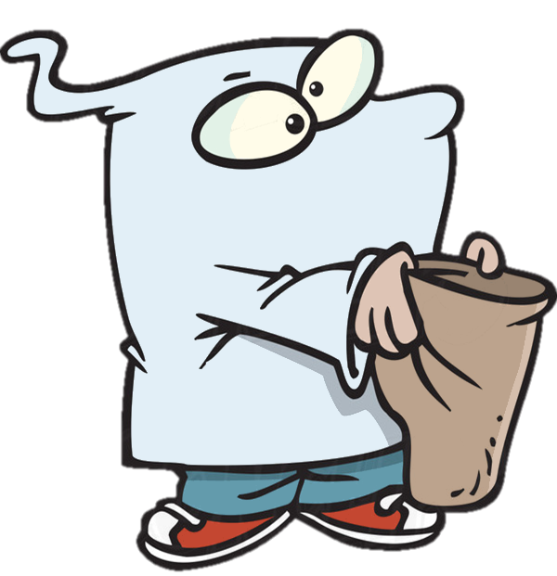
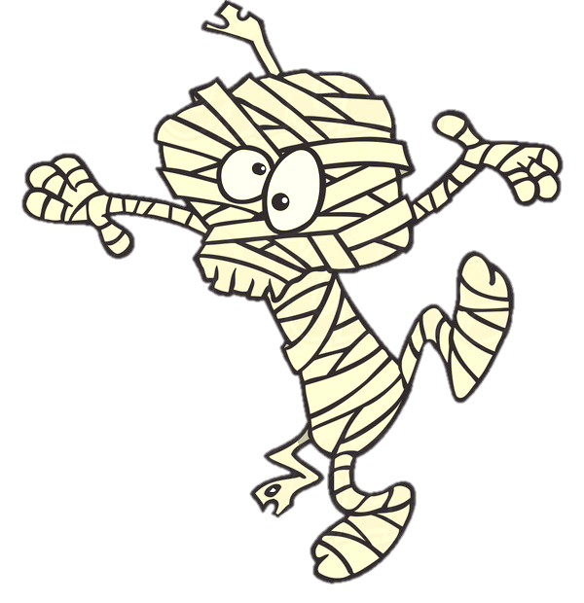
This is a …
ghost
zombie
mummy
Yes, it’s a mummy! Xác ướp
NEXT

Slide 4
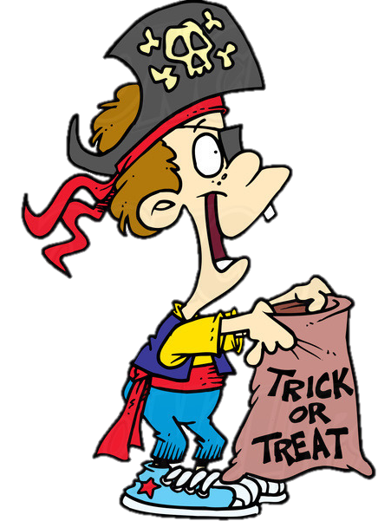
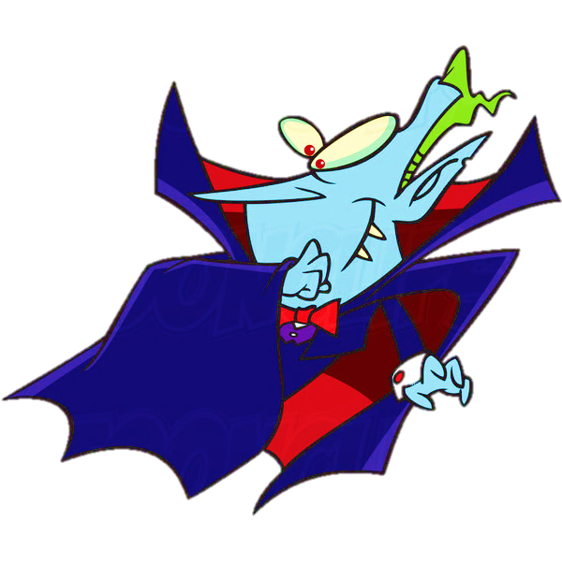
This is a …
vampire
zombie
ghost
Yes, it’s a vampire!
Ma cà rồng
NEXT

Slide 5
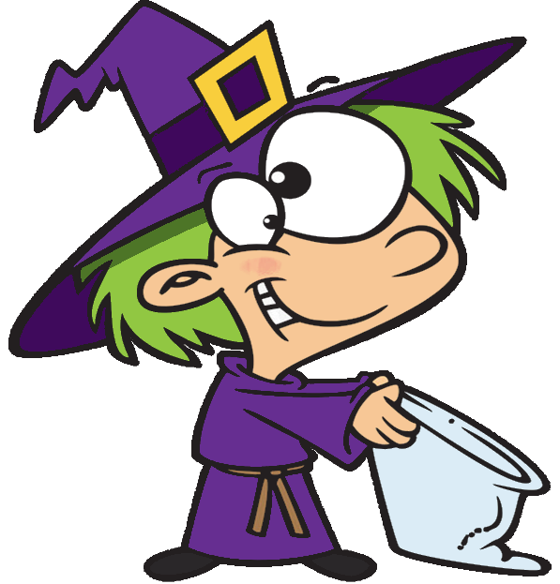
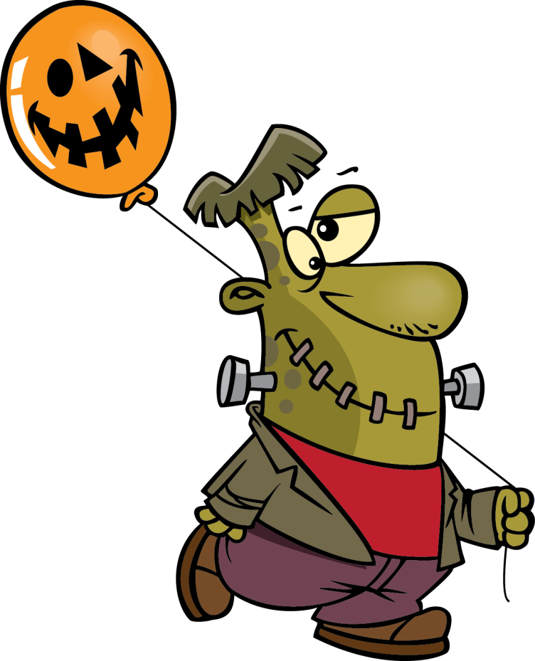
This is a …
ghost
monster
zombie
Yes, it’s a monster!
Quái vật
NEXT

Slide 6
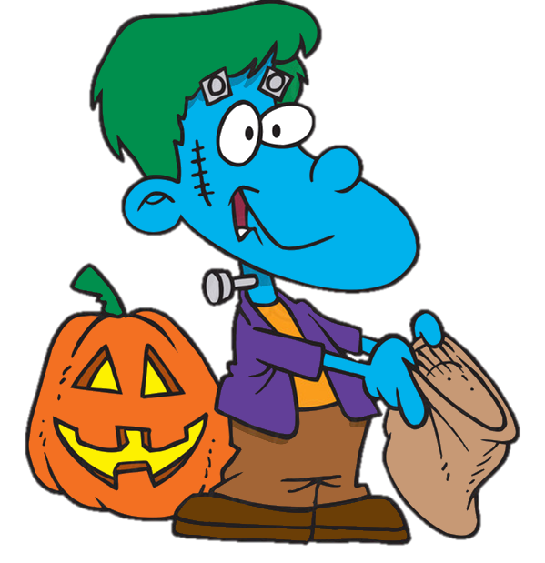
This is a …
witch
zombie
ghost
Yes, it’s a ghost!
Ma
NEXT

Slide 7
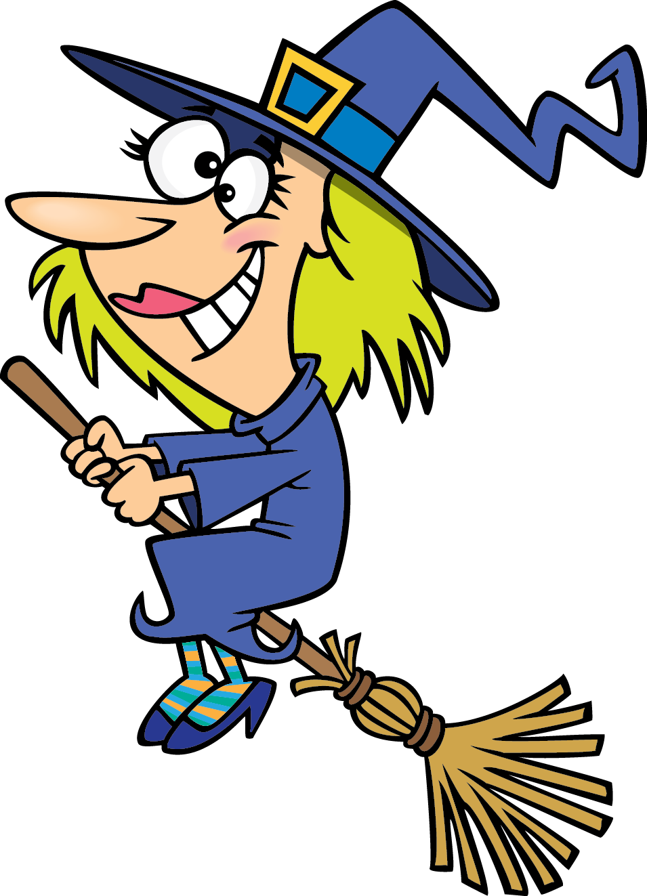
This is a …
skeleton
zombie
witch
Yes, it’s a witch!
Phù thuỷ
NEXT

Slide 8
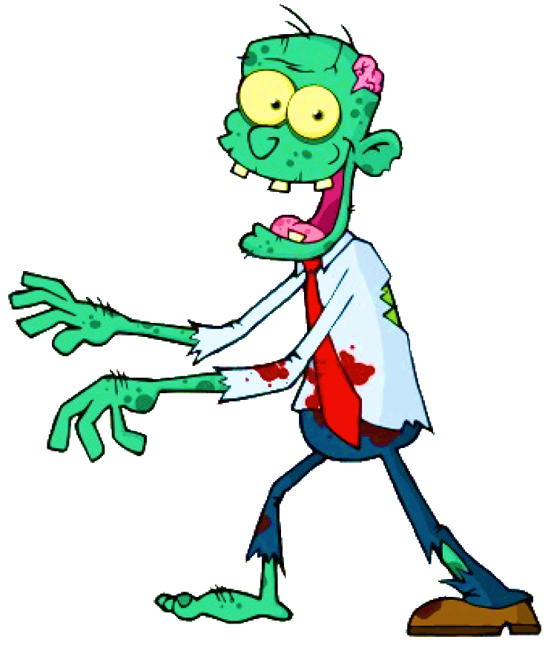
This is a …
skeleton
zombie
werewolf
Yes, it’s a zombie!
Thây ma
NEXT

Slide 9
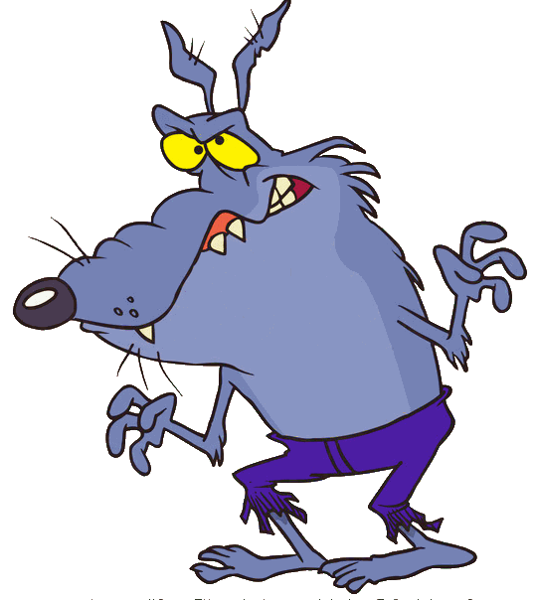
This is a …
skeleton
werewolf
Jack-o-lantern
Yes, it’s a werewolf!
Người sói
NEXT

Slide 10
This is a …
skeleton
bat
Jack-o-lantern
Yes, it’s a
jack-o-lantern!
Đèn bí ngô
NEXT

Slide 11
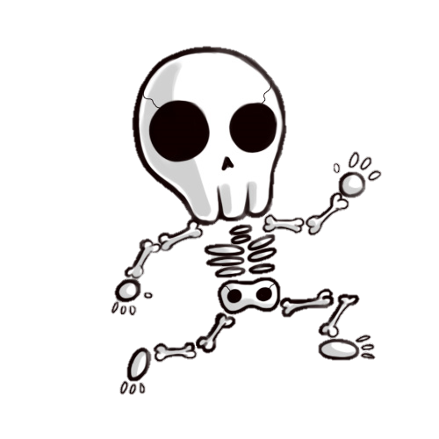
This is a …
bat
devil
skeleton
Yes, it’s a skeleton!
Bộ xương
NEXT

Slide 12
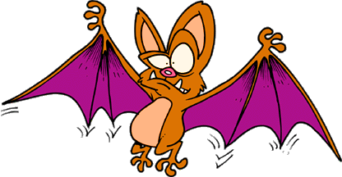
This is a …
skeleton
devil
bat
Yes, it’s a bat!
Con rơi
NEXT

Slide 13
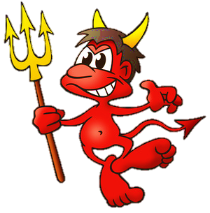
This is a …
monster
devil
vampire
Yes, it’s a devil
Quỷ dữ
NEXT

Slide 14
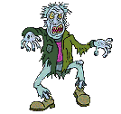
GOOD JOB!
THANK YOU!
EXIT

