Slide 1








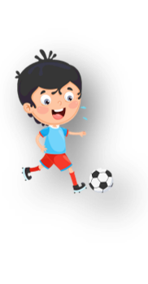












Unit 1
My family
Lesson 3 – Task 1,2,3
Notes:
Để nguyên trang bìa như này, chỉ thay đổi tên bài trong quá trình làm. Logo của sách Wonderful World

Slide 2




Slide 3





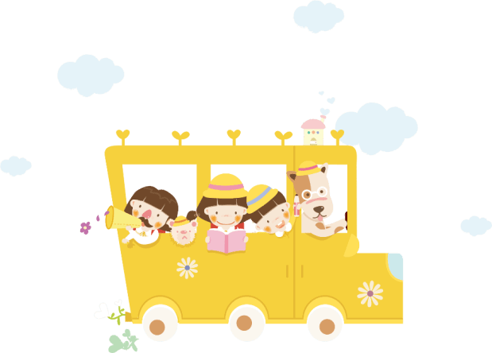
Warm up
Game: Silent ball

Slide 4







Notes:
Movement Game: “Silent ball”
While the music plays, students pass the ball around the class. When the music stops, the student with the ball has to choose a pair of cards to play matching game (review family words).
-Let the sts in take turn to choose the numbers to find the 2 matched pictures and words.

Slide 5
GAME:
MATCHING
Match the picture with its word.
Notes:
-Divide class into 2 teams- Boys and girls
-Let the sts in each team take turn to choose the numbers to find the 2 matches picture and word

Slide 6

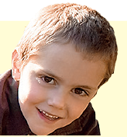
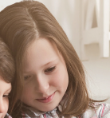




1
2
3
mum
4
5
6
dad
7
8
9
sister
grandpa
10
11
12
grandma
brother

Slide 7

Presentation
Task 1: Listen and point. Repeat

Slide 8
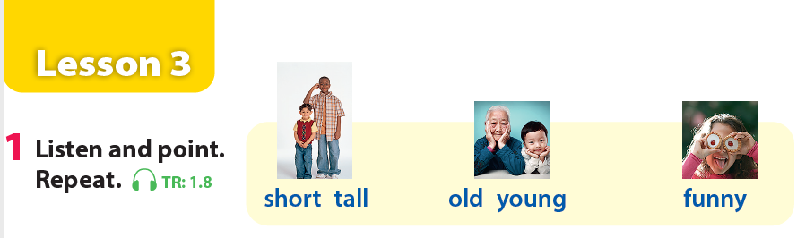

Notes:
GV click phần Audio sau đó nghe tới đâu từ nào thì click vào ảnh từ đó.
Let the sts listen and point
Then repeat

Slide 9
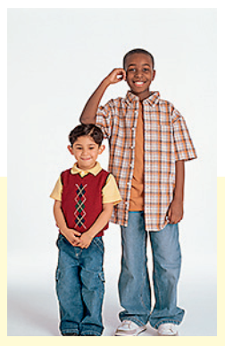
short-tall
Notes:
Let the sts look at the picture and repeat

Slide 10
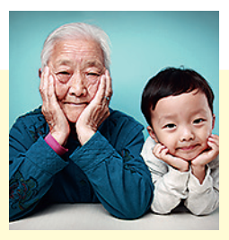
old-young
Notes:
Let the sts look at the picture and repeat

Slide 11
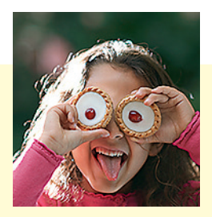
funny
Notes:
Let the sts look at the picture and repeat

Slide 12

Practice
Task 2: Listen and tick

Slide 13
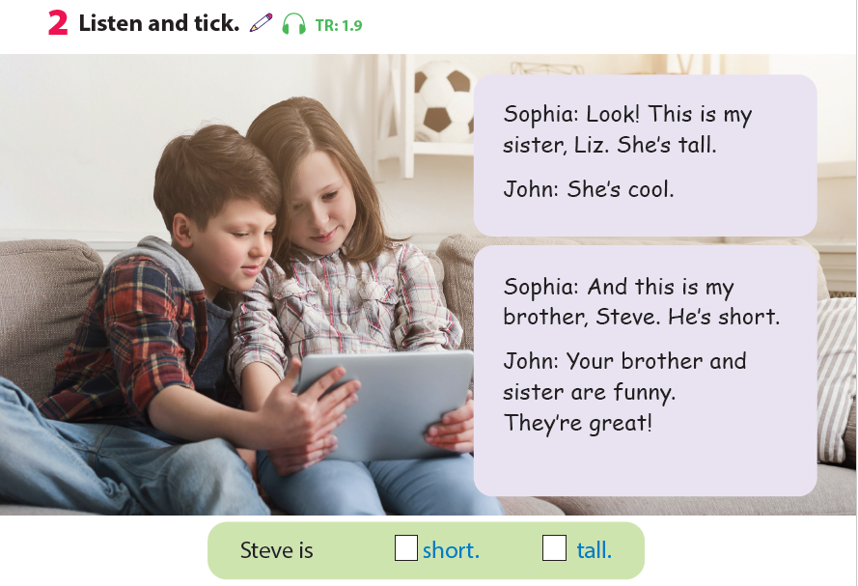

Notes:
Ask the sts some questions about the picture:
-Who are they?
-Where are they? At home or at school.?
-What are they doing?
Let the sts listen for the first time. Then ask them “ Is Steve short or tall? Then Click the answer.

Slide 14
Game: Listen and tick

Slide 15



Listen and tick the box
✓
A
B
C
Notes:
Divide the class into groups of 4 (each group has 4 sts).
Give cards with letter A,B,C for the groups.
Sts listen and choose the correct answer (A,B,C). Who can make it will get points.

Slide 16

Listen and tick the box
✓
A
B
C
Notes:
Divide the class into groups of 4 (each group has 4 sts).
Give cards with letter A,B,C for the groups.
Sts listen and choose the correct answer (A,B,C). Who can make it will get points.

Slide 17

Listen and tick the box
✓
A
B
C
Notes:
Divide the class into groups of 4 (each group has 4 sts).
Give cards with letter A,B,C for the groups.
Sts listen and choose the correct answer (A,B,C). Who can make it will get points.

Slide 18
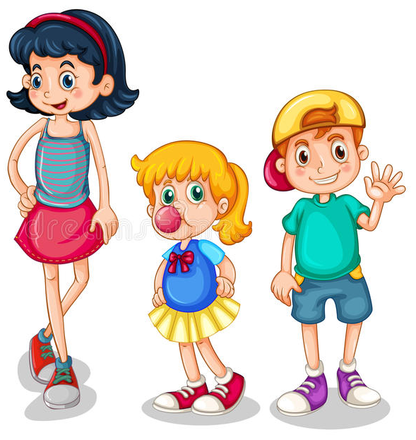
Listen and tick the box
✓
A
C
B
Notes:
Divide the class into groups of 4 (each group has 4 sts).
Give cards with letter A,B,C for the groups.
Sts listen and choose the correct answer (A,B,C). Who can make it will get points.

Slide 19
Listen and tick the box
✓
A
C
B
Notes:
Divide the class into groups of 4 (each group has 4 sts).
Give cards with letter A,B,C for the groups.
Sts listen and choose the correct answer (A,B,C). Who can make it will get points.

Slide 20
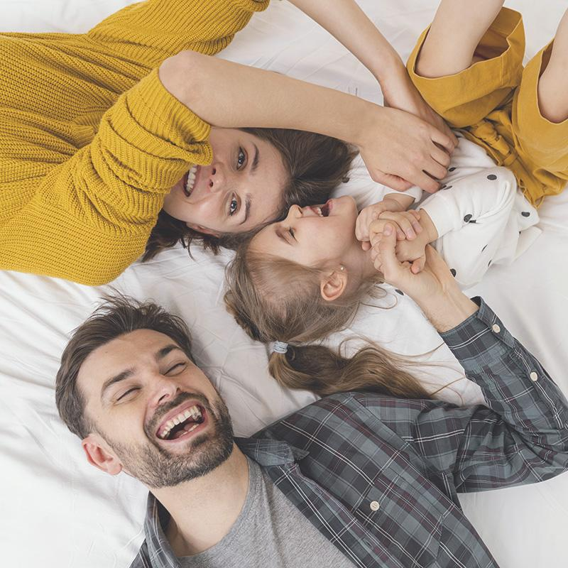
Practice
Task 3: Match and say

Slide 21
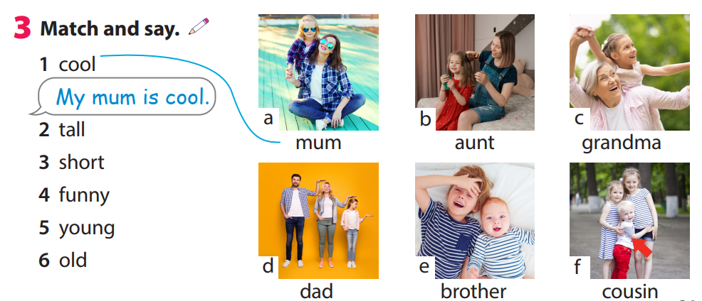
Notes:
Ask the sts to match the numbers with letters to talk about their family (choose freely)

Slide 22
Game time!
Choose and say.

Slide 23


d
b
f
a
c
e
Go
Notes:
This game can be played in groups/teams.
Each member of a group choose a letter talk about their family members.
Give points for the groups.

Slide 24
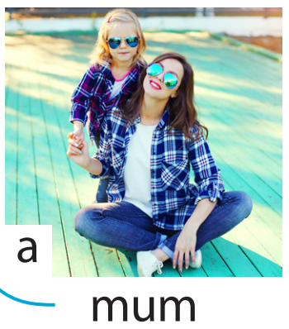
My mum is …..
tall/short/funny/great/cool/young/old
Well done!
Notes:
This game can be played in groups/teams.
Each member of a group choose a letter talk about their family members.
Give points for the groups.

Slide 25
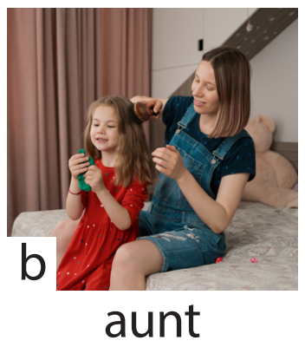
My aunt is …..
tall/short/funny/great/cool/young/old
Great job!
Notes:
This game can be played in groups/teams.
Each member of a group choose a letter talk about their family members.
Give points for the groups.

Slide 26
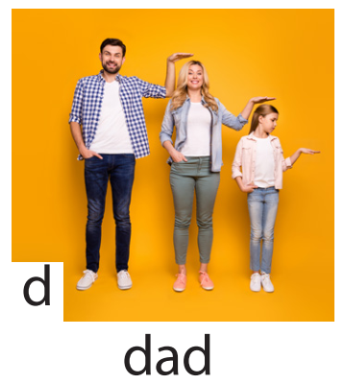
My dad is …..
tall/short/funny/great/cool/young/old
Amazing!
Notes:
This game can be played in groups/teams.
Each member of a group choose a letter talk about their family members.
Give points for the groups.

Slide 27
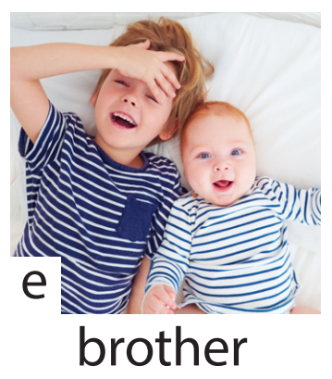
My brother is …..
tall/short/funny/great/cool/young/old
Good job!
Notes:
This game can be played in groups/teams.
Each member of a group choose a letter talk about their family members.
Give points for the groups.

Slide 28
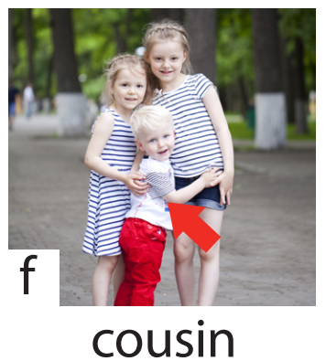
My cousin is …..
tall/short/funny/great/cool/young/old
Well done!
Notes:
This game can be played in groups/teams.
Each member of a group choose a letter talk about their family members.
Give points for the groups.

Slide 29

Production
Draw a picture and write a text about family

Slide 30
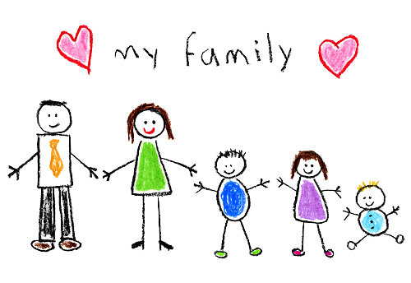
Example: This is my family. My mum is cool. My dad is tall. My sister is young. My baby brother is funny. I love my family.
Notes:
-Let the sts draw a picture of members in their family and write a text about them using adjectives. (read the example on the board)
-Call some sts to present their own work

Slide 31

Assessment

Slide 32
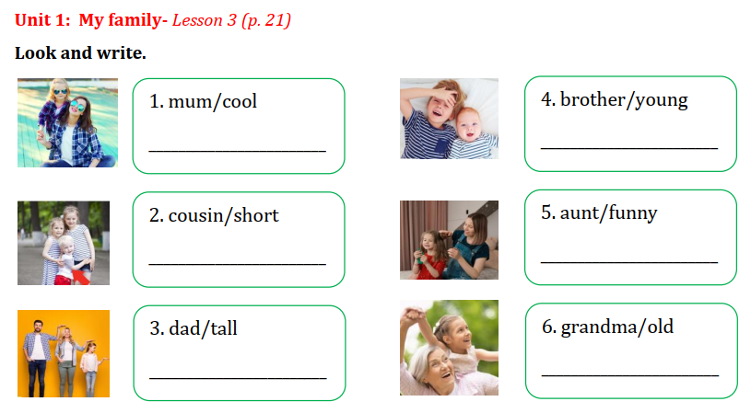
My mum is cool.
My brother is young.
My cousin is short.
My aunt is funny.
My dad is tall.
My grandma is old.
Notes:
THIẾT KẾ HOẠT ĐỘNG TƯƠNG TÁC CHO 6 CÂU NÀY. TRẢ LỜI TỰ LUẬN
Sts look at the picture and given words. Write the sentences on the board or on their notebooks.

Slide 33




Good bye.
See you again!

