Slide 1








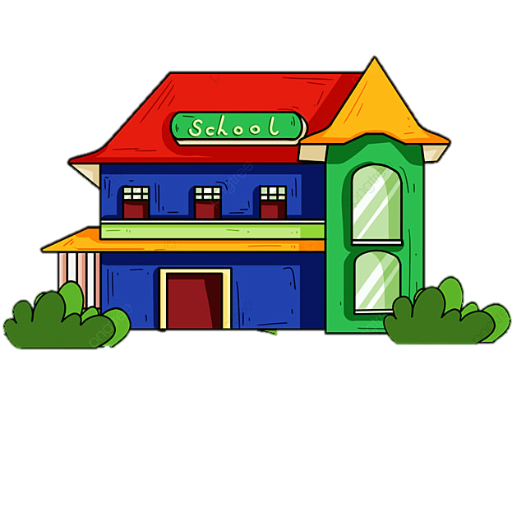
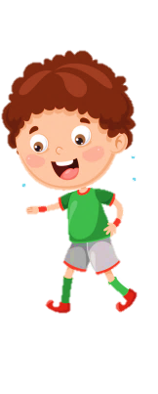
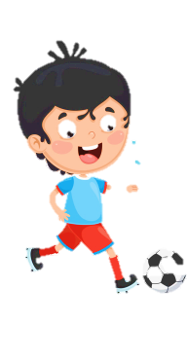












Slide 2

olmbrep
Ready?
GO!
STOP!
problem

Slide 3
piesrcat
Ready?
GO!
STOP!
practise

Slide 4
tnesfserictne
Ready?
GO!
STOP!
fitness centre

Slide 5
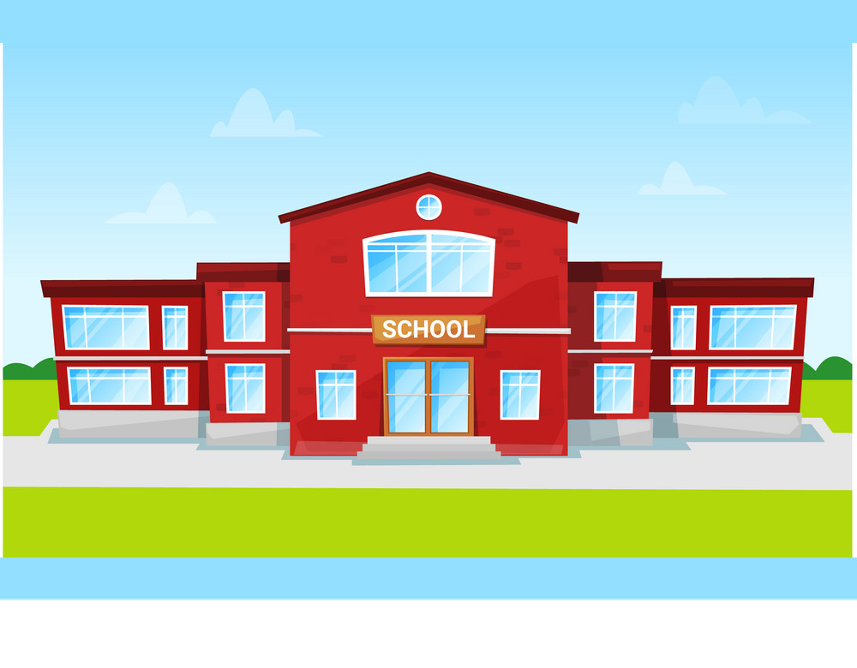
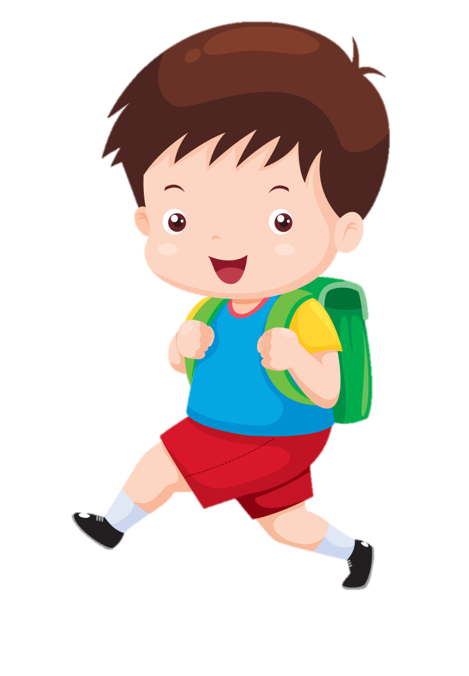
go to school
/gəʊ tuː skuːl/

Slide 6

do homework
/duː 'həʊmwɜːk/

Slide 7
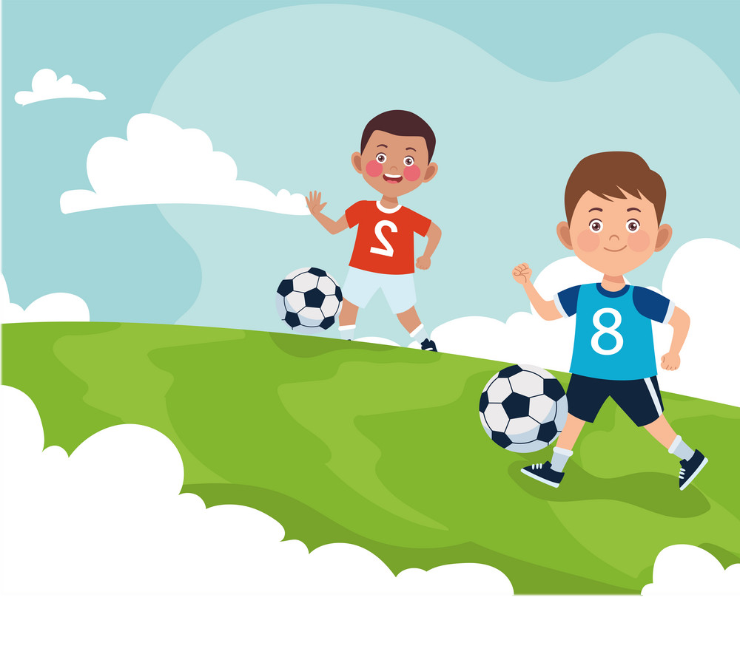
play football
/plei 'fʊtbɔːl/

Slide 8
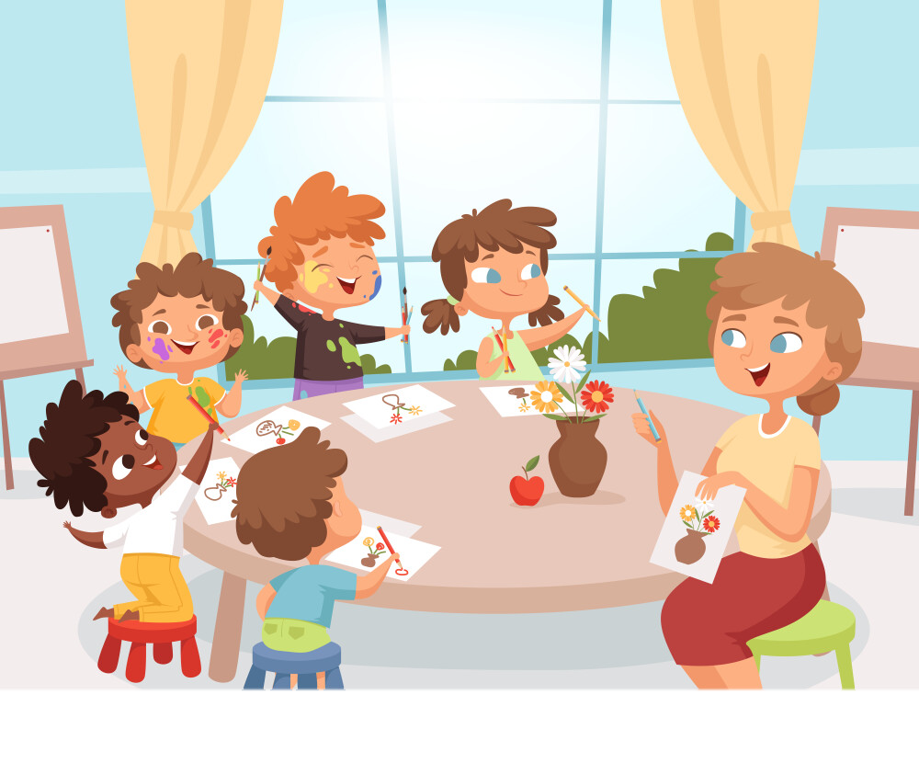
have art class
/hæv ɑːt klɑːs/

Slide 9


go to school
I +
play football
We +
They +
study English
You +
have art class
do homework

Slide 10

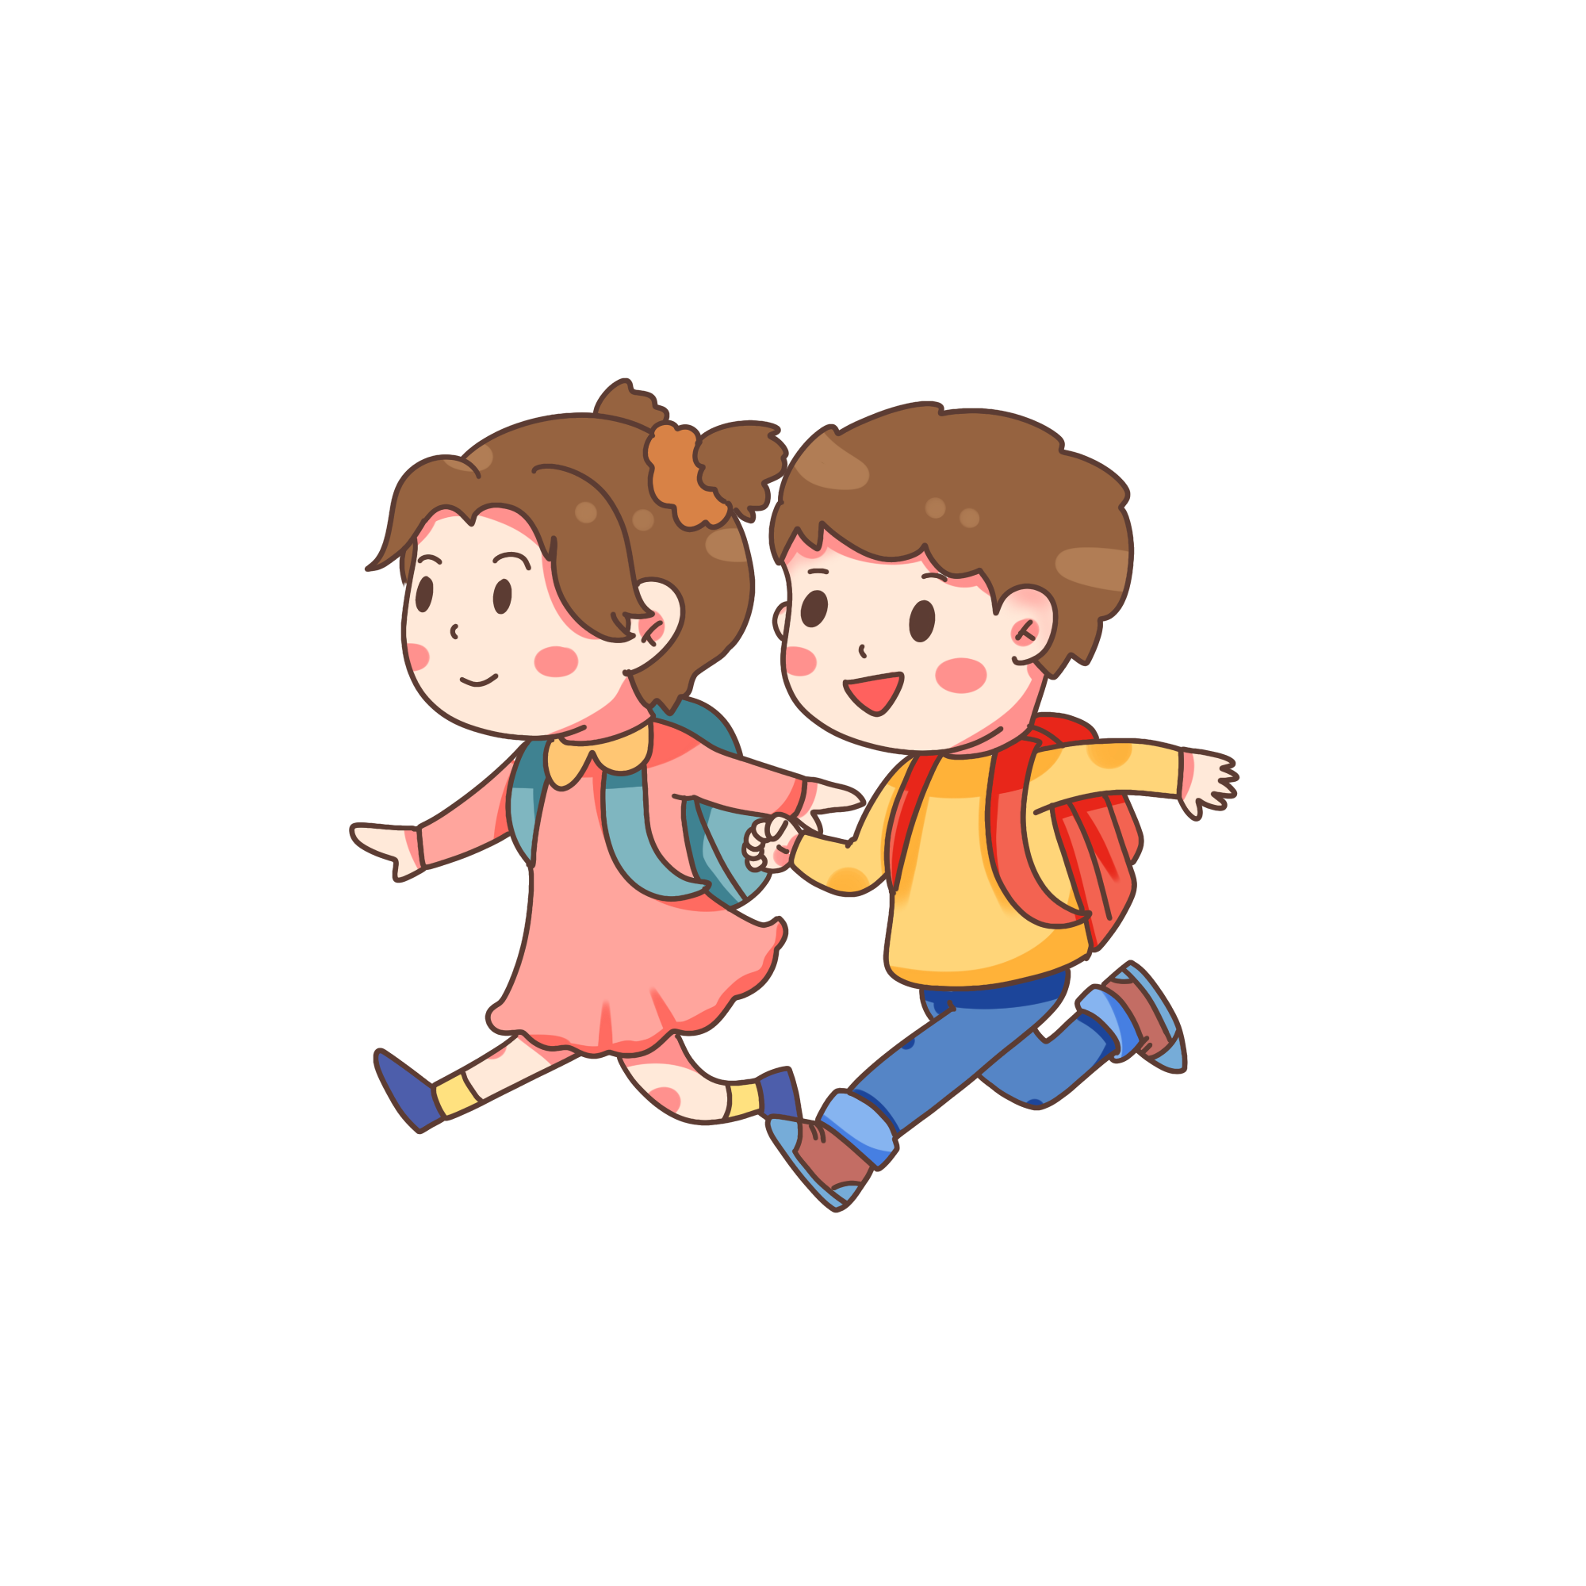
Present simple tense
We use the present simple to talk about:
- habits, things that we do regularly (daily routine)
Example: I go to school every day.
- facts, things that are always or usually true:
Example: The Earth goes around the sun.

Slide 11
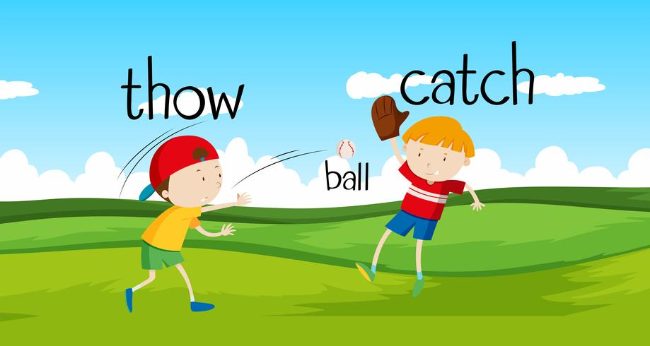
Throwing
and
catching
Game
Ss make a sentence with other phrasal verbs and throw the ball.
Whoever catches the ball must make a sentence throws the ball to other students who does the same.

Slide 12
goes to school
He +
plays football
She +
studies English
It +
has art class
does homework

Slide 13
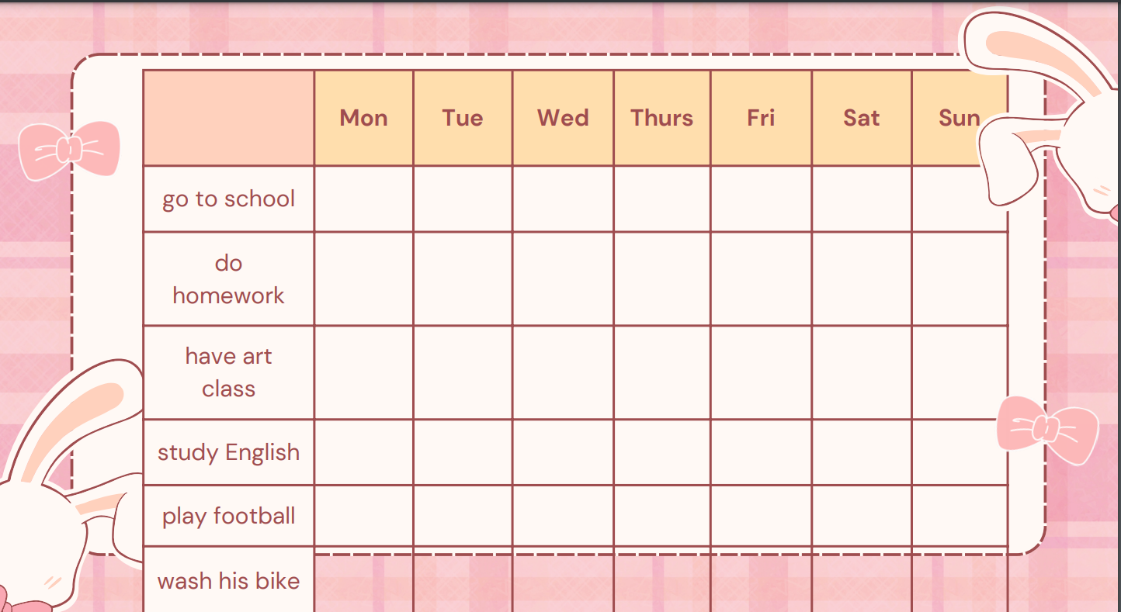


4 Listen and tick.

Slide 14
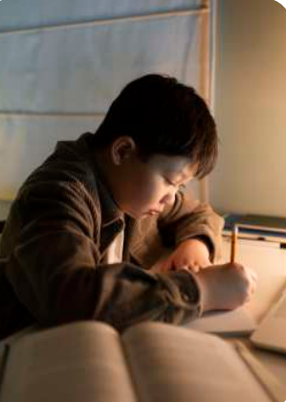
5 Use the given words to make meaningful sentences.
1 He / do his homework / the evening /.
_____________________________________
2 We / play football / the weekends /.
_____________________________________
3 My brother / practise sport / Sundays /.
_____________________________________
4 He / play football / Monday /.
_____________________________________
5 My brother / study maths / the afternoon /.
_____________________________________
6 Tom / have music class / Sunday /.
_____________________________________
He does his homework in the evening.
We play football at the weekends.
My brother practises sport on Sundays.
He plays football every Monday.
My brother studies maths in the afternoon.
Tom has a music class every Sunday.

Slide 15
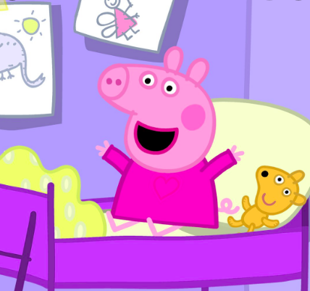
Peppa pig ____(get) up at 07:00.
A: get
B: gets

Slide 16
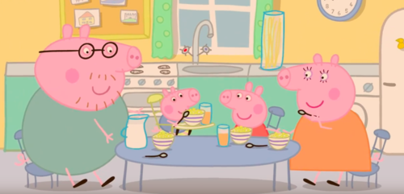
She____(eat) breakfast with her family at 07:30.
A: eats
B: eat

Slide 17
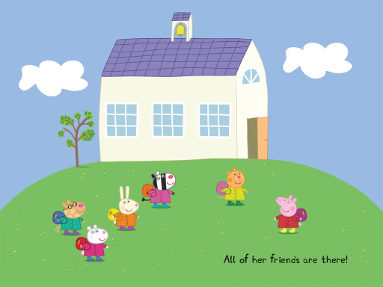
She ____(go) to school at 08:00.
A: goes
B: go

Slide 18
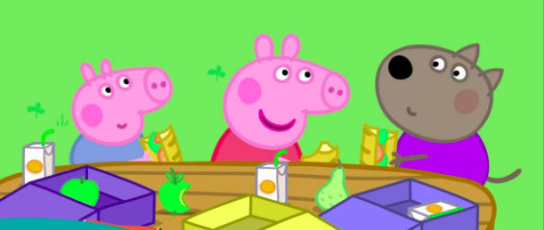
They____(eat) lunch at 12:00.
A: eats
B: eat

Slide 19
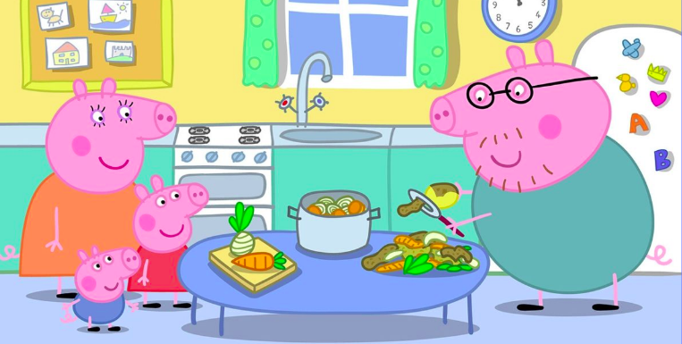
Daddy pig____(cook) dinner for
the family.
A: cook
B: cooks

Slide 20
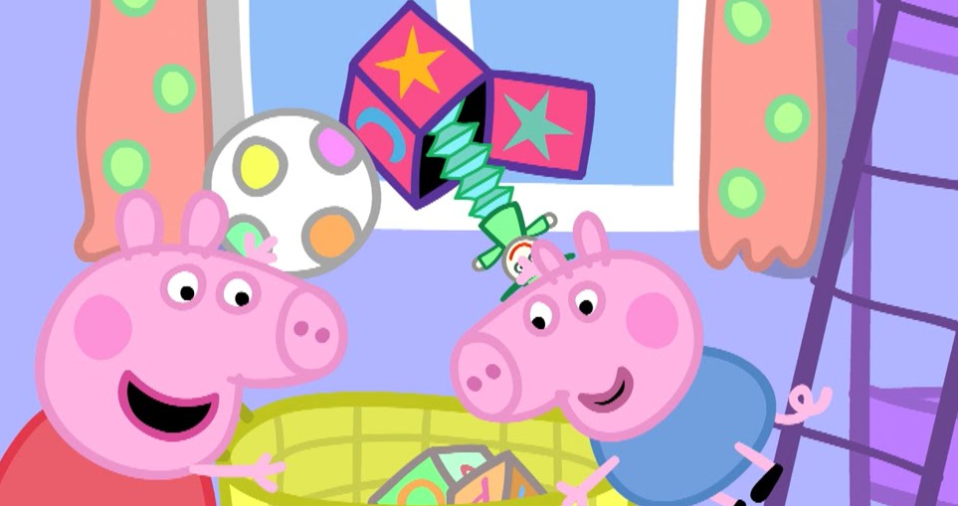
They____(pick up) their room.
A: pick up
B: picks up

Slide 21
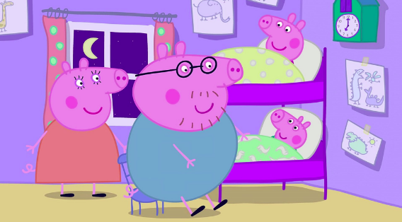
She____(go) to bed at 08:00.
A: goes
B: go

Slide 22

Unit 3: School life
Lesson 1 – Part 4,5,6
What have we learnt today?
Time expressions
Present simple (affirmative)
every day/week / month/year
once/twice/three times a week
in the morning/afternoon/ evening
on Monday/ Tuesday/Saturday
always/usually/often/sometimes/
never
I
You
We + V
They
He
She + Vs, es
It
Notes:
-Giáo viên yêu cầu học sinh nhắc lại nội dung bài học hôm nay. Sau đó, giáo viên mới hiển thị nội dung đã được học.

Slide 23

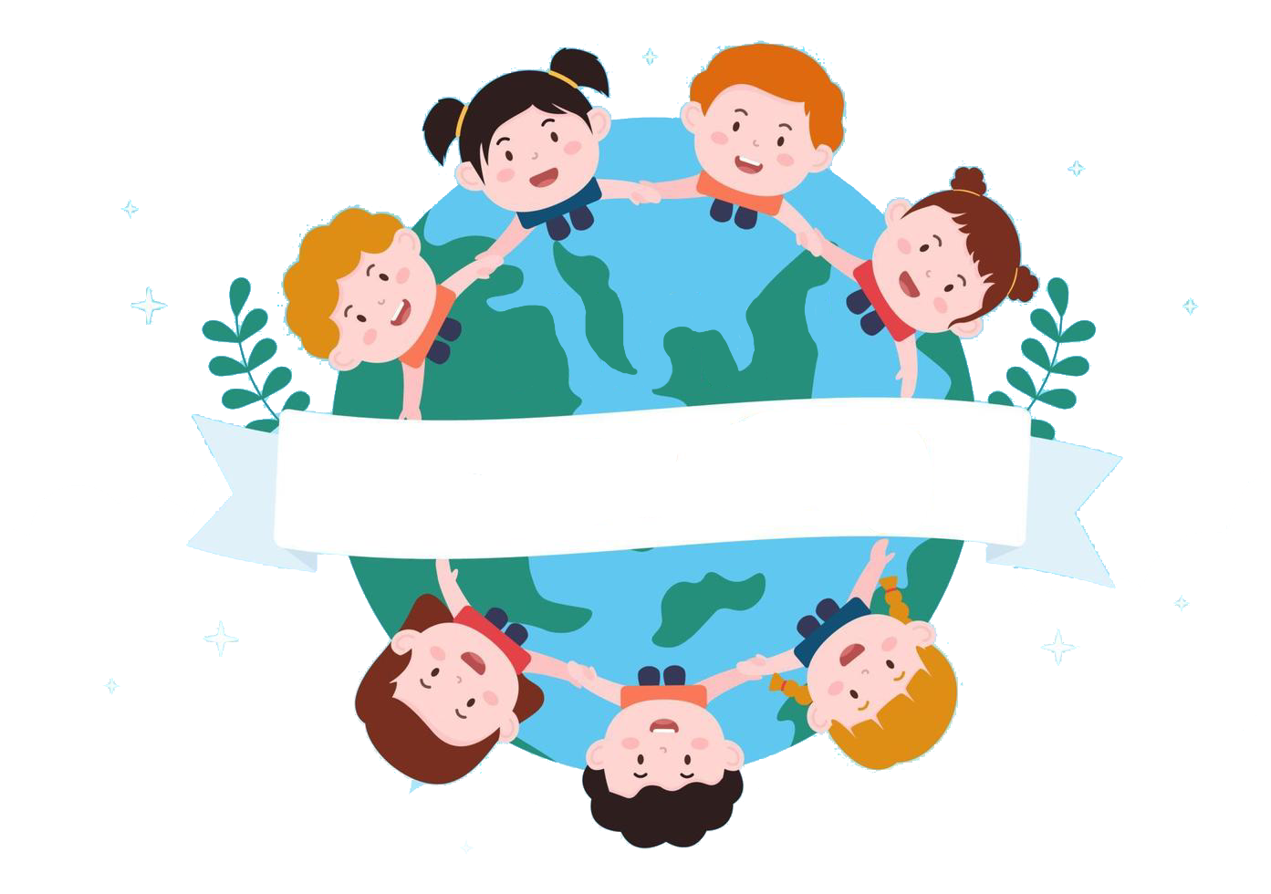
Thank you
& goodbye!

