Slide 1
Unit 2: Holidays
Lesson 1.1
Page 20

Slide 2
Objectives
By the end of this lesson, students will be able to…
Vocabulary: Pronounce and identify the words related to the topic properly: Halloween, New Year's Eve, Lunar New Year (Tết), Christmas, Teachers' Day, Children's Day.
Structure: What's your favorite holiday? - It's Halloween.
What's her favorite holiday? - It's Christmas

Slide 3
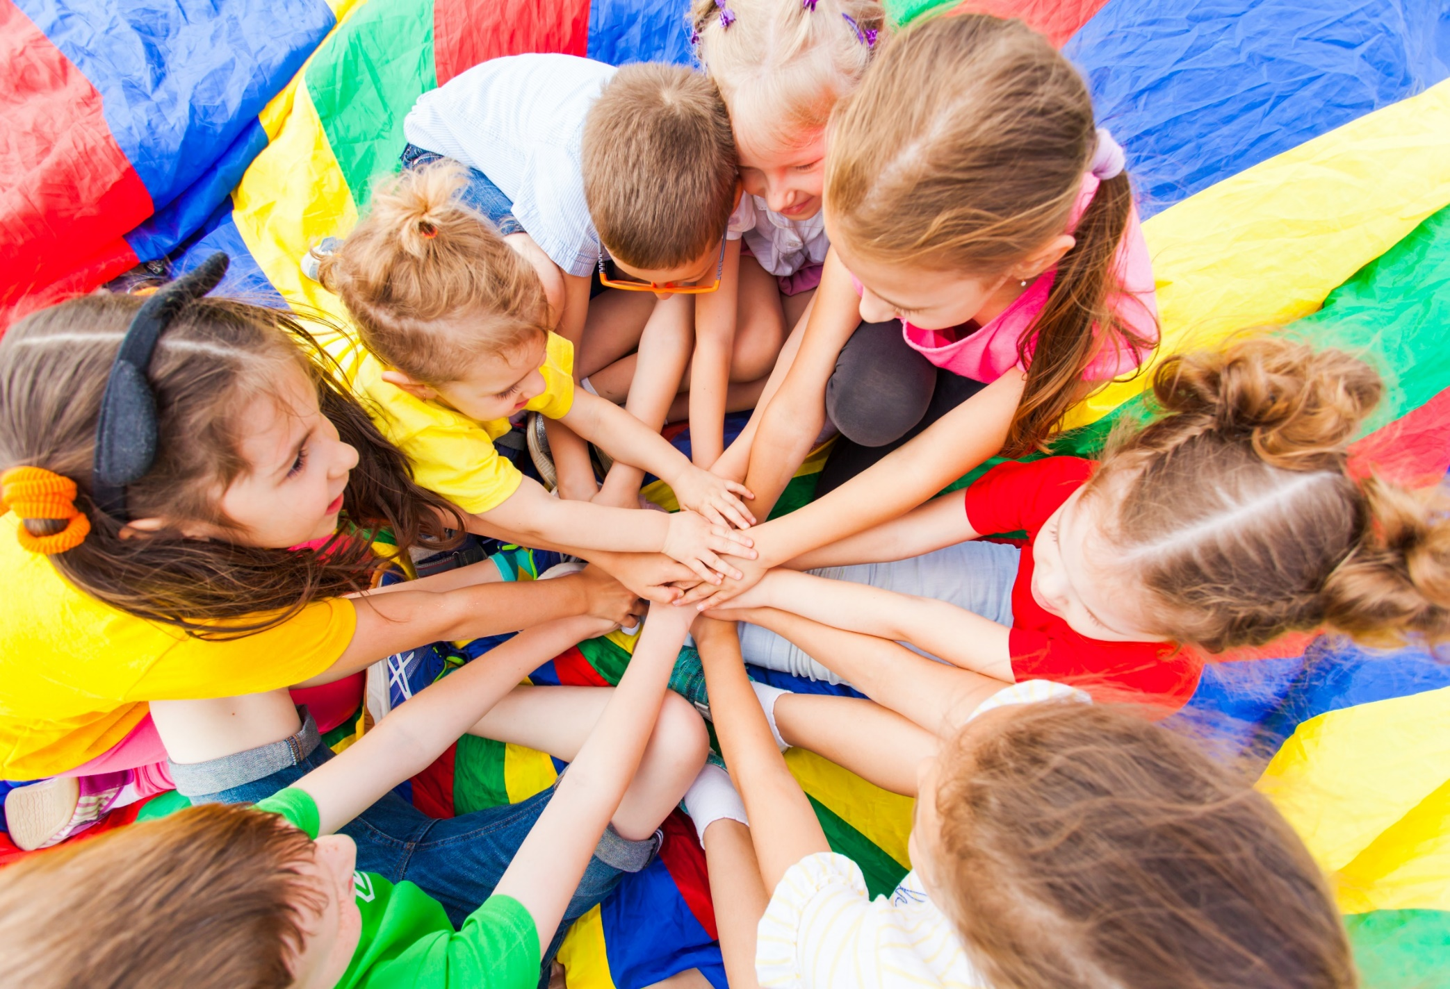
WARM-UP

Slide 4
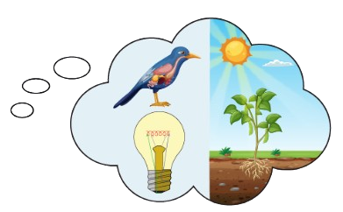
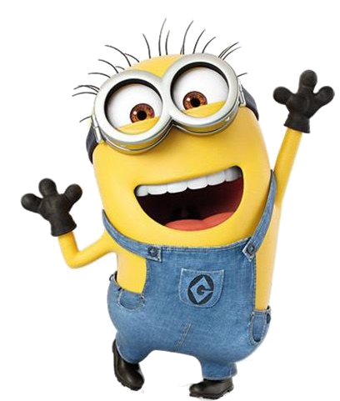
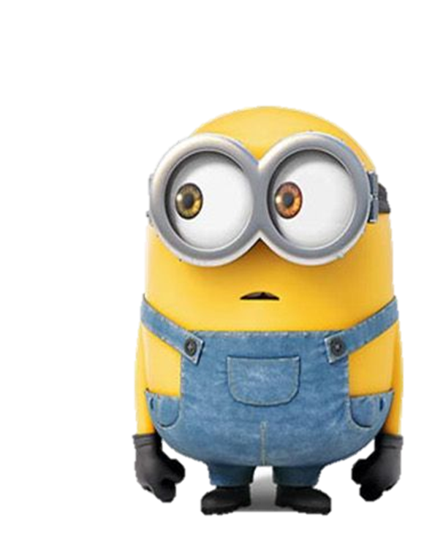
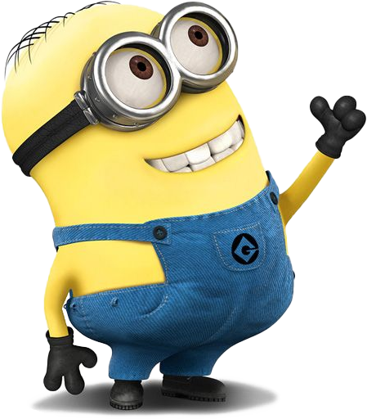
History
Science

Slide 5
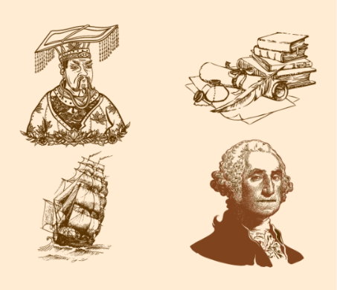
History
English

Slide 6
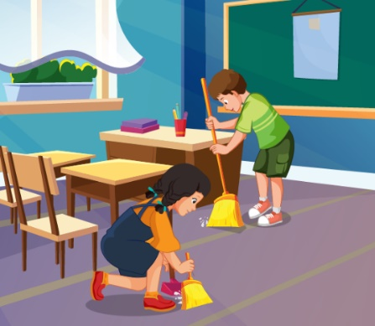
IT
Ethics

Slide 7
Geography
Science

Slide 8
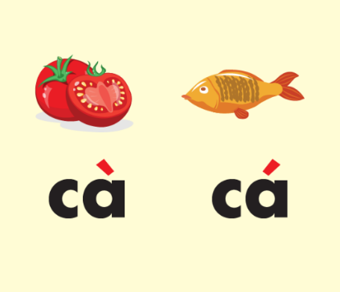
History
Vietnamese

Slide 9
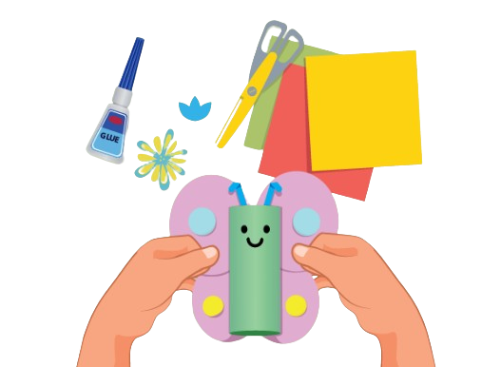
using computers
making things

Slide 10
reading stories
learning languages

Slide 11
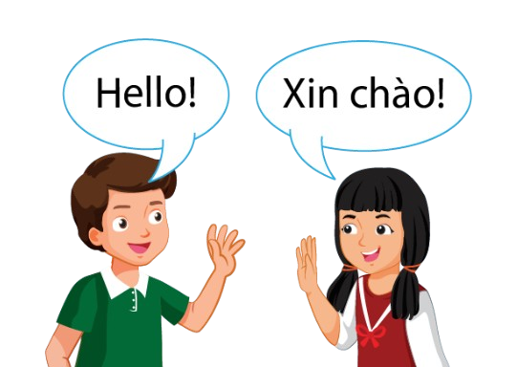
learning languages
do experiments

Slide 12
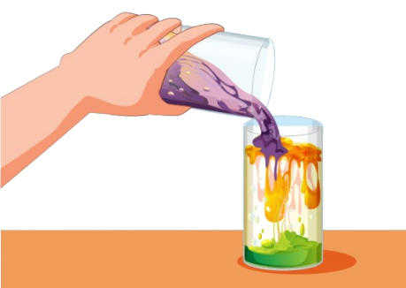
do experiments
solving problems

Slide 13
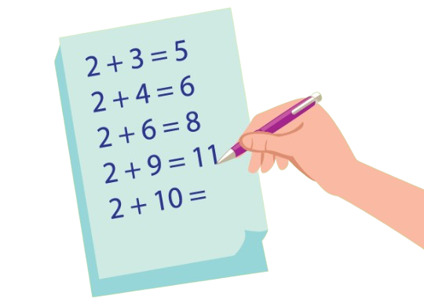
using computers
solving problems

Slide 15
It’s time to learn …

Slide 16
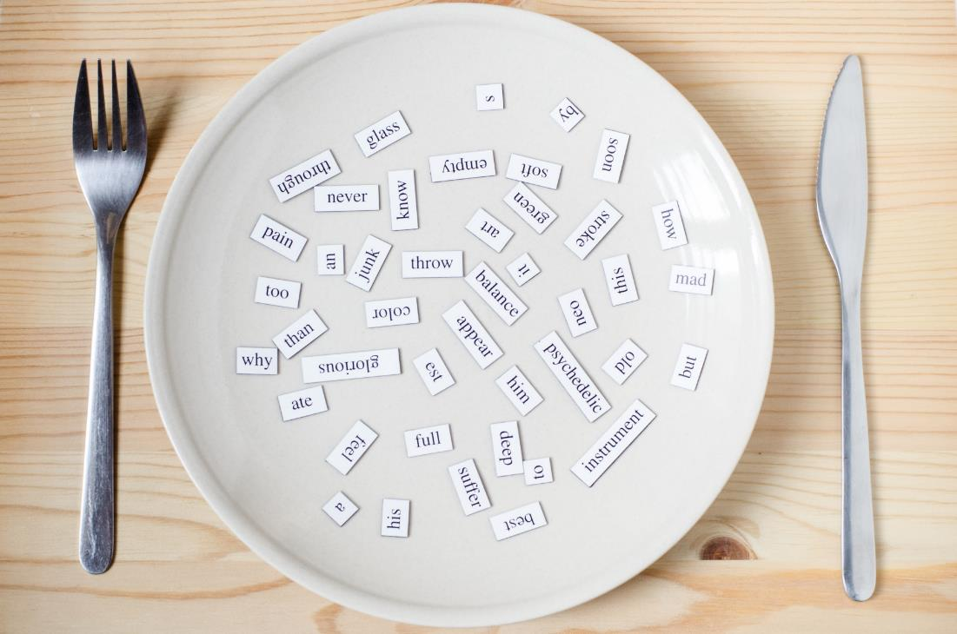
New words
Halloween, New Year's Eve,
Lunar New Year (Tết),
Christmas, Teachers' Day,
Children's Day

Slide 17
Presentation

Slide 18
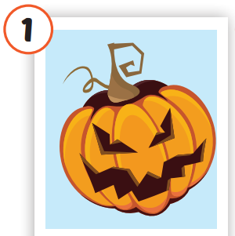
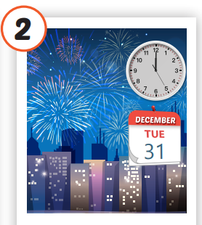
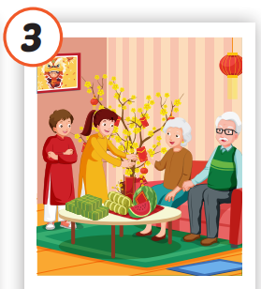
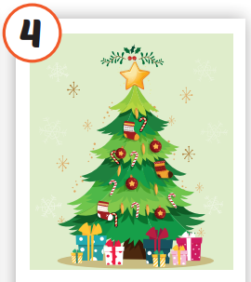
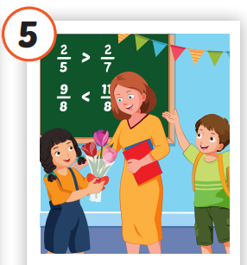
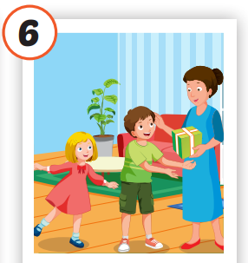
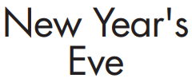
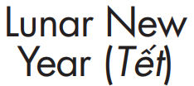
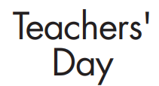
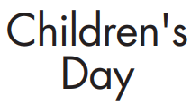
Click on each picture to hear the sound.
/ˌhæloʊˈiːn/
lễ hội Halloween
/ˈtʃɪldrənz deɪ/
Ngày Quốc tế
Thiếu nhi
/ˌnjuː jɪrz ˈiːv/
đêm Giao thừa
/ˈluːnər nuː jɪrz/
tết Nguyên đán
/ˈkrɪsməs/
Giáng sinh
/ˈtiːtʃərz deɪ/
Ngày Nhà giáo
Notes:
Click vào hình A. 1. Listen and point. Repeat để cho cả audio full chạy

Slide 19
Practice

Slide 20
Check your memory

Slide 21
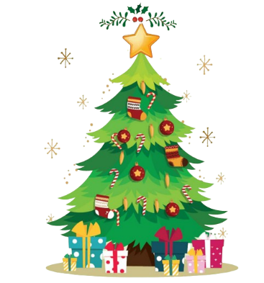
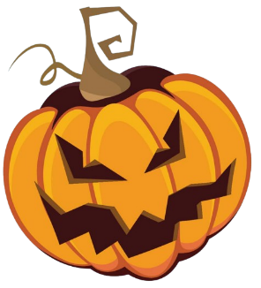
What’s next?
?
Christmas
Halloween

Slide 22
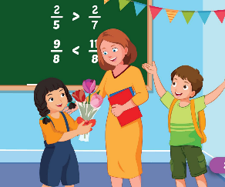
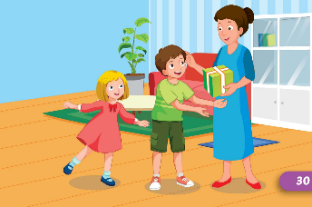
What’s next?
?
Teachers' Day
Children's Day

Slide 23
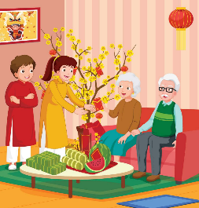
What’s next?
?
Children's Day
Lunar New Year

Slide 24
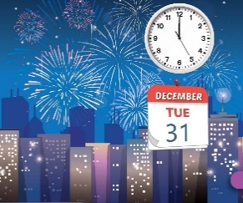
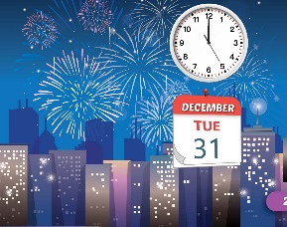
What’s next?
?
New Year's Eva
Children's Day

Slide 25
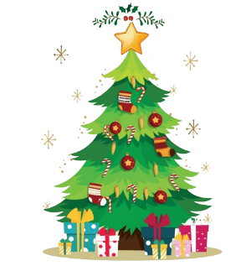
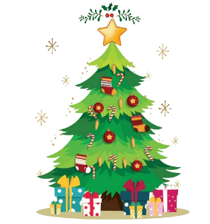
What’s next?
?
Children's Day
Christmas

Slide 27
Structure
What's your favorite holiday?
- It's Halloween.
What's her favorite holiday?
- It's Christmas.

Slide 28
Presentation

Slide 29
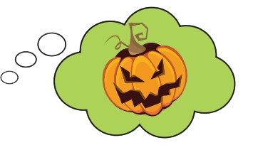
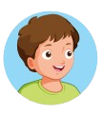
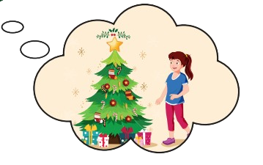
Structure

Slide 30
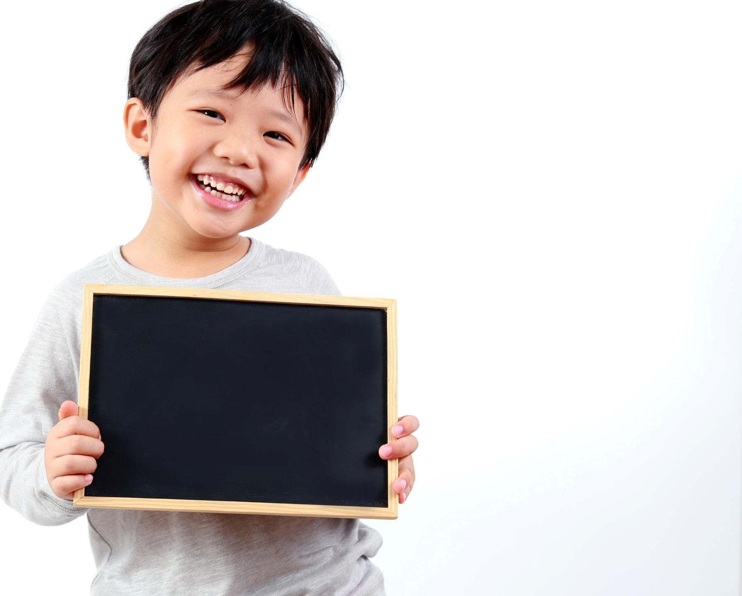
Practice

Slide 32
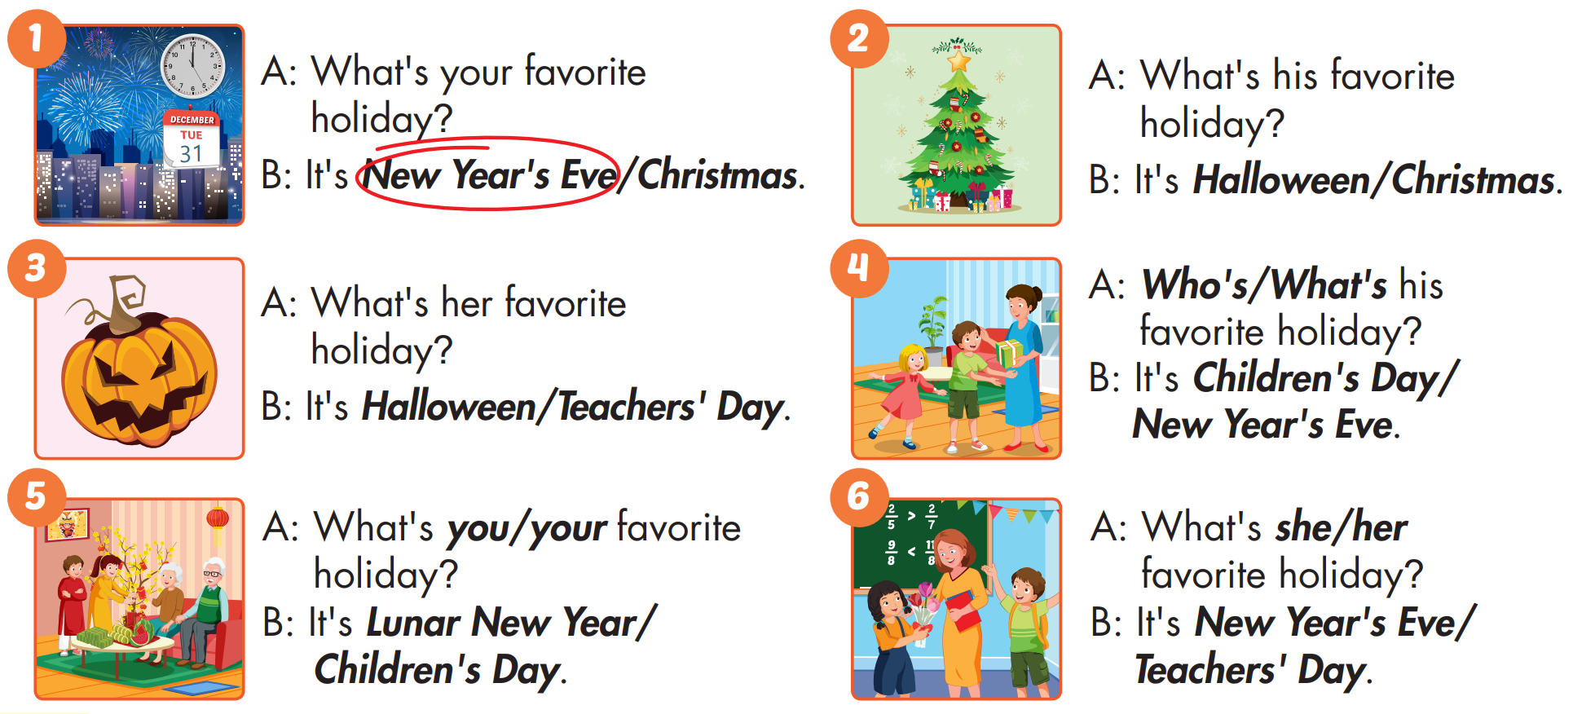
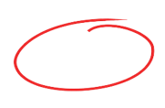

Slide 33
Production

Slide 34
CONSOLIDATION

Slide 35
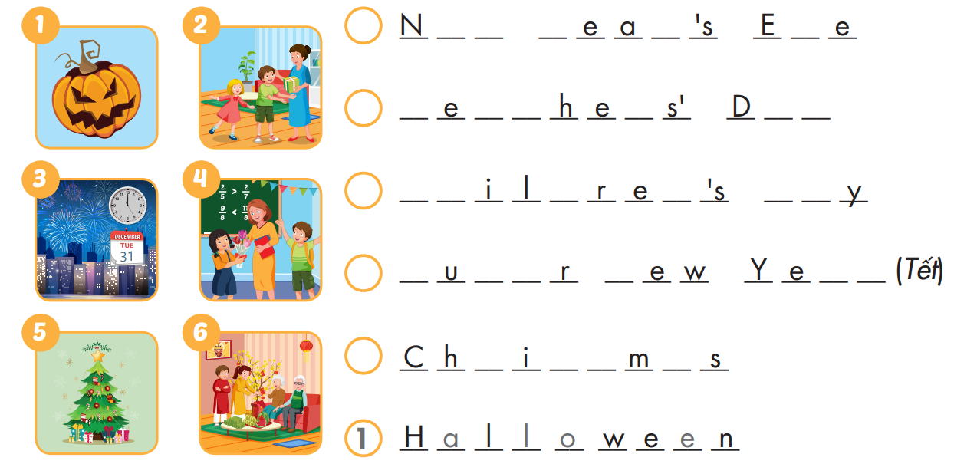
Extra Practice
WB, page 12
3
e
w
Y
r
v
2
T
a
c
r
a
y
2
C
h
d
n
D
a
6
L
n
a
N
a
r
5
r
s
t
a

Slide 36
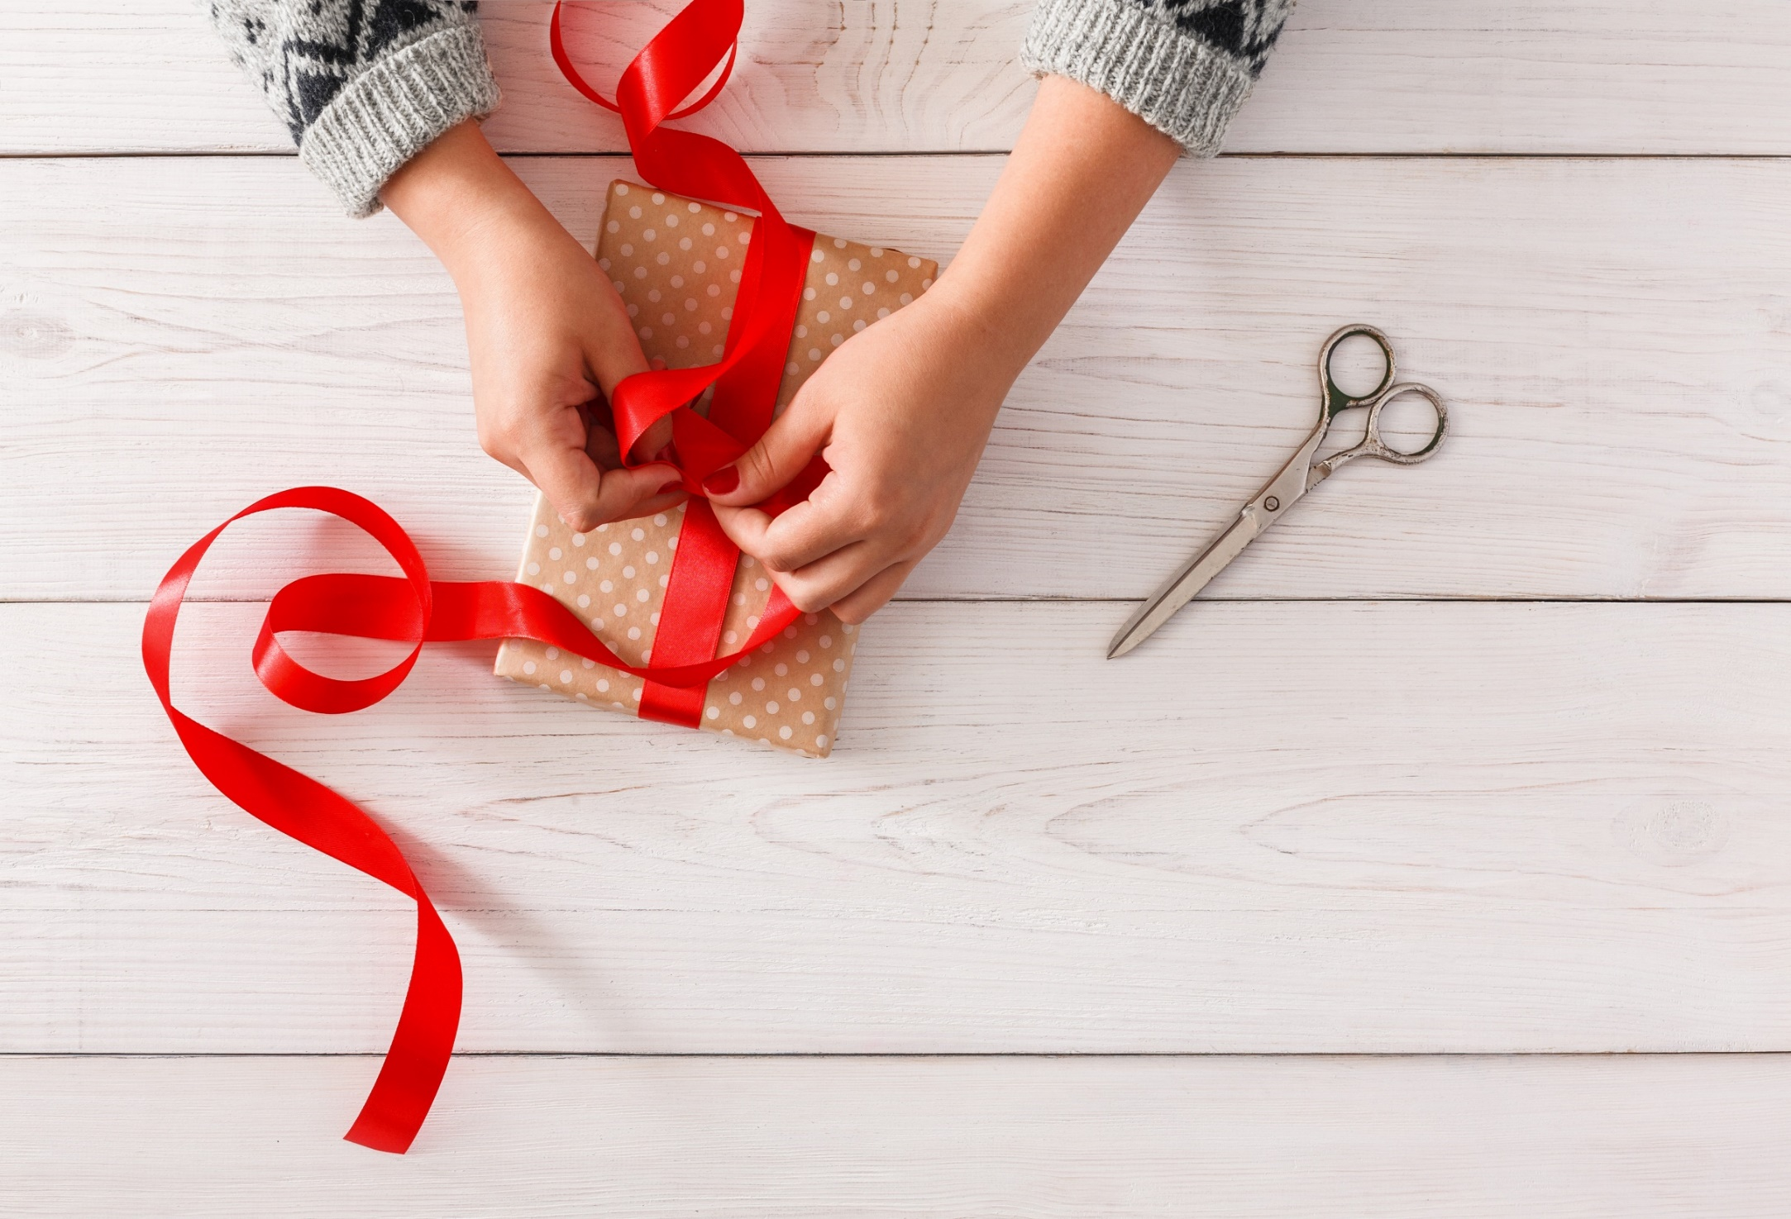
WRAP-UP

Slide 37
Today’s lesson
Vocabularies
Halloween, NewYear's Eve, Lunar New Year (Tết), Christmas, Teachers' Day,
Children's Day
Structures/ Sentence patterns
What's your favorite holiday?
- It's Halloween.
What's her favorite holiday?
- It's Christmas.

Slide 38
Homework
Practice the vocabularies and structure, and make sentences using them.
Do the exercises in Tiếng Anh 5 i-Learn Smart Start WB (page 12)
Do the exercises in Tiếng Anh 5 i-Learn Smart Start Notebook (page 10)
Prepare the next lesson (page 21 SB)
Play the consolidation games in Tiếng Anh 5 i-Learn Smart Start DHA App on www.eduhome.com.vn

