Slide 1
LONG BIEN DISTRICT DEPARTMENT OF EDUCATION AND TRAINING
GIANG BIEN PRIMARY SCHOOL
WELCOME TEACHERS
TO
4A1 ENGLISH CLASS
English Teacher: Nguyen Thi Thu Hien.

Slide 2
WARM UP

Slide 3
LET’S PLAY!
What’s missing?
Notes:
Put three or four FLASHCARDS (clothes) on the board and tell your child to look at them. Ask them to close their eyes and take one card away. When your child opens their eyes, ask them to guess what is missing.

Slide 4
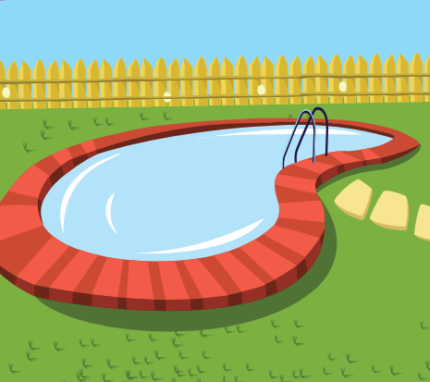

Slide 10
REVIEW 2
library
stadium
park
water park
swimming pool
market

Slide 11
Enjoy your day!

