Slide 1
Unit 1: SCHOOL
Lesson 3.1
Page 12

Slide 2
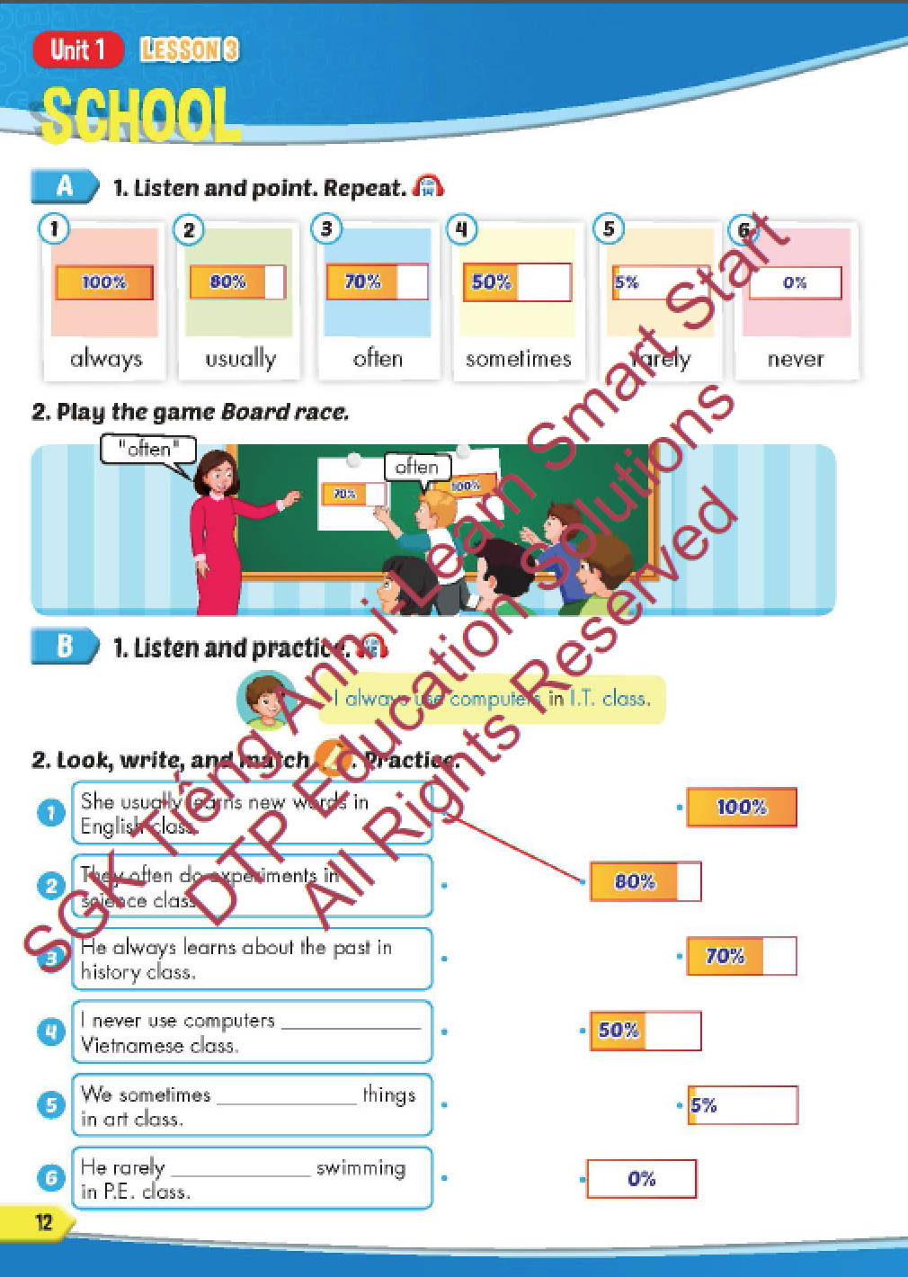
Lesson Outline
Warm-up
Vocabulary
Structure
Consolidation
Wrap-up

Slide 3
Objectives
By the end of this lesson, students will be able to recognize and practice adverbs of frequency and practice saying how often they do things in different classes.
Vocabulary: always, usually, often, sometimes, rarely, never.
Structure: I always use computers in I.T. class.

Slide 4
It’s time to learn …

Slide 5
New words

Slide 6
Click on the picture to hear the sound.
/ˈɑːlweɪz/
luôn luôn
/ˈjuːʒuəli/
thường xuyên
/ˈɔːfən/
thường
/ˈsʌmtaɪmz/
thỉnh thoảng
/ˈrerli/
hiếm khi
/ˈnevər/
không bao giờ
Notes:
Click vào hình A. 1. Listen and point. Repeat để cho cả audio full chạy

Slide 7
Click on the picture to hear the sound.
always
/ˈɑːlweɪz/
luôn luôn

Slide 8
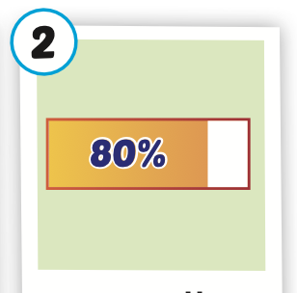
Click on the picture to hear the sound.
usually
/ˈjuːʒuəli/
thường xuyên

Slide 9
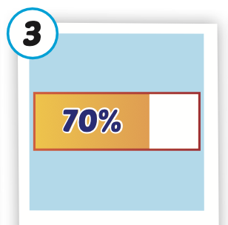
Click on the picture to hear the sound.
often
/ˈɔːfən/
thường

Slide 10
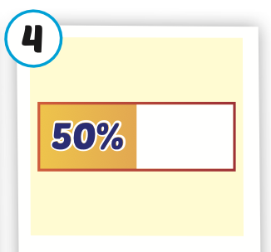
Click on the picture to hear the sound.
sometimes
/ˈsʌmtaɪmz/
thỉnh thoảng

Slide 11
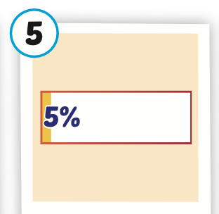
Click on the picture to hear the sound.
rarely
/ˈrerli/
hiếm khi

Slide 12
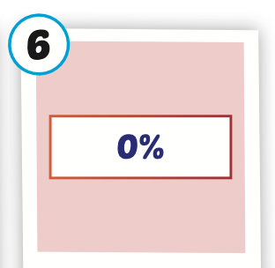
Click on the picture to hear the sound.
never
/ˈnevər/
không bao giờ

Slide 13
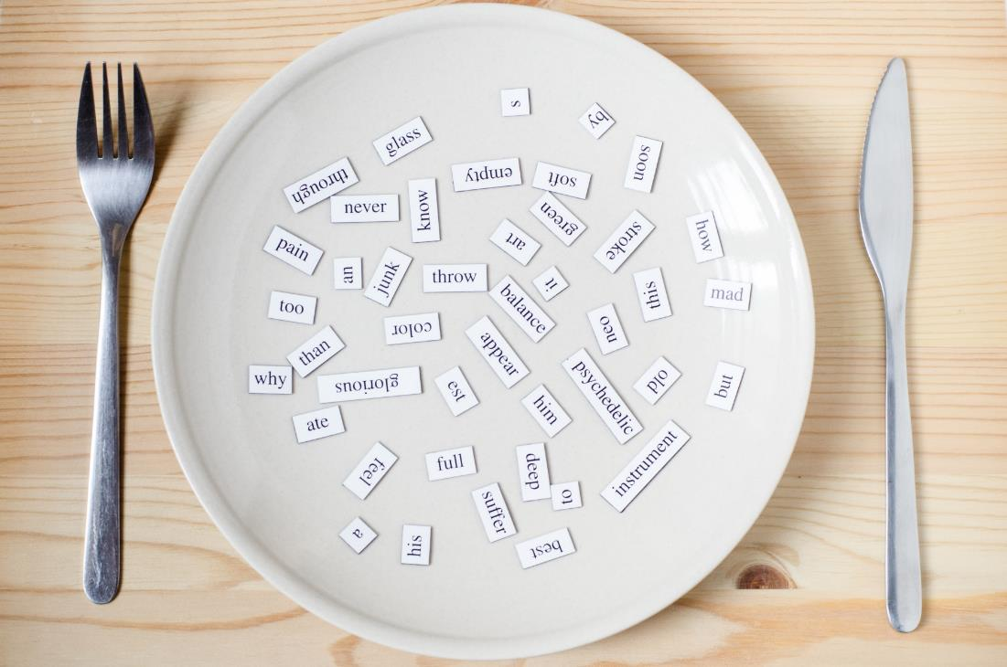
New words
always,
usually,
often,
sometimes,
rarely,
never.

Slide 14
Lesson 3
Stay positive and have a nice day!

