Slide 1
Unit 6
DESCRIBING PEOPLE
LESSON 1. 2 - PAGE 79

Slide 2
Objectives
By the end of this lesson, students will be able toto identify the / I / sound and practice the conversations
Vocabulary: slim, big
Phonics: /I/

Slide 3
WARM UP

Slide 4
Lucky Numer
A
B
1
2
3
1
2
3
4
5
1
2
3
4
5
4
5
6
7
8
9

Slide 5
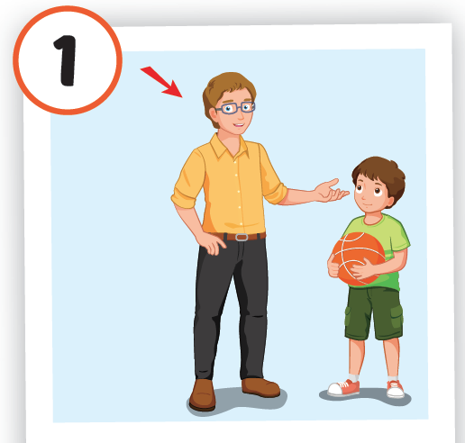

Slide 6
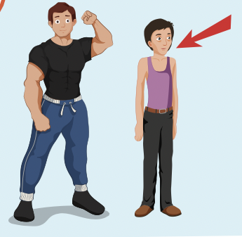

Slide 7
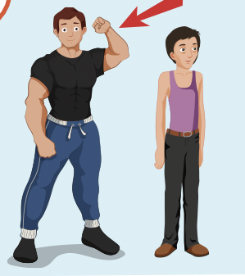

Slide 8
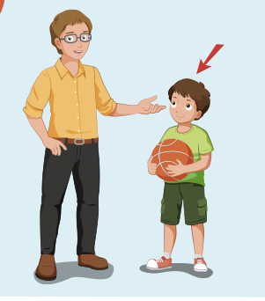

Slide 9
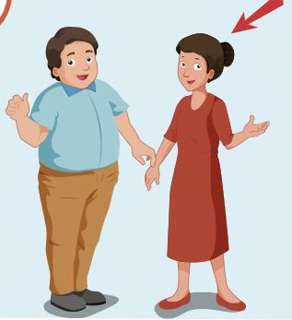

Slide 10
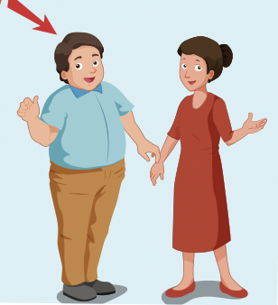

Slide 11
Lucky Number

Slide 12
It’s time to learn …

Slide 13
Phonics
/I/
slim, big.

Slide 14
Presentation

Slide 15
Click the icon to hear the sound.
big
slim
/bɪɡ/
/slɪm/

Slide 16
Practice

Slide 19
Speaking

Slide 20
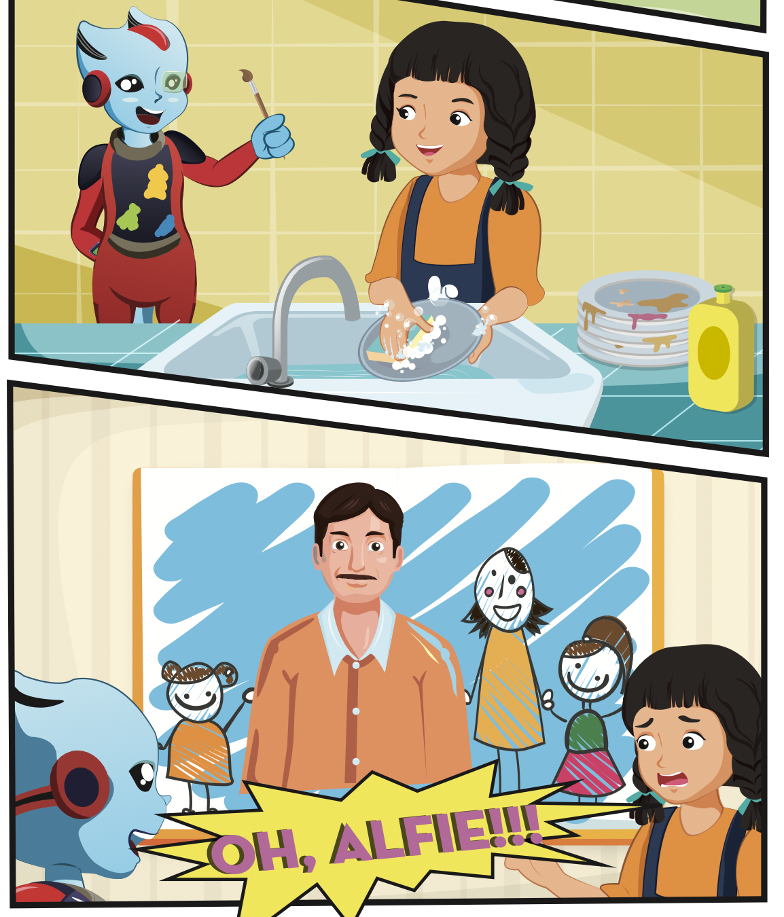
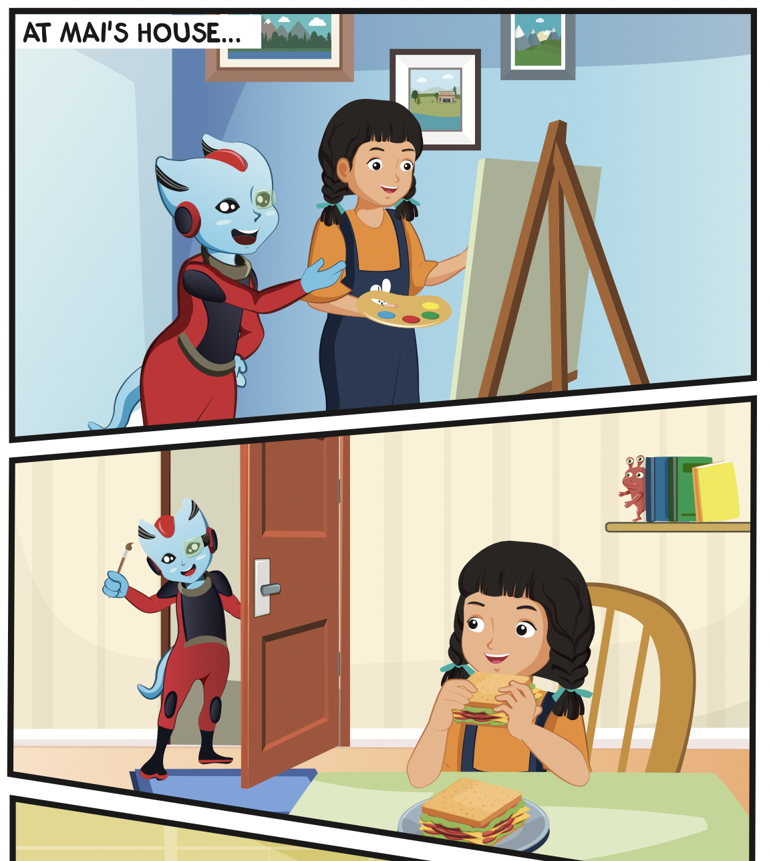
Who is in the story?
Where are they?
What is Mai doing?

Slide 21
Listening

Slide 23
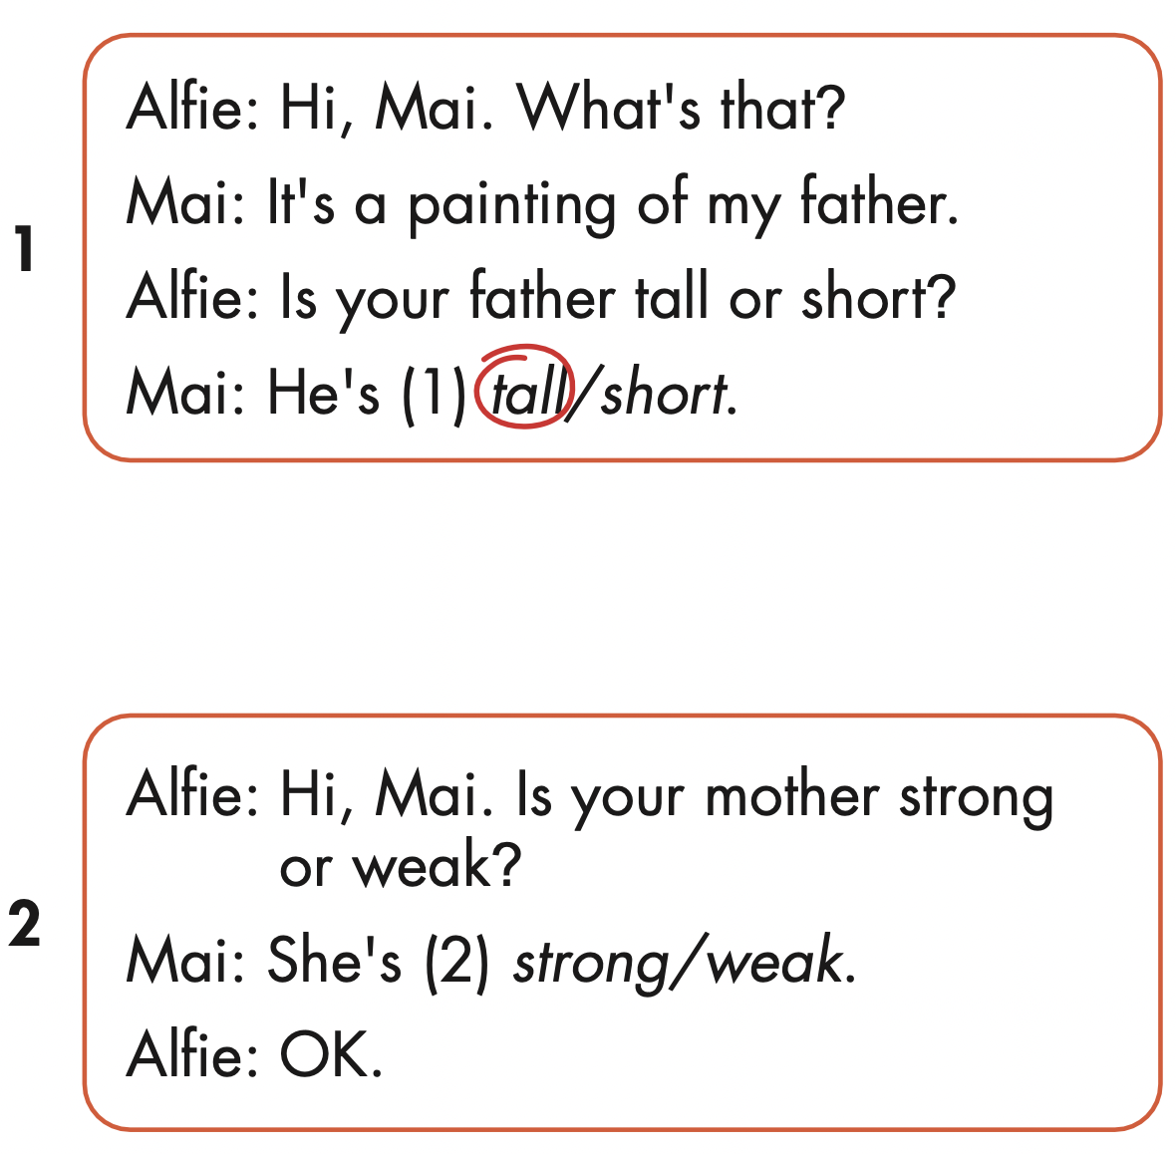
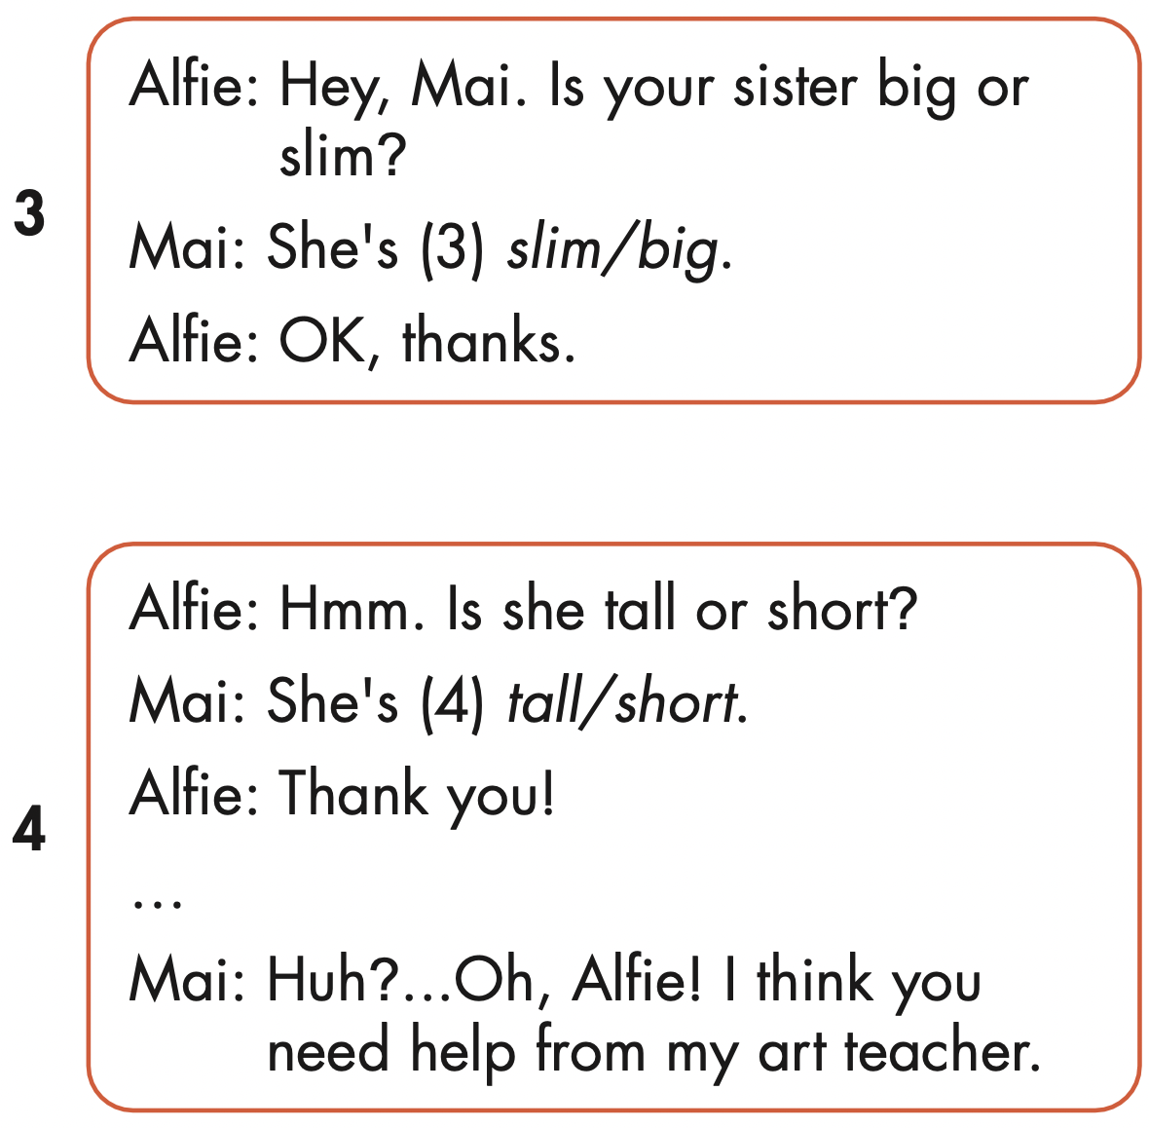

Slide 24
Speaking

Slide 26
Production

Slide 27
Writing

Slide 28
MAKE YOUR OWN STORY

Slide 29
CONSOLIDATION

Slide 30
Extra Practice
WB, page 53

Slide 31
WRAP-UP

Slide 32
Today’s lesson
Phonics
/I/
Structures/ Sentence patterns
Is your father slim or big?
He’s slim.

Slide 33
Homework
Practice the vocabularies and structure; and make sentences using them.
Do the exercises in Tiếng Anh 4 i-Learn Smart Start WB (page 53)
Do the exercises in Tiếng Anh 4 i-Learn Smart Start Notebook (page 34)
Prepare the next lesson (page 80 SB)
Play the consolidation games in Tiếng Anh 4 i-Learn Smart Start DHA App on www.eduhome.com.vn

