Slide 1

Unit 2: Family
Lesson 2.3
Page 29

Slide 2
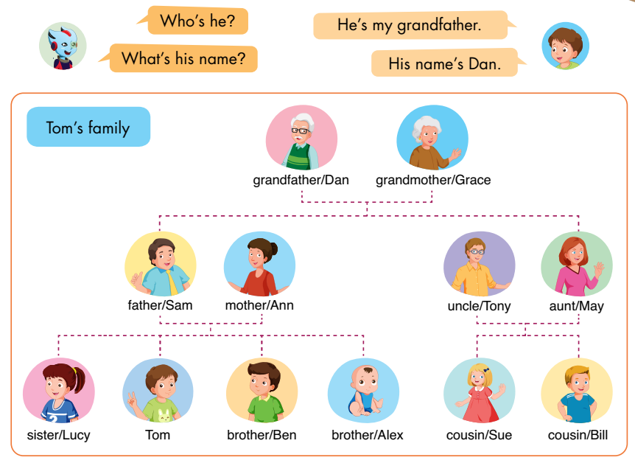
E
Point, ask, and answer.
Notes:
Have the class look at the picture.
Ask them to name the family members and spell the names in the pictures.
E. Point, ask, and answer.
Divide the class into two pairs.
Demonstrate the activity using the speech bubbles.
Have the student A point to a person in the picture, have the student B introduce.
Swap roles and repeat.
Afterwards, have some pairs demonstrate the activity in front of the class.

Slide 3
E
2. Role-play.
Example:
Tina: This is my brother, Ben.
Mark: Hello, Ben. I’m Mark.
Ben: Hello, Mark.
Notes:
2. Role-play.
Divide the class into groups of three.
Demonstrate the activity using the example.
Ask them to role-play the activity.
Swap roles and repeat.
Afterwards, have some pairs demonstrate the activity in front of the class.

Slide 4
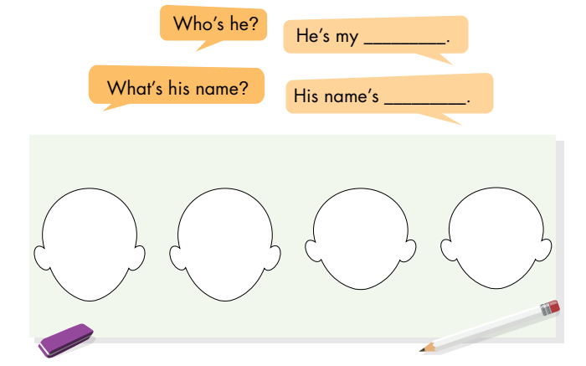
F
Draw your family. Ask and answer.
Notes:
F. Draw your family. Ask and answer.
Have the students draw the faces of their family members.
Divide the class into two pairs.
Have the students look at their drawings, then ask and answer.
Swap roles and repeat.
Afterwards, have some pairs demonstrate the activity in front of the class.

Slide 5

F
2. Role-play.
Example:
Lily: This is my sister, Mary.
Sam: Hello, Mary. I’m Sam.
Mary: Hello, Sam.
Notes:
2. Role-play.
Divide the class into groups of three.
Demonstrate the activity using the example.
Ask them to role-play the activity.
Swap roles and repeat.
Afterwards, have some pairs demonstrate the activity in front of the class.

