Slide 1
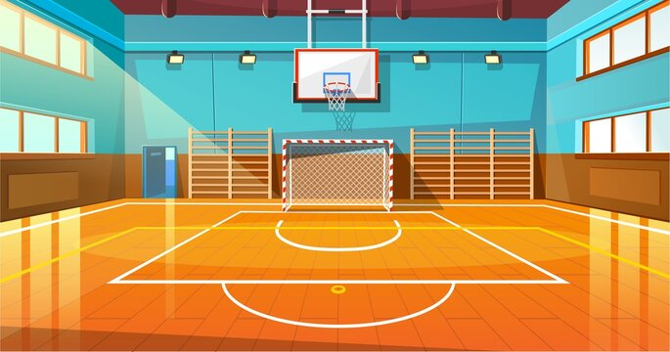
Unit 7 My Favourite Sport Task 7,8,9

Slide 2
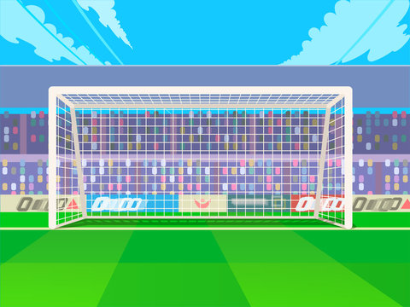
Warm Up
01
GAME: Wheel of fortune

Slide 3
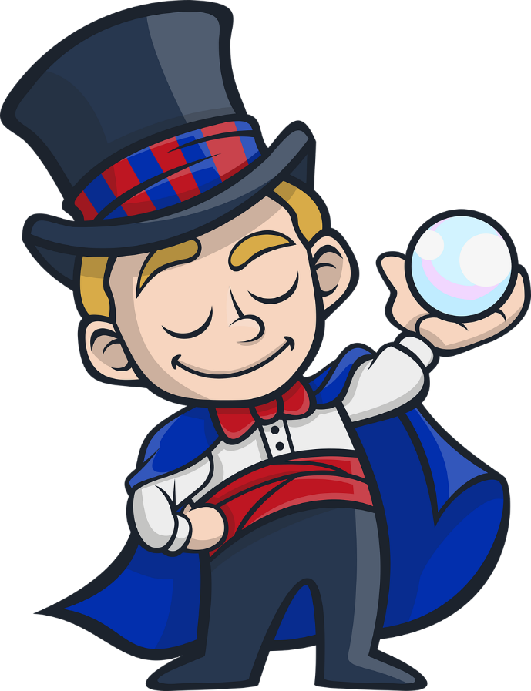
Next
WHEEL of FORTUNE
1 star
2 stars
1 star
1
2
2 stars
1 star
1 star
0 star
0 star
4 stars
3
3 stars
1 star
2 stars
Notes:
Choose the questions and answer, then spin the wheel to get the stars .

Slide 4
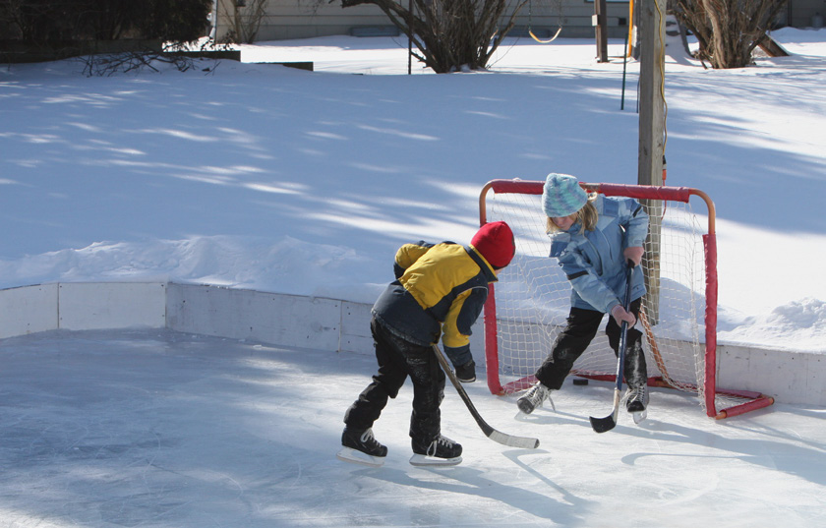
1. What is the missing letter ?
O
U
E
H
O
C
K
E
Y
Next

Slide 5
2. What is the missing letter ?
U
E
A
T
E
A
Next
E
M

Slide 6
3. Which word is pronounced differently?
A. sit
B. library
C. drink
Next

Slide 7
02
Presentation

Slide 8
/ɪ:/
team

Slide 9
/ɪ/
hockey

Slide 10
Let’s say :
Let’s listen !
team
hockey
Words
/ɪ:/
/ɪ/
Sounds

Slide 11
Task 7. Listen and Repeat.
team
hockey
I’m playing hockey with my team.

Slide 12
03
Practice

Slide 13
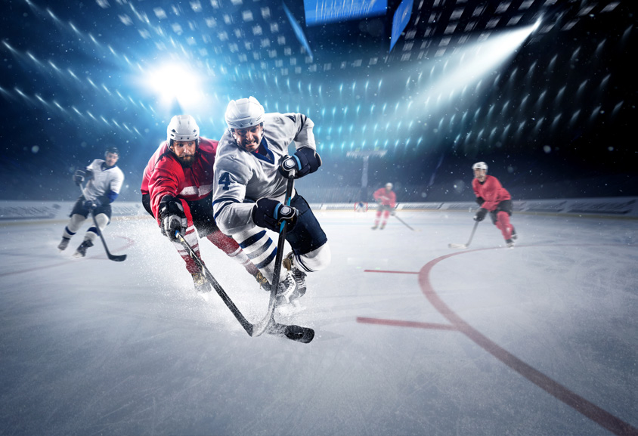
Task 8. Listen and chant.
Team team team! Wear this T-shirt! Come play hockey with my team. Team team team! Wear that T-shirt! Come play hockey with his team.

Slide 14
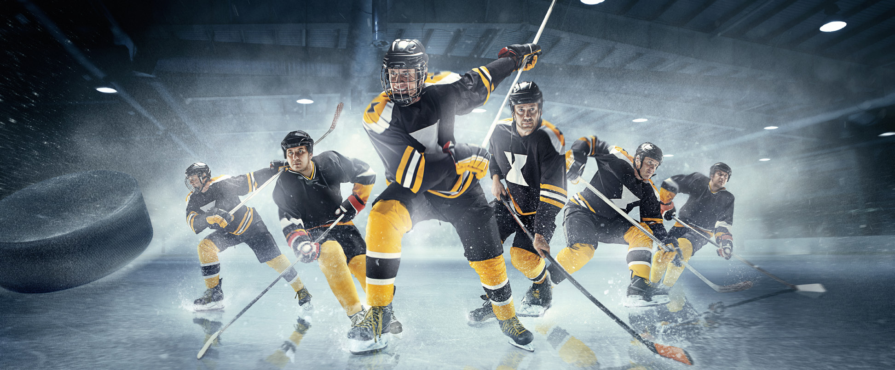
Task 9. Say it!
1. I’m wearing my uniform and playing hockey with my team. 2. My team is running and hitting the ball. 3. My hockey team and I can watch our match on TV.

Slide 15
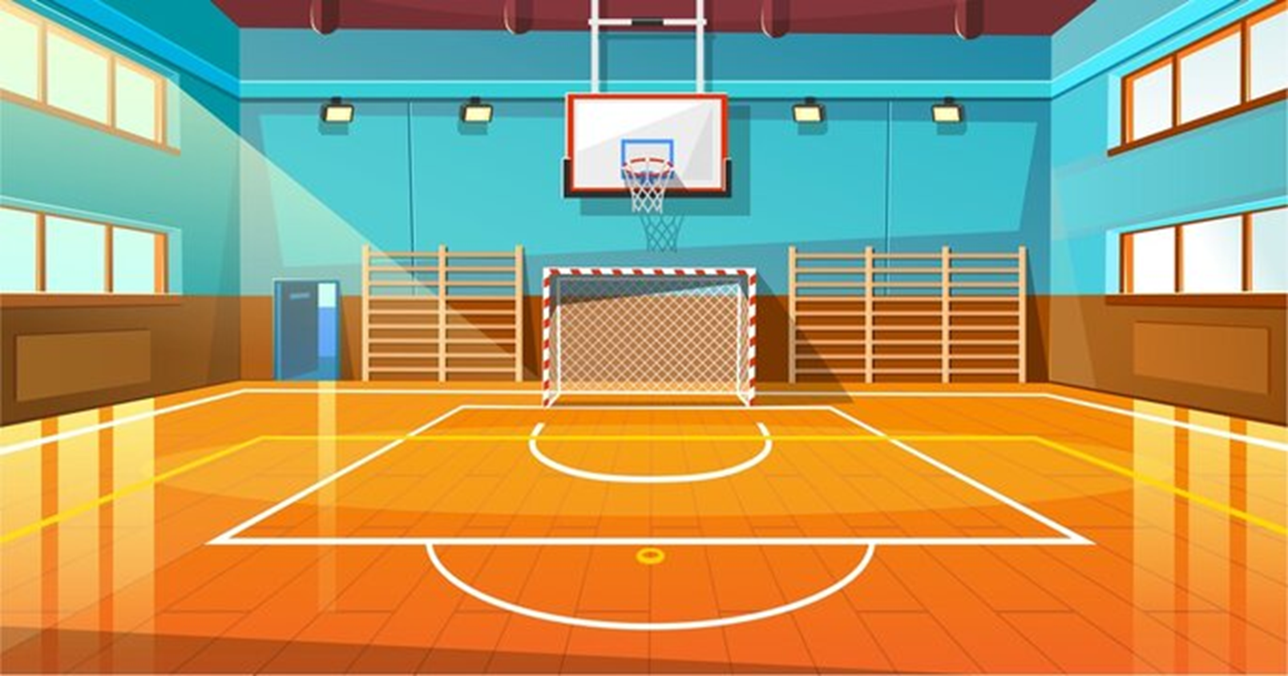
04
Assessment
Listen and number from 1 to 5.

Slide 16
Listen and number from 1 to 5.
4
2
3
1
5

Slide 17
Thank You

