Slide 1









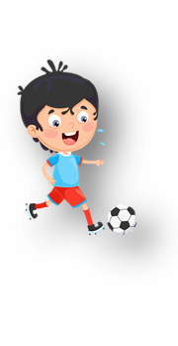
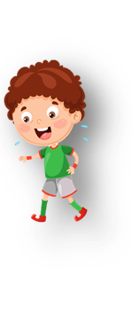











Notes:
Để nguyên trang bìa như này, chỉ thay đổi tên bài trong quá trình làm. Logo của sách Wonderful World

Slide 2



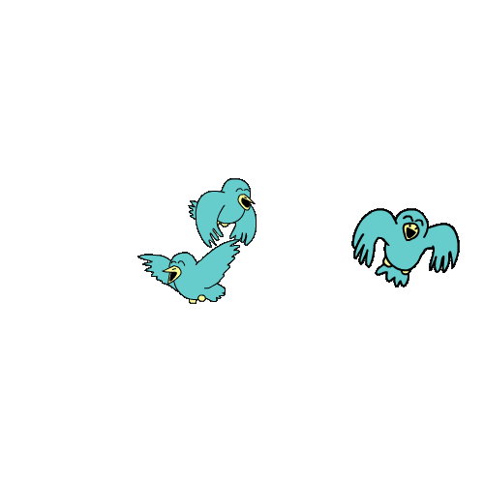


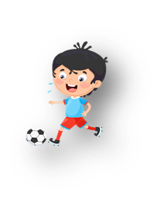




Unit 10: On holiday
Lesson 1. Task 4,5,6

Slide 3


1.Warm-up

Slide 4
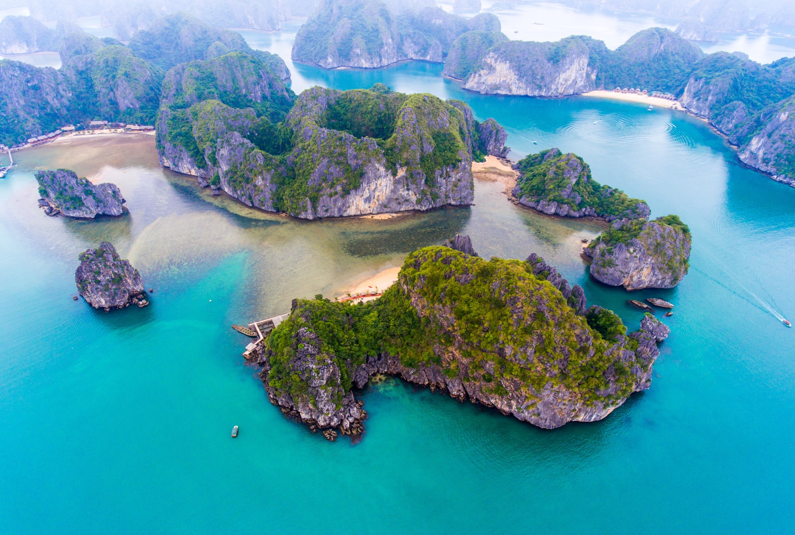
b
a
y
NEXT

Slide 5
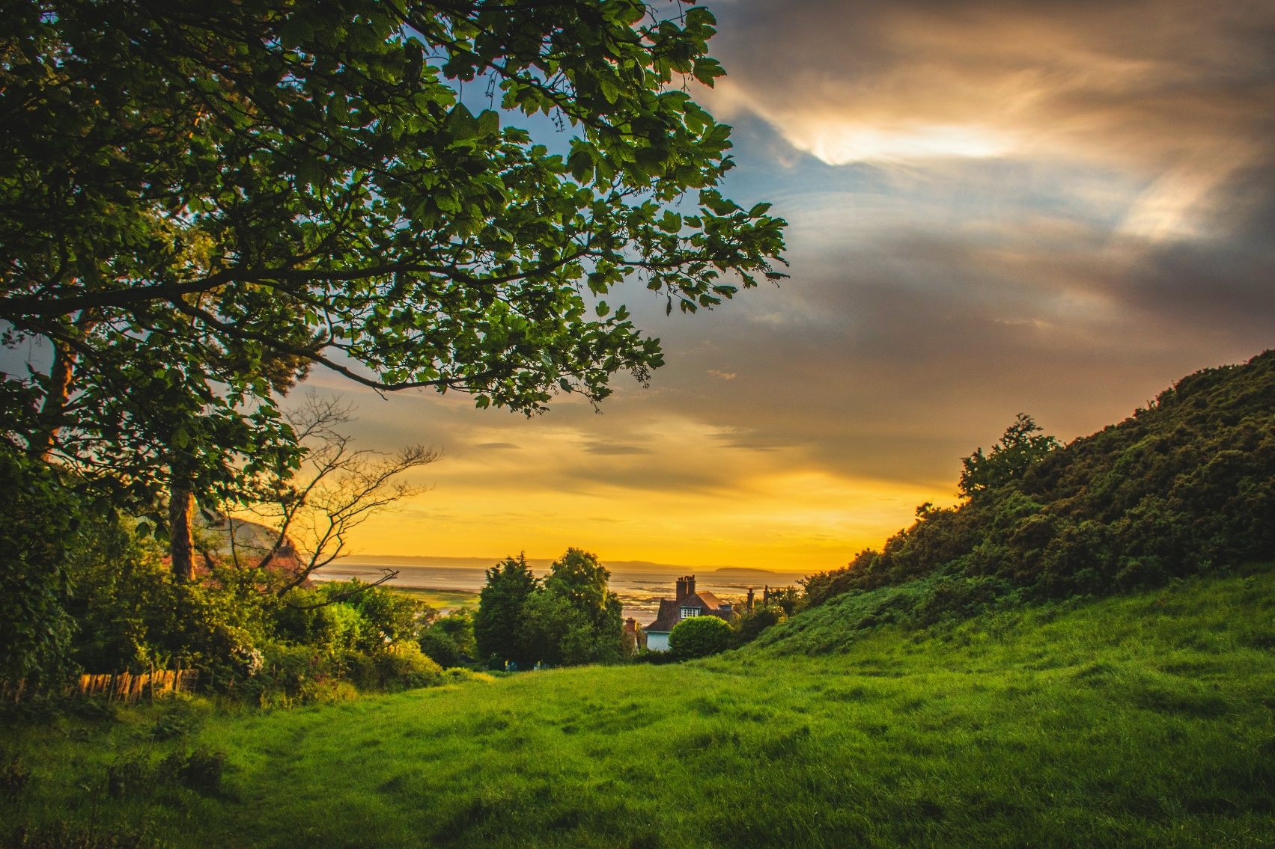
h
i
l
l
NEXT

Slide 6
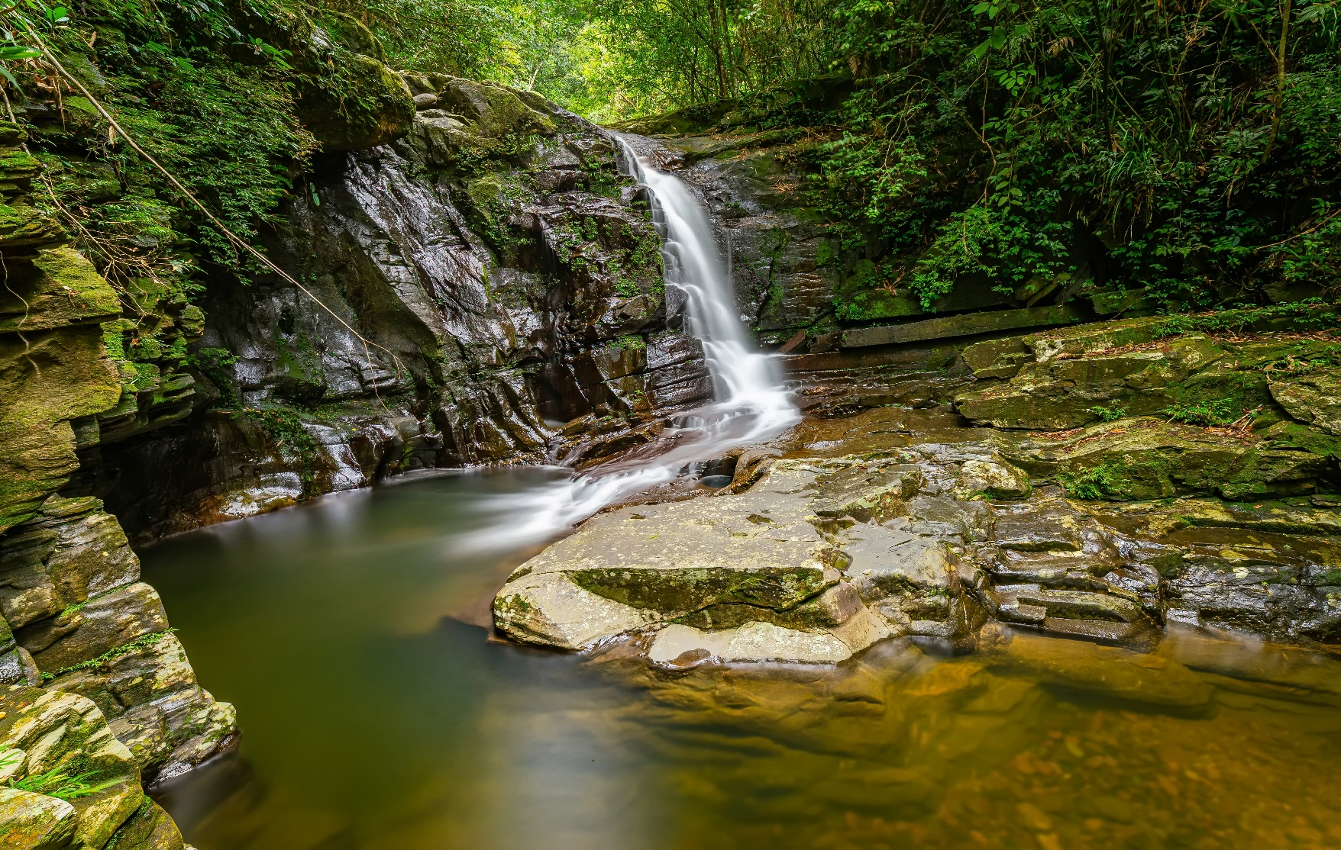
n
a
t
i
o
n
a
l
p
a
r
k
NEXT

Slide 7
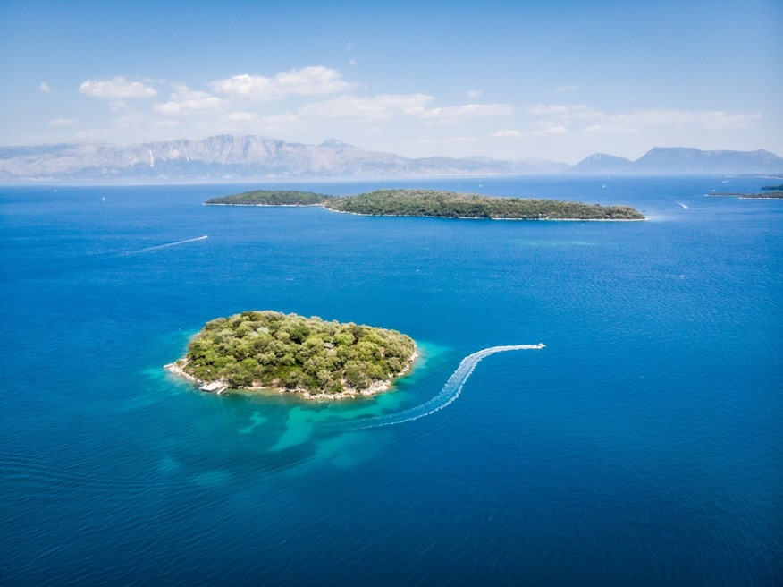
i
s
l
a
n
d
NEXT

Slide 8
2. Presentation

Slide 9

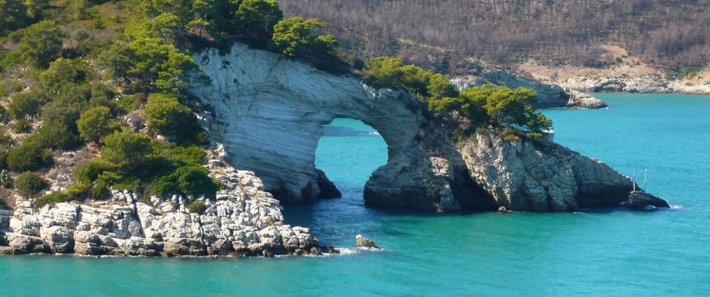

4. Listen and repeat. Tr:10.3
Which plαce would you like to visit on holidαy?
I'd like to visit Gαrgαno Nαtionαl Pαrk.

Slide 10

3. Practice

Slide 11
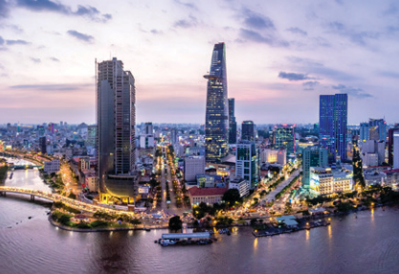
5. Look and say.
Which plαce would you like to visit on holidαy?
I'd like to visit
Ho Chi Minh City.
1. Ho Chi Minh City

Slide 12
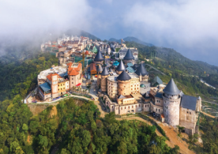
5. Look and say.
Which plαce would you like to visit on holidαy?
I'd like to visit
Ba Na Hill.
2. Bα Nα Hills

Slide 13
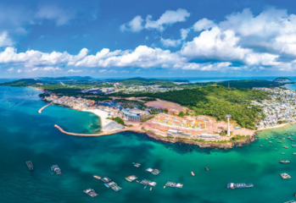
5. Look and say.
Which plαce would you like to visit on holidαy?
I'd like to visit
Phu Quoc Islαnd.
3. Phu Quoc Islαnd

Slide 14
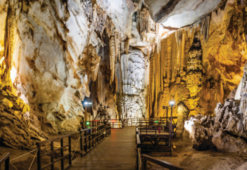
5. Look and say.
Which plαce would you like to visit on holidαy?
I'd like to visit
Phong Nhα-Ke Bαng Nαtionαl Pαrk.
4. Phong Nhα-Ke Bαng Nαtionαl Pαrk

Slide 15


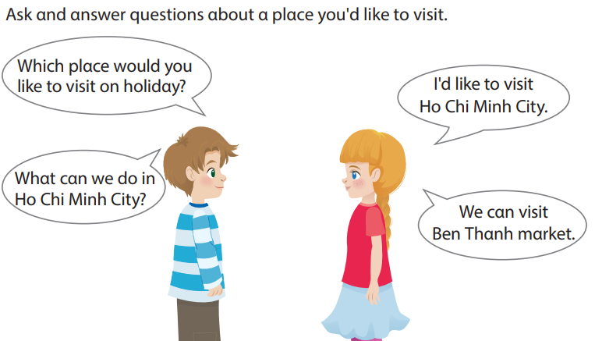
6. Let’s talk.

Slide 16
4. Production

Slide 17



ASSESSMENT
TEAM 1
TEAM 2
TEAM 3
TEAM 4
Vận dụng xuất sắc những kiến thức đã học vào thực hành
Vận dụng tốt những kiến thức đã học vào thực hành
Biết cách vận dụng những kiến thức đã học vào thực hành

Slide 18



5
Assessment

Slide 19
Look and circle.
We’d like to visit Ha Long Bay/ Hill in summer.
There are a lot of trees and birds in Cuc Phuong Island/ National Park.
Phu Quoc Island / Bay has got many beautiful beaches.
I’d like to visit Ba Na Hills / Island by train.

Slide 20
UNIT 10: On holiday
LESSON 1 – Task 4, 5, 6
What we learnt today
Vocabulary: bay, hill, island, national park.
Structure:
- Which place would you like to visit on holiday?
- I’d like to visit……………………

Slide 21






