Slide 1
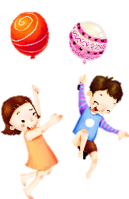
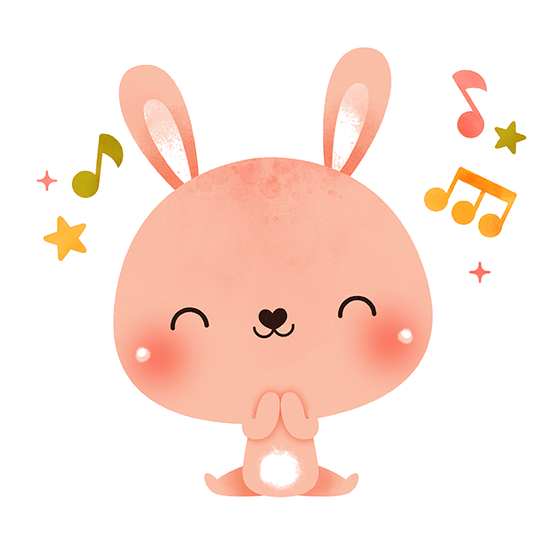
Warm up
01
Let’s sing a song!

Slide 2
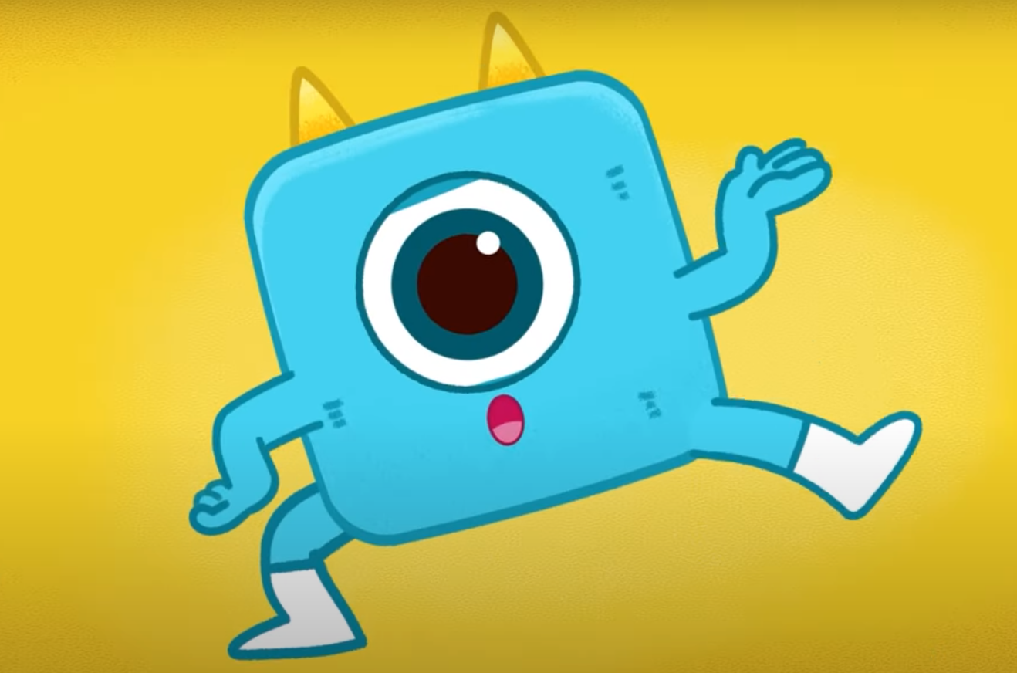
List all hobbies in the video!
Playing guitar
Swimming
Cooking
Singing
Listening to hip-hop music
Playing soccer
Surfing
Drawing
Reading books

Slide 3
Review
02
Let’s play a game!!!
‘Lucky box’

Slide 4
1
2
3
4
5
6
Next

Slide 5
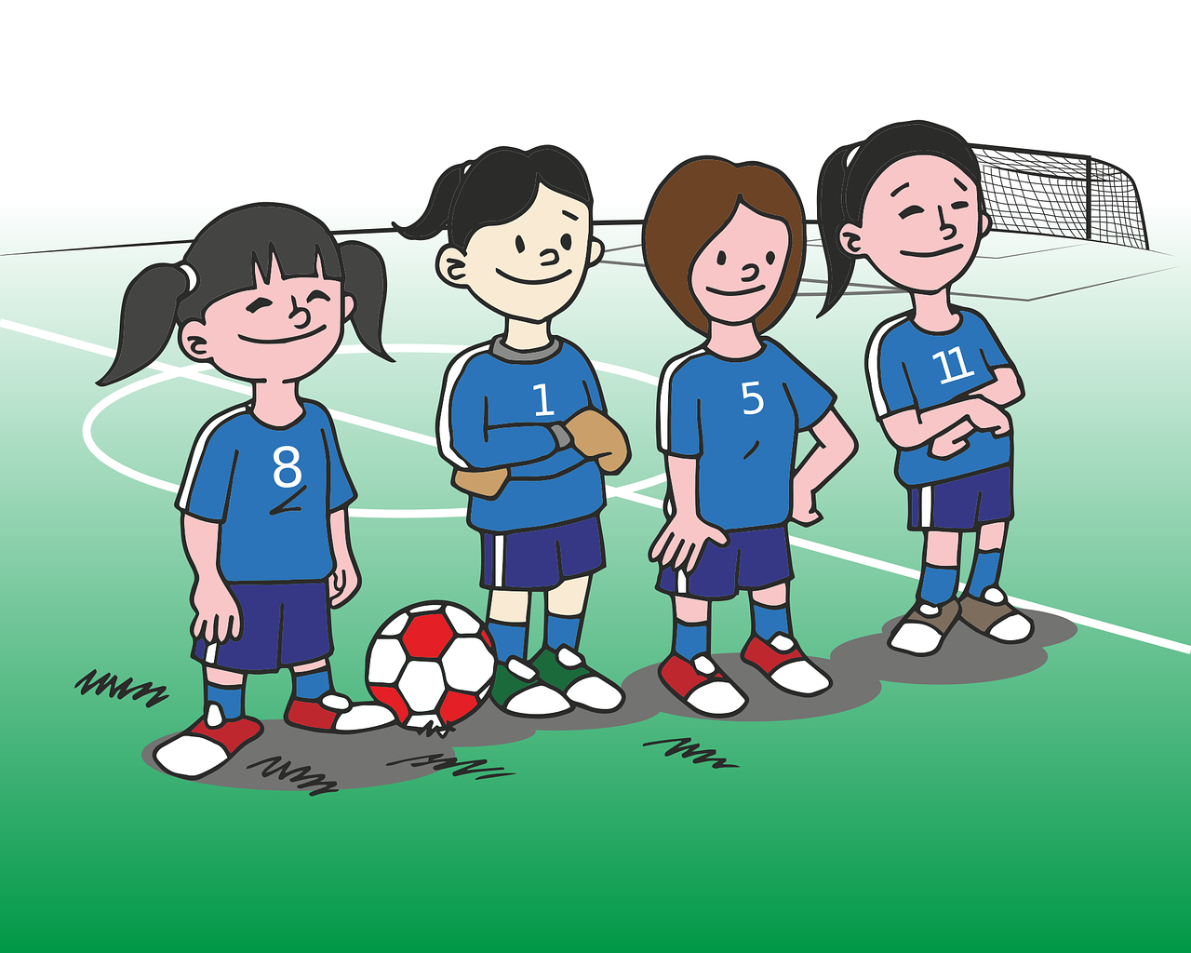
Look and say
playing soccer
We are good at ______________.
Back

Slide 6
Look and say
Anna can ______________.
make a paper bird
Back

Slide 7
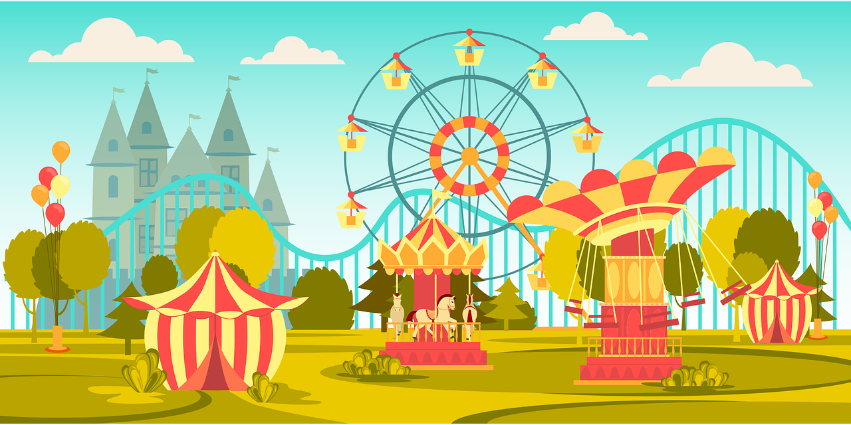
Look and say
amusement park
Dad, can we go to the ______________?
Back

Slide 8
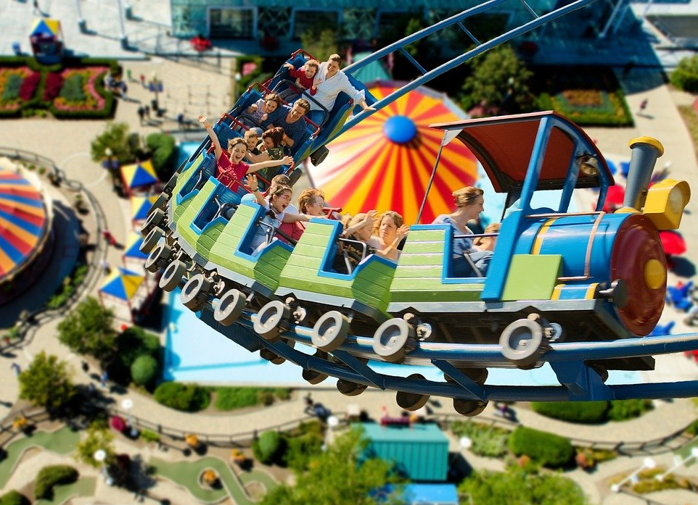
Look and say
ride the roller coaster
Sorry, I can’t _________________.
Back

Slide 9
Look and say
My grandpa loves ________________.
collecting stamps
Back

Slide 10
You’ve got a lucky box!!!!
Back

Slide 11
Practice
03

Slide 12
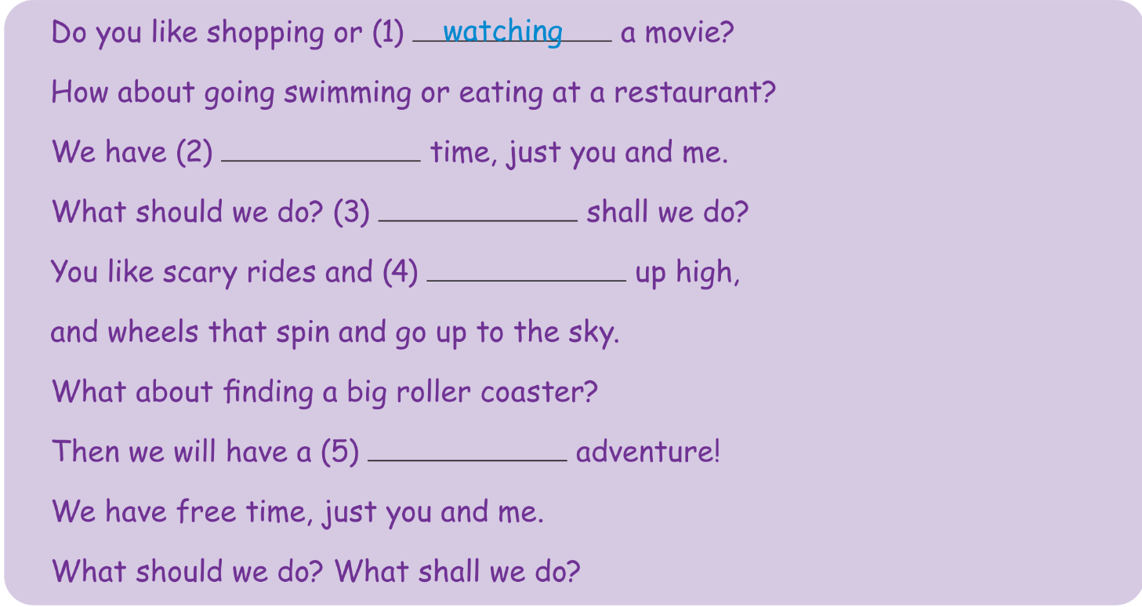
free
What
going
fun

Slide 13
Production
04

Slide 14
Describe and guess!
Notes:
4 or 5 students go to the stage, turns his/her back on the board and faces the class. One student looks at the picture in the screen and do actions, gives the hints about the numbers of the word (without saying anything). The first S will watch the action and guess what action it is.

Slide 15
go swimming

Slide 16
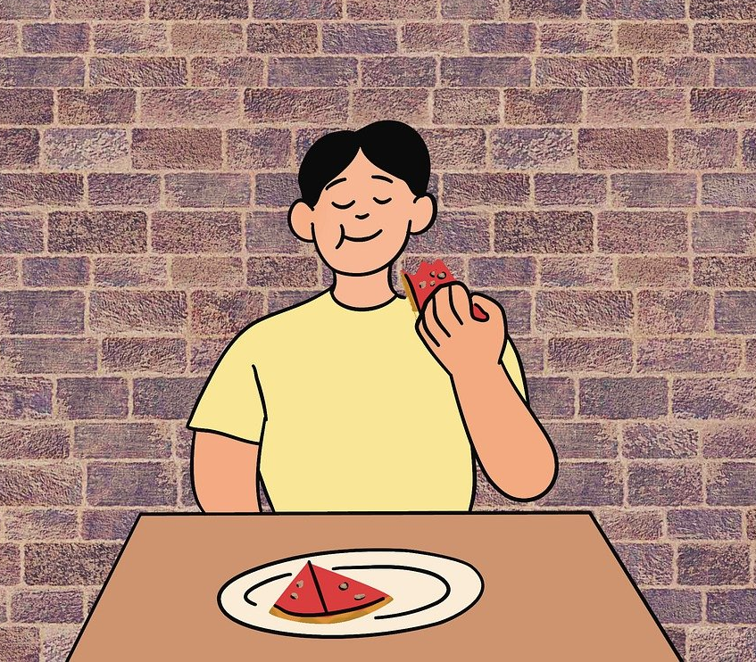
eat at a restaurant

Slide 17
go shopping

Slide 18
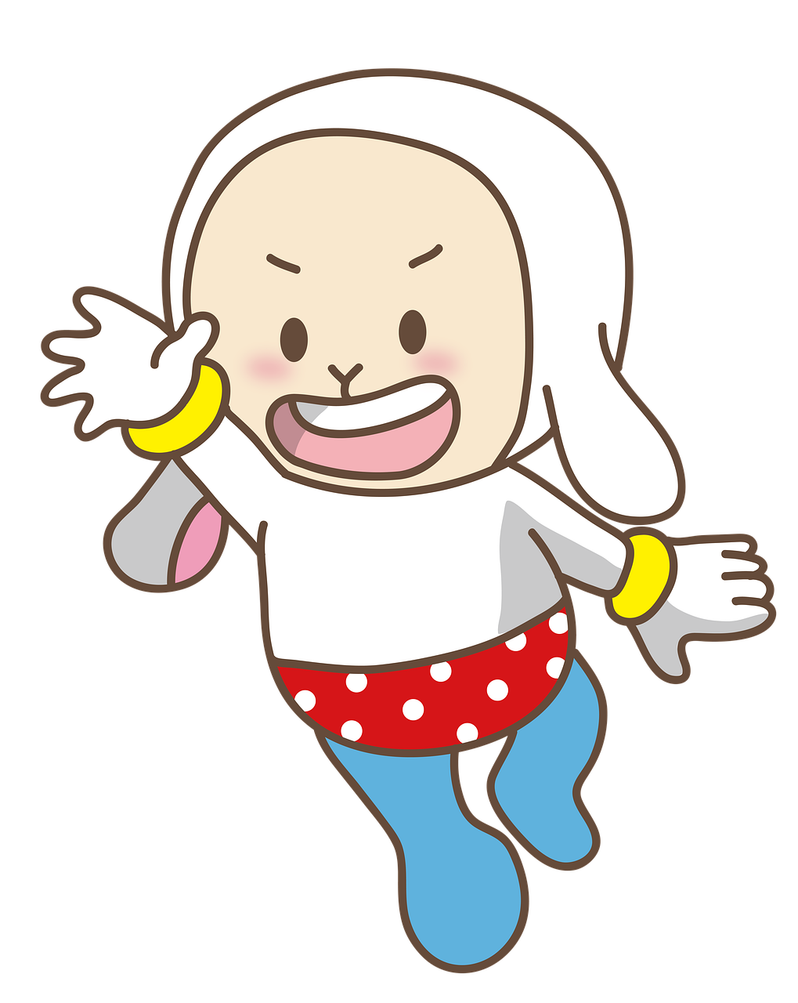
go up

Slide 19
Wrap-up & Assessment
05

Slide 20
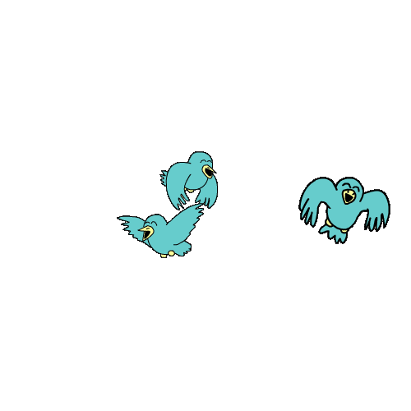
Unit 4: Free time Fun time & Project
What have we learnt today?
Review: Vocabulary about hobbies:
go ice-skating, ride rolling coaster, collect stamps, watch movies, make a paper bird, play football, etc.

