Slide 1
Unit4 ACTIVITIES
CULTURE 1.1
Notes:
Thanh Yến Trần 0967 255 149 zalo/ FB https://www.facebook.com/thanhyentrananhngutaymy

Slide 2
TABLE OF CONTENTS
01
02
03
Warm up
Vocabulary
Grammar

Slide 3
01
WARM UP

Slide 5
02
VOCABULARY
++

Slide 6
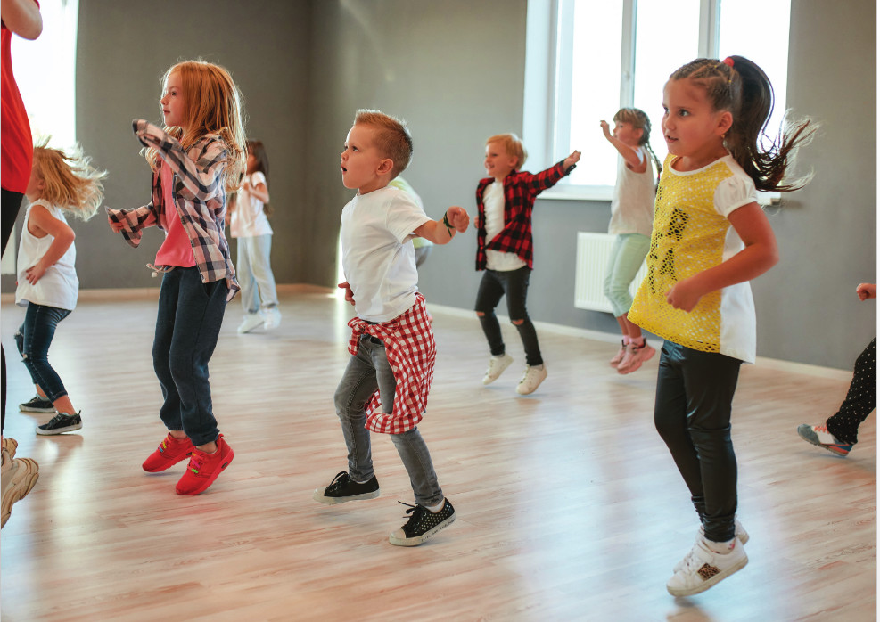
studio

Slide 7
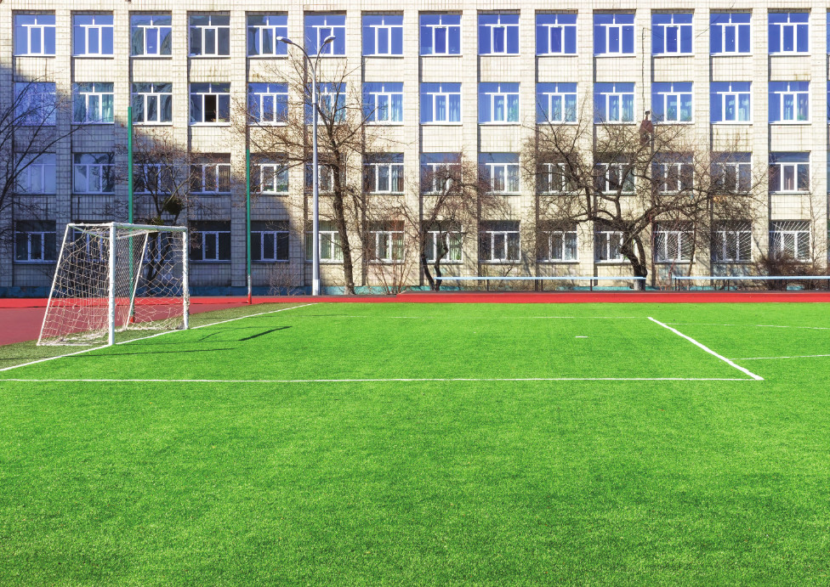
soccer field

Slide 8
arcade

Slide 9
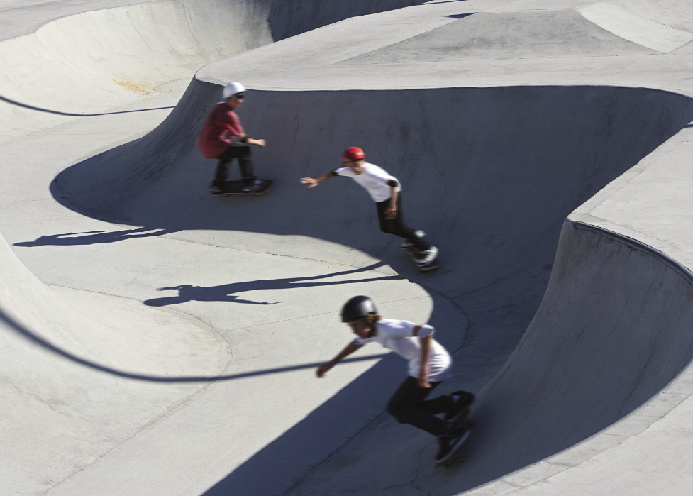
skate park

Slide 10
coffee shop
Notes:
pp

Slide 11
A. 1.Listen and point. Repeat.
1
2
3
studio
soccer field
arcade
4
5
skate park
coffee shop

Slide 12
REVIEW VOCABULARY
++
++

Slide 13
Notes:
Thanh Yến Trần 0967 255 149 zalo/ FB https://www.facebook.com/thanhyentrananhngutaymy/

Slide 14
Answer the question
I want to play football. Where can I go ?
soccer field
CHECK
Notes:
Thanh Yến Trần 0967 255 149 zalo/ FB https://www.facebook.com/thanhyentrananhngutaymy/

Slide 15
I want to drink juice. Where can I go ?
coffee shop
CHECK

Slide 16
I want to play game. Where can I go ?
arcade
CHECK

Slide 17
I want to play skating. Where can I go ?
skate park
CHECK

Slide 18
I want to dance. Where can I go ?
studio
CHECK

Slide 19
B. 1.Listen and practice.
What’s she doing ?
She’s dancing at the studio.
They’re playing soccer at the soccer field.
What are they
doing ?

Slide 20
What +is + she/he +doing ?
He’s/ She’s + V-ing

Slide 21
What + are + you/we/they + doing ?
We/You/They +’re + V-ing

Slide 22
REVIEW SENTENCES
++
++

Slide 23
PLAY
Notes:
Thanh Yến Trần 0967 255 149 zalo/ FB https://www.facebook.com/thanhyentrananhngutaymy

Slide 24
Ms Huyền Phạm
0936.082.789

Slide 25
B. reading book
A. dancing
C. skating
He’s …. at the coffee shop.
Notes:
Thanh Yến Trần 0967 255 149 zalo/ FB https://www.facebook.com/thanhyentrananhngutaymy

Slide 26
B. arcade
A. skate park
C. studio
They’re dancing at the…….
Notes:
Thanh Yến Trần 0967 255 149 zalo/ FB https://www.facebook.com/thanhyentrananhngutaymy

Slide 27
B. Who
What
C. Would
…is he doing ?
He’s reading.

Slide 28
B. He’s playing
arcade at the
video games.
He’s video
games at the
playing arcade.
C. He’s playing
video games
at the arcade.
at / video/ the/
games/ playing/ arcade./ He’s

Slide 29
B
C
A
They’re skating at the…

Slide 30
B. is
A. are
C. am
She…dancing at the studio.

Slide 31
B. skating
C. talking with friends
A. dancing
She’s…..at the coffee shop.
Notes:
Thanh Yến Trần 0967 255 149 zalo/ FB https://www.facebook.com/thanhyentrananhngutaymy

Slide 32
B. What’s she doing ?
A. What are they doing ?
C. What’s he doing ?
They’re playing soccer at the soccer field.
Notes:
Thanh Yến Trần 0967 255 149 zalo/ FB https://www.facebook.com/thanhyentrananhngutaymy

Slide 33
EXIT
Notes:
Thanh Yến Trần 0967 255 149 zalo/ FB https://www.facebook.com/thanhyentrananhngutaymy

Slide 34
PRACTICE

Slide 35
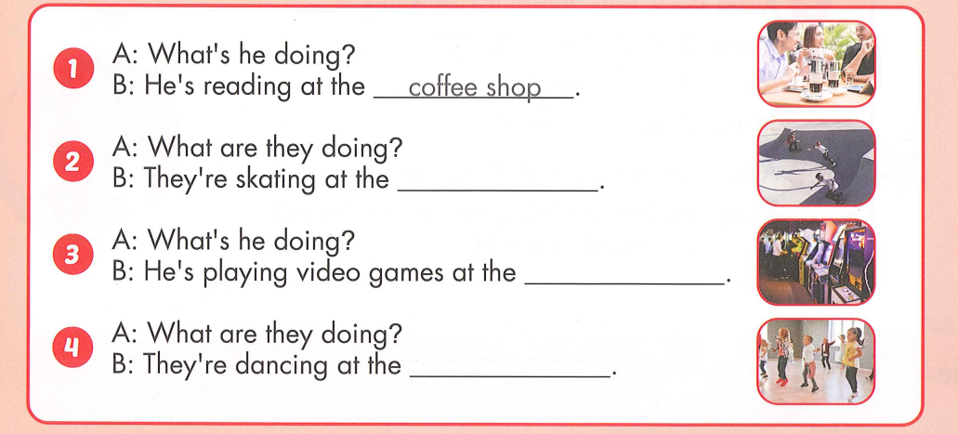
2. Look and write. Practice.
skate park
arcade
studio

Slide 36
GOODBYE

