Slide 1
Unit 4: Travel
Lesson 4.1
Page 57

Slide 2
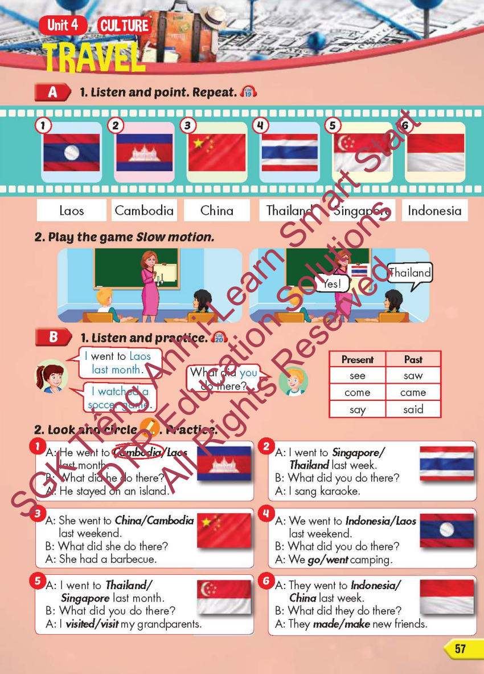
Lesson Outline
Warm-up
Vocabulary
Structure
Consolidation
Wrap-up

Slide 3
Objectives
By the end of this lesson, students will be able to…
Vocabulary: Pronounce and use the words related to the topic properly: Laos, Cambodia, China, Thailand, Singapore, Indonesia
Structure: I went to Laos last month.
- What did you do there?
- I watched a soccer game.

Slide 4
WARM-UP

Slide 6
> Someone has deleted some words.
> Guess the deleted word within the time limit (12 seconds).

Slide 7
They went by van.
CHECK
Notes:
7

Slide 8
They went by helicopter.
CHECK
Notes:
8

Slide 9
They went by plane.
CHECK
Notes:
9

Slide 10
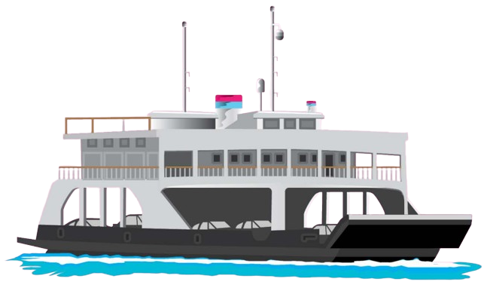
They went by ferry.
CHECK
Notes:
10

Slide 11
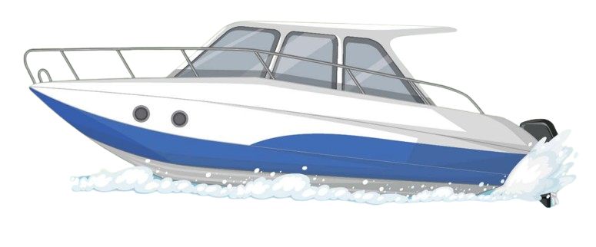
They went by speedboat.
CHECK
Notes:
11

Slide 12
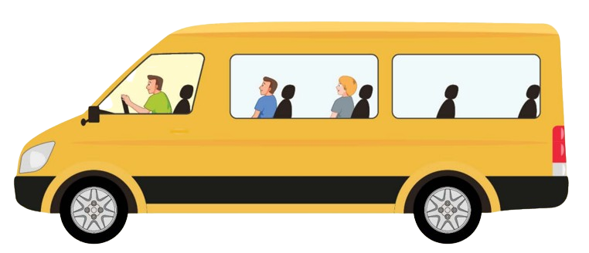
They went by minibus.
CHECK
Notes:
12

Slide 13
It’s time to learn …

Slide 14
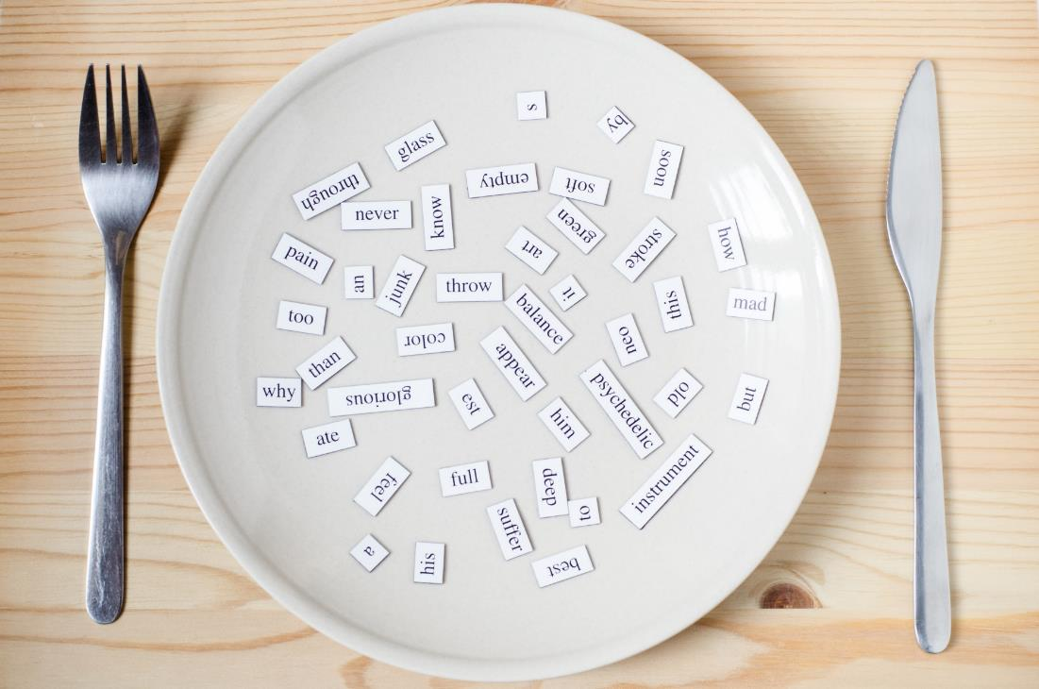
New words
Laos, Cambodia, China,
Thailand, Singapore, Indonesia

Slide 15
Presentation

Slide 16
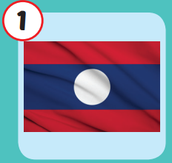
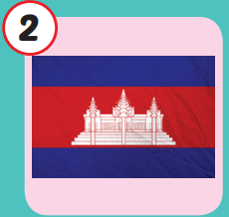
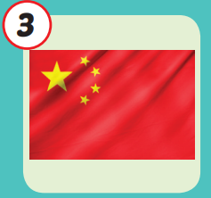
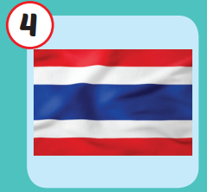
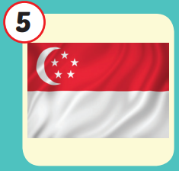
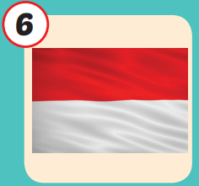
/laʊs/
nước Lào
/kæmˈbəʊdiə/
nước Campuchia
/ˈtʃaɪnə/
nước
Trung Quốc
/ˈtaɪlænd/
nước Thái Lan
/ˈsɪŋəpɔːr/
nước Singapore
/ˌɪndəˈniːʒə/
nước Indonesia
Notes:
Click vào hình A. 1. Listen and point. Repeat để cho cả audio full chạy

Slide 17
/laʊs/
nước Lào

Slide 18
/kæmˈbəʊdiə/
nước Campuchia

Slide 19
/ˈtʃaɪnə/
nước
Trung Quốc

Slide 20
/ˈtaɪlænd/
nước Thái Lan

Slide 21
/ˈsɪŋəpɔːr/
nước Singapore

Slide 22
/ˌɪndəˈniːʒə/
nước Indonesia

Slide 23
Practice

Slide 24
Check your memory

Slide 25
QUESTION
DUCKS
START

Slide 26
Look and choose
LAO
JAPAN
CAMBODIA

Slide 27
Look and choose
LAO
THAILAND
CAMBODIA

Slide 28
Look and choose
CHINA
THAILAND
COMBODIA

Slide 29
Look and choose
LAO
SINGAPORE
INDONESIA

Slide 30
Look and choose
SINGAPORE
THAILAND
COMBODIA

Slide 31
Look and choose
LAO
SINGAPORE
THAILAND

Slide 33
Structure
I went to Laos last month.
- What did you do there?
- I watched a soccer game.

Slide 34
Presentation

Slide 35
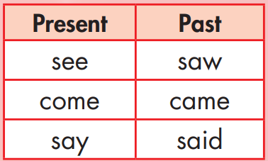
Structure

Slide 36
Practice

Slide 38
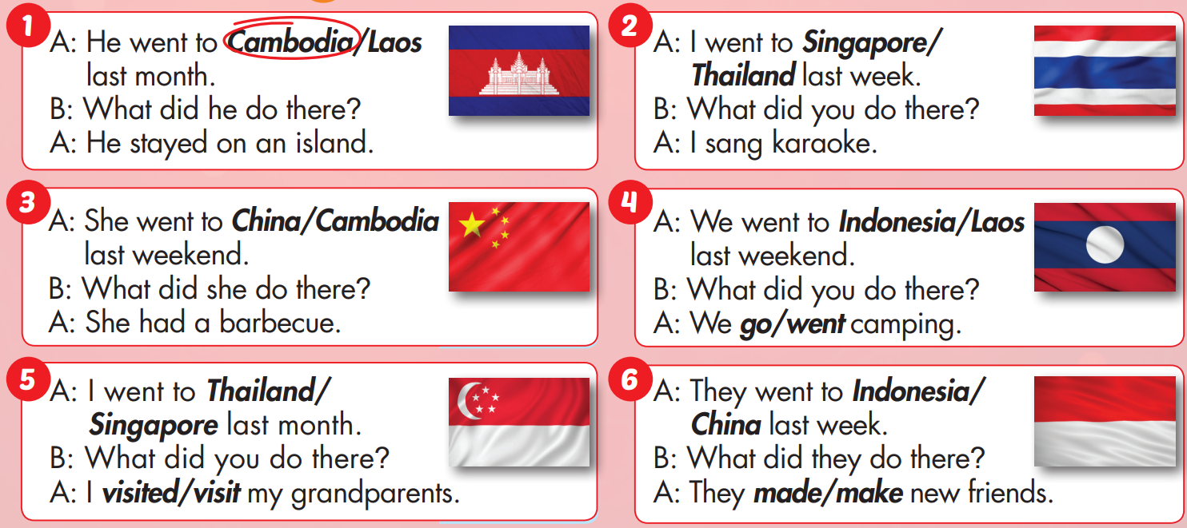

Slide 39
Production

Slide 40
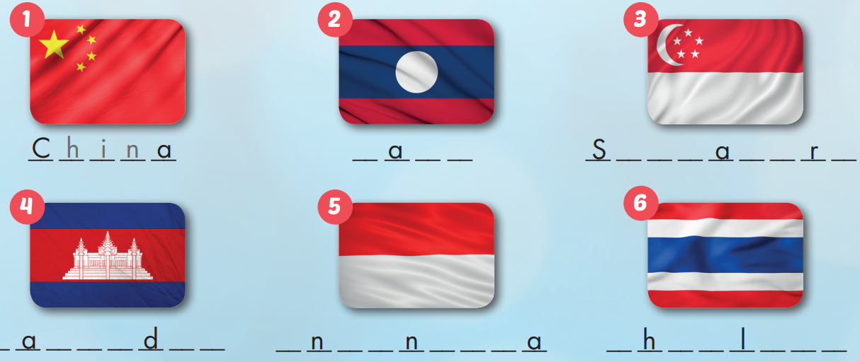
Extra Practice
WB, page 38
L o s
i n g p o e
C m b o i a
I d o e s i
T a i a n d

Slide 41
CONSOLIDATION

Slide 42
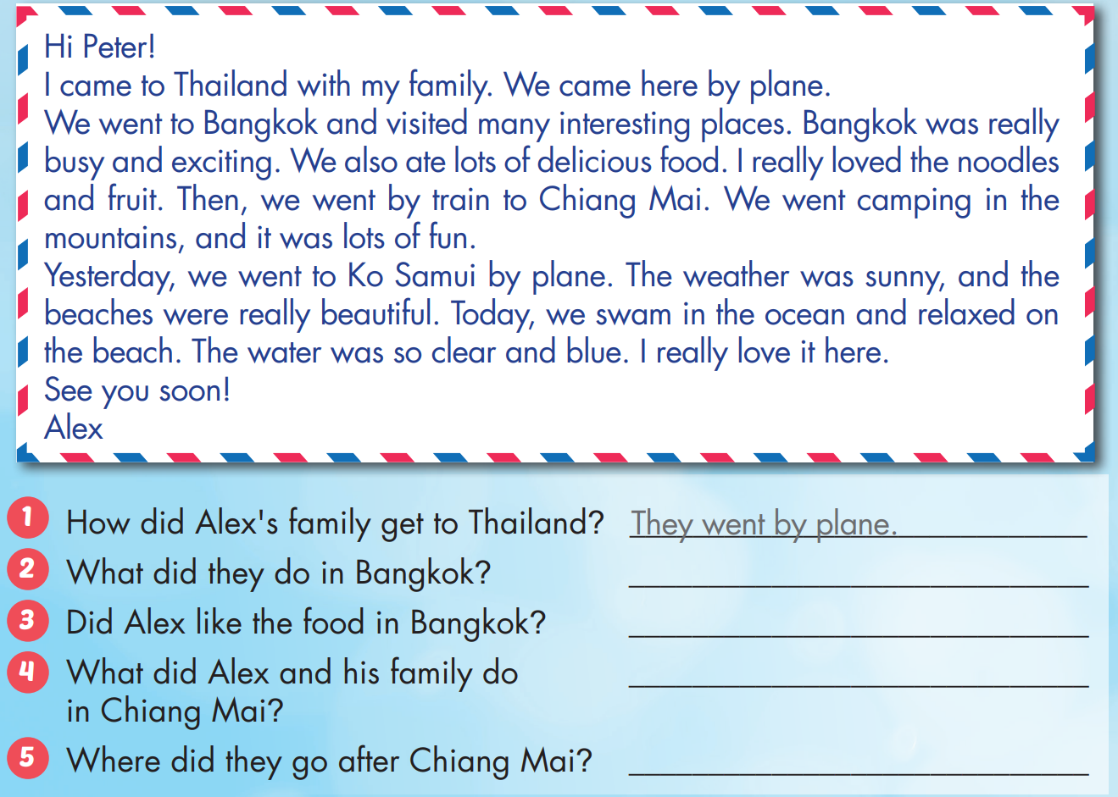
Extra Practice
WB, page 38

Slide 43
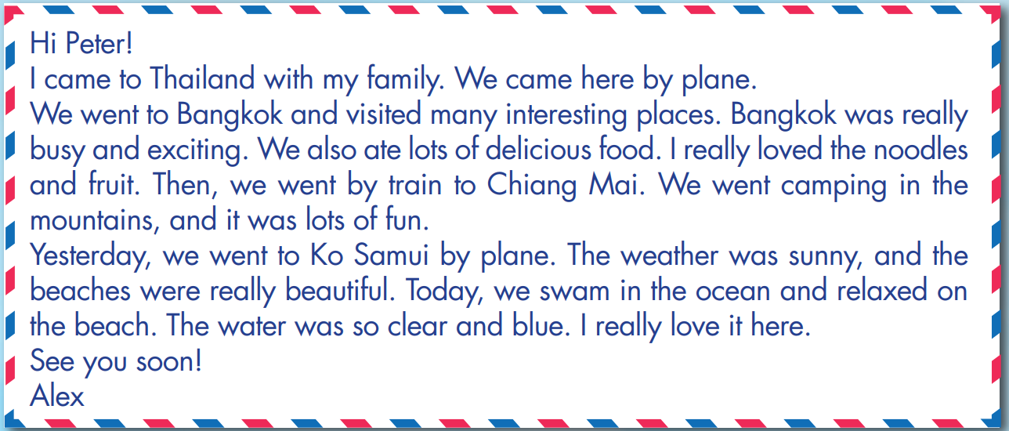
Extra Practice
WB, page 38

Slide 44
Extra Practice
WB, page 38
They visited many interesting places and ate lots of delicious food.
Yes, he did.
They went camping (in the mountains).
They went to Ko Samui.

Slide 45
WRAP-UP

Slide 46
Today’s lesson
Vocabularies
Laos, Cambodia, China, Thailand, Singapore, Indonesia
Structures/ Sentence patterns
I went to Laos last month.
- What did you do there?
- I watched a soccer game.

Slide 47
Homework
Practice the vocabularies and structure, and make sentences using them.
Do the exercises in Tiếng Anh 5 i-Learn Smart Start WB (page 37)
Do the exercises in Tiếng Anh 5 i-Learn Smart Start Notebook (page 25)
Prepare the next lesson (page 58 SB)
Play the consolidation games in Tiếng Anh 5 i-Learn Smart Start DHA App on www.eduhome.com.vn

Slide 48
Enjoy your day!

Slide 49
Lesson 3
Stay positive and have a nice day!

