Slide 1
Unit 19
Which place would you like to visit?
Lesson 2

Slide 2
Vocabulary

Slide 3
Vocabulary
expect
exciting
beautiful
interesting
attractive
delicious
friendly
/ɪkˈspekt/
/ɪkˈsaɪtɪŋ/
/ˈbjuːtɪfl/
/ˈɪntrestɪŋ/
/əˈtræktɪv/
/dɪˈlɪʃəs/
/ˈfrendli/
: Chờ đợi, tưởng
: Thú vị
: Đẹp
: hấp dẫn
: hấp dẫn
: thơm ngon
: thân thiện

Slide 4
Grammar

Slide 5
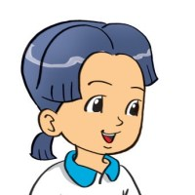
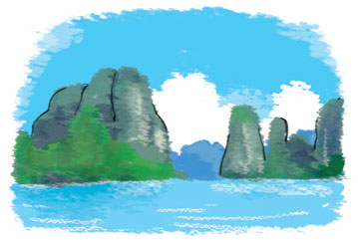
2. Point and say
What do you think of ________________ ?
Ha Long Bay
It's more ____________
than I expected.
attractive

Slide 6
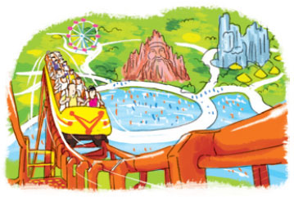
2. Point and say
What do you think of ________________ ?
Dam Sen Park
It's more ____________
than I expected.
exciting

Slide 7
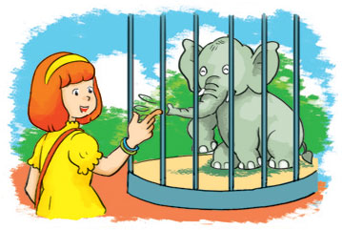
2. Point and say
What do you think of ________________ ?
Thu Le zoo
It's more ____________
than I expected.
interesting

Slide 8
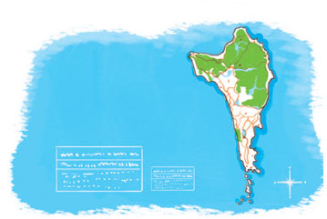
2. Point and say
What do you think of ________________ ?
Phu Quoc Island
It's more ____________
than I expected.
beautiful

Slide 9
3. Let’s talk.
Where did you go ______________?
I went to ______________.
What do you think of ______________?
It's more ______________ than I expected.

Slide 10
4. Listen and circle a or b.
1. Tom thinks Phu Quoc is more ___________
than he expected.
a. exciting b. beautiful
2. Phong thinks Dam Sen Park is more ___________
than he expected.
a. interesting b. exciting
3. Tony thinks Nha Trang is more ___________
than he expected.
a. attractive b. exciting

Slide 11
5. Read and complete.
Tom: What did you do last weekend?
Nam: I went to (1) _________.
Tom: What do you think of it?
Nam: It's more (2) _________ than I expected. The food was (3) _________ and the people were (4) _________. I had a good time there.
Tom: Will you go there (5) _________.
Nam: Yes, I will!
friendly
again
delicious
exciting
Can Tho
Can Tho
exciting
delicious
friendly
again

