Slide 1


















Slide 2



Unit 2 - My House
Lesson 1 – Period 2

Slide 3
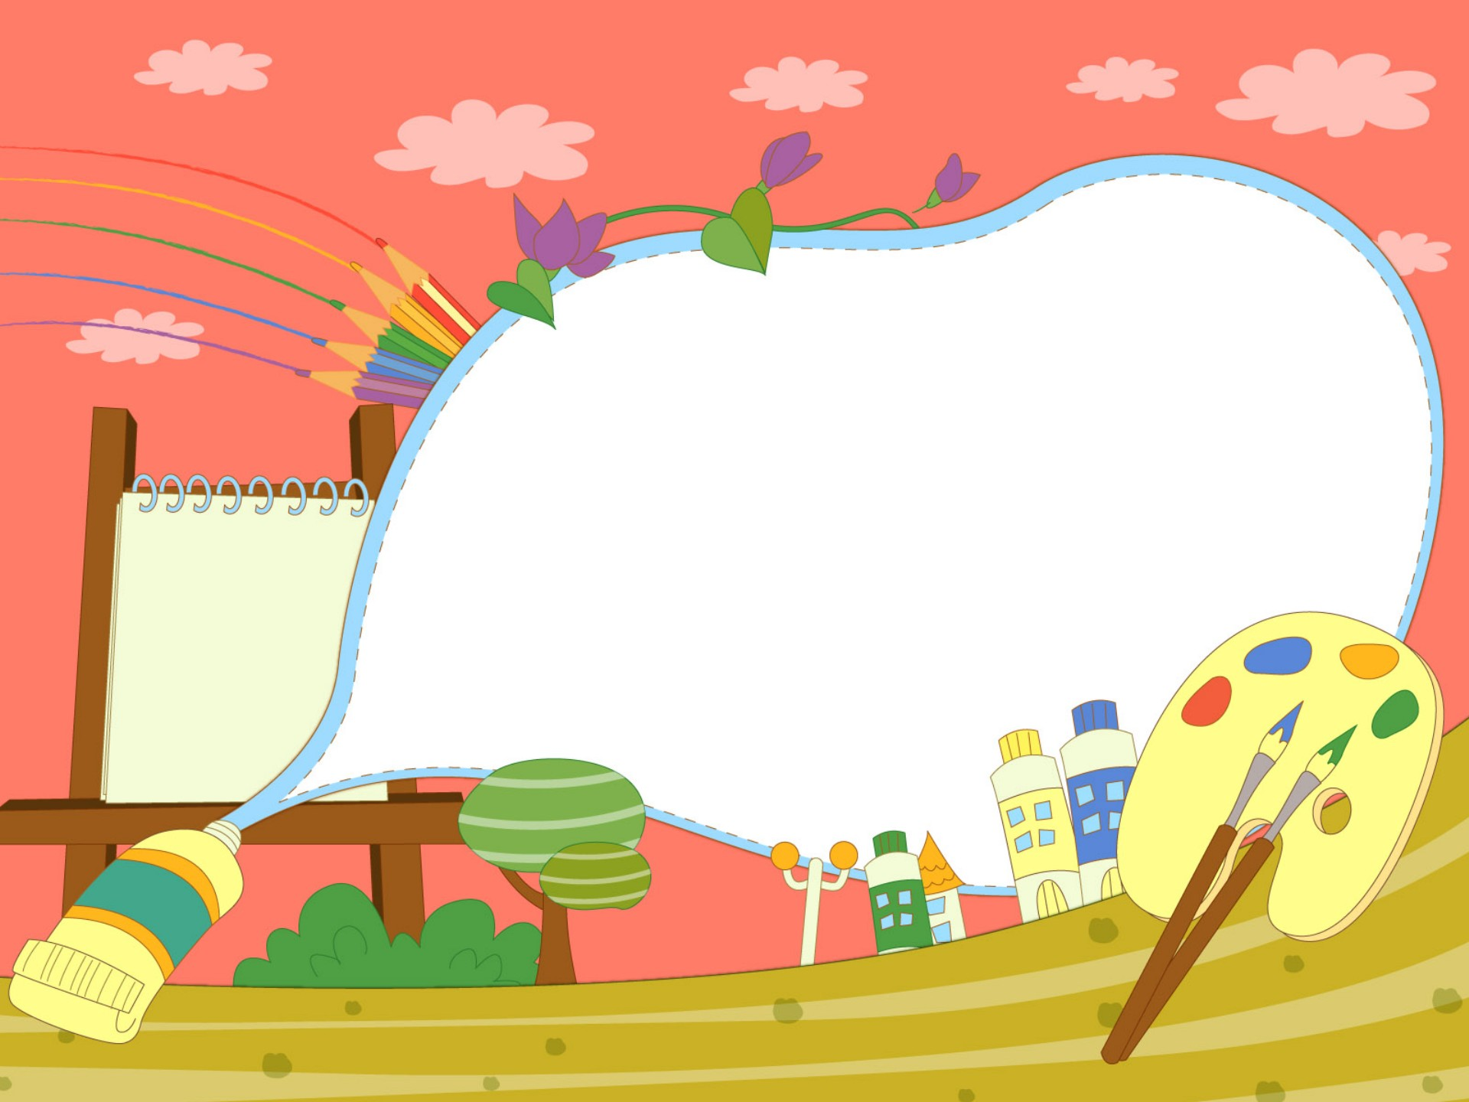

1. Warm up

Slide 4

Do a crossword in red?
6
1
B
A
T
H
R
O
O
M
2
D
I
N
I
N
G
R
O
O
M
3
C
O
M
P
U
T
E
R
4
B
O
W
L
S
5
P
E
N
Next
Notes:
Chọn số 1-5, hiện slide hình để hs trả lời
Ân back sẽ tự động hiện từ ở slide 4
Câu 6 ấn sẽ hiện key.

Slide 5
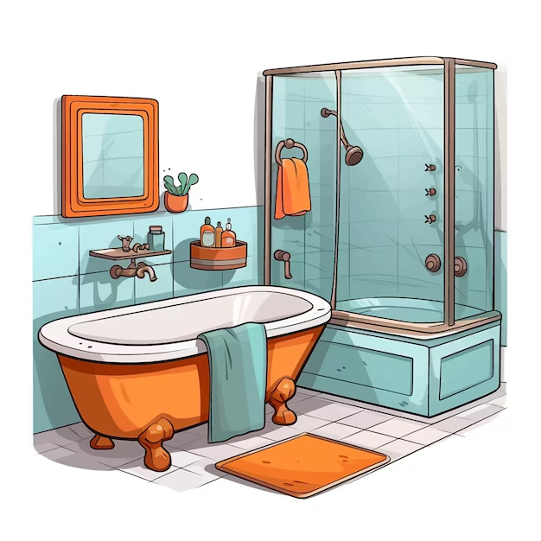
HOME

Slide 6
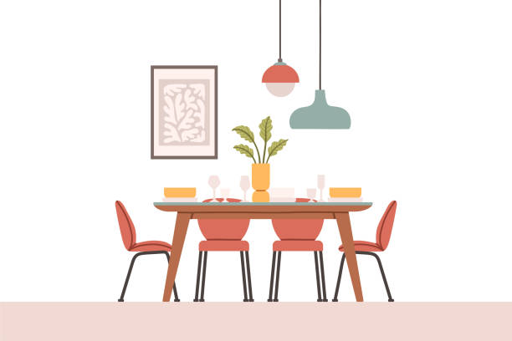
HOME

Slide 7

HOME

Slide 8
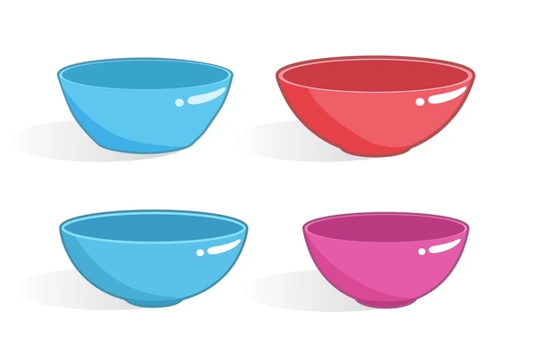
HOME

Slide 9
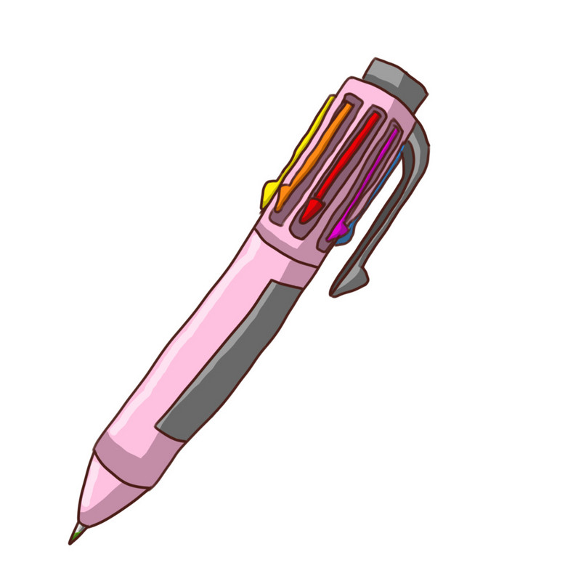
HOME

Slide 10

Presentation
4
Listen and repeat.

Slide 11


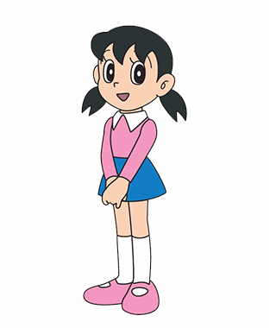

Possessive Adjective
He
- his
I
- my
We
- our
She
- her
They
- their

Slide 12

Practice
5
Look and say.

Slide 13

Yes or No

Slide 14
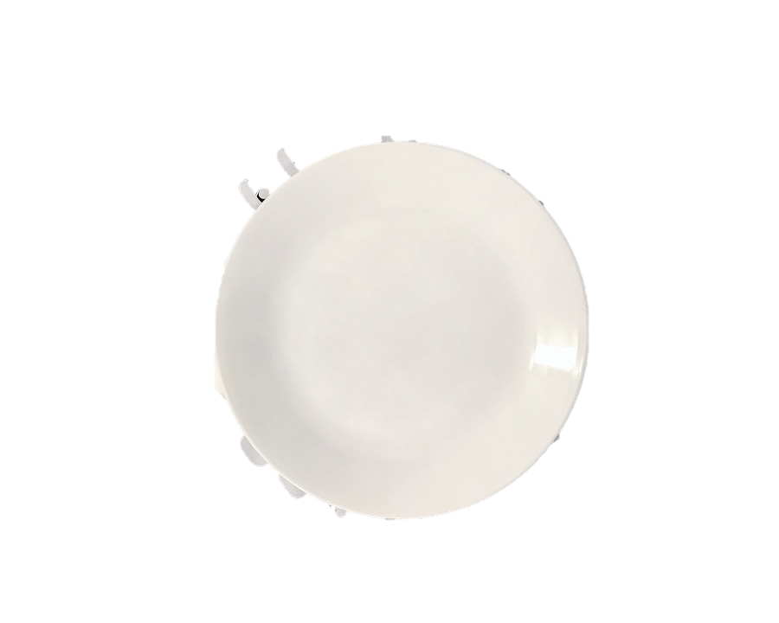
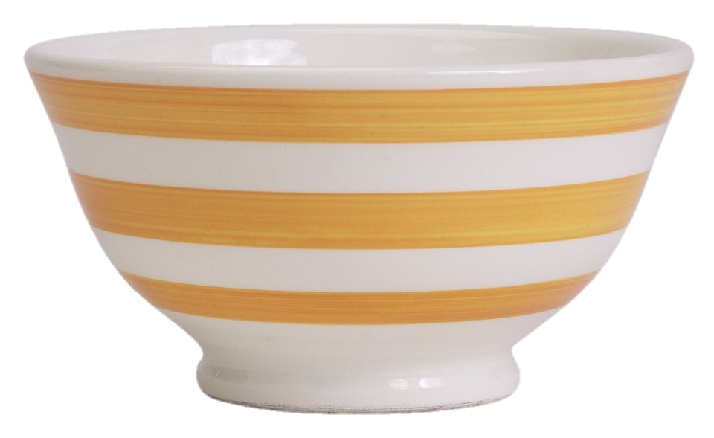
1. Is this a bowl?
2. Is this a spoon?
Yes
No
Yes
No
No, it’s a plate.

Slide 15
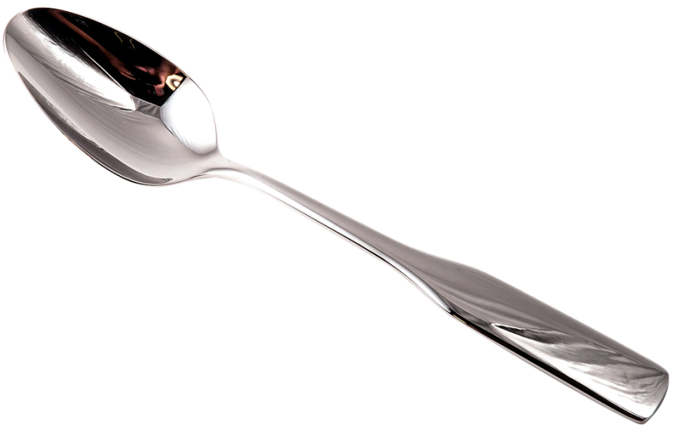

3. Are there two plates?
4. Is this a garden?
Yes
No
Yes
No
No, they are spoons.

Slide 16

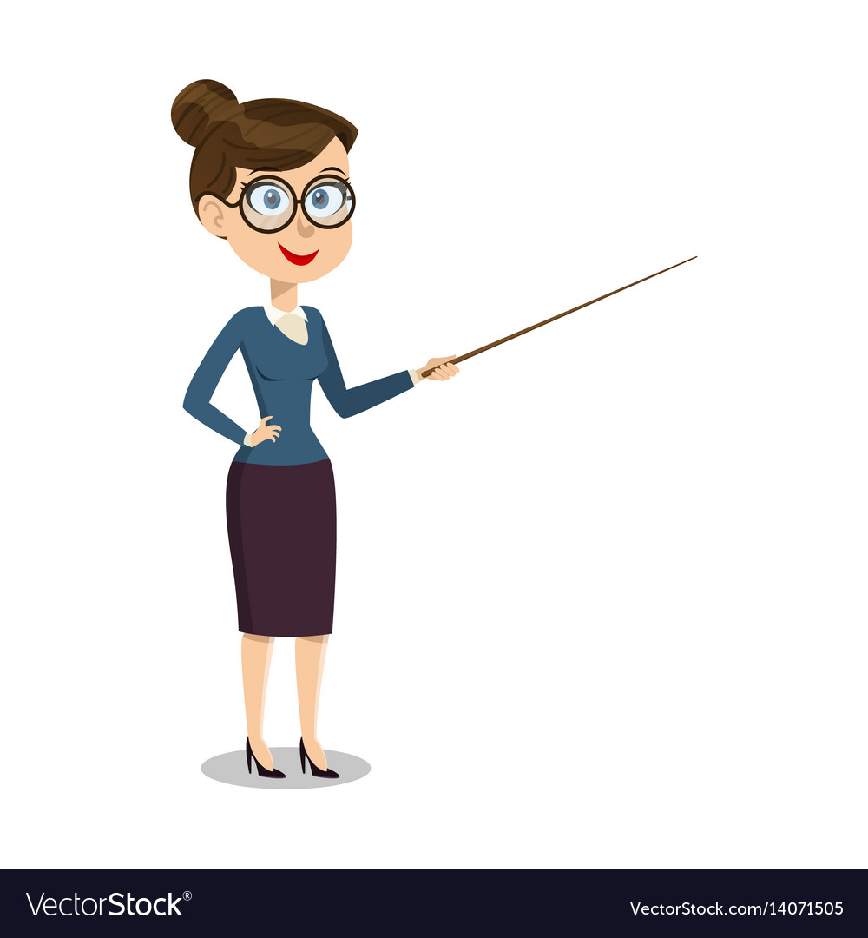
5
Look and say.
bowl/his
Whose bowl is it?
It’s his bowl.

Slide 17

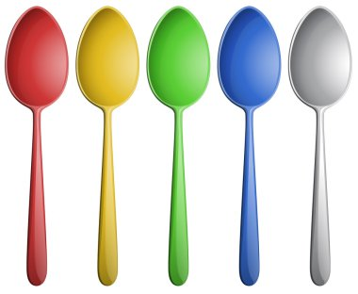

spoons/her
Whose spoons are they?
They’re her spoons.

Slide 18

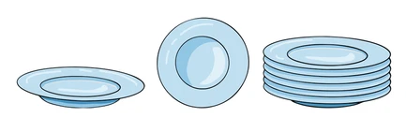
plates/our
Whose plates are they?
They’re our plates.

Slide 19

garden/their
Whose garden is it?
It’s their garden.

Slide 20
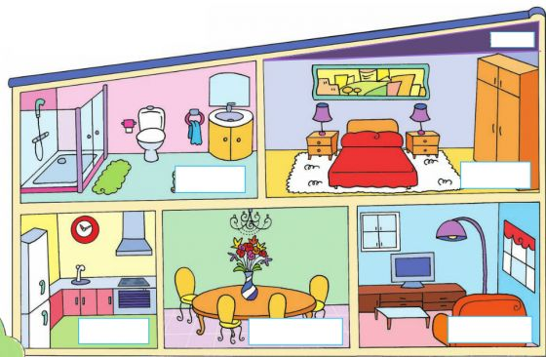
Further practice
It is…/ They are...
my …
his …
her …
our …
their…

Slide 21

Production
6
Let’s talk.

Slide 22

Assessment

Slide 23

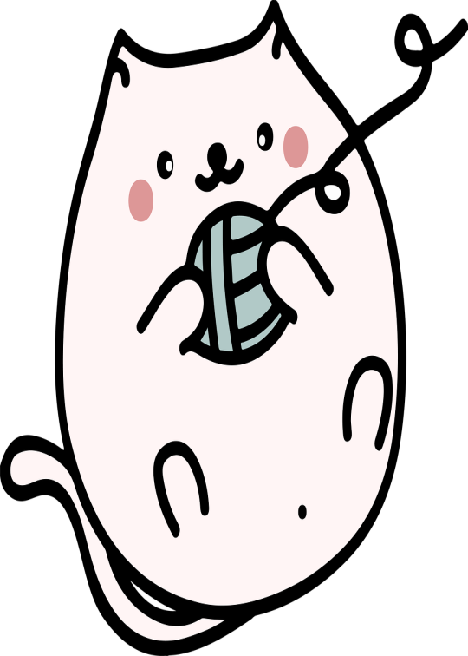
Choose the correct answers.
1. It ___ my pen.
A. is
B. are
C. do
D. does
2. They’re our ____________.
A. boke
B. bokso
C. bowk
D. books
3. Whose spoon is it? It’s ____ spoon.
A. I
B. we
C. his
D. he
4. Your _______ is so big!
A. is
B. dining room
C. do
D. does
Notes:
HOẠT ĐỘNG TƯƠNG TÁC

Slide 24
Wrap up
Notes:
Đây k phải là extra, đây là hđ 3 của bài

Slide 25
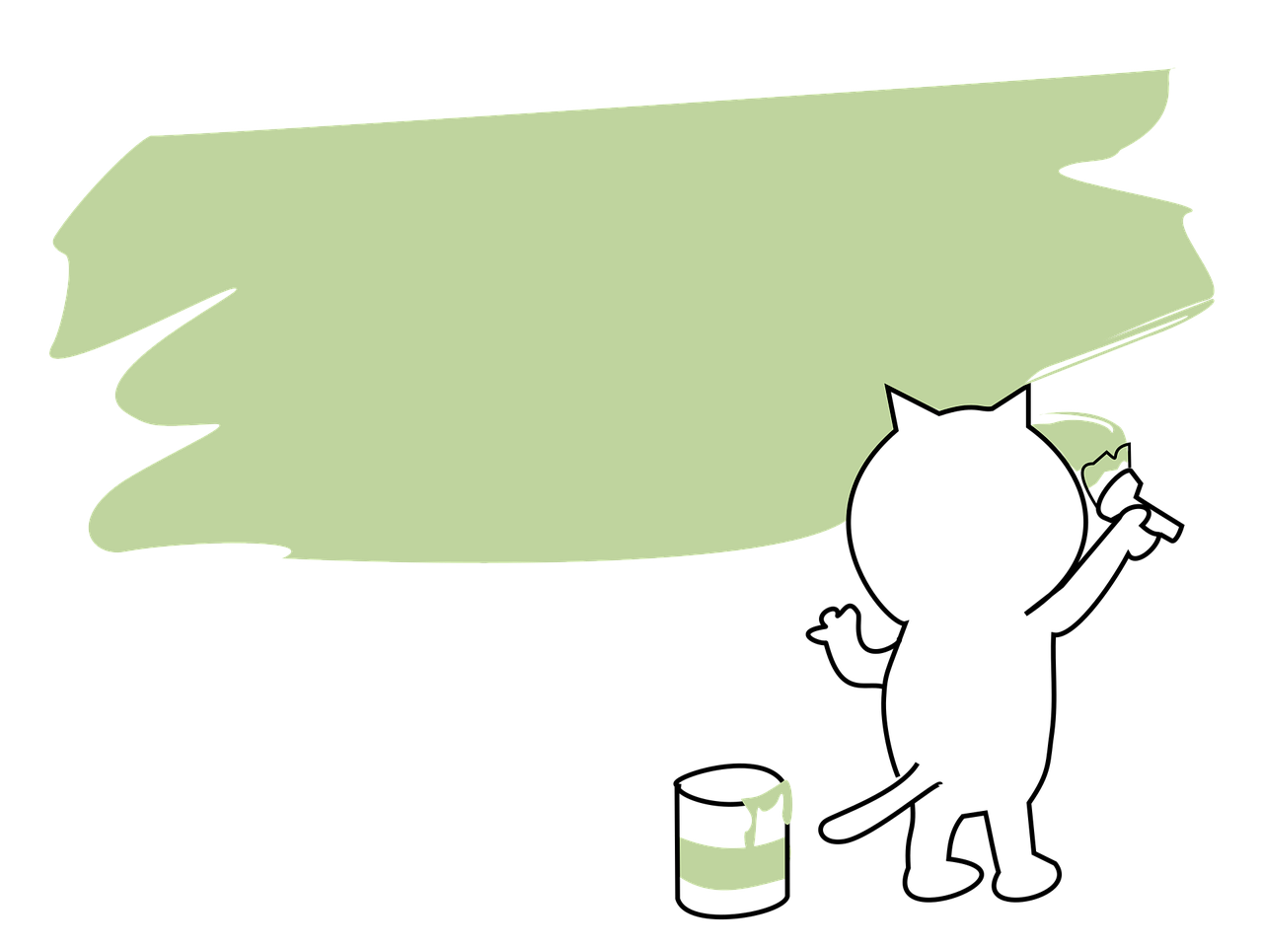
Structure
Whose ___ is it/ are they?
It’s____.
They’re ___.

