Slide 1







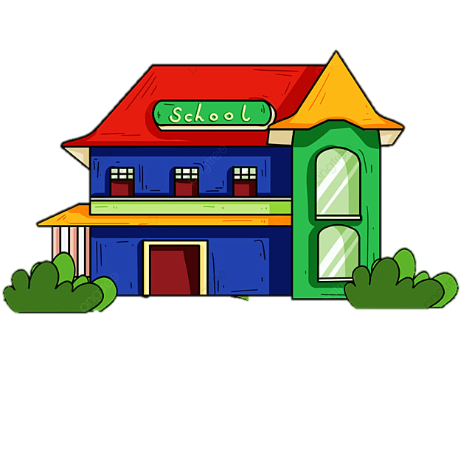











Notes:
Để nguyên trang bìa như này, chỉ thay đổi tên bài trong quá trình làm. Logo của sách Wonderful World

Slide 2



Unit 2 - My Home
Lesson 2 – Period 1

Slide 3
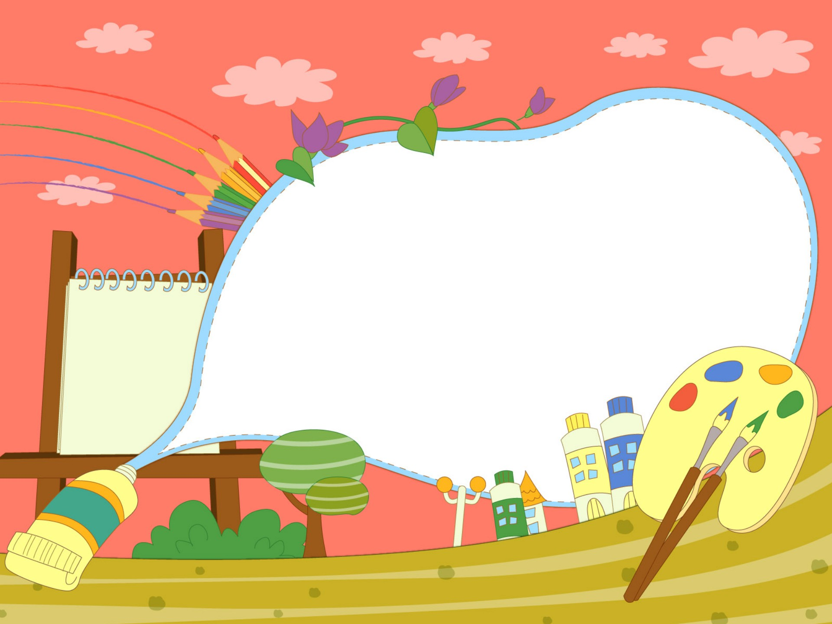

Warm up
Guessing Game

Slide 4
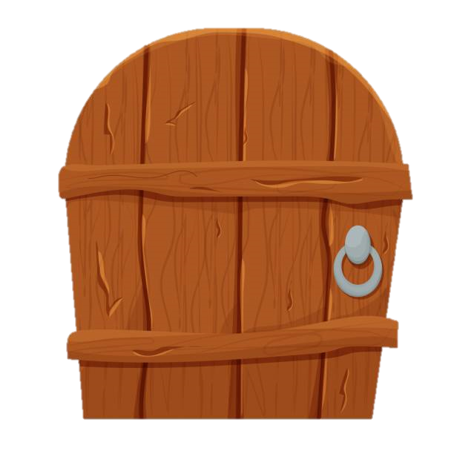

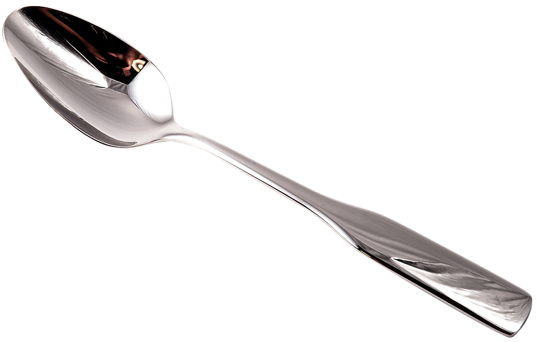
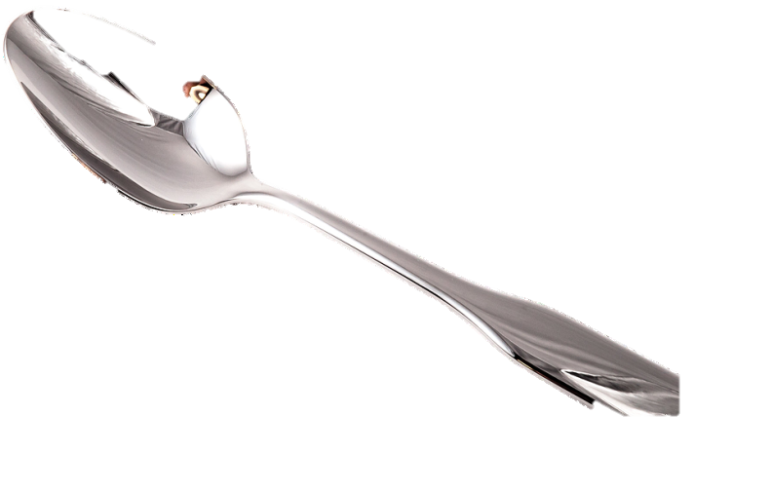
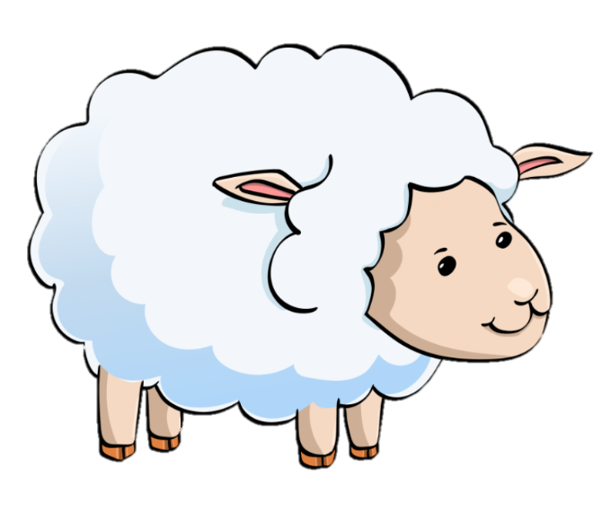
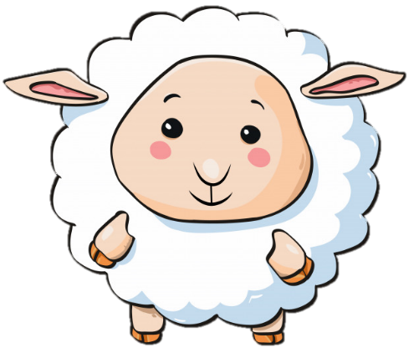
5 stars
What is it?
It’s a spoon.

Slide 5
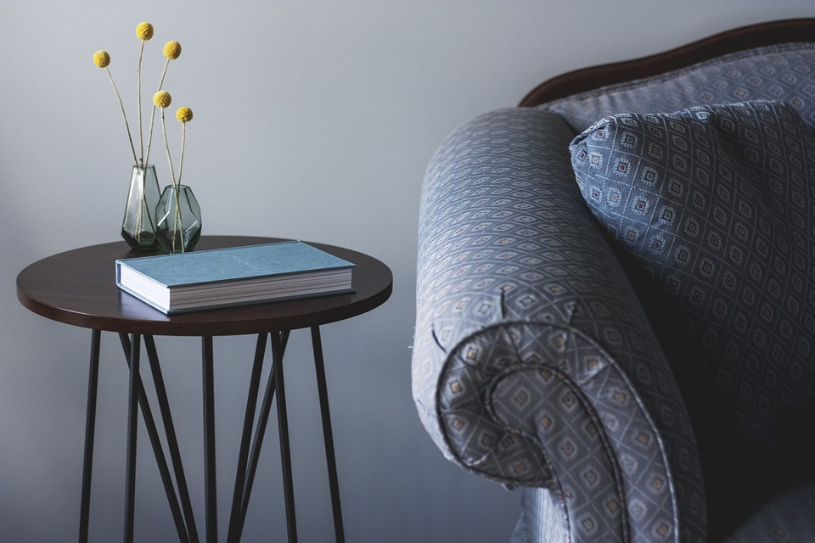
3 stars
It’s their ____.
It’s their table.
Notes:
Dấu chấm câu

Slide 6
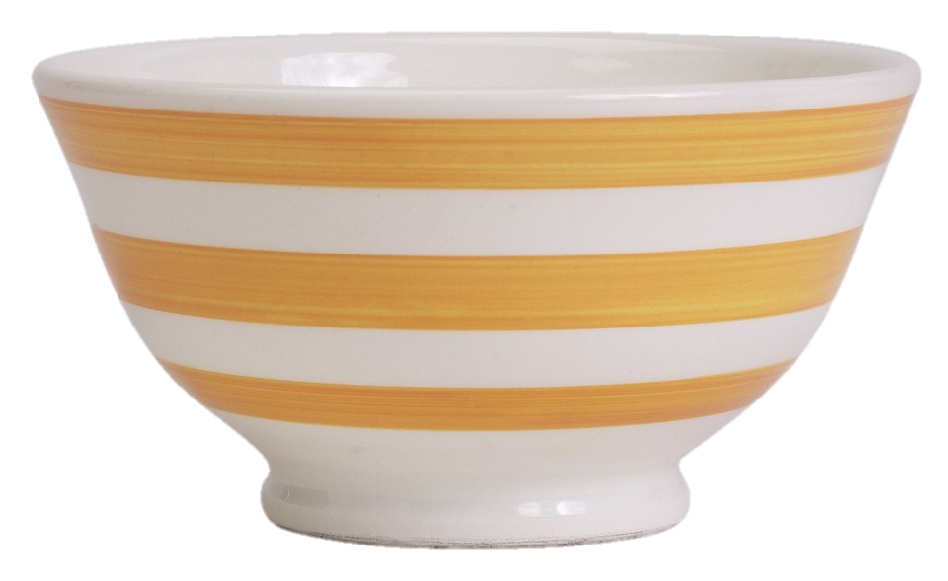
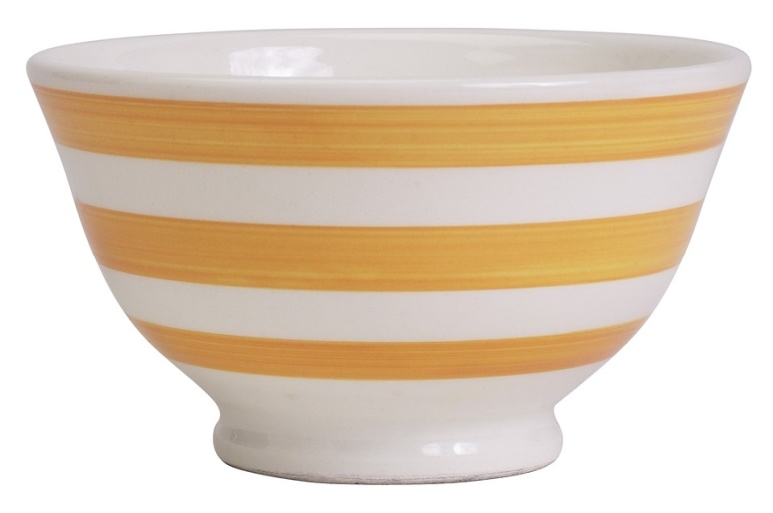
4 stars
It’s her _____.
It’s her bowl.

Slide 7
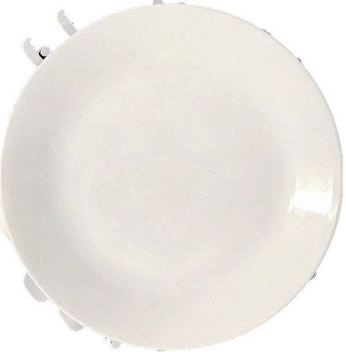
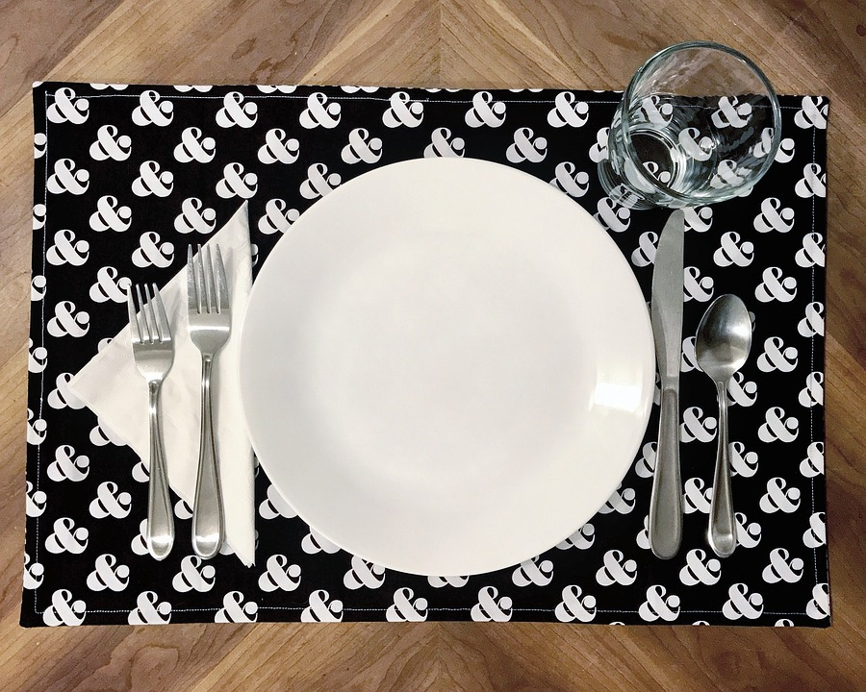

5 stars
Look at my ____.
Look at my plate.

Slide 8

Presentation
1
Listen and point. Repeat.

Slide 9


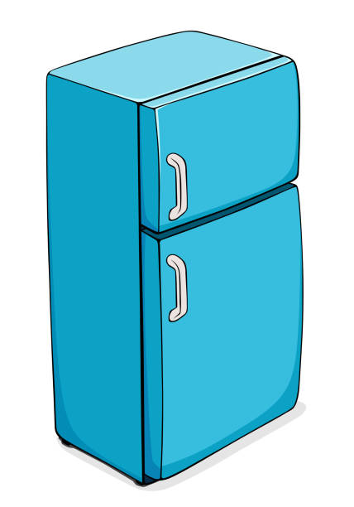
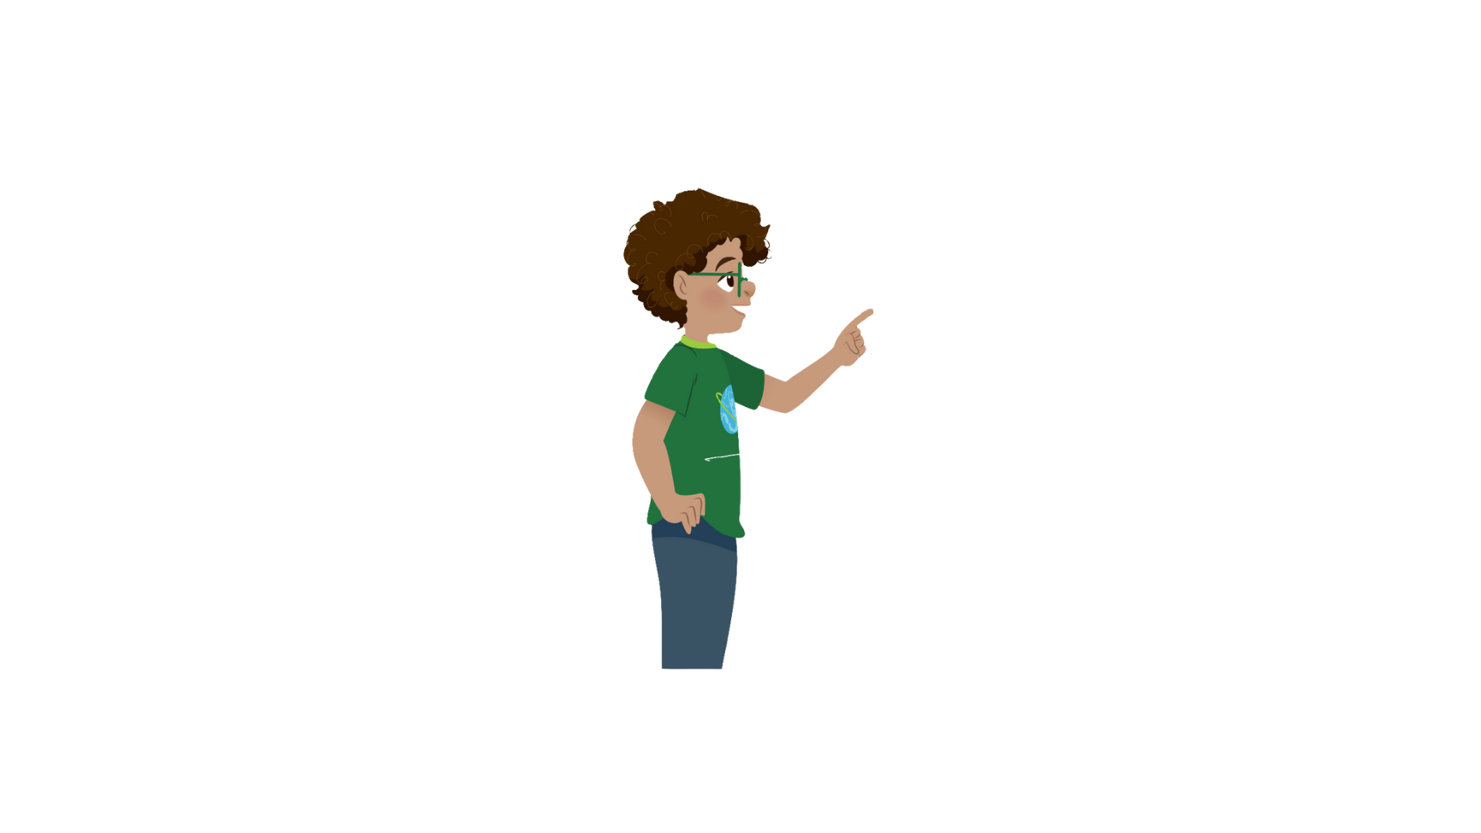

1
Listen and point. Repeat.
fridge

Slide 10
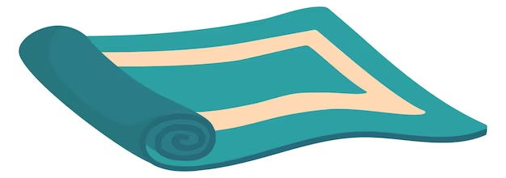

rug

Slide 11
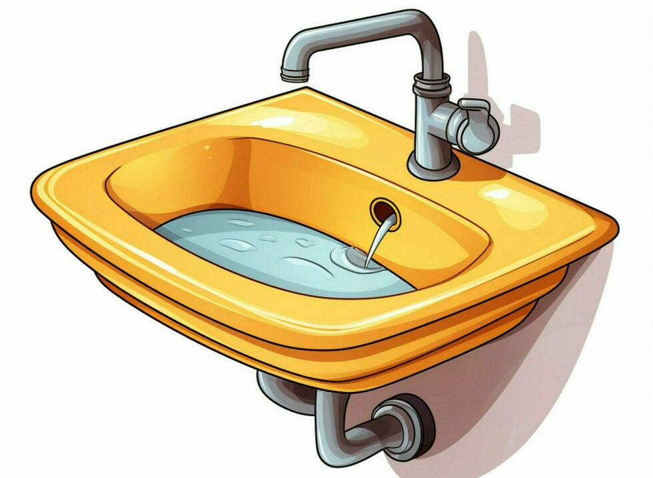

sink

Slide 12

sofa

Slide 13
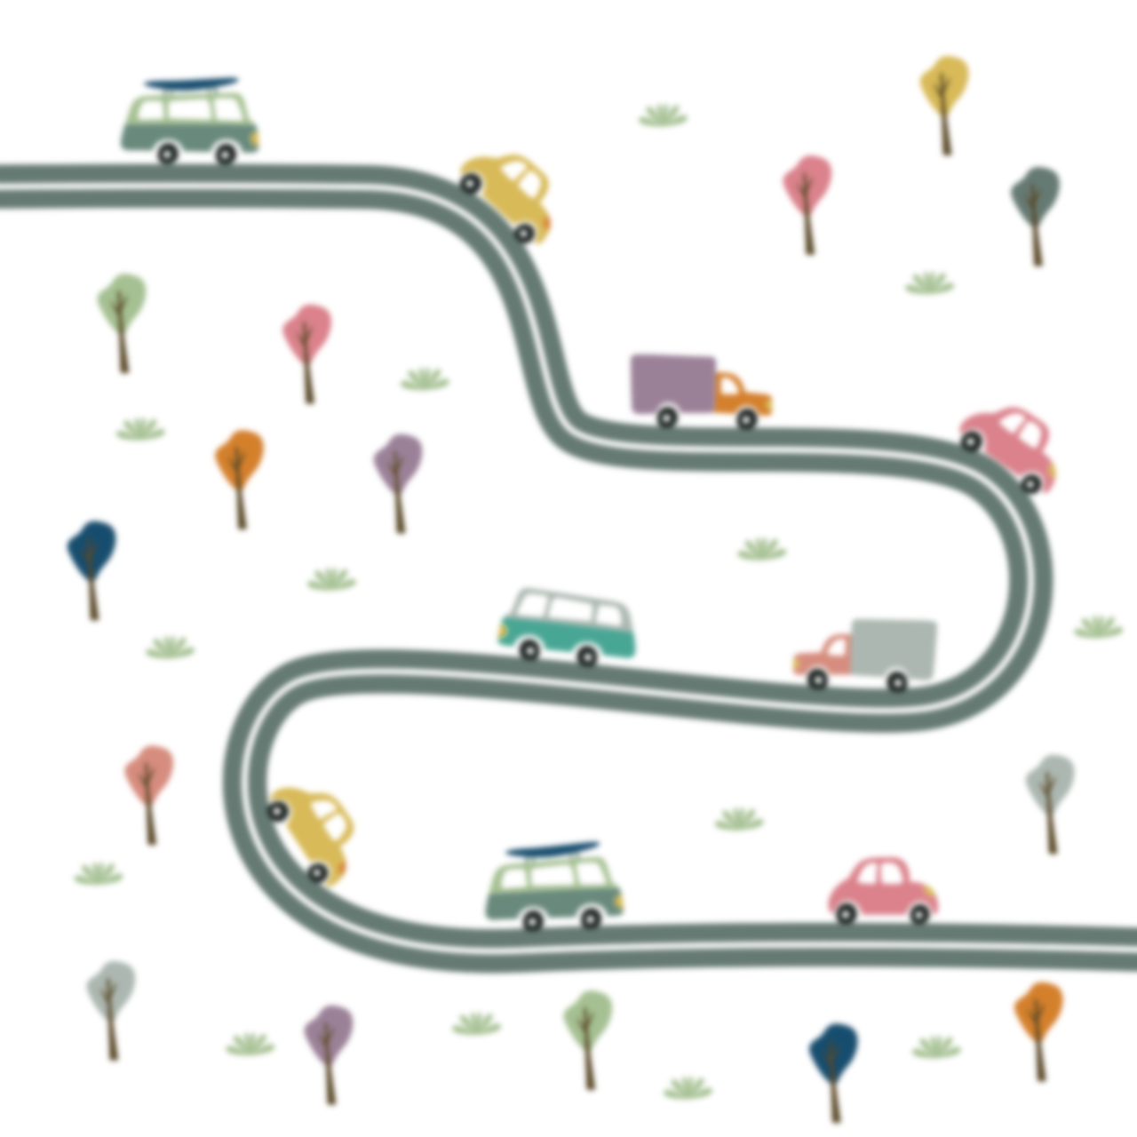
1
Listen and point. Repeat.
fridge
rug
sink
sofa

Slide 14

Practice
2
Listen and read. Tick

Slide 15

Production

Slide 16
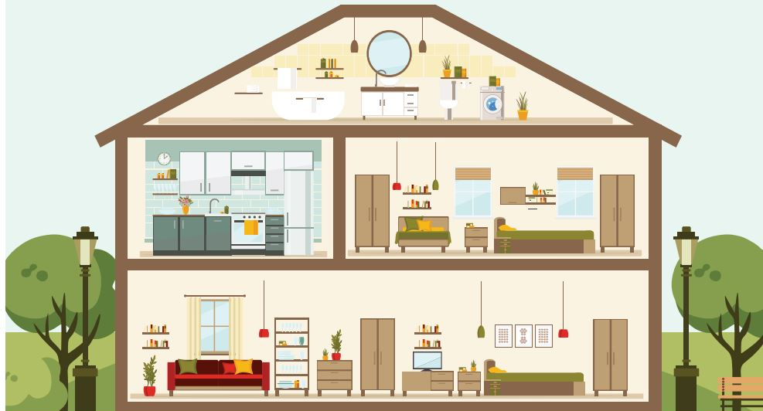


3
Look and say.
What room is it?
It’s a living room.

Slide 17
3
Look and say.
No, it isn’t.
It’s a kitchen.
Is it the bedroom?

Slide 18
1
2
3
4
Next

Slide 19
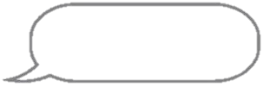
3
Look and say.
There’s a sofa in our living room.
BACK
Living room

Slide 20
There is a fridge in our kitchen.
Kitchen
BACK

Slide 21

There’s a rug in our living room.
Living room
BACK

Slide 22
There’s a sink in our kitchen.
Kitchen
BACK

Slide 23

Assessment

Slide 24
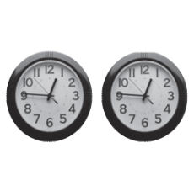
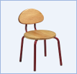


Look and read. Put tick (✓) or cross (✗) in the box.
Ex:
There are two pens.
✗
This is a chair.
✓
1. There is a rug.
3. A sink is in the kitchen.
2. There is a sofa.
4. A fridge is in the bedroom.
Notes:
HOẠT ĐỘNG TƯƠNG TÁC

Slide 25
Wrap up
Notes:
Đây k phải là extra, đây là hđ 3 của bài

Slide 26
REMEMBER
VOCABULARY:
Sink
Sofa
Rug
Fridge
STRUCTURE:
Where is the sofa?
- It’s in the living room.
26

