Slide 1








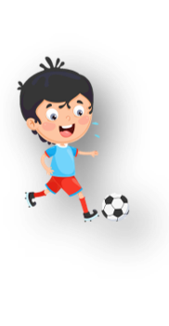












Unit 1
My family
Lesson 3 – Task 1,2,3
Notes:
Để nguyên trang bìa như này, chỉ thay đổi tên bài trong quá trình làm. Logo của sách Wonderful World

Slide 2



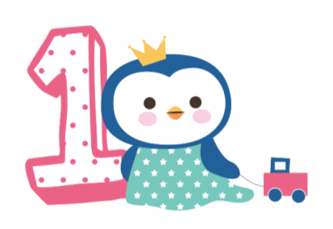



Warm up
Game: Silent ball

Slide 3
GAME:
MATCHING
Match the picture with its word.
Notes:
-Divide class into 2 teams- Boys and girls
-Let the sts in each team take turn to choose the numbers to find the 2 matches picture and word

Slide 4

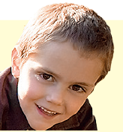
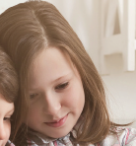

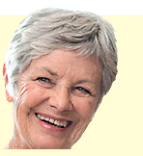


1
2
3
mum
4
5
6
dad
7
8
9
sister
grandpa
10
11
12
grandma
brother

Slide 5

Presentation
Task 1: Listen and point. Repeat

Slide 6
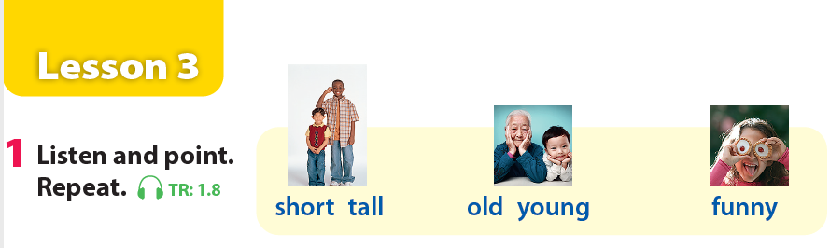
Notes:
GV click phần Audio sau đó nghe tới đâu từ nào thì click vào ảnh từ đó.
Let the sts listen and point
Then repeat

Slide 7
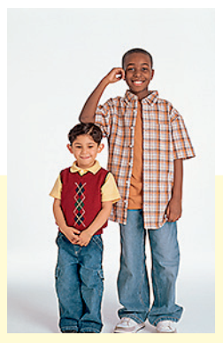
short-tall
Notes:
Let the sts look at the picture and repeat

Slide 8
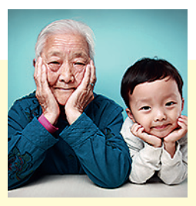
old-young
Notes:
Let the sts look at the picture and repeat

Slide 9
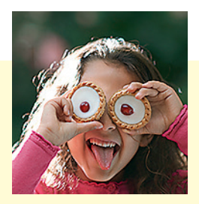
funny
Notes:
Let the sts look at the picture and repeat

Slide 10

Practice
Task 2: Listen and tick

Slide 11



Listen and tick the box
✓
A
B
C
Notes:
Divide the class into groups of 4 (each group has 4 sts).
Give cards with letter A,B,C for the groups.
Sts listen and choose the correct answer (A,B,C). Who can make it will get points.

Slide 12
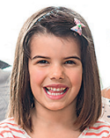
Listen and tick the box
✓
A
B
C
Notes:
Divide the class into groups of 4 (each group has 4 sts).
Give cards with letter A,B,C for the groups.
Sts listen and choose the correct answer (A,B,C). Who can make it will get points.

Slide 13
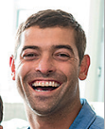
Listen and tick the box
✓
A
B
C
Notes:
Divide the class into groups of 4 (each group has 4 sts).
Give cards with letter A,B,C for the groups.
Sts listen and choose the correct answer (A,B,C). Who can make it will get points.

Slide 14

Listen and tick the box
✓
A
C
B
Notes:
Divide the class into groups of 4 (each group has 4 sts).
Give cards with letter A,B,C for the groups.
Sts listen and choose the correct answer (A,B,C). Who can make it will get points.

Slide 15
Listen and tick the box
✓
A
C
B
Notes:
Divide the class into groups of 4 (each group has 4 sts).
Give cards with letter A,B,C for the groups.
Sts listen and choose the correct answer (A,B,C). Who can make it will get points.

Slide 16
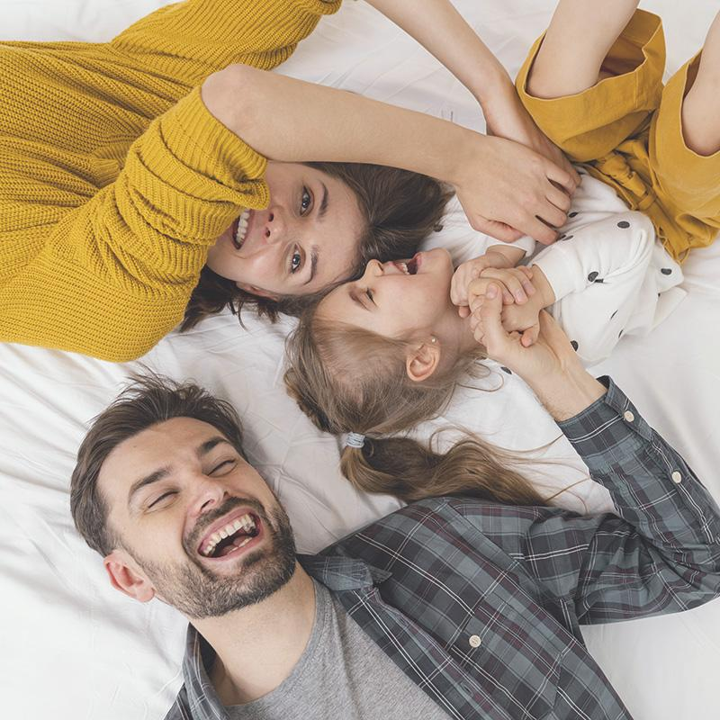
Practice
Task 3: Match and say

Slide 17
Game time!
Choose and say.

Slide 18


d
b
f
a
c
e
Go
Notes:
This game can be played in groups/teams.
Each member of a group choose a letter talk about their family members.
Give points for the groups.

Slide 19

My mum is …..
tall/short/funny/great/cool/young/old
Well done!
Notes:
This game can be played in groups/teams.
Each member of a group choose a letter talk about their family members.
Give points for the groups.

Slide 20
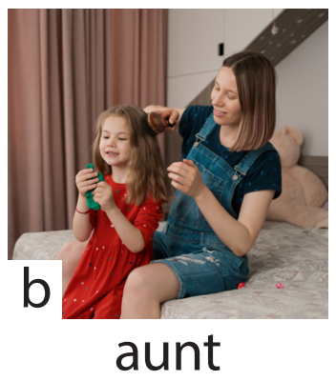
My aunt is …..
tall/short/funny/great/cool/young/old
Great job!
Notes:
This game can be played in groups/teams.
Each member of a group choose a letter talk about their family members.
Give points for the groups.

Slide 21
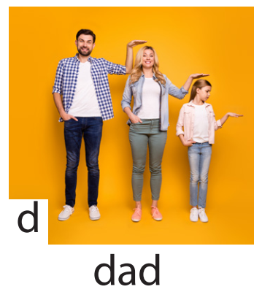
My dad is …..
tall/short/funny/great/cool/young/old
Amazing!
Notes:
This game can be played in groups/teams.
Each member of a group choose a letter talk about their family members.
Give points for the groups.

Slide 22
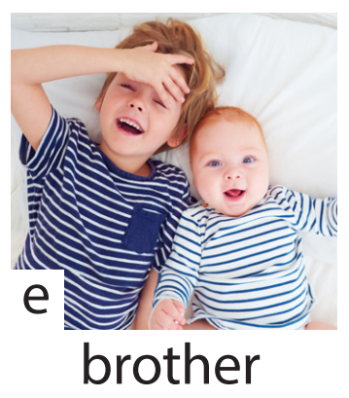
My brother is …..
tall/short/funny/great/cool/young/old
Good job!
Notes:
This game can be played in groups/teams.
Each member of a group choose a letter talk about their family members.
Give points for the groups.

Slide 23
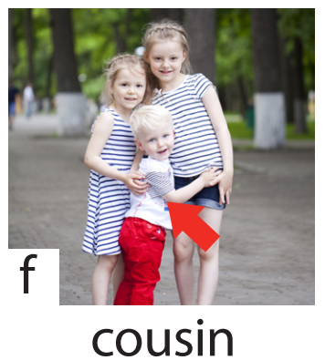
My cousin is …..
tall/short/funny/great/cool/young/old
Well done!
Notes:
This game can be played in groups/teams.
Each member of a group choose a letter talk about their family members.
Give points for the groups.

Slide 24

Production
Draw a picture and write a text about family

Slide 25
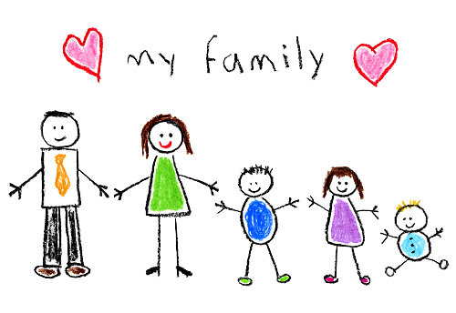
Example: This is my family. My mum is cool. My dad is tall. My sister is young. My baby brother is funny. I love my family.
Notes:
-Let the sts draw a picture of members in their family and write a text about them using adjectives. (read the example on the board)
-Call some sts to present their own work

Slide 26

Assessment

Slide 27
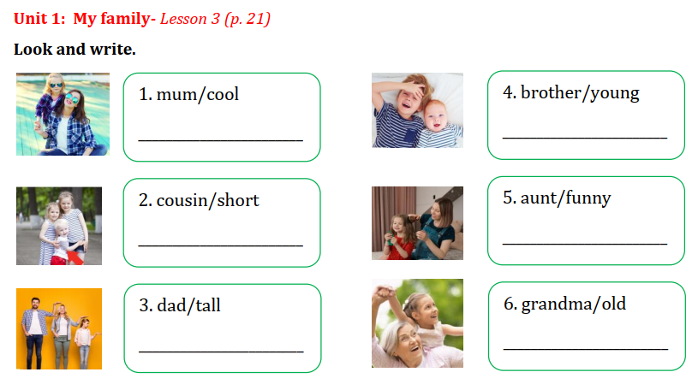
My mum is cool.
My brother is young.
My cousin is short.
My aunt is funny.
My dad is tall.
My grandma is old.
Notes:
THIẾT KẾ HOẠT ĐỘNG TƯƠNG TÁC CHO 6 CÂU NÀY. TRẢ LỜI TỰ LUẬN
Sts look at the picture and given words. Write the sentences on the board or on their notebooks.

