Slide 1









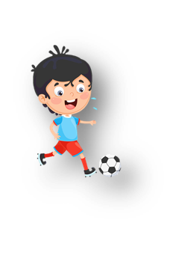

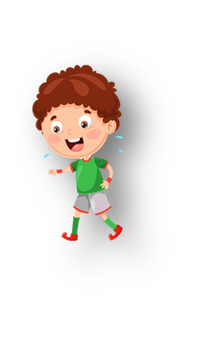









Unit 0
Greetings
Notes:
Để nguyên trang bìa như này, chỉ thay đổi tên bài trong quá trình làm. Logo của sách Wonderful World

Slide 2



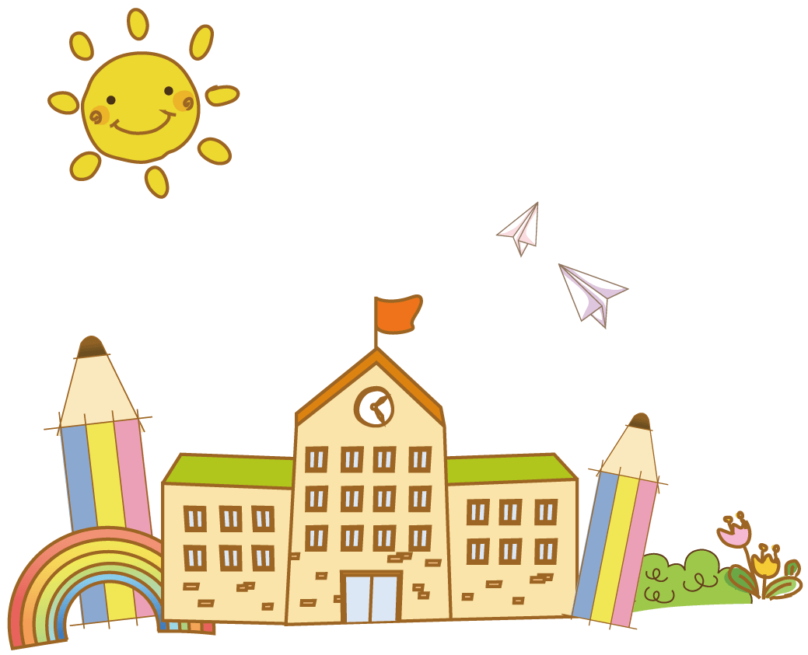

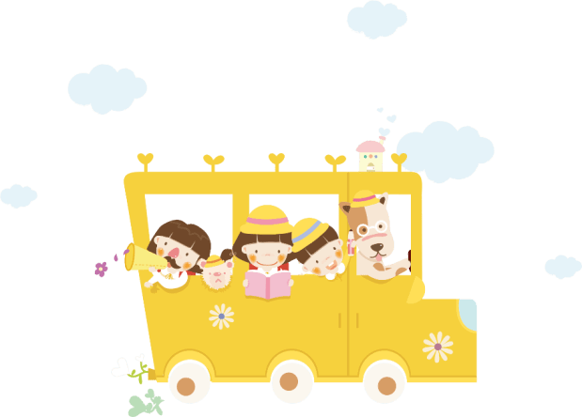
Warm up!

Slide 3
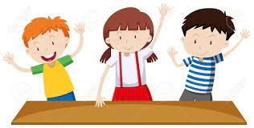



Movement Game: Hip hip hooray
Hands up!
Hands down!
Hip hip hooray
Go to Wonderful World!
Notes:
+ Hands up: raise 2 hands up
+ Hands down: Put to hands down
+ Hip hip hooray (2 times): smack 2 hands on hips then put hands to mouth when saying hooray (2 times)
+ Go to Wonderful World: join 2 hands and make waves then raise both hands up and wave.

Slide 4
Memorization
game

Slide 5

Presentation
Task 1: Listen and repeat

Slide 6


Slide 7





Notes:
Do as a model
Say a word/sentence for sts to repeat then point.

Slide 8
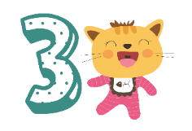
Practice
Task 2: Say

Slide 9
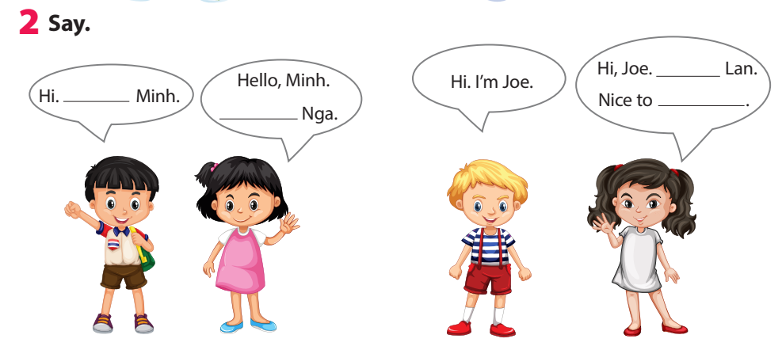
I’m
meet you
I’m
I’m
Notes:
Task 2: Say
- Ask sts how many friends can they see and their names.
- Have sts look at the bubbles and ask them to complete (spoken).
- Have sts practice the dialogues in chorus, group, pairs.

Slide 10
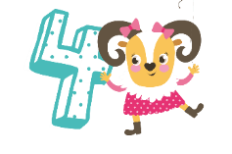
Production
Make a name tag

Slide 11
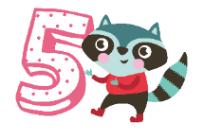
Assessment
Choose the correct answer!
Notes:
Thiết kế hoạt động tương tác ở phần Assessment (nội dung câu hỏi ở slide 17, 18.)

Slide 12

Choose the correct answer!
  1. ……, I’m Nhung.
Hello B. I’m Tuan
2. Hi, ……….
A. Hello B. I’m Ana
3. I’m Thanh. …….
A. Hello, Thanh B. Nice to meet you
Notes:
Choose the correct answer
……, I’m Nhung.
A. Hello B. I’m Tuan
2. Hi, ……….
A. Hello B. I’m Ana
3. I’m Thanh. …….
A. Hello, Thanh B. Nice to meet you
- Check in pair then whole class.
- Say goodbye

Slide 13
Good bye.
See you again!

