Slide 1
Unit 1: Animals
Lesson 2.1
Page 9

Slide 2
Objectives
By the end of this lesson, students will be able to…
Vocabulary: Pronounce and use the words related to the topic properly: panda, giraffe, lion, dolphin, tiger, zebra.
Structure: What's this? - It's a panda.
What's that? - It's a dolphin.

Slide 3
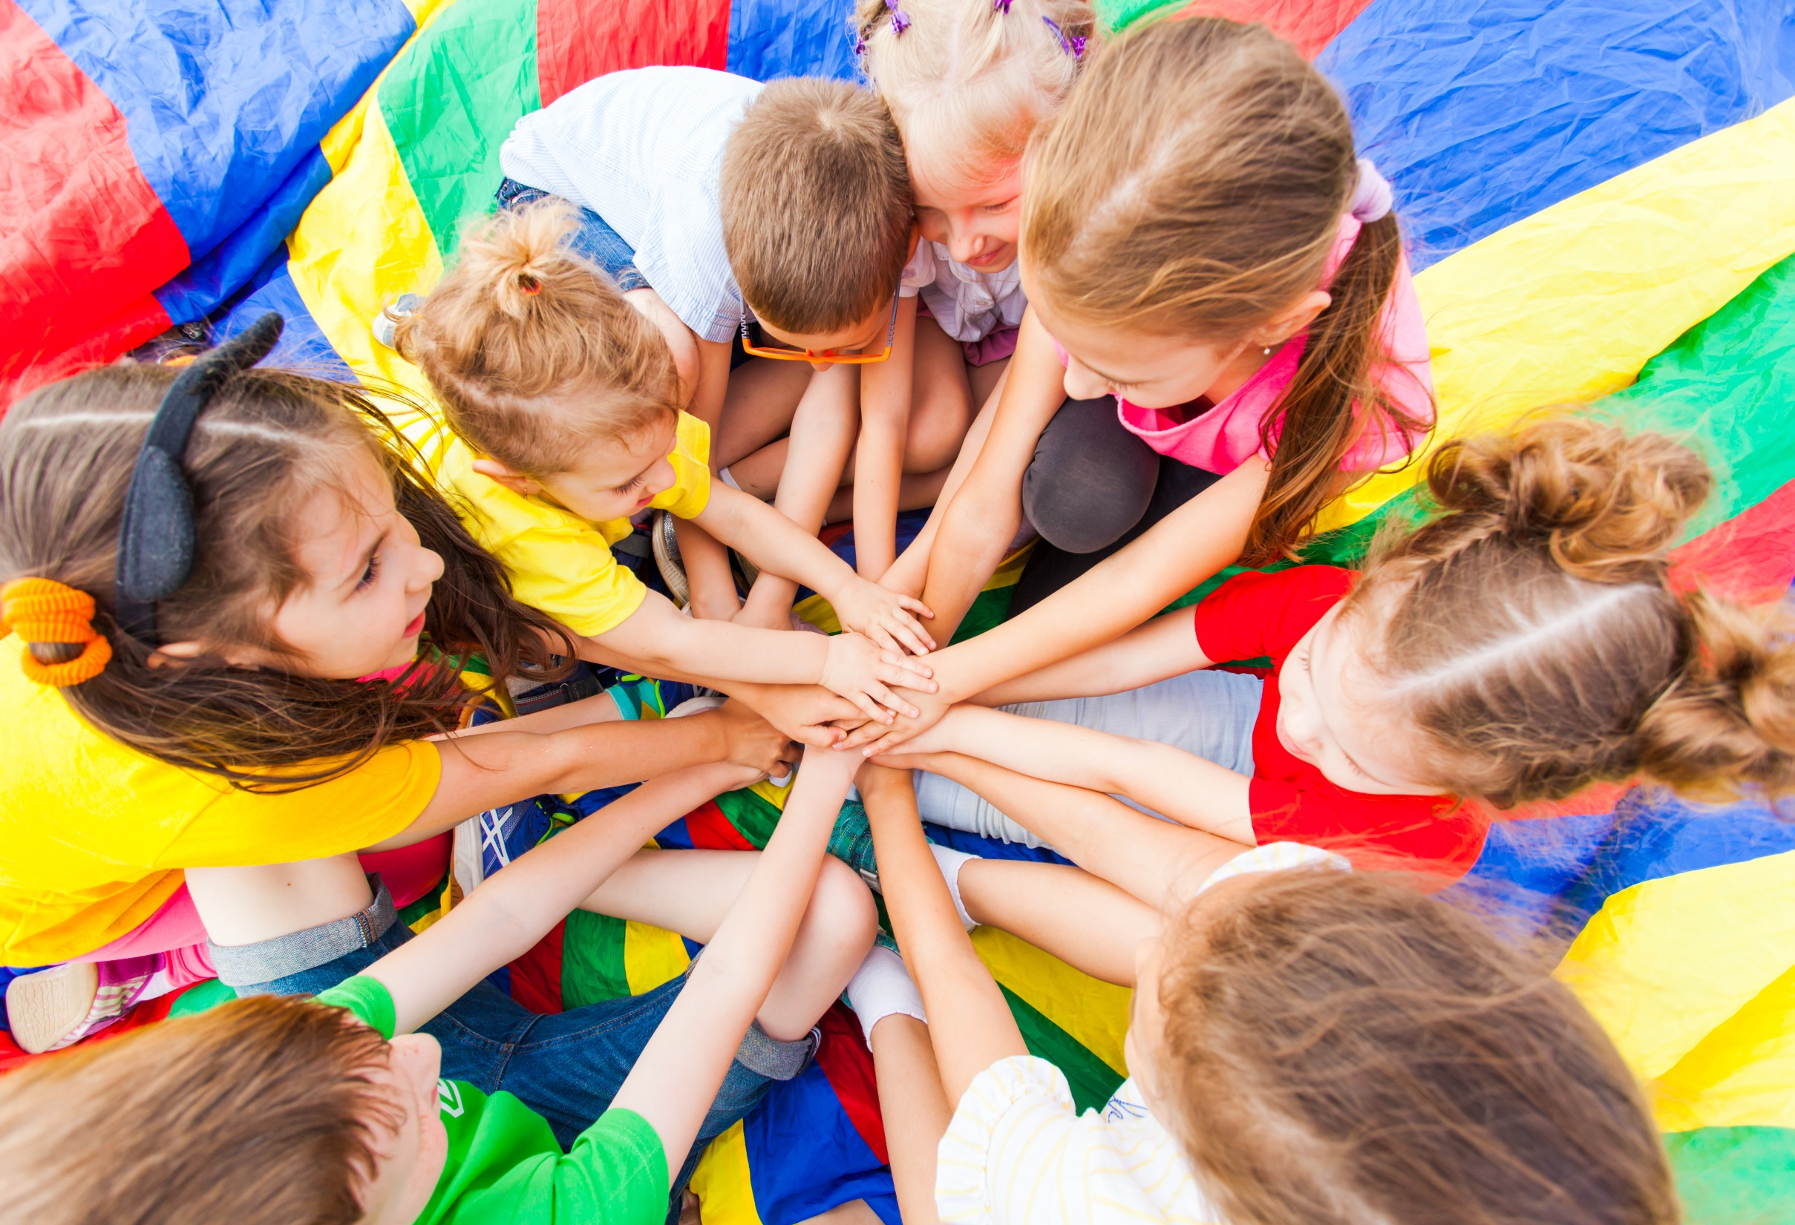
WARM UP

Slide 4
Look quickly and say aloud the word.
Who’s faster?

Slide 5
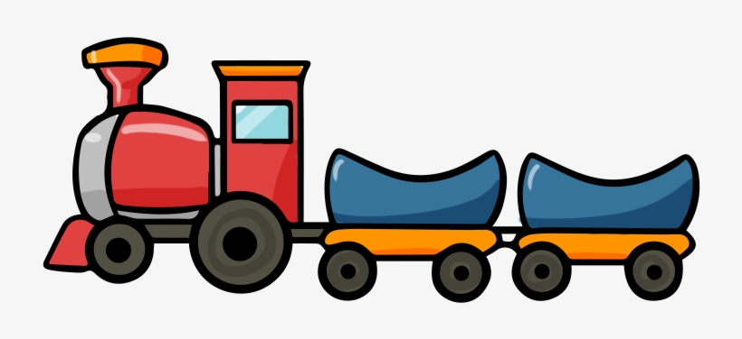
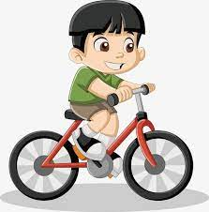
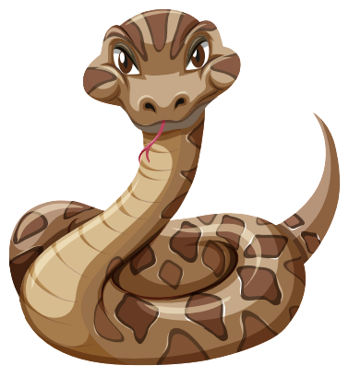

Slide 6
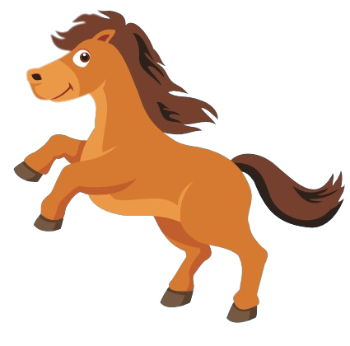

Slide 7
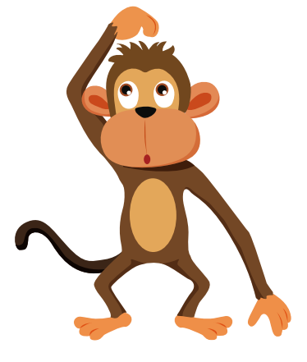

Slide 8
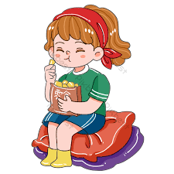
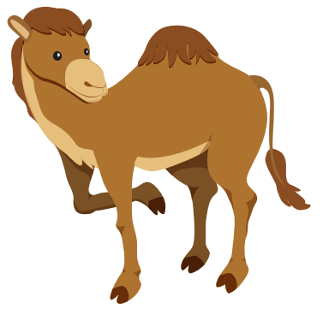

Slide 9
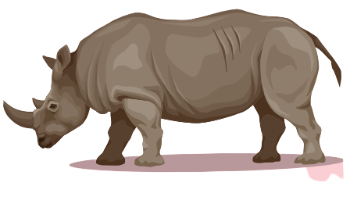

Slide 11
It’s time to learn …

Slide 12
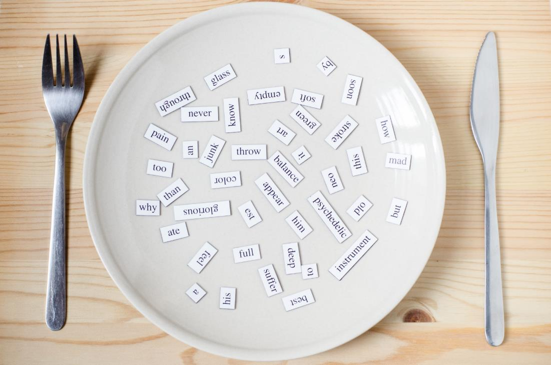
New words
panda, giraffe, lion,
dolphin, tiger, zebra

Slide 13
Presentation

Slide 14
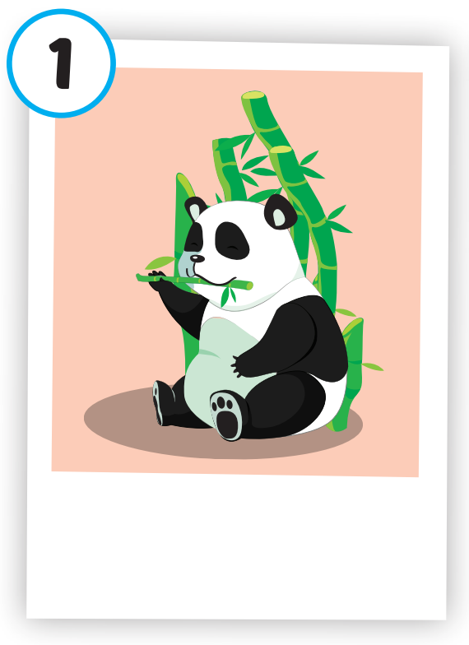
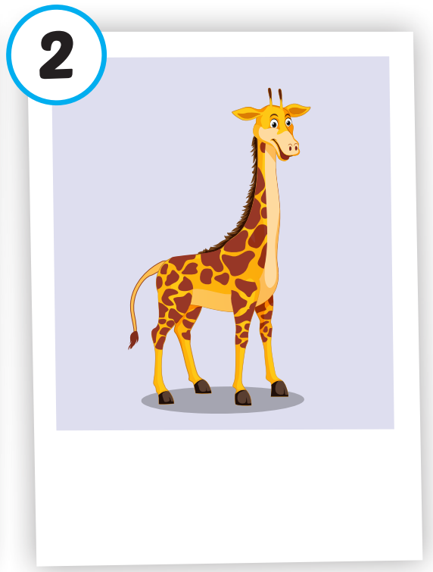
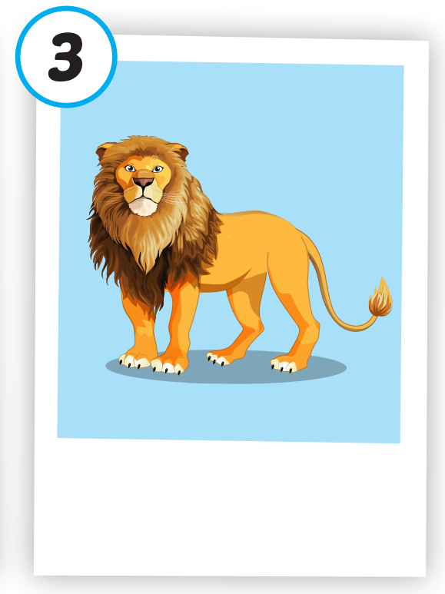
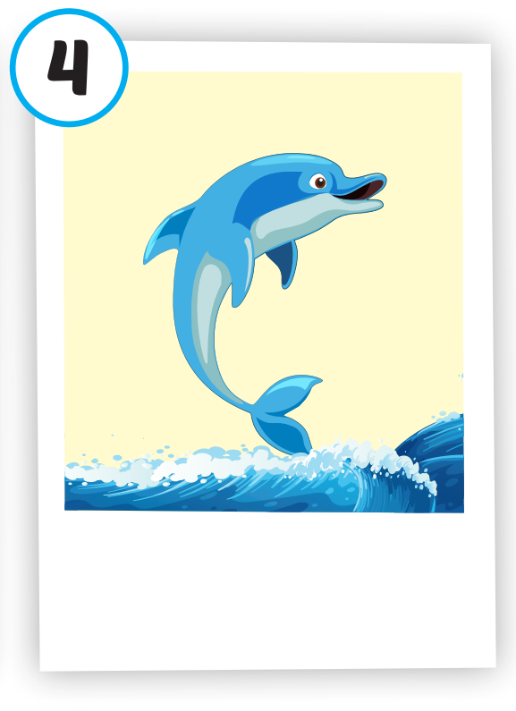
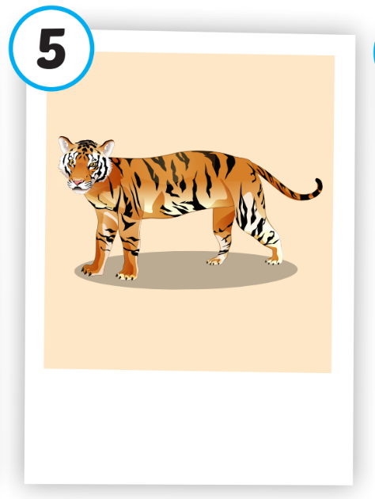
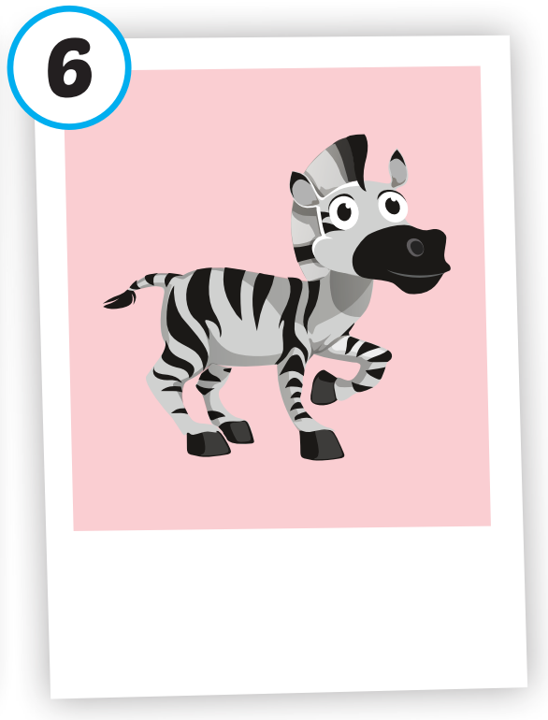
/ˈpændə/
con gấu trúc
/ˈlaɪən/
con sư tử
/ˈdɑːlfɪn/
cá heo
/ˈtaɪɡər/
con hổ
/ˈziːbrə/
con ngựa vằn
/dʒɪˈræf/
con hươu cao cổ

Slide 15
Click on each picture to hear the sound.
/ˈpændə/
con gấu trúc
Notes:
Click vào hình A. 1. Listen and point. Repeat để cho cả audio full chạy

Slide 16
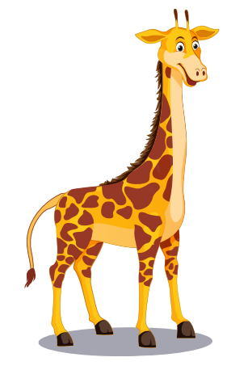
Click on each picture to hear the sound.
/dʒɪˈræf/
con hươu cao cổ
Notes:
Click vào hình A. 1. Listen and point. Repeat để cho cả audio full chạy

Slide 17
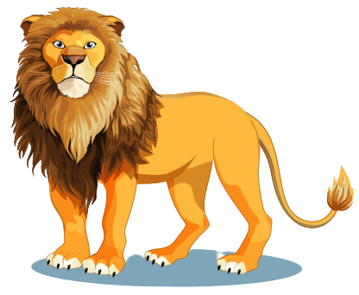
Click on each picture to hear the sound.
/ˈlaɪən/
con sư tử

Slide 18
Click on each picture to hear the sound.
/ˈdɑːlfɪn/
cá heo
Notes:
Click vào hình A. 1. Listen and point. Repeat để cho cả audio full chạy

Slide 19
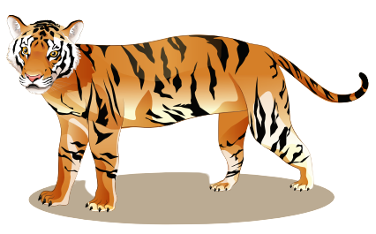
Click on each picture to hear the sound.
/ˈtaɪɡər/
con hổ

Slide 20
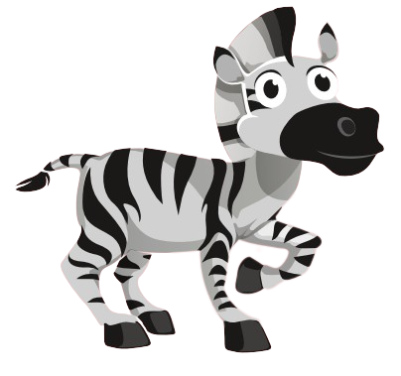
Click on each picture to hear the sound.
/ˈziːbrə/
con ngựa vằn

Slide 21
Practice

Slide 22
Check your memory

Slide 23
A. tiger
B. lion
C. panda

Slide 24
A. dolphin
B. giraffe
C. duck

Slide 25
A. monkey
B. lion
C. tiger

Slide 26
A. dolphin
B. tiger
C. lion

Slide 27
A. camel
B. tiger
C. giraffe

Slide 28
A. lion
B. tiger
C. zebra

Slide 30
Structure
What's this? - It's a panda.
What's that? - It's a dolphin.

Slide 31
Presentation

Slide 32
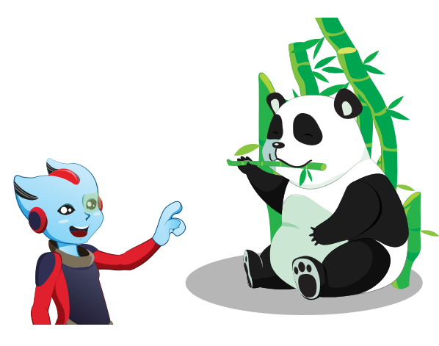
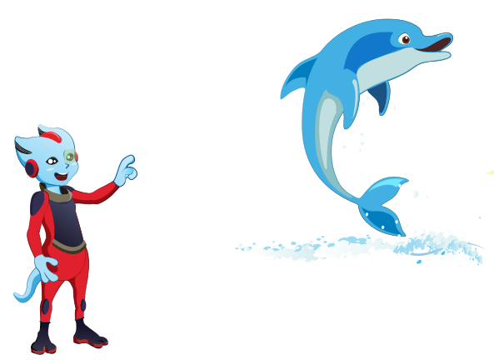
Structure

Slide 33
Practice

Slide 35
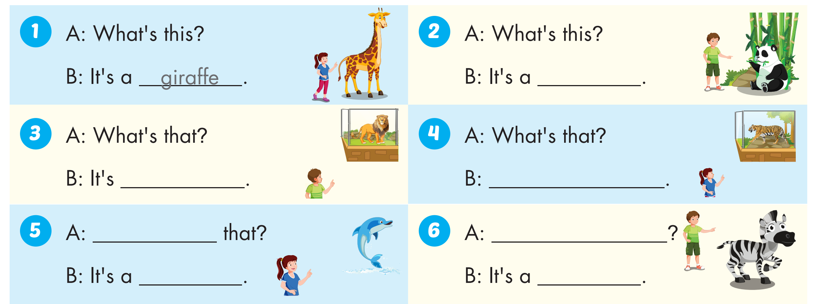
panda
a lion
It's a tiger
What's
What's this?
dolphin
zebra

Slide 36
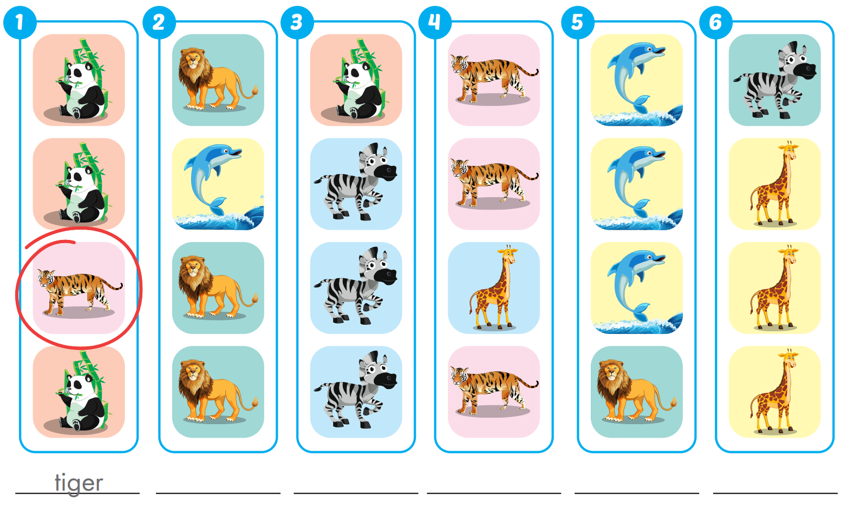
Extra Practice
WB, page 4
dolphin
panda
giraffe
lion
zebra

Slide 37
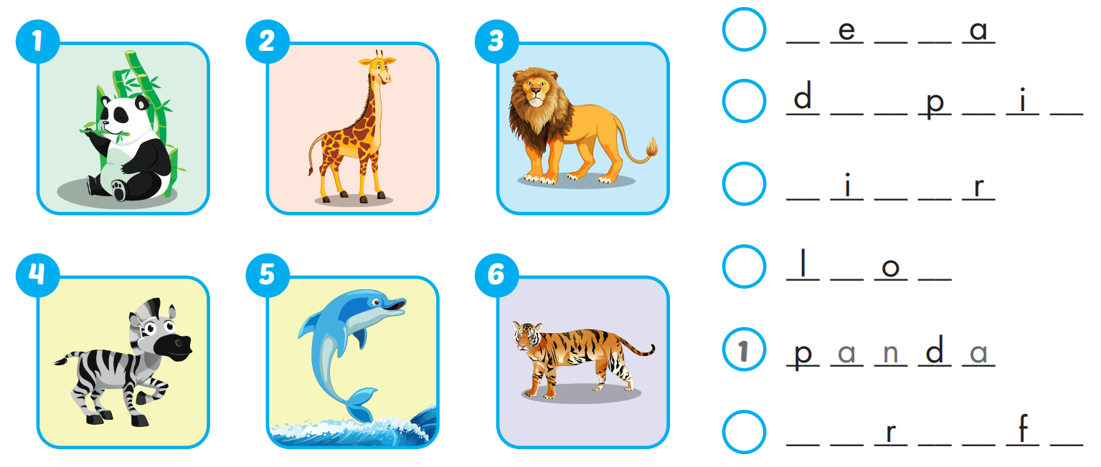
Extra Practice
WB, page 4
4
z b r
5
o l h n
6
t g e
3
i n
2
g i a f e

Slide 38
Today’s lesson
Vocabularies
panda, giraffe, lion, dolphin, tiger, zebra.
Structures/ Sentence patterns
What's this? - It's a panda. What's that? - It's a dolphin.

