Slide 1
Unit 3: WEATHER
Lesson 1.1
Page 34

Slide 2
Objectives
By the end of this lesson, students will be able to pronounce the correct adjectives about types of weather; ask and answer about weather.
Vocabulary: sunny, rainy, snowy, cloudy, windy, foggy.
Structure: What's the weather like today?
It's sunny.

Slide 3
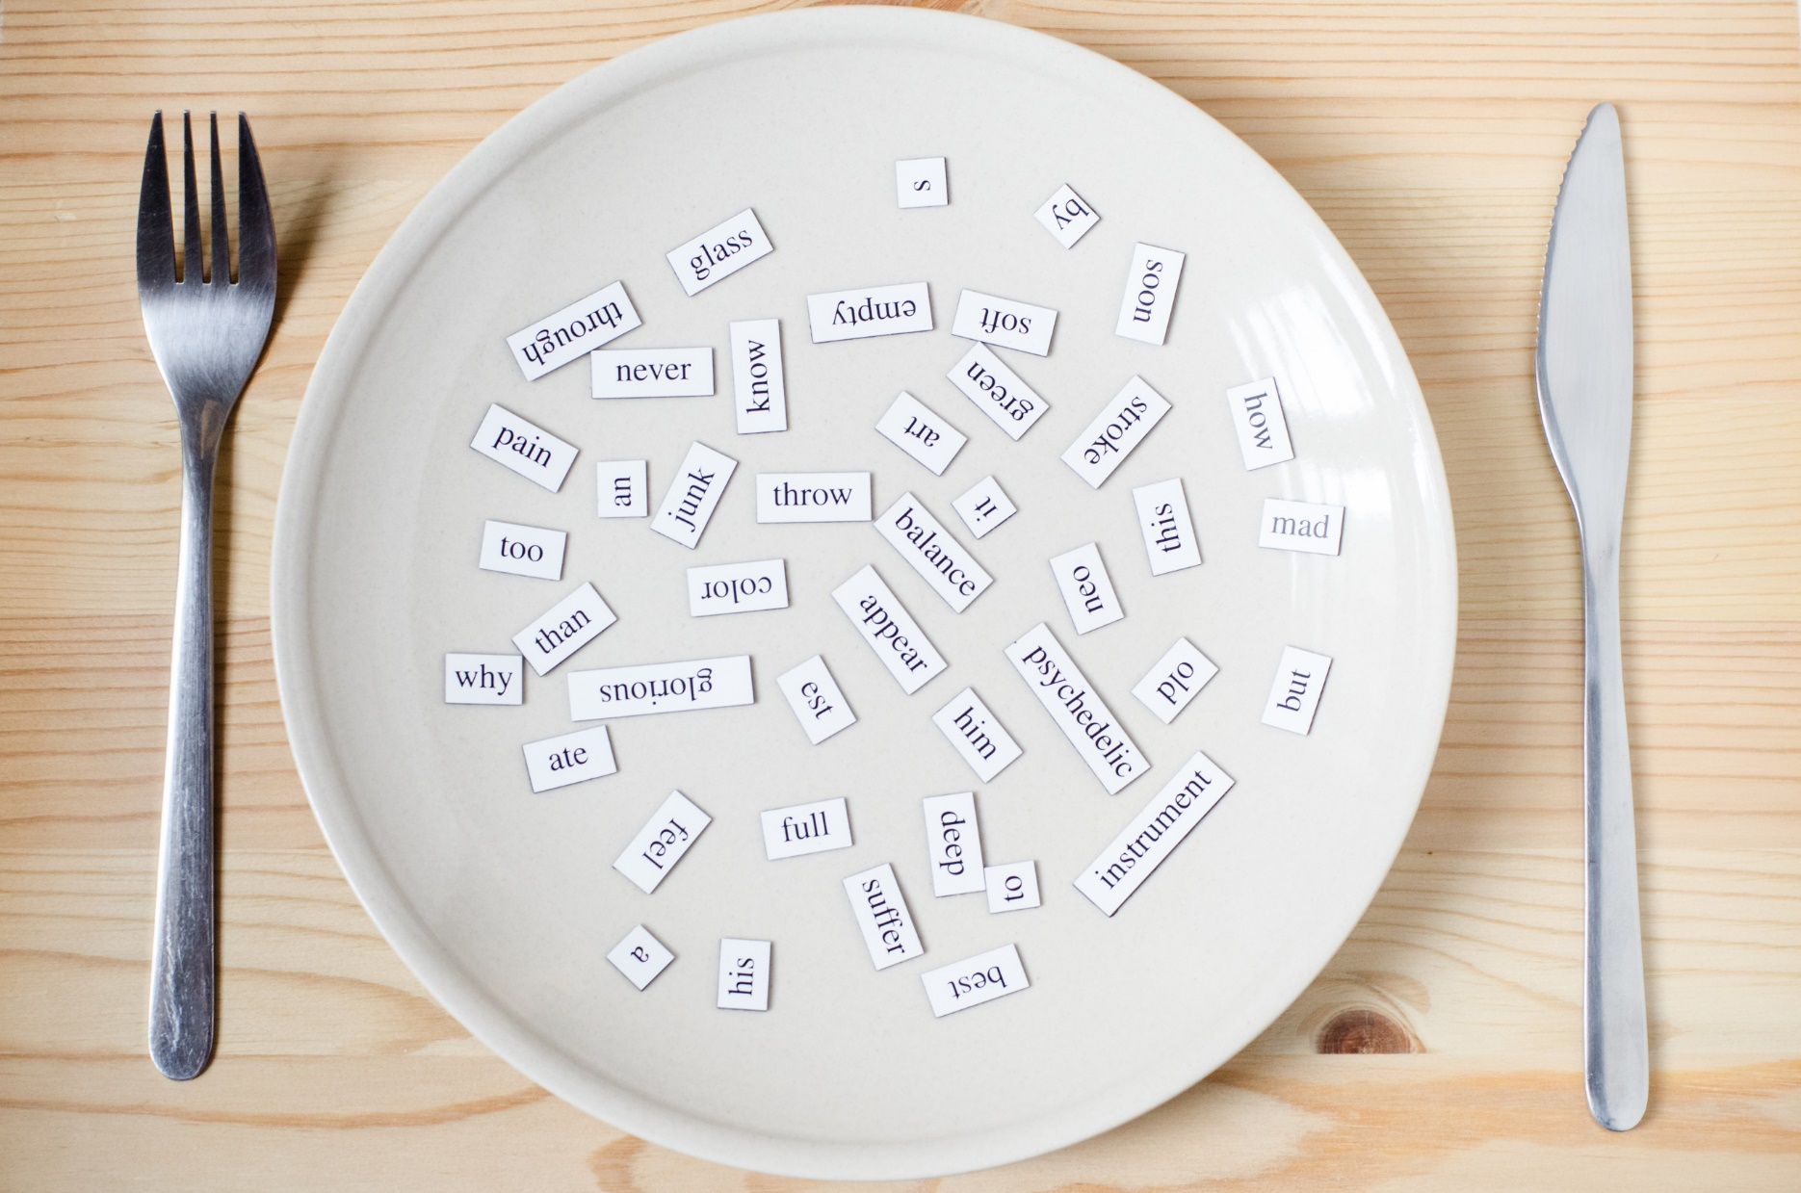
New words
sunny, rainy, snowy, cloudy, windy, foggy

Slide 4
Vocabulary

Slide 6
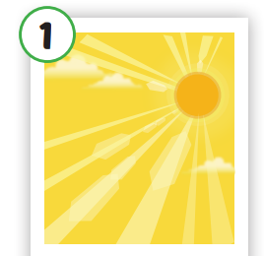
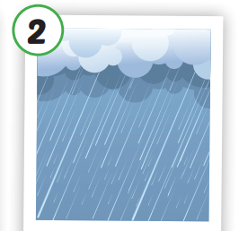
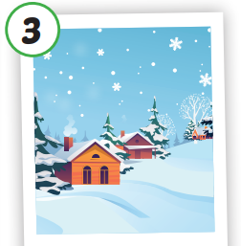
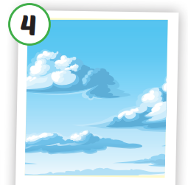
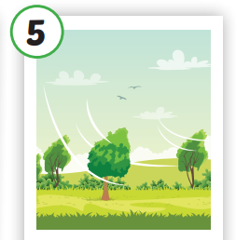
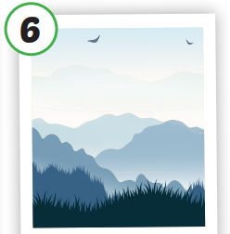
Click each English word to hear the sound.
sunny
rainy
snowy
cloudy
windy
foggy
/ˈsʌni/
có nắng
/ˈreɪni/
có mưa
/ˈsnoʊi/
có tuyết
/ˈklaʊdi/
có nhiều mây
/ˈwɪndi/
có gió
/ˈfɑːɡi/
có sương mù

Slide 7
Click each English word to hear the sound.
sunny
/ˈsʌni/
có nắng

Slide 8
Click each English word to hear the sound.
rainy
/ˈreɪni/
có mưa

Slide 9
Click each English word to hear the sound.
snowy
/ˈsnoʊi/
có tuyết

Slide 10
Click each English word to hear the sound.
cloudy
/ˈklaʊdi/
có nhiều mây

Slide 11
Click each English word to hear the sound.
windy
/ˈwɪndi/
có gió

Slide 12
Click each English word to hear the sound.
foggy
/ˈfɑːɡi/
có sương mù

Slide 13
Practice

Slide 15
Structures
What's the weather like today?
It's sunny.

Slide 16
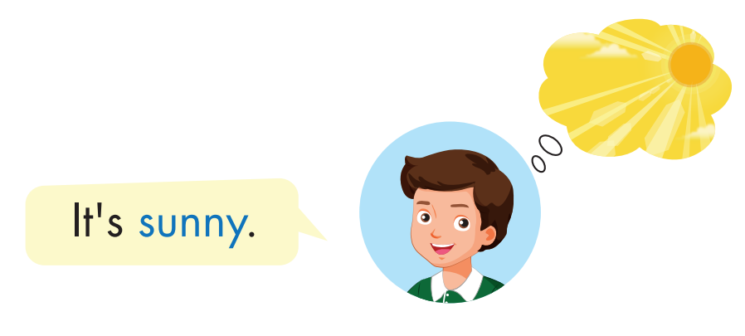
Click each English word to hear the sound.

Slide 17
Practice

Slide 18
What's the weather like today?
It's cloudy.

Slide 19
What's the weather like today?
It's snowy.

Slide 20
What's the weather like today?
It's rainy.

Slide 21
What's the weather like today?
It's foggy.

Slide 22
What's the weather like today?
It's windy.

Slide 24
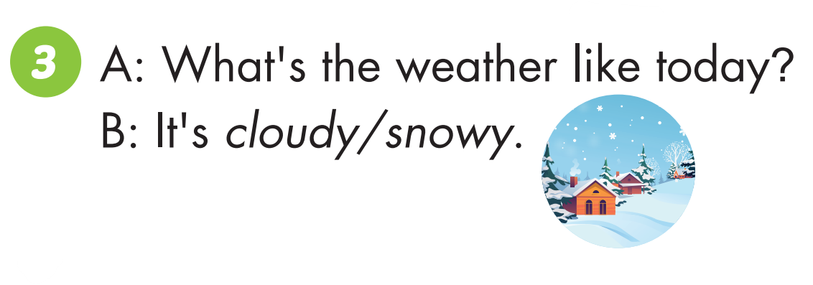

Slide 26
Practice

Slide 27
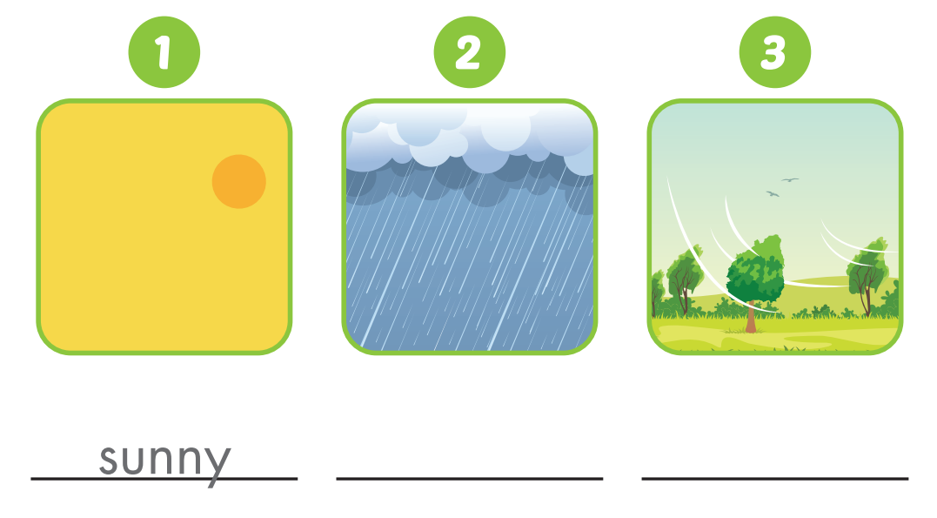
sunny
rainy
windy

Slide 28
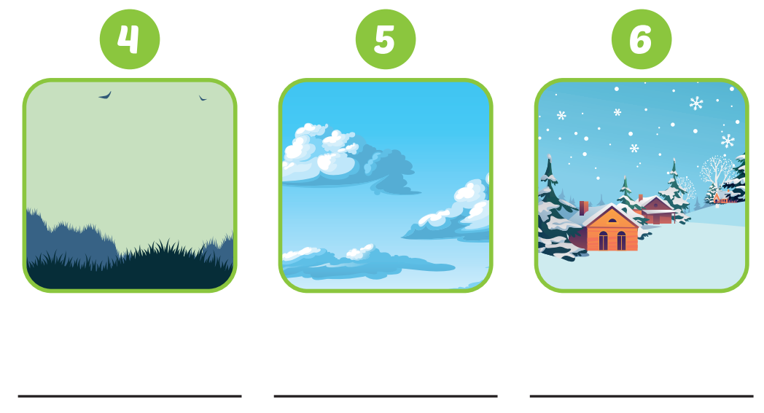
foggy
cloudy
snowy

Slide 29
CONSOLIDATION

Slide 30
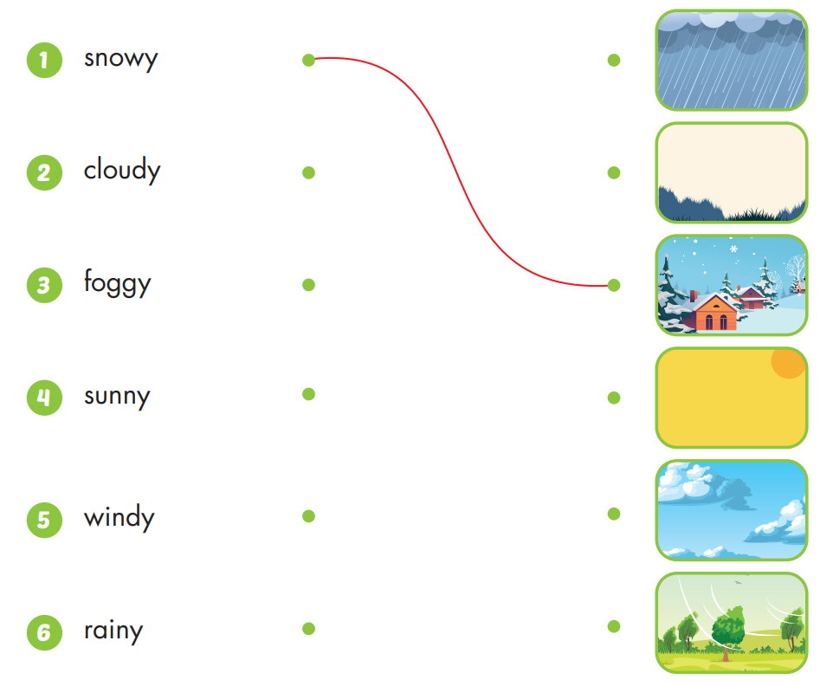

Slide 31
Today’s lesson
Vocabularies
sunny, rainy, snowy, cloudy, windy, foggy.
Structures/ Sentence patterns
What's the weather like today?
It's sunny.

