Slide 1
UNIT 3
MY FRIENDS
Let’s start our lesson!

Slide 2
Grammar
The present continuous
We use the present continuous for actions happening now.
Example: - She’s talking.
- They’re not talking.
We can use the present continuous with now, at present, or at the moment.
Example: - I’m doing my homework at present.
- A: Are you reading now?
B: Yes, I am.

Slide 3
Grammar
The present continuous
Form | Example
S + am/is/are + V_ing + … . | We are going to school by bus now.
S + am/is/are + not + V_ing + … . | I am not playing football at the moment.
Am/is/are + S + V_ing + … ? | Are they listening to music?
W/H + am/is/are + S + V_ing + … ? | What are you doing now?

Slide 4
Put the verbs in brackets in the present continuous.
is reading
a book now.
1.
Nam (read)
a book now.
They (play)
are playing
football at the moment.
2.
football at the moment.
a sandwich at present.
3.
My sister (not make)
isn’t making
a sandwich at present.
4.
am going
I (go) to the supermarket at the moment.
5.
they (talk) about their new friends?
talking
Are
they (talk) about their new friends?

Slide 5
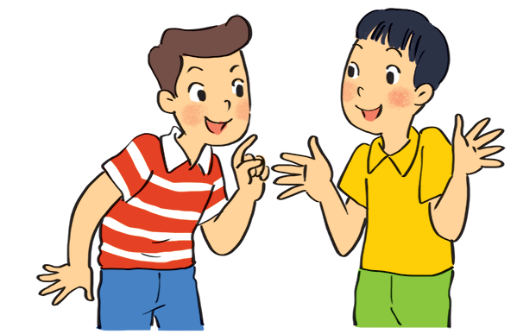
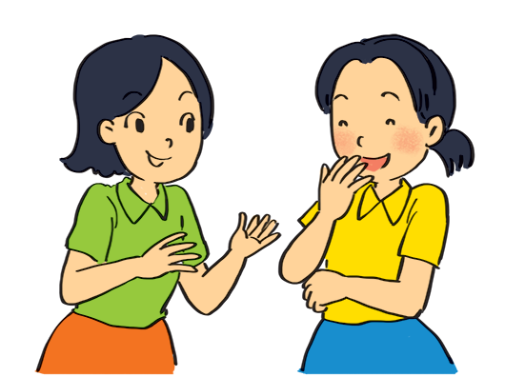
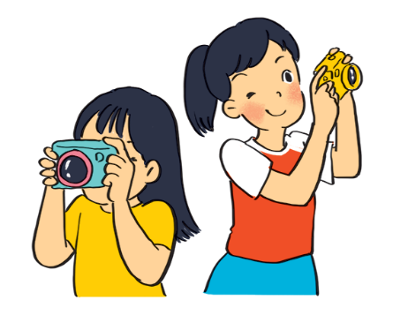
Look at the pictures. Write sentences like the example. Use positive or negative present continuous verbs.
1.
Nam and Ba ______________________________.
(eat ice cream)
Example:
are not / aren’t eating ice cream
2.
are taking photos
Lan and Trang ___________________.
(take photos)
She’s talking to Mai. (talk)

Slide 6
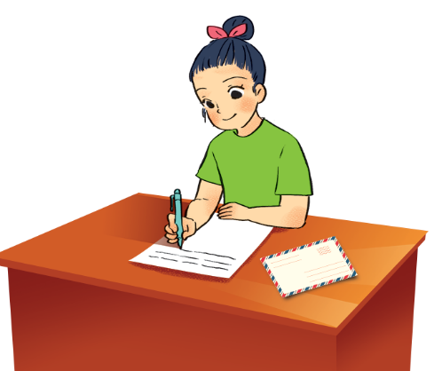
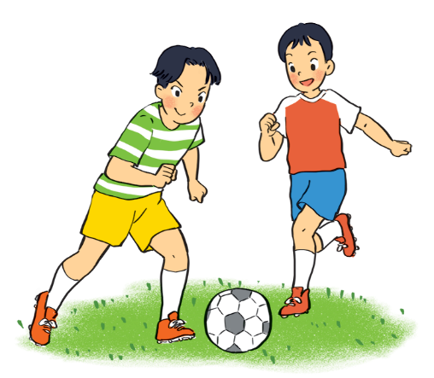
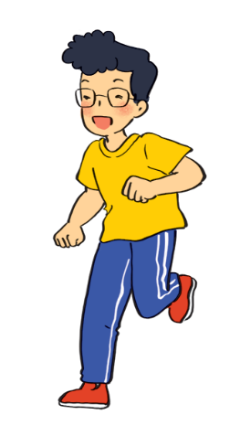
Look at the pictures. Write sentences like the example. Use positive or negative present continuous verbs.
3.
is / Ha’s writing a letter
Ha _________________________.
(write a letter)
4.
Duong and Hung ____________________________.
(play badminton)
are not / aren’t playing badminton
5.
Phong _________________________.
(draw a picture)
is not / isn’t drawing a picture

Slide 7
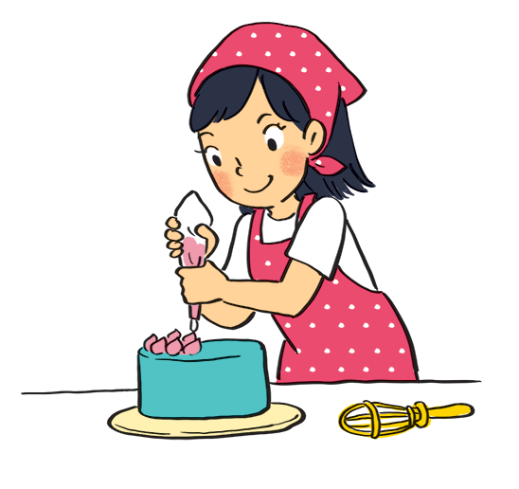
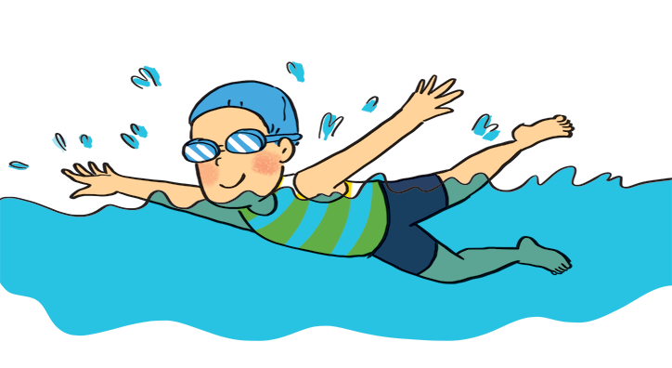
Look at the pictures. Ask and answer.
Example:
1
A: your sister / make a cake?
Is your sister making a cake?
B: Yes, she is.
A: your friend / swim?
B:
Is your friend swimming?
Yes, he is.

Slide 8
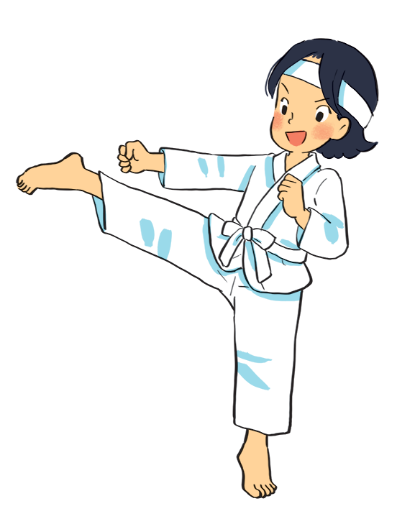
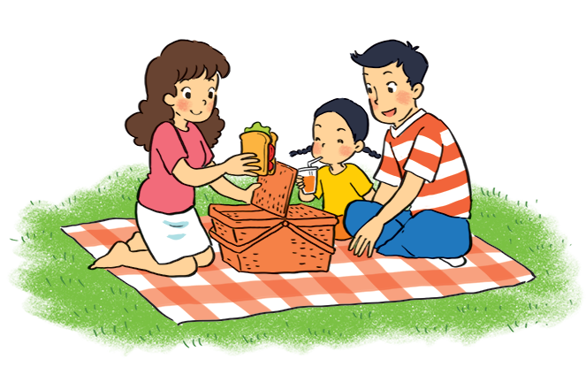
Look at the pictures. Ask and answer.
2
3
A: they / listen to music?
B:
A: Mi / play the piano?
B:
Are they listening to music?
Is Mi playing the piano?
No, they aren’t.
No, she isn’t.
(They’re / They are having a picnic.)
(She’s / She is doing karate.)

Slide 9
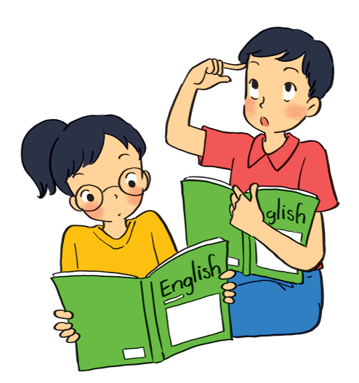
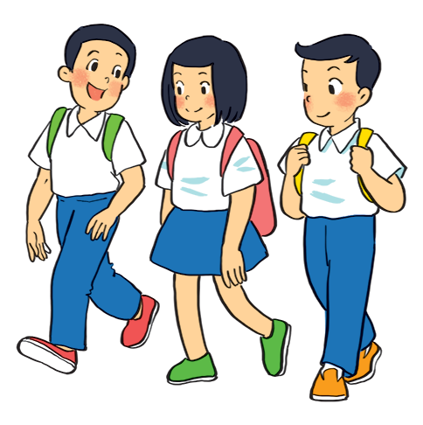
Look at the pictures. Ask and answer.
4
5
A: they / learn English?
B:
A: your friends / cycle to school?
B:
Are they learning English?
Are your friends cycling to school?
Yes, they are.
No, they aren’t.
(They’re / They are walking to school.)

Slide 10
Grammar
The present continuous
When something often happens or is fixed, we use the present simple.
When something is happening now, we use the present continuous.

Slide 11
Put the verbs in brackets in the present simple or present continuous.
My best friend (not walk) ___________________ to school every day.
Sometimes she (cycle) _____________.
1.
does not / doesn’t walk
cycles
2.
is
playing
Look! What ______ he (play) __________?
3.
Do
study
your friends (study) _____________ in the library every afternoon?
am / ‘m writing
4.
I (write) _________________ an email to my friend now.
5.
He (not do) _____________________ his homework now.
He (read) ______________________.
is / ‘s reading
is not / isn‘t doing.

Slide 12
See you later!

