Slide 1

Unit 2
My House
Here begins our lesson!

Slide 2

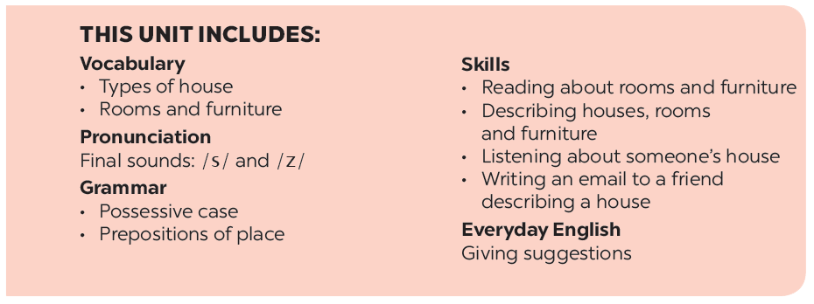
Contents Of Unit 2

Slide 3
LESSON 1
Getting started

Slide 4
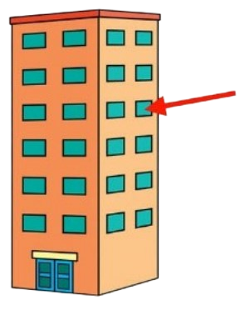
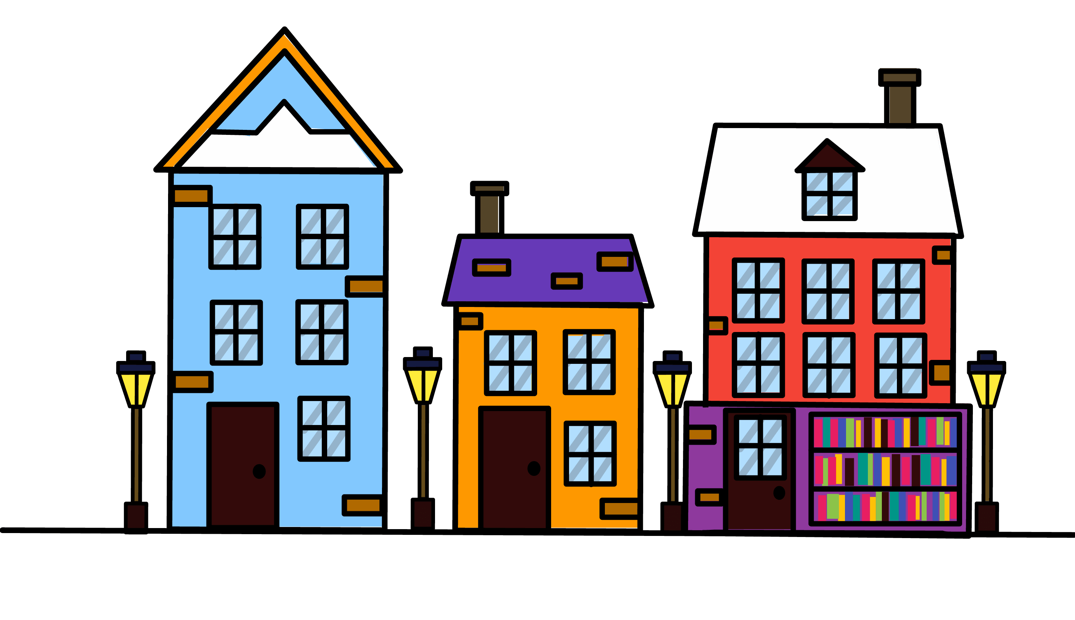

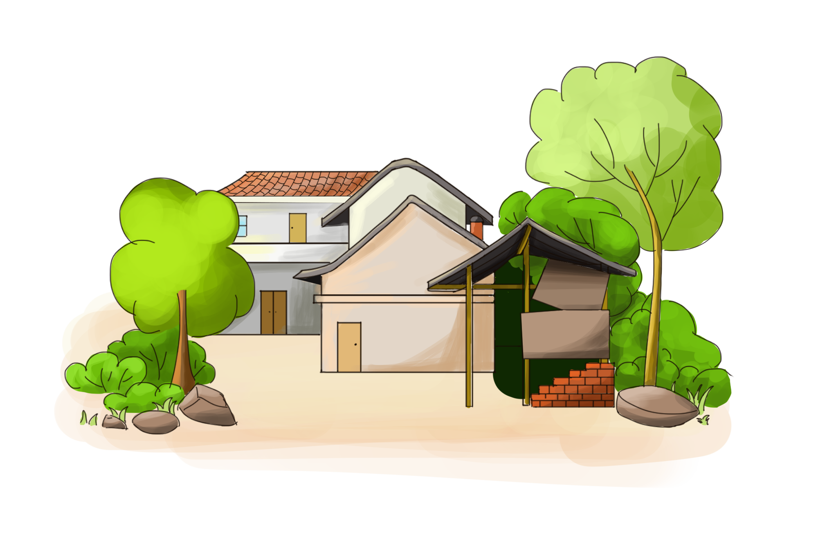
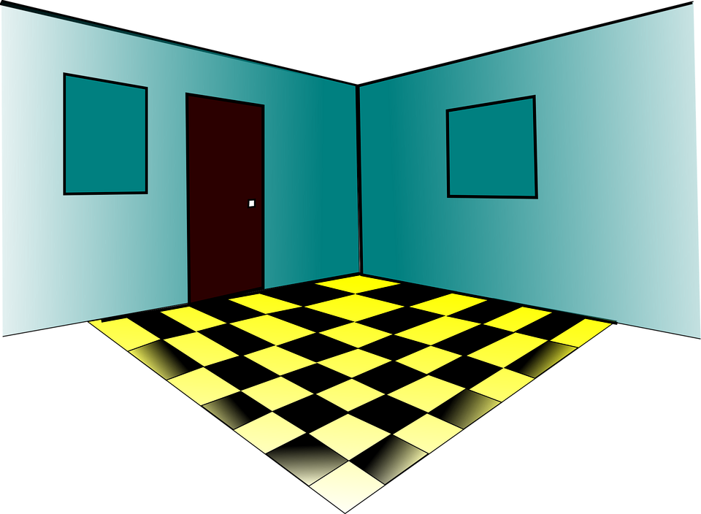
Vocabulary
town house
/ˈtaʊn haʊs/
flat
/flæt/
country house
/ˌkʌntri ˈhaʊs/
hall
/hɔːl/

Slide 5
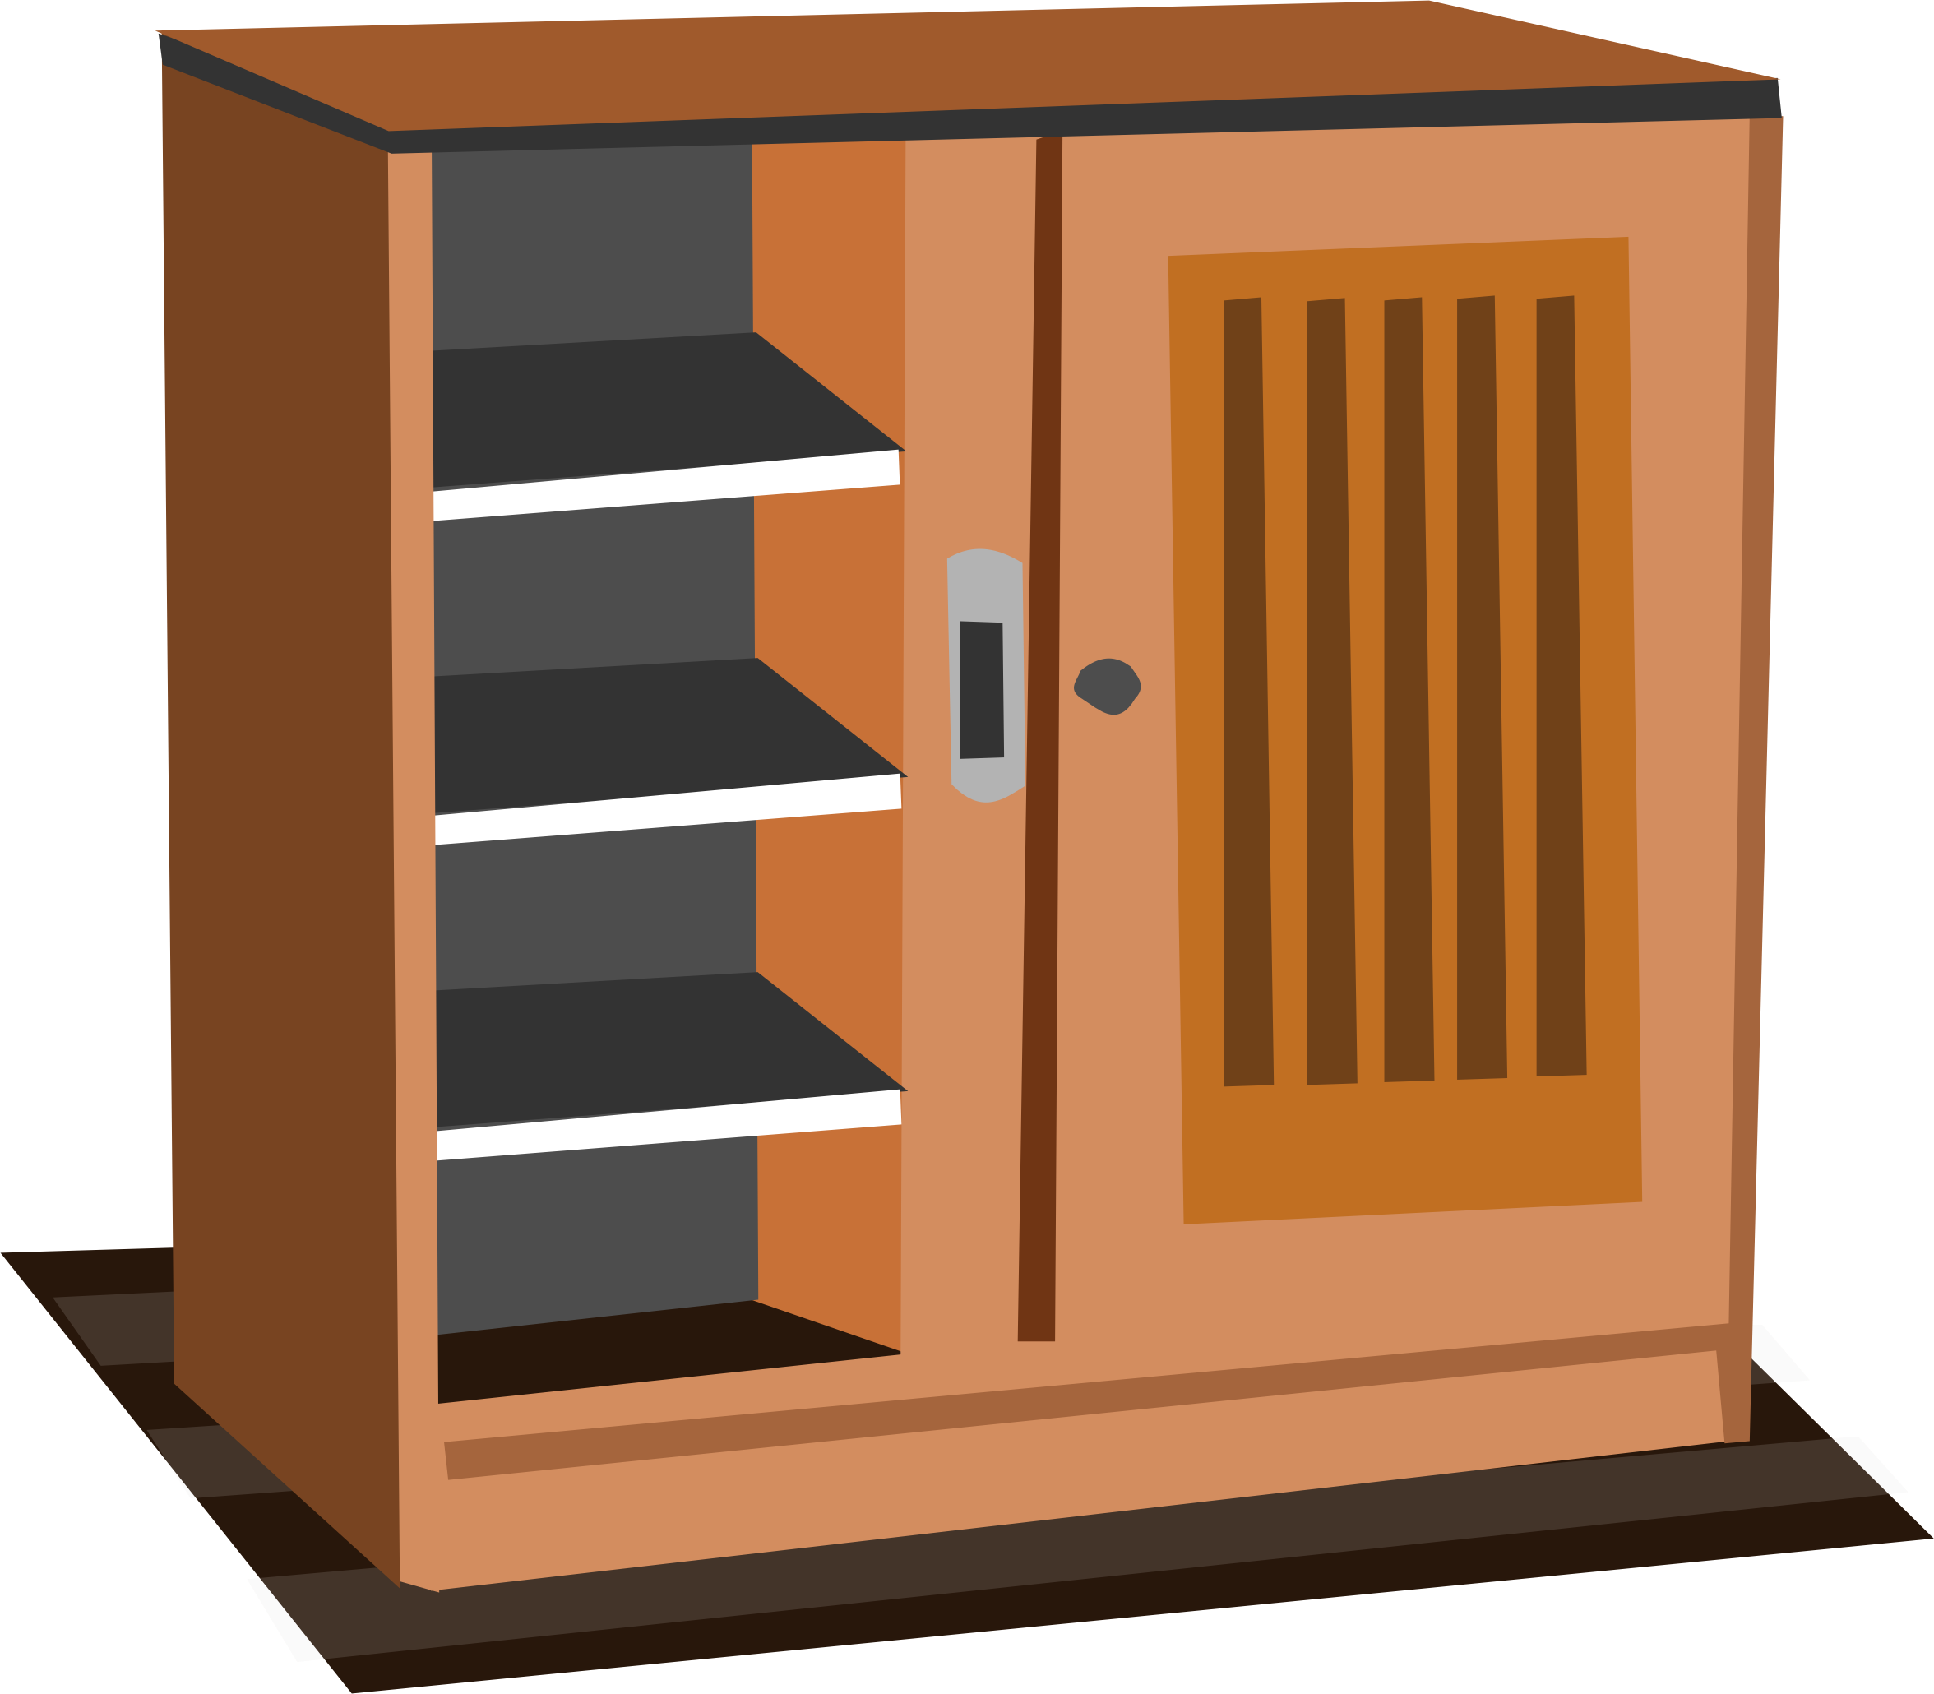
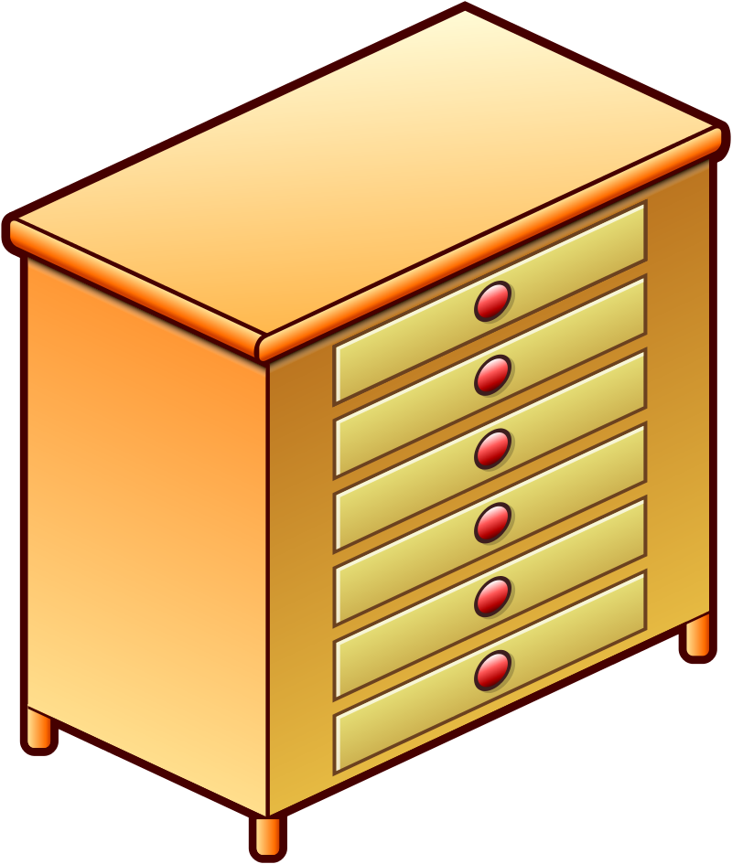
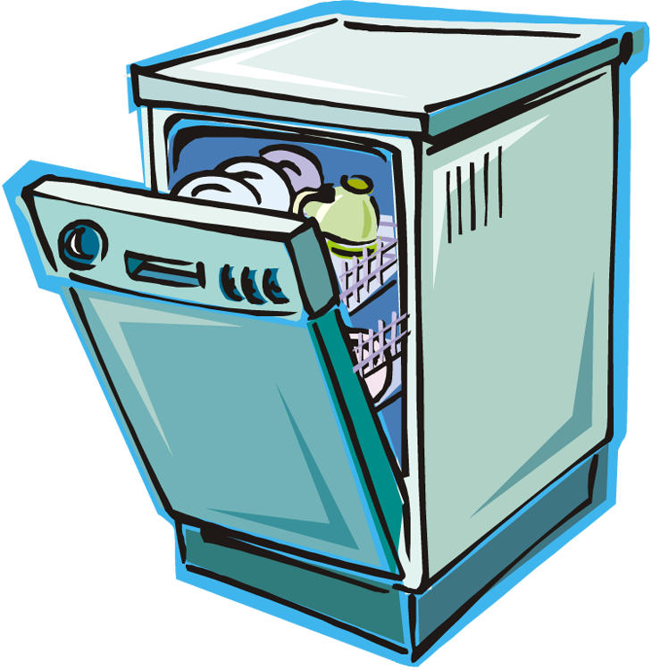
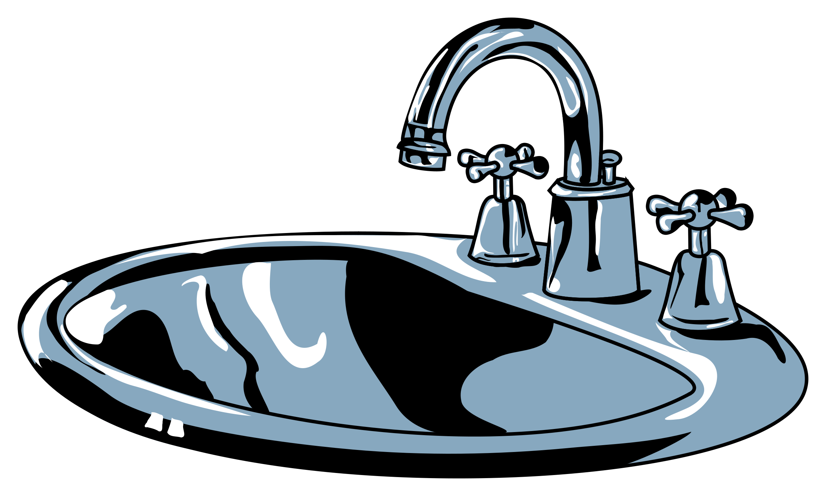
Vocabulary
cupboard
/ˈkʌbəd/
chest of drawers
/ˌtʃest əv ˈdrɔːz/
dishwasher
/ˈdɪʃwɒʃə/
sink
/sɪŋk/

Slide 6

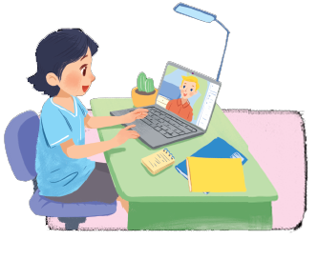
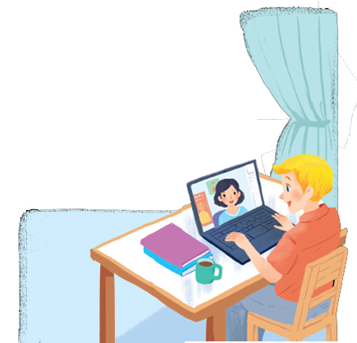
Listen and read
Mi: Wow! Your room looks so big, Nick.
Nick: It’s Elena’s room. She’s my sister.
Mi: I see. Is there a TV behind you?
Nick: Yes, there is. Where do you live, Mi?
Mi: I live in a town house. And you?
Nick: I live in a country house. Who do you live with?
Mi: My parents and younger brother. We’re moving to a ﬂat next month!
Nick: Are you?
Mi: Yes. My aunt lives near there, and I can play with my cousin.
Nick: Are there many rooms in your new ﬂat?
Mi: Yes, there are. There’s a living room, three bedrooms, a kitchen and two bathrooms.

Slide 7


Which family members does Mi talk about? Put a tick ( )
1. | parents
2. | sister
3. | brother
4. | aunt
5. | cousin





Slide 8

Read the conversation again.
Complete each sentence with ONE word.
sister
1.
Elena is Nick’s .
2.
TV
There is a in Elena’s room.
3.
Now Mi lives in a house.
town
country
4.
Nick lives in a house.
5.
three
Mi’s new flat has bedrooms.

Slide 9

Complete the word web. Use the words from the conversation and the ones you know.
villa
cottage
town house
country house
TYPES OF HOUSE
flat
stilt house
farmhouse

Slide 10

Work with your teacher. Ask where he/she and his/her family and friends live.
A: Where do you live?
B: I live in a flat.

Slide 11

Thank you!

