Slide 2
• Ss work in two teams. • Ss receive slips of paper with simple sentences or compound sentences. • Pick out all the simple sentences and run as fast as possible to stick them on the board. • Then underline the subjects and double-underline the verbs of those simple sentences. • The team with the more correct answers will be the winner.
WARM-UP
BOARD RACE
RULE:

Slide 3
1. She is a noisy and curious girl. 2. They joined a full-day city tour. 3. I found it enjoyable to watch the tournament. 4. She’ll record our voices during the interview. 5. Minh has some problems with his schoolwork.
WARM-UP
BOARD RACE
ANSWERS:

Slide 4
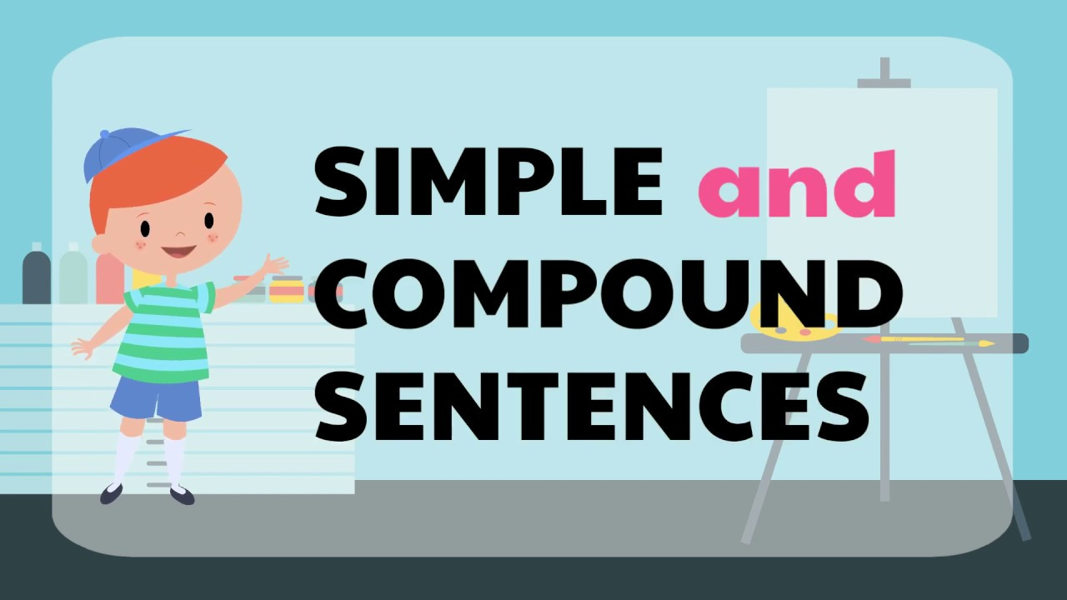
Unit
3
TEENAGERS
LESSON 3: A CLOSER LOOK 2

Slide 5
LESSON 3: A CLOSER LOOK 2
WARM-UP
Game: Board race
PRESENTATION
Simple sentences and compound sentences
Task 1: Tick the simple sentences.
Task 2: Write S for simple sentences and C for compound sentences
Task 3: Choose the correct answer A, B, or C.
Task 4: Combine the two sentences to make compound sentences.
PRACTICE
PRODUCTION
Task 5: Game: Which group has the most sentences?
CONSOLIDATION
Wrap-up
Homework

Slide 6
PRESENTATION
Simple sentences & Compound sentences
Eg1: Minh has some problems with his schoolwork.
Eg2: Mark is hard-working; therefore, he usually gets high scores on exams.
s
v
s₁
v₁
s₂
v₂
connector

Slide 7
PRESENTATION

Slide 8
PRACTICE
1
Tick the simple sentences.
We work together on different projects.
Teens need good friends and tolerant teachers at school.
She plays chess very well, and she won the first prize last year.
Sports activities at school help me relax.
Teens should learn teamwork, and they should also have
communication skills.

Slide 9
PRACTICE
2
Write S for simple sentences and C for compound sentences.
S
____ 1. Teenagers are often very active and talkative.
____ 2. He often chats with his friends on Facebook Messenger.
____ 3. She is a smart student, and she is an active member of our club.
____ 4. My friends and I joined a sports competition last year.
____ 5. He is a club member, but he never participates in any of the activities.
S
C
S
C

Slide 10
PRACTICE
3
Choose the correct answer A, B, or C.
1. Parents should give teens some freedom,______ they should also set limits.
A. for B. so C. but
2. We don’t cheat on exams, ______ it is a wrong thing to do.
A. or B. for C. and

Slide 11
PRACTICE
3. Lan wants to join the school music club; ______, she can’t sing or play any instruments.
A. however B. otherwise C. therefore
4. Schoolwork causes teens a lot of pressure, ______ they also feel pressure from their parents.
A. and B. but C. or
5. She wanted to prepare for the exam; ______, she turned off her mobile phone.
A. however B. otherwise C. therefore

Slide 12
PRACTICE
4
Combine the two sentences to make compound sentences, using the words from the box.
1. Phong has to study harder. He may fail the exam.
___________________________________________________
2. She is very sensitive. Don’t comment on her new hairstyle.
___________________________________________________
Phong has to study harder; otherwise, he may fail the exam.
She is very sensitive; therefore, don’t comment on her new hairstyle.

Slide 13
PRACTICE
3. Mi wants to have more friends. She doesn’t connect well with others.
__________________________________________________________
4. Students can work in groups. She can work in pairs.
___________________________________________________
5. My friend likes showing off her new things. She often posts pictures on social media.
___________________________________________________ _____________________
Mi wants to have more friends, but she doesn’t connect well with others.
Students can work in groups, or they can work in pairs.
My friend likes showing off her new things, so she often posts pictures on social media.

Slide 14
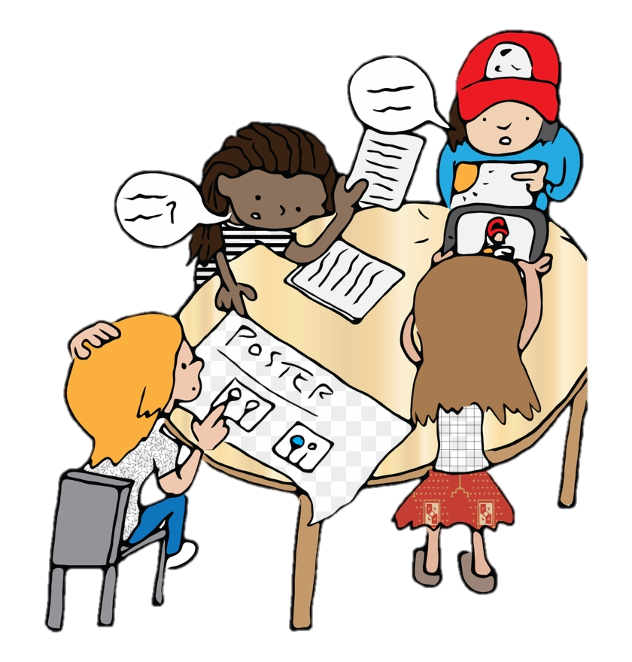
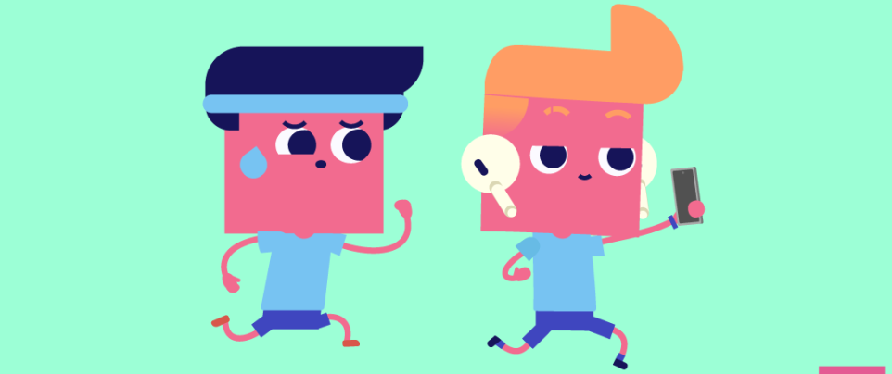
PRODUCTION
GAME: SENTENCE RACE
Which group has the most sentences?
Work in groups. Each group makes as many compound sentences as possible. The group with the most correct sentence is the winner.

Slide 15
CONSOLIDATION
1
Wrap-up
Say out loud the connectors (coordinating conjunctions and conjunctive adverbs) you have learned in the lesson.
Talk about the meanings of the connectors and how to use commas and semicolons with connectors.

Slide 16
CONSOLIDATION
2
Homework
- Do exercise in the workbook.

