Slide 1
BOARDING PASS
FLIGHT
Unit 7: Traffic
B345
GATE
D8
SEAT
29E
NOTE:
Lesson 7: Looking back

Slide 2
OBJECTIVES
BOARDING PASS
FLIGHT
B345
GATE
“Review the vocabulary and grammar of Unit 7”
D8
SEAT
29E

Slide 3
VOCABULARY
train, bus, bike, car, coach, cycle, fly, helicopter, motorbike, plane, railway station, ship, tricycle, vehicle, etc.
Means of transport:
Road signs:
ttraffic light, traffic jam, traffic rule, signpost, prohibitive, no right turn, cycle lane, school ahead, no cycling, hospital ahead, etc.

Slide 4
PRONUNCIATION
/eɪ/ | /aɪ/
Gate, date, late, nation, Asian, rain, train, paint, wait, day, play, break, great, eight, neighbour
Time, white, side, sky, fly, like, rice, why, high, night, childhood, kind, mind, eye, island, guy

Slide 5
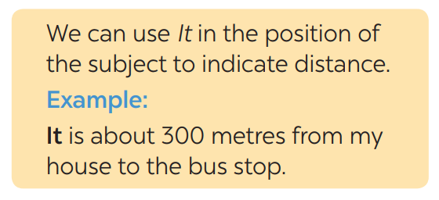
GRAMMAR: IT – INDICATING DISTANCE

Slide 6
GRAMMAR: SHOULD/ SHOULDN’T

Slide 7
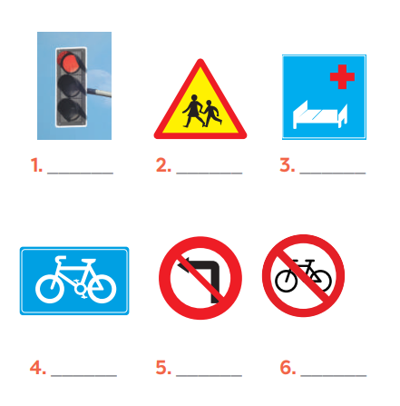
Label each sign. Work in pairs. What does each sign tell us to do?
red light
school ahead
hospital ahead
cycle lane
no left turn
No cycling

Slide 8
Fill in each gap with one word to complete the sentences.
A road ___________ is anyone who uses a road, such as a pedestrian, cyclist or motorist.
Does your dad _____________ his motorbike carefully?
A __________ is a person travelling in a car, bus, train,… but not driving.
My cousin wants to become a pilot. He is learning to _______ planes.
We should be careful when the __________ light turns yellow.
user
ride
passenger
fly
traffic

Slide 9
Write complete sentences, using these cues.
Over 100km/ my hometowwn/ Ho Chi Minh city.
It’s over 100km from my home town to Ho Chi Minh City
2. About 25 km/ my grandparents' house.
→ It is about 25km to my grandparents’ house.
3. not very far / our school / the city museum.
It is not very far from our school to the city museum.
4. how far / your house / the gym?
→ How far is it from your house to the gym?
5. it / a long distance / Ha Noi / Ban Gioc Waterfall?
→ Is it a long distance from Ha Noi to Ban Gioc Waterfall?

Slide 10
Choose A, B, or C to complete the sentences.
Dùng should/ shouldn’t: Đưa ra lời khuyên hoặc Để nói điều gì là đúng đắn hoặc tốt nhất để làm
“must” :muốn nói rằng điều đó là cần thiết hoặc rất quan trọng; rằng điều gì đó sẽ xảy ra trong hiện tại hoặc tương lai hoặc để nhấm mạnh ý kiến
You ________ put the rubbish in the waste bins over there.
should B. would C. shouldn’t
2. You_________ be over eighteen to ride a motorbike.
would B. must C. could
3. Children _________ ride their bikes too fast.
mightn’t B. wouldn’t C. shouldn’t

Slide 11
Choose A, B, or C to complete the sentences.
Can và could cũng được dùng để nói về sự cho phép hoặc cấm đoán đã được quy định sẵn, và về những điều được phép làm hoặc không được phép làm theo luật.
Would thường đứng trước động từ để nói về một việc đáng lẽ đã xảy ra trong quá khứ, nhưng thực tế lại không xảy ra.
4. I am a bit lost. _______ you help me, please?
Could B. Should C. Might
5. You_________ eat so many cookies. Too much sugar is bad of you.
couldn’t B. wouldn’t C. shouldn’t
6. This is a big park. You ________ run or cycle here.
should B. can C. could

Slide 12
BOARDING PASS
Thank you!
FLIGHT
B345
GATE
D8
SEAT
29E

