Slide 1
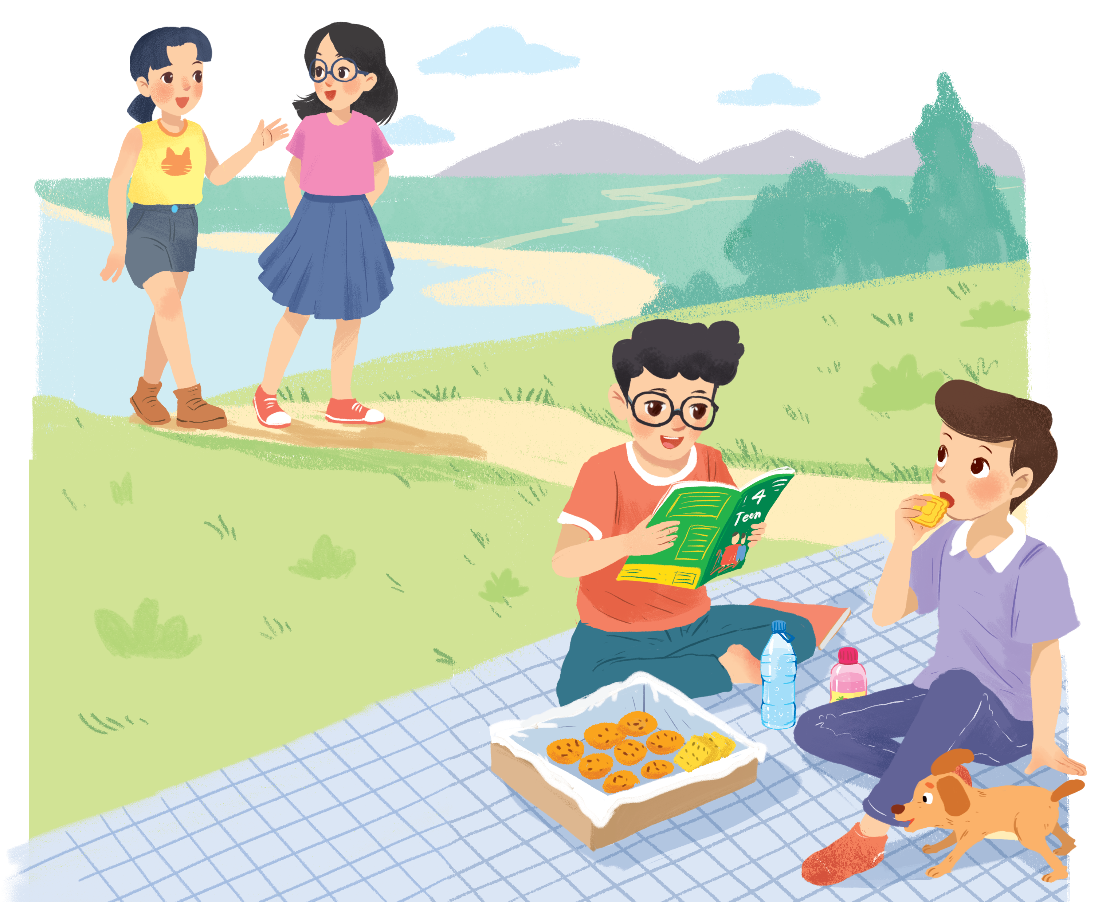
UNIT 3: MY FRIENDS
LESSON 4: COMMUNICATION
English 6

Slide 2


Everyday English
1
Listen and read the dialogue between Linda and Mi. Pay attention to the highlighted.
2
Work with a classmate. Ask him / her about his / her best friend. Remember to use the two questions highlighted in 1.
3
Read about these students in 4Teen magazine. Use one or two adjectives to describe them.
Date of birth and personality
4
We may have different personalities because we have different birthdays. Read the descriptions below. Do you think they match the friends in 3?
5
Read the descriptions in 4. Share your opinion with the class.

Slide 3


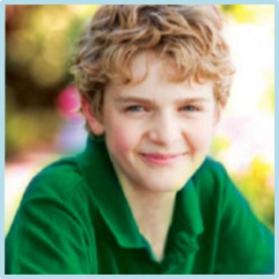
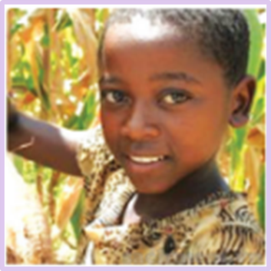

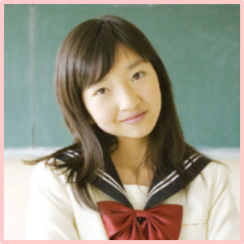
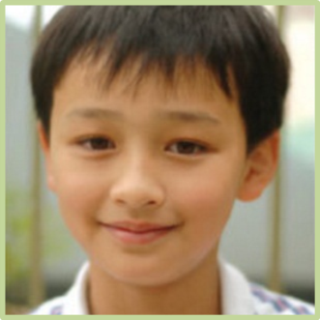
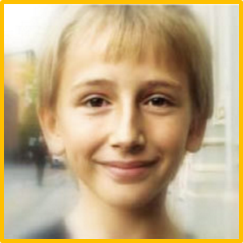
By Nguyetlinarose

Slide 4

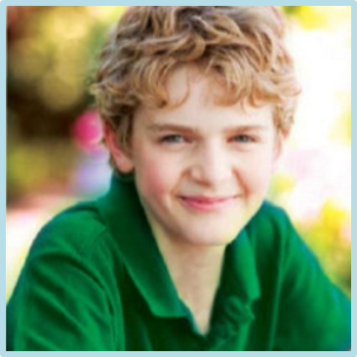
He has got blue eyes, fair short straight hair, a small nose and a small mouth.
A
He has got blue eyes, fair short curly hair, a high nose and a small mouth.
B
He has got blue eyes, fair short straight hair, a big nose and a small mouth.
C
Click on the correct letter

Slide 5

She has got purple eyes, white straight hair, a small nose and small ears.
A
She has got purple eyes, white straight hair, a big nose and big ears.
B
She has got blak eyes, dark curly hair, a big nose and big ears.
C
Click on the correct letter

Slide 6
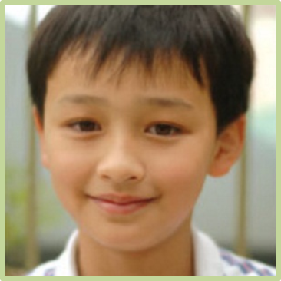
He has got pink eyes, light brown curly hair and a long nose.
A
He has got pink eyes, dark brown straight hair.
B
He has got dark eyes, light brown straight hair.
C
Click on the correct letter

Slide 7

He has got blue big eyes, blonde straight hair, high nose and big ears.
A
He has got blue big eyes, white short hair, small nose and small ears.
B
He has got blue big eyes, white long hair, long nose and big ears.
C
Click on the correct letter

Slide 8
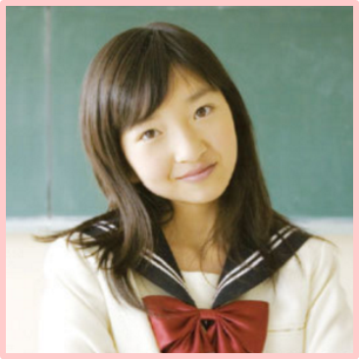

She has got green big eyes, red straight hair and thin lips.
A
She has got dark big eyes, dark straight hair and thin lips.
B
She has got dark big eyes, red curly hair and thin lips.
C
Click on the correct letter

Slide 9
Everyday English
Asking about appearance and personality

Slide 10

1
Listen and read the dialogue between Linda and Mi. Pay attention to the highlighted.
…
Linda: What does your best friend look like?
Mi: She’s short with long black hair.
She has bright brown eyes.
Linda: What’s she like?
Mi: She’s very kind and creative.
…
Notes:
Slide này không đúng.

Slide 11
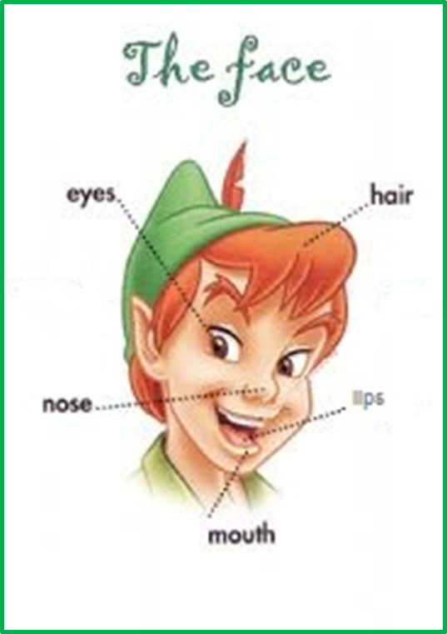
2
Work with a classmate. Ask him/ her about his/ her best friend. Remember to use the two questions highlighted in 1.
What does your best friend look like?
What’s she like?

Slide 12
Useful adjectives and their opposites:
Character: intelligent, silly, generous, quiet, talkative, friendly, stupid, envious, selfish, funny, ignorant, clever, cheerful, aggressive, loving,
Appearance
- Body (height and build): short, medium, tall, fat, thin (slim), ugly, beautiful
- Complexion (skin): brown, dark, white
- Face: oval, round, square, triangle, long, heart
- Hair: short, long, straight, black, grey, brown, red, fair, blonde, curly, ponytails
- Eyes: black, green, brown, blue
- Nose: small, turned up, straight, hooked, long, snub, beaky, crooked (curved)
- Mouth and lips: full, thin, large, small
- Others: v.v …

Slide 13
Now think about yourself. You can use the following questions to get ideas:
Is your hair long or short?
What colour is your hair?
What colour are your eyes?
Have you got a large or
small mouth?
Are you strong?
Are you fat or thin?

Slide 14
Date of birth and personality

Slide 15
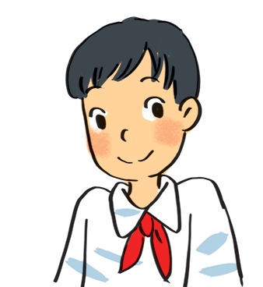
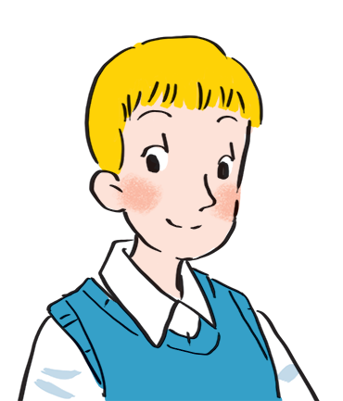
3
Read about these students in 4Teen magazine. Use one or two adjectives to describe them.
I live in Da Nang. At home, I can do my homework without my parents’ help. At school, I like speaking English. I’m going to an English club now.
clever
hard-working
I come from Cambridge. In my free time, I draw pictures and play the piano. I also help some old people near my house. I usually read to them at the weekend. Now I’m drawing in my garden.
creative
kind
Notes:
City landmarks phải ở trên mục 3

Slide 16
We may have different personalities because we have different birthdays. Read the descriptions below. Do you think they match the friends in 3?
4
21/3 – 19/4: confident, active
20/4 – 20/5: loving, hard-working
21/5 – 21/6: active, friendly
22/6 – 22/7: caring, clever
23/7 – 22/8: confident, creative
23/8 – 22/9: careful, hard-working
23/9 – 23/10: creative, friendly
24/10 – 21/11: careful, funny
22/11 – 21/12: clever, confident
22/12 – 19/1: careful, hard-working
20/1 – 18/2: friendly, clever
19/2 – 20/3: kind, creative
Each person has a star sign, depending on his / her birthday, and the star sign may decide a person's personality.

Slide 17













By Nguyetlinarose

Slide 18










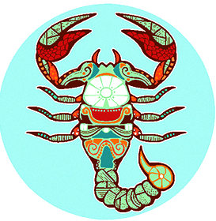

Aries
Aquarius
Gemini
Cancer
Taurus
Leo
Virgo
Libra
Sagittarius
Capricorn
Scorpio
Pisces
Notes:
Aries: bạch dương - biểu tượng con cừu
Aquarius: bảo bình - biểu tượng bình nước
Gemini: song tử - cặp song sinh
Cancer: cự giải - biểu tượng con cua lớn
Taurus: kim ngưu - biểu tượng con bò
Leo: sư tử - biểu tượng con sư tử
Virgo: xử nữ - biểu tượng trinh nữ
Libra: thiên bảo - biểu tượng cán cân
Sagittarius: nhân mã - biểu tượng cung thủ
Capricorn: ma kết - biểu tượng con dê biển
Scorpio: thần nông - biểu tượng con bọ cạp
Pisces: song ngư - biểu tượng hai con cá

Slide 19
21/3 – 19/4
Ấn hai lần để mở và đóng hiệu ứng ở mỗi khung ngày tháng
20/4 - 20/5
21/5 – 21/6
22/6 – 22/7
23/7 – 22/8
23/8 -22/9
23/9 – 23/10
24/10 - 21/11
When’s your birthday?
22/11 – 21/12
22/12 – 19/1
Your zodiac sign is …….
20/1 – 18/2
You are …………………
19/2 – 20/3

Slide 20

5
Read the descriptions in 4. Share your opinion with the class.
Example:
My birthday is …
It’s true that …
It isn’t true that …

Slide 21

Talk about your best friend
My best friend is Mai . We go to the same school, and we’ve been together for five years.
Mai is very pretty. She has short black hair and big brown eyes. She is clever and hard-working, and she is also very funny. I like being with her. We often do our homework together, and she helps me a lot.
I hope that in the future we’ll still be best friends.

Slide 22

Homework
Learn vocabulary by heart.
Write about your best friend (his/her appearance, qualities of a good friend that he/she has).
Prepare the next lesson: Skills 1

